Slide 2
Concept, Importance and Objectives of Conservation
Presented to: Dr Abdul Rehman
Presented by: Kashif Nawaz

Slide 3
What is conservation
It is exploitation and protection of human and natural resources in a wise manner ensuring derivation of their highest economics and social benefits on a continuing or long term basis.

Slide 4
Conservation agriculture
Conservation Agriculture (CA) is defined as a sustainable agriculture production system comprising a set of farming practices adapted to the requirements of crops and local conditions of each region, whose farming and soil management techniques protect the soil from erosion and degradation, improve its quality and biodiversity, and contribute to the preservation of the natural resources, water and air, while optimizing yields.

Slide 5
Goal of CA
To conserve, improve and make more efficient use of natural resources through integrated management of available soil, water and biological resources combined with external inputs.
CA is resource efficient and resource effective form of Agriculture.

Slide 7
Importance of Conservation Agriculture
Conservation Agriculture provides a number of benefits on regional, global and farm level.
It increases the soil fauna and flora without sacrificing the yield.
It enhances the biodiversity.

Slide 8
Importance
It saves time, labour and capital.
Increased soil OM.
Improved soil quality.
Increased available plant nutrients.

Slide 9
Importance
High infiltration and less runoff through soil.
Increased available water for plants.
Reduced soil erosion.
Improved crop production economics.

Slide 10
Importance
Reduced machinery cost.
Reduced fossil fuel cost.
Improved global environment.
Reduction in pollution.

Slide 11
It improves the soil structure.
It reduces the fertilizer loss.
Due to higher moisture low temperature of soil thereby less OM destruction.

Slide 12
Favourable in crop nutrition management.
Availability of fertile soil is increased.
Saving of inputs.
Disease attack is minimized.

Slide 13
Financial stability is attained.

Slide 14
Objectives of Conservation
• Use mulch cover to reduce soil erosion and land degradation.
• Reduce soil temperature and conserve moisture for plant growth.
• Increase organic matter levels and improve soil structure and fertility.

Slide 15
Sustained production on long term basis.
Increase available plant nutrients in soil.
Control erosion, runoff, seepage and enhance water use efficiency.

Slide 16
Practices used in Conservation Agriculture
Zero tillage.
Minimum and reduced tillage.
Cover crops.
Green manuring.

Slide 17
Contour farming.
Strip cropping.
Mulching.

Slide 18
Levelling.
• Integrated pest management (IPM).
• Crop rotation.

Slide 19
Multiple cropping.

Slide 20
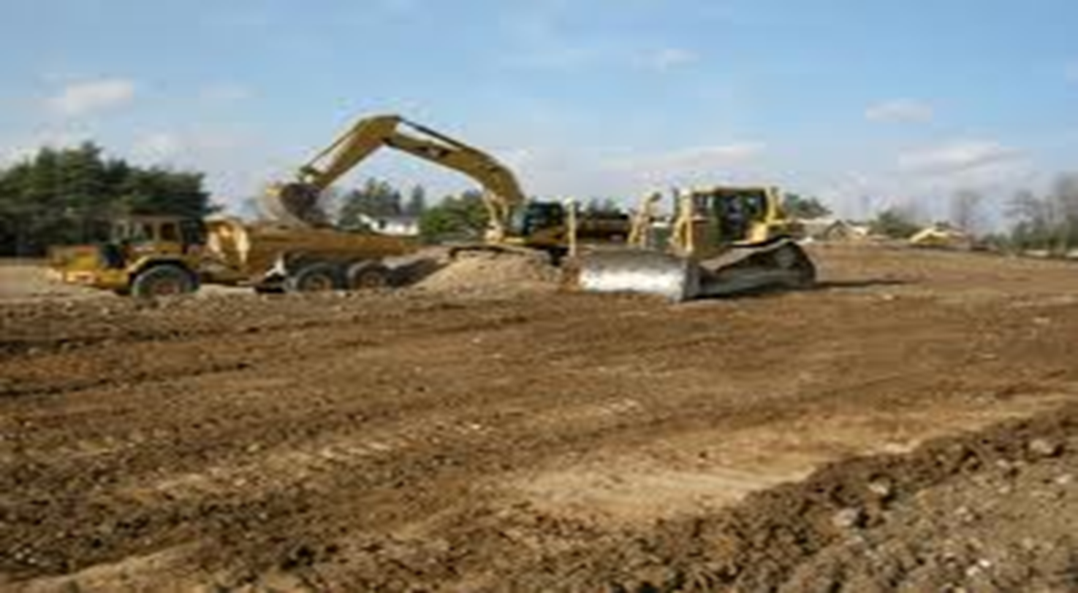
Levelling

Slide 21
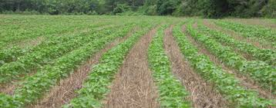
Zero Tillage

Slide 22
Contour Farming

Slide 23
