Slide 1
SQL (Structured Query Language)

Slide 2
SQL (Structured Query Language)
SQL AND, OR and NOT Operators
MIN() and MAX() Functions
The SQL SELECT TOP Clause
The SQL COUNT(), AVG() and SUM() Functions
The SQL LIKE Operator
SQL IN Operator
SQL BETWEEN Operator
SQL NULL Values
Limit and OffSet

Slide 3
INNER JOIN

Slide 4
LEFT JOIN

Slide 5
RIGHT JOIN

Slide 6
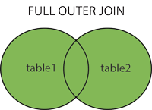
FULL OUTER JOIN

