Slide 1
Skewness, Kurtosis and Describing a Frequency Distribution.

Slide 2
Skewness:
Lack of symmetry is called skewness. If a distribution is not symmetrical then it is called a skewed distribution. So, the mean, median and mode are different in value and one tail becomes longer than the other. The skewness may be positive or negative.
Positively Skewed Distribution If the frequency curve has a longer tail to right side, the distribution is known as a positively skewed distribution and Mean > Median > Mode.
Negatively Skewed Distribution If the frequency curve has a longer tail to left, the distribution is known as a negatively skewed distribution and Mean < Median < Mode.

Slide 3
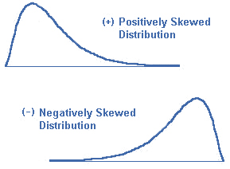

Slide 4
Measures of Skewness:
According to measure the degree of skewness of a distribution or curve, Karl Pearson(1857-1936) introduced a coefficient of skewness denoted by Sk and defined by
Sk = $\frac{Mean −Mode}{Standard deviation}$
The coefficients usually varies between -3(negative skewed) and +3 (positive skewed) and the sign indicates the direction of skewness.

Slide 5
A.L Bowley:
A.L Bowley(1869-1957), a British statistician, has also proposed a measure of skewness that is based on the median and the two quartiles. A.L Bowley’s coefficients of skewness is
Sk = $\frac{Q_{1}+Q_{3} −2Median}{Q_{3}−Q_{1}}$
Its values lies between 0 and + 1.

Slide 6
Kurtosis:
Karl Pearson introduce the term Kurtosis for the degree of peakedness or flatness of a frequency curve.
A curve which is tall and at the top is called Leptokurtic.
A curve which is flat like a plate at the top is called Platykurtic.
A curve with a moderate peak is called normal or Mesokurtic.

Slide 7
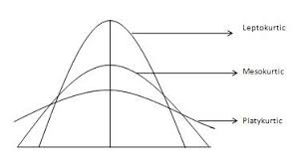

Slide 8
Kurtosis is usually measured by the fourth standard moment or the moments-ratio $β$₂ = ($μ4/μ22)$ whose values for a normal distribution is equal to 3.When $β$₂ is greater than 3, the curve is more sharply peaked and has wider tails than the normal curve and is said to be leptokurtic. When it is less than 3, the curve has a flatter top and relatively narrow tails than the normal curve and is said to be platykurtic.

Slide 9
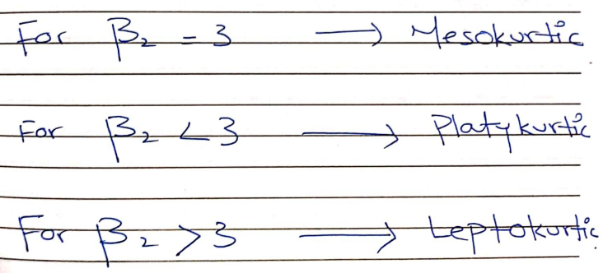

Slide 10
Describe a Frequency Distribution:
To describe a major characteristics of a frequency distribution, we need the calculations of the following five quantities.
The number of observations that describes the size of the data.
A measure of central tendency such as the mean or median that provides information about the center or average value.
A measure of dispersion such as standard deviation that indicates the variability of the data.
A measure of skewness that shows the lack symmetry in the frequency distribution.
A measure of kurtosis that gives information about its peakedness.

