Slide 1
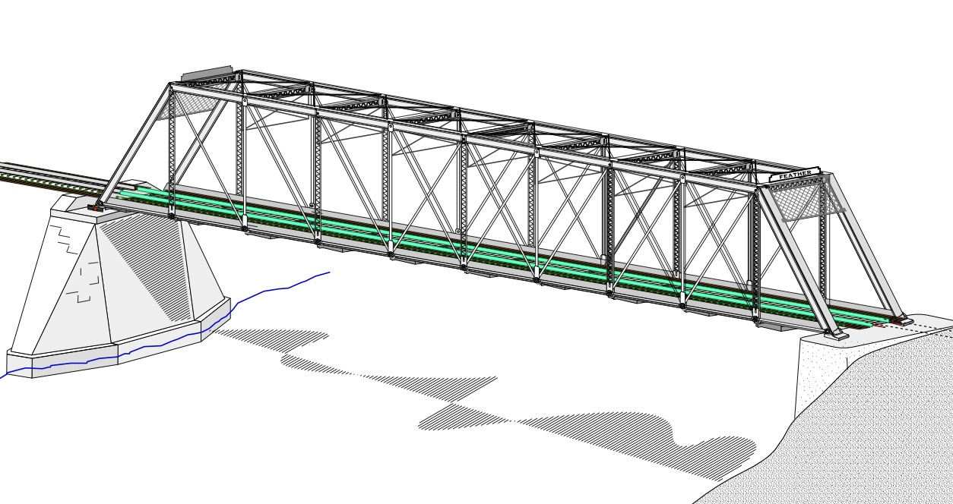
COLLEGE OF ENGINEERING AND TECHNOLOGY UNIVERSITY OF SARGODHA STEEL STRUCTURES (CT-313) (B.S TECHNOLOGY)
13-Nov-2020
LECTURE-13, 14 & 15
TENSION MEMBERS
Effective Area
Staggered fasteners
Block shear
Engineer Aqeel Ahmed
Lecturer, CET, UOS, Sargodha

Slide 2
TENSION MEMBERS
EFFECTIVE AREA
Of the several factors influencing the performance of a tension member, the manner in which it is connected is the most important.
A connection almost always weakens the member, and the measure of its influence is called joint efficiency.
This factor is a function of the ductility of the material, fastener spacing, stress concentrations at holes, fabrication procedure and a phenomenon known as shear lag.
All contribute to reducing the effectiveness of the member, but shear lag is the most important.

Slide 3
TENSION MEMBERS
EFFECTIVE AREA…………
Shear lag occurs when some elements of the cross section are not connected, as only leg of an angle is connected to gusset plate as shown in figure 3.6.
The consequence of this partial connection is that the connected element becomes over loaded and the unconnected part is not fully stressed.
Lengthening the connected region will reduce this effect.
Research reported by Munse and Chesson (1963) that the Shear Lag be accounted for by using the reduced, or effective, net area.
Because shear lag affects both welded and bolted connections, the effective net area concepts applies to both type of connections.

Slide 4
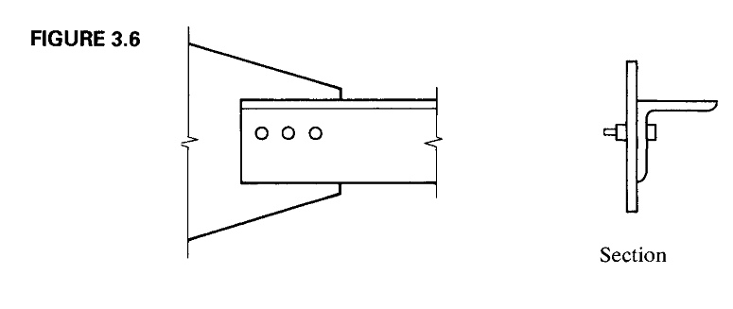

Slide 5
TENSION MEMBERS
EFFECTIVE AREA………

Slide 6
TENSION MEMBERS
EFFECTIVE AREA…………
Where the reduction factor U is given in AISC D3.3, Table D3.1. (page #1508 AISC manual soft form) the table gives a general equations that will cover most situations and as well as alternative numerical values for specific cases. The rules for determining U fall into five categories.

Slide 7
TENSION MEMBERS
EFFECTIVE AREA…………
This definition of was formulated by Munse and Chesson (1963).
If a member has two symmetrically loaded planes of connection, is measured from the centroid of the nearest one-half of the area.

Slide 8
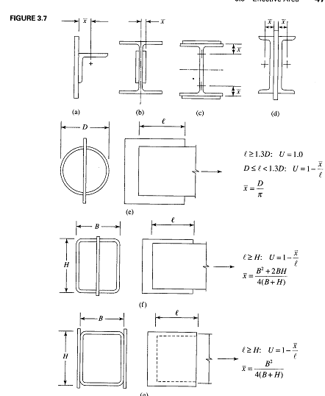

Slide 9
TENSION MEMBERS
EFFECTIVE AREA…………
Figure 3.7, illustrates for various types of connection.
The length in Equation 3.1 is the length of the connection in the direction of the load as shown in Figure 3.8.
For bolted connections, it is measured from the center of the bolt at one end of the connection to the center of the bolt at other end of the connection.
For welds, it is measured from one end of the weld to the other. If there are segments of different lengths in the direction of the load, the longest segment is used.

Slide 10
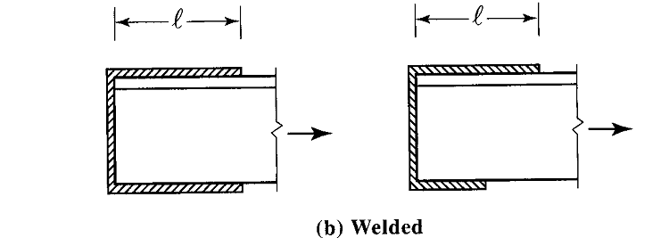

Slide 11
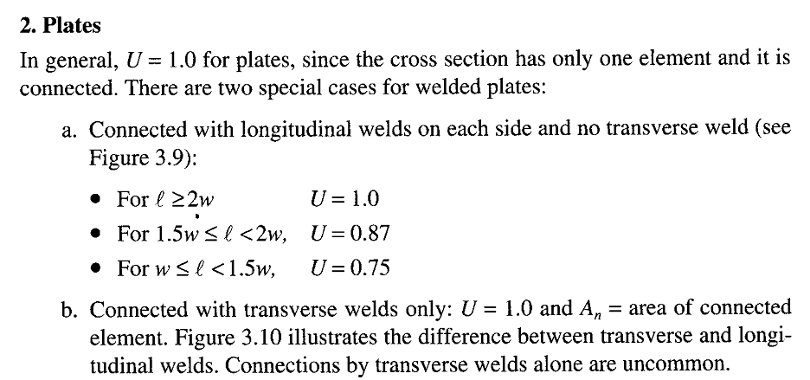
TENSION MEMBERS
EFFECTIVE AREA…………

Slide 12
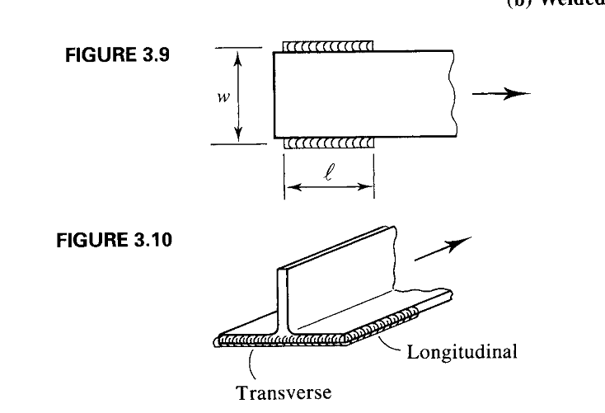

Slide 13
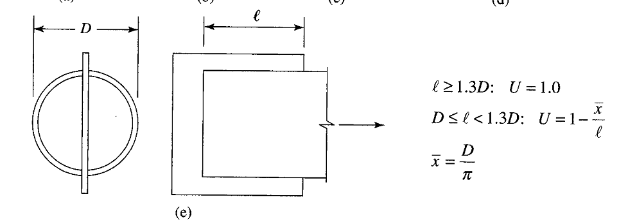
TENSION MEMBERS
EFFECTIVE AREA…………

Slide 14
TENSION MEMBERS
EFFECTIVE AREA…………

Slide 15
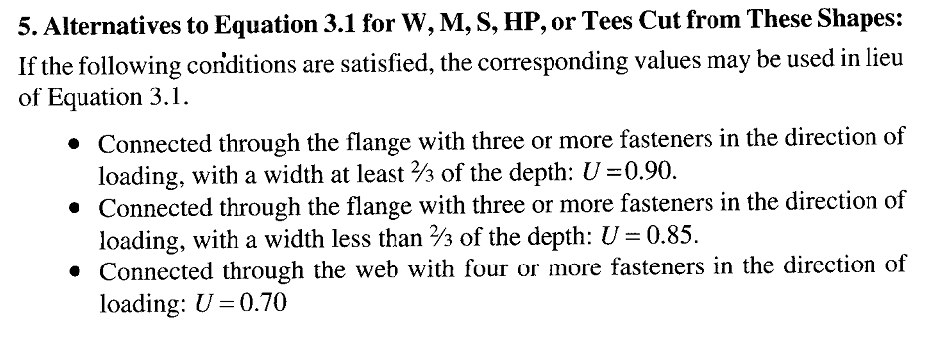
TENSION MEMBERS
EFFECTIVE AREA…………

Slide 16
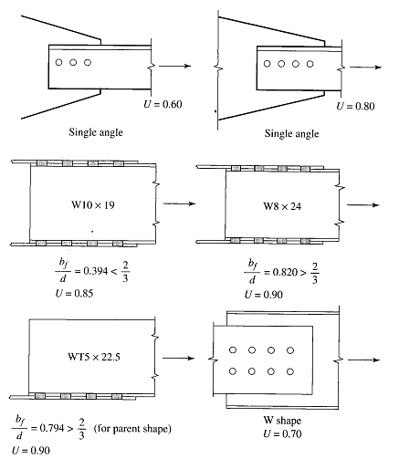

Slide 17
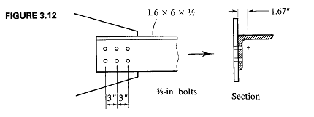

Slide 18
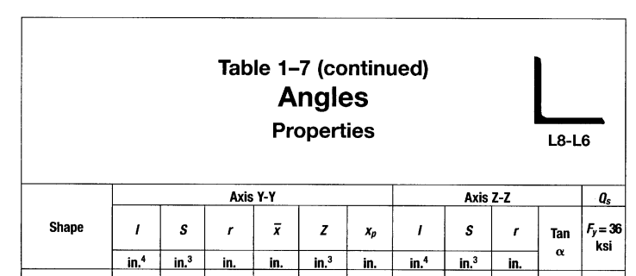

Slide 19
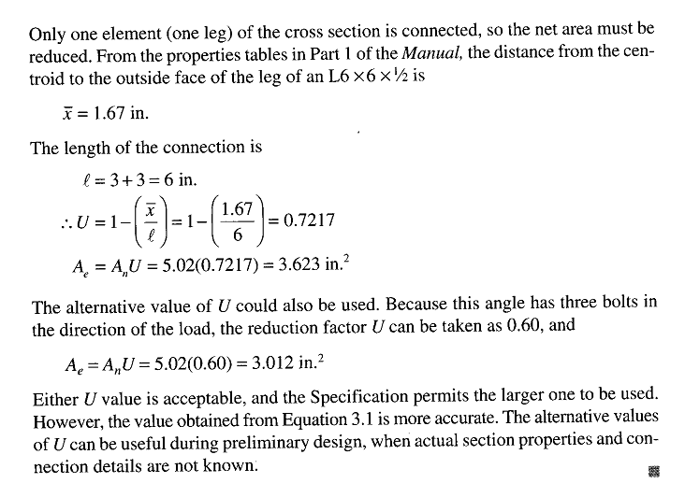

Slide 20
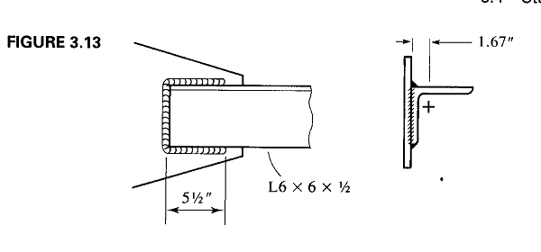

Slide 21
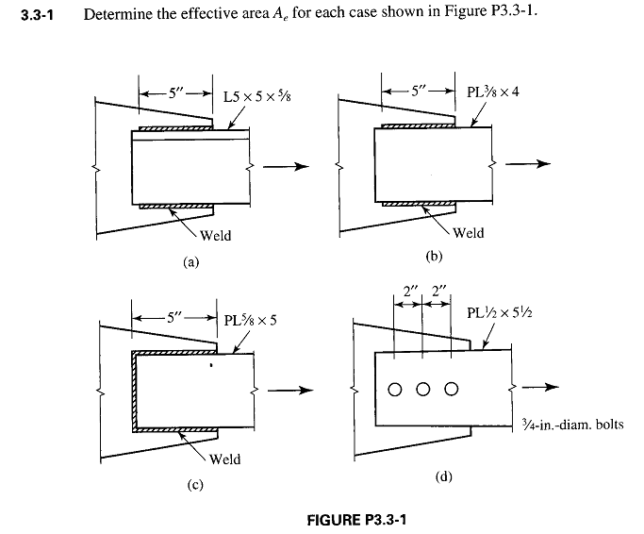
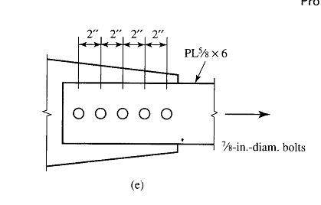

Slide 22
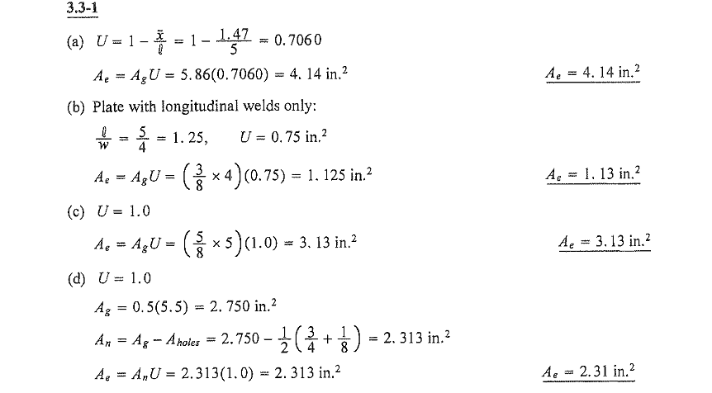

Slide 24
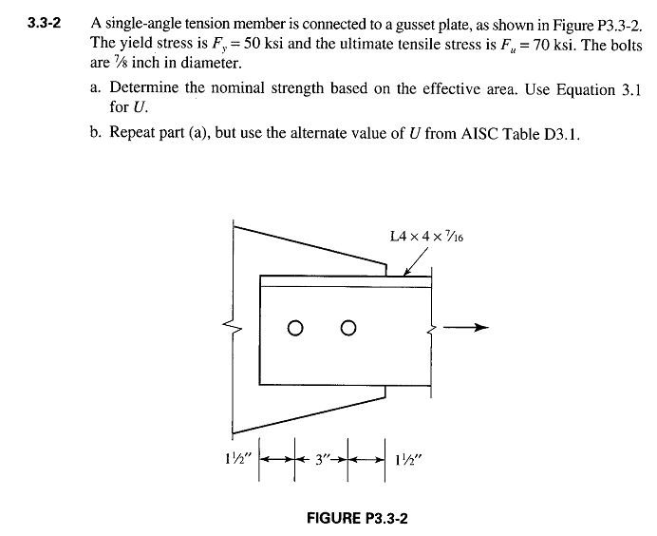

Slide 25
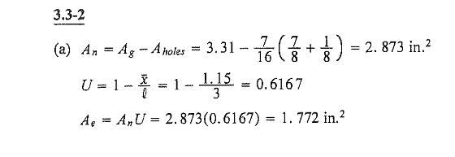

Slide 26
TENSION MEMBERS
STAGGERED FASTENERS
If a tension member connection is made with bolts, the net area will be maximized if the fasteners are placed in single line.
Sometimes space limitations, such as a limit on dimension a in figure 3.14a, necessitate using more than one line.
If so, the reduction in cross-sectional area is minimized if the fasteners are arranged in a staggered pattern, as shown.
Sometimes staggered fasteners are required by the geometry of a connection such as the one shown in figure 3.14 b.
In either case, any cross section passing through holes will pass through fewer holes than if the fasteners are not staggered.

Slide 27
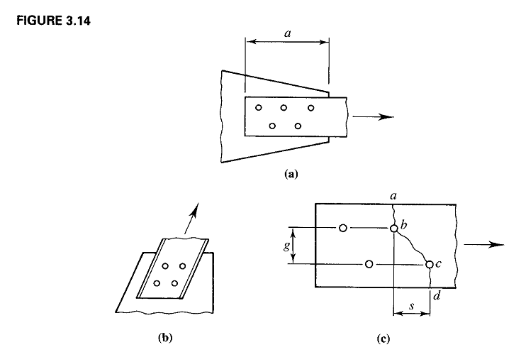

Slide 28
TENSION MEMBERS
STAGGERED FASTENERS……..
If the amount of stagger is small enough, the influence of an offset hole may be felt by a nearby cross section and fracture along an inclined an inclined path such as abcd in figure 3.14 c is possible.
In such a case, the relationship F=p/A does not apply and stresses on the inclined portion b-c are a combination of tensile and shearing stresses.
Several approximate methods have been proposed to account for the effects of staggered holes. Cochrane (1922) proposed that when deducting the area corresponding to a staggered hole, use a reduced diameter given

Slide 29
TENSION MEMBERS
STAGGERED FASTENERS……………
Where d is the hole diameter, S is the stagger or pitch of the bolts (spacing in the direction of the load) and g is the gage (transverse spacing).
This means that in a failure pattern consisting of both staggered and unstaggered holes, use d for holes at the end of a transverse line between holes (S=0) and use d’ for holes at the end of an inclined line between holes.

Slide 30
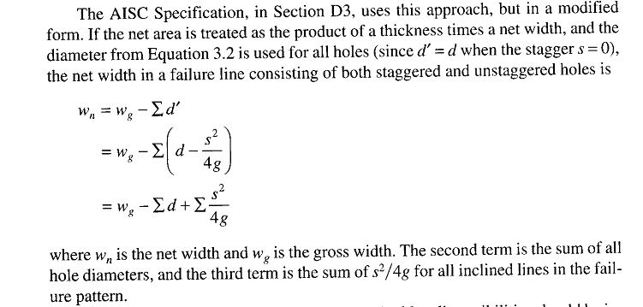
TENSION MEMBERS
STAGGERED FASTENERS……………
The AISC specification, in section D3, uses this approach, but in modified form.
If the net area is treated as the product of a thickness times a net width and the diameter from equation 3.2 is used for all holes (since d’-d when the staggers S=0), the net width in a failure line consisting of both staggered and unstaggered holes is

Slide 31
TENSION MEMBERS
STAGGERED FASTENERS……………
when more than one failure pattern is conceivable, all possibilities should be investigated and the one corresponding to smallest load capacity should be used.
Note that this method will not accommodate failure patterns with lines parallel to the applied load.

Slide 32
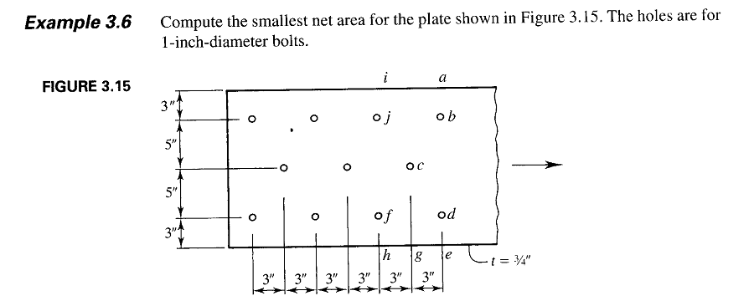

Slide 33
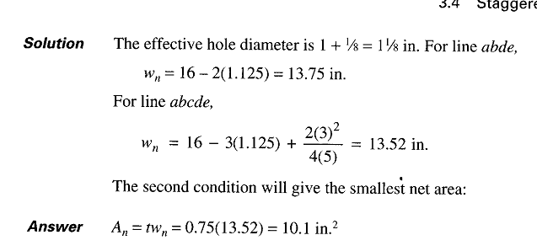

Slide 34
As each fastener resists share of the load (an assumption used in the design of simple connections), different potential failure lines may be subjected to different loads.
For example, line abcde in figure 3.15, must resist the full load, whereas ijfh will be subjected to 8/11 of the applied load.
The reason is that 3/11 of the load will have been transferred from the member before ijfh receives any load.
When lines of bolts are present in more than one element of the cross section of a rolled shape and the bolts in these lines are staggered with respect to one another, the use of areas and Equation 3.2 is preferable to the net width approach of the AISC specification.

Slide 35
If the shape is an angle, it can be visualized as a plate formed by “unfolding” the legs to more clearly identify the pitch and gage distances.
AISC B2 specifies that any gage line crossing the heel of the angle be reduced by an amount that equals the angle thickness.
Thus the distance g in figure 3.16, to be used in the term would be 3 +2 – ½ = 4 ½

Slide 36
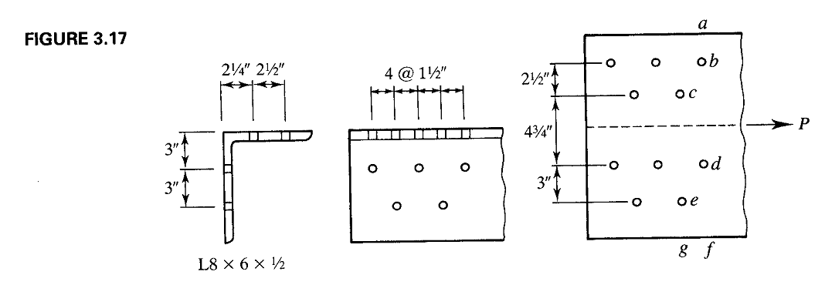

Slide 37
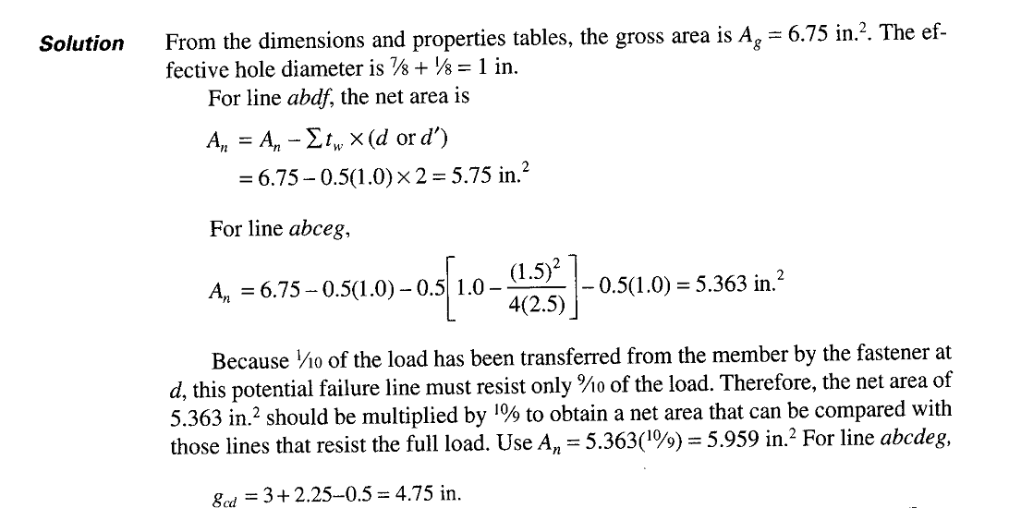

Slide 38
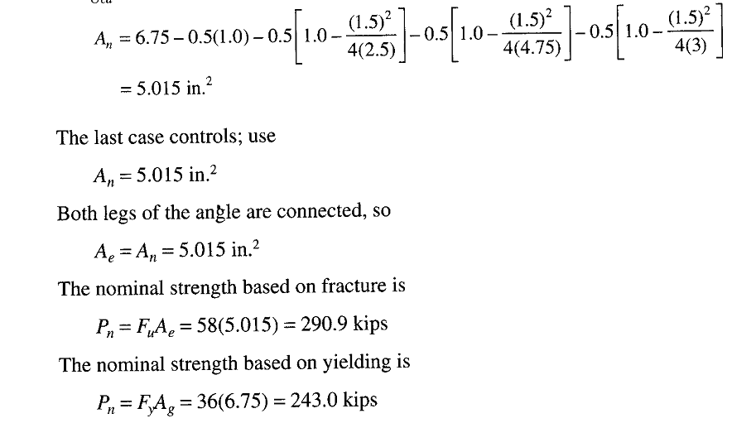

Slide 39
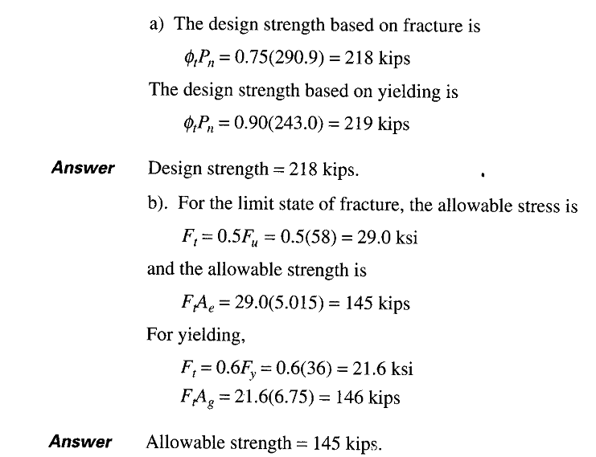

Slide 40
TENSION MEMBERS
BLOCK SHEAR
For certain connection configurations, a segment or “block” of material at the end of member can tear out.
For example, the connection of the single- angle tension member shown in figure 3.21 is susceptible to this phenomenon, called block shear.
For the case illustrated, the shaded block would tend to fail by shear along the longitudinal section ab and by tension on the transverse section bc.

Slide 41
TENSION MEMBERS
BLOCK SHEAR………

Slide 42
TENSION MEMBERS
BLOCK SHEAR………
For certain arrangements of bolts, block shear can also occur in gusset plates.
Figure 3.22 shows a plate tension member connected to a gusset connection, block shear could occur in both gusset plate and the tension member.
For the gusset plate, tension failure would be along the transverse section df, and shear failure would occur on two longitudinal surfaces, de and fg.
Block shear failure in the plate tension member would be tension on ik and shear on both hi and jk.

Slide 43
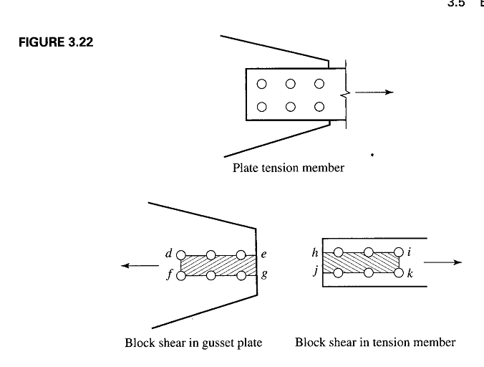
TENSION MEMBERS
BLOCK SHEAR…………

Slide 44
TENSION MEMBERS
BLOCK SHEAR…………
The model used in the AISC Specification assumes that failures occurs by rupture (fracture) on the shear and rupture on the tension area.
Both surfaces contribute to the total strength and the resistance to block shear will be the sum of strengths of the two surfaces.
The shear rupture stress is taken as 60 % of the tensile ultimate stress, so the nominal strength in shear is 0.6 Fu Anv and the nominal strength in tension is Fu Ant.

Slide 45
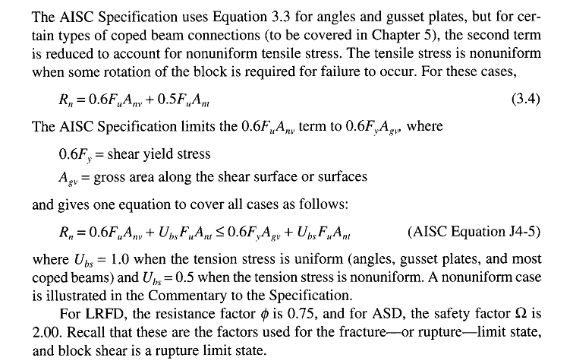
TENSION MEMBERS
BLOCK SHEAR…………

Slide 46
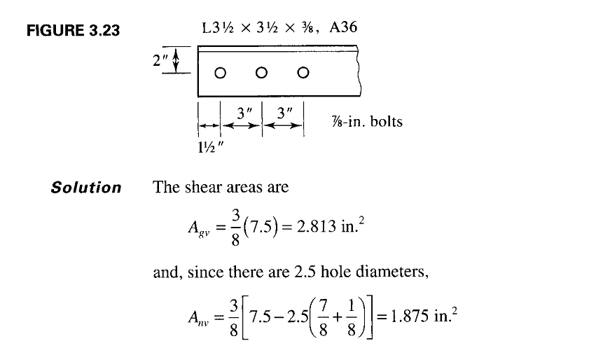

Slide 47
