Slide 1
Chapter 7
Modifiability

Slide 2
Chapter Outline
• What is Modifiability?
• Modifiability General Scenario
• Tactics for Modifiability
• A Design Checklist for Modifiability

Slide 3
What is Modifiability?
Modifiability is about change and our interest in it is in the cost and risk of making changes.
To plan for modifiability, an architect has to consider three questions:
What can change?
What is the likelihood of the change?
When is the change made and who makes it?
What is the cost of the change? Making a system more modifiable involves two types of cost:
The cost of introducing the mechanism(s) to make the system more modifiable
The cost of making the modification using the mechanism(s)

Slide 4
Sample Concrete Modifiability Scenario
The developer wishes to change the user interface by modifying the code at design time. The modifications are made with no side effects within three hours.

Slide 5
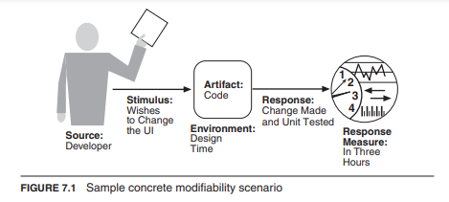
concrete modifiability scenario
Figure 7.1 illustrates a concrete modifiability scenario: The developer wishes to change the user interface by modifying the code at design time. The modifications are made with no side effects within three hours.

Slide 6
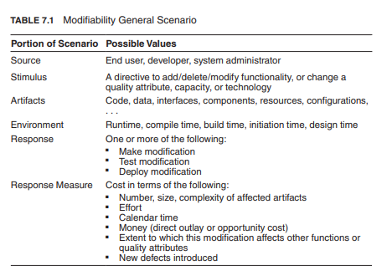
Modifiability general scenario
Table 7.1 enumerates the elements of the general scenario that characterize modifiability

Slide 7
Goal of Modifiability Tactics
Tactics to control modifiability have as their goal controlling the complexity of making changes, as well as the time and cost to make changes.

Slide 8
Coupling
Generally, a change that affects one module is easier and less expensive than if it changes more than one module. However, if two modules’ responsibilities overlap in some way, then a single change may well affect them both.
We can measure this overlap by measuring the probability that a modification to one module will propagate to the other. This is called coupling, and high coupling is an enemy of modifiability.

Slide 9
Cohesion
Cohesion measures how strongly the responsibilities of a module are related.
Informally, it measures the module’s “unity of purpose.”
Unity of purpose can be measured by the change scenarios that affect a module.
The cohesion of a module is the probability that a change scenario that affects a responsibility will also affect other (different) responsibilities

Slide 10
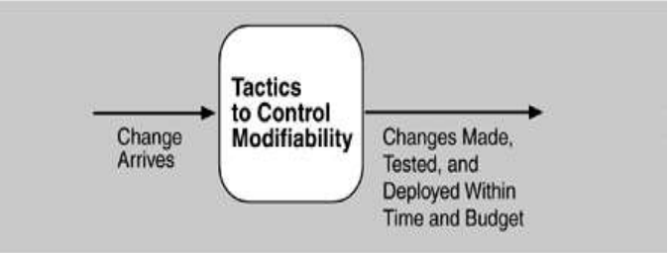
Goal of Modifiability Tactics

Slide 11
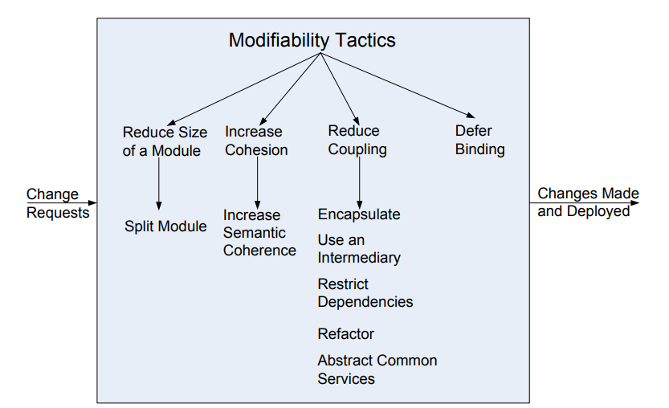
Modifiability Tactics
Now we may understand tactics and their consequences as affecting one or more of the previous parameters: reducing the size of a module, increasing cohesion, reducing coupling, and deferring binding time. These tactics are shown in Figure 7.3.

Slide 12
Parameters of Modifiability
we can now identify the parameters that we will use to motivate modifiability tactics:
Size of a module. Tactics that split modules will reduce the cost of making a modification to the module that is being split as long as the split is chosen to reflect the type of change that is likely to be made.

Slide 13
Parameters of Modifiability
Coupling. Reducing the strength of the coupling between two modules A and B will decrease the expected cost of any modification that affects A. Tactics that reduce coupling are those that place intermediaries of various sorts between modules A and B.
Cohesion. If module A has a low cohesion, then cohesion can be improved by removing responsibilities unaffected by anticipated changes.

Slide 14
Parameters of Modifiability
Binding time of modification.
An architecture that is suitably equipped to accommodate modifications late in the life cycle will, on average, cost less than an architecture that forces the same modification to be made earlier.
The preparedness of the system means that some costs will be zero, or very low, for late life-cycle modifications.
This, however, neglects the cost of preparing the architecture for the late binding.

Slide 15
Reduce Size of a Module
• Split Module:
If the module being modified includes a great deal of capability, the modification costs will likely be high. Refining the module into several smaller modules should reduce the average cost of future changes.

Slide 16
Increase Coherence
Increase Semantic Coherence:
If the responsibilities A and B in a module do not serve the same purpose, they should be placed in different modules. This may involve creating a new module or it may involve moving a responsibility to an existing module.

Slide 17
Reduce Coupling
Encapsulate:
Encapsulation introduces an explicit interface to a module. This interface includes an API and its associated responsibilities, such as “perform a syntactic transformation on an input parameter to an internal representation.”
• Use an Intermediary: Given a dependency between responsibility A and responsibility B (for example, carrying out A first requires carrying out B), the dependency can be broken by using an intermediary.

Slide 18
Reduce Coupling
Restrict Dependencies:
restricts the modules which a given module interacts with or depends on.
Refactor:
undertaken when two modules are affected by the same change because they are (at least partial) duplicates of each other.
Abstract Common Services:
where two modules provide not-quite-the-same but similar services, it may be cost-effective to implement the services just once in a more general (abstract) form

Slide 19
Defer Binding
In general, the later in the life cycle we can bind values, the better.
If we design artifacts with built-in flexibility, then exercising that flexibility is usually cheaper than hand-coding a specific change.
However, putting the mechanisms in place to facilitate that late binding tends to be more expensive.

Slide 20
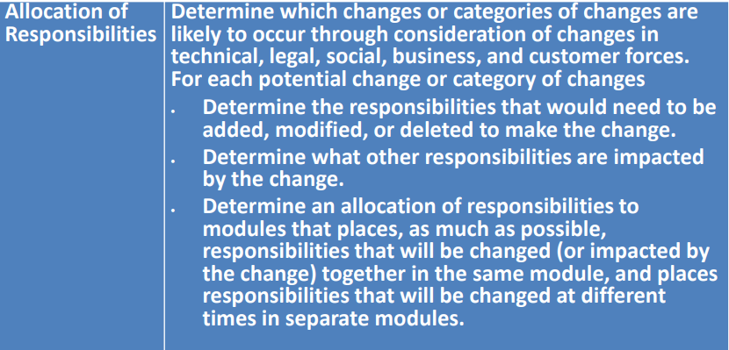
Design Checklist for Modifiability

Slide 21
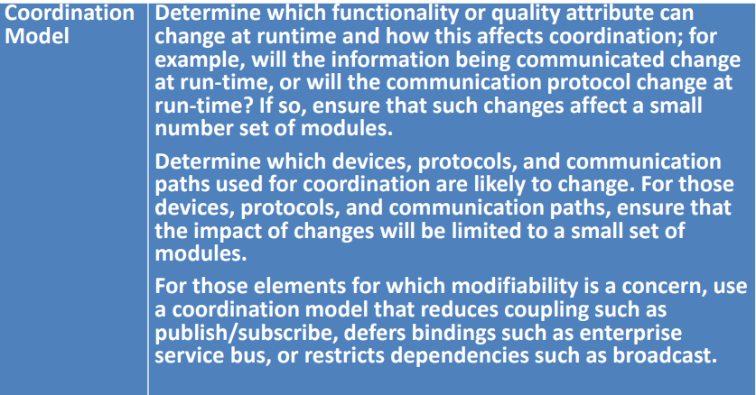
Design Checklist for Modifiability

Slide 22
Design Checklist for Modifiability

Slide 23
Design Checklist for Modifiability

Slide 24
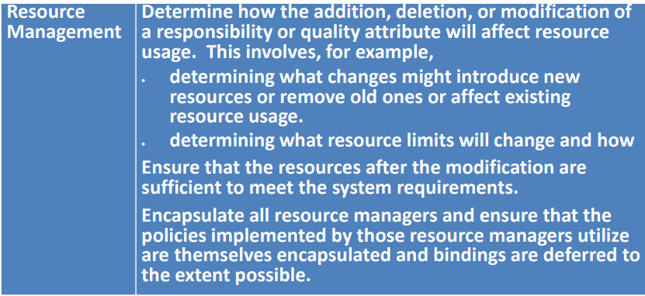
Design Checklist for Modifiability

Slide 25
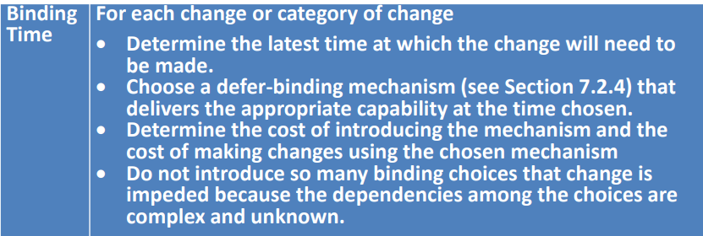
Design Checklist for Modifiability

Slide 26
Design Checklist for Modifiability

