Slide 1
SOCIAL AND POLITICAL PHILOSOPHY

Slide 2
Social philosophy and political philosophy are both very closely related fields of philosophy generally dealing with the role of the individual in society as well as the role of government.

Slide 3
SOCIAL PHILOSOPHY:
Social philosophy is the philosophical study of questions about social behaviour ( typically of humans)
Social philosophy addresses a wide range of subjects:
from individual meaning to legitimacy of laws
from the social contract to criteria for revolution
from the functions of everyday actions to the effects of science on culture
from changes in human demographics to the collective order of a wasps net
Social philosophy attempts to understand the patterns, changes and tendencies of societies:

Slide 5
POLITICAL PHILOSOPHY:
It is the study of questions about the city,Government,politics,liberty,justice,property,rights,law and inforcement of a legal code by authority
What they are?
Why there are needed?
What makes a government Legitimate?
what rights and freedom it should protect and why?
what forms it should take and why?
what the law is and what duties citizens are to a legitimate governmnt?
Political philosophy can also be understood by analyzing it through the prespective of Metaphysics,epistemology and axiology thereby unearthing the ultimate reality side the knowledge or methodical slide and the value aspects of politics

Slide 7
POLITICAL PHILOSOPHY:
Three cenisal concerns of political philisophy have been there:
Political economy by which propert rights are defined and access to capital is regulated
the demand of justice in distribution and punishment
rules of truth and evidence that determine judgements in law.
A society is a body of human generally seen as a community or group of humans or other organism of a single species that is delineated by the sounds of euthural identity,social solidarity,functional interdependence or eusociality.
Human societies are characterized by the patterns of relationship between individuals that share a distinctive culture or institutions like other groups,society allows its indiviual members to achieve individuals needs or wishes that they could not fulfill separately by themselves,without the exsistence of the social group
members of society may form different ethnic groups. A society may be a particular ethnic group such as a nation state as BHUTAN, a broader cultural group such as

Slide 9
Continue.....
the western society or even a social organism such as ant colony.

Slide 10
Social philosophers:
John Stuart Mill:
British philosopher, known for essays on social and political philosophy. He was also proponent of utilitarianism
He was also proponent of utilitarianism
Mill theory:
the permissibility of any action is determined by examining their outcome & comparing those outcomes with what would have happened if some other action have been performed.
Harm principle:
A person in a society can do whatever he wants as long as his actions do not harm others and if they harm others, society is able to prevent those actions.
His essay “On Liberty” is about how much control society has over preventing or allowing the actions of a person.

Slide 11
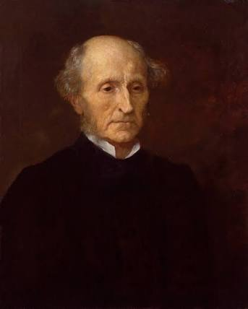

Slide 12
Emile Durkheim:
His main concern was how societies could maintain integrity and coherence in this modern era.
Social integration:
Process in which minorities or newcomers are incorporated in host society.
Higher extant of integration contributes to closer social distance between groups and therefore its purpose is to maintain and achieve peaceful social relation.
Collective effervescence:
Society may at a time comes together and simultanously communicate the same thought and participate in same action.
This excites the individuals and serve to unify the society.

Slide 14
Cornelius Castoriadis:
He was social critic and philosopher.
Famous book “Imaginary Institution Of Society”.
Social imaginary:
Set of values, institutions, laws and symbols common to a particular social group.
Imaginary are laces which tie a society together and the forms which define what for a given society is real.

Slide 15
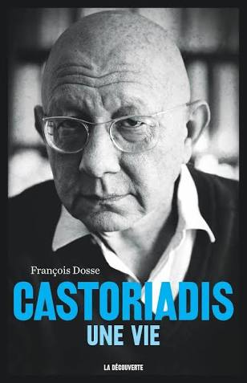

Slide 16
Political philosophers:
Plato:
The Republic, philosophy of Plato about ideal state.
He was against the democratic system of government.
The ruler should be a wise person “The Philosopher King”.
Classes in ideal society:
Workers: the laborers who mae goods and services in a society.
Soldiers: who keep order in society and protect it from invaders.
Guardians ( philosopher king): most intelligent, rational, wise person, in love with wisdom and well suited to make decisions for community.

Slide 17
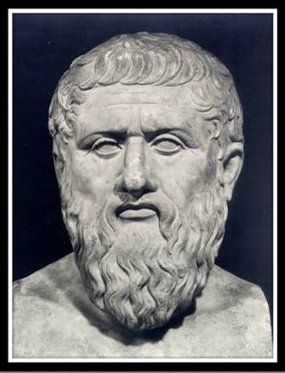

Slide 18
Aristotle:
Wrote his book “Politics” on political philosophy.
Politics means “the things concerning to Polis”
“Polis” a Greek word means “city”.
“humans are social animals and the polis existed to bring
out goof life appropriate to such animals.”
State should be democratic (constitutional government).

Slide 19
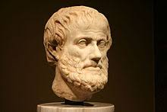

Slide 20
John lock:
Made contribution to the modern theories limited liberal government.
He presented “Two Treatise OF Government”.
Social contract:
When the government fails to secure general rights ir satisfy the best interests of society, citizens can withdraw their obligations to obey or change their leadership through elections.
Property:
We have a right to acquire private property.
We acquire property by mixing our labor with natural resources.
For example: if I discover some grapes growing on a vine through my labor in picking and collecting these grapes, I acquire an ownership right over them.

Slide 21
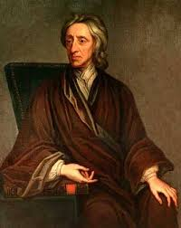

Slide 22
SOCIAL PHILOSOPHY:
Definition:
“Social philosophy is the study of social interactions and behavior between two or more people.”
Such philosophical study are usually conducted on humans but also on other animals such as dolphin
and apes.
There are two main elements of social philosophy of social philosophy are
Society and individual.

Slide 23
There are many overlapping disciplines with the philosophy of society. E.g it overlaps with other philosophical disciplines such as ethics , language philosophy ,political philosophy and social epistemology.
Emmanuel Kant believed that fundamental element of a good society is freedom. By this, He means the freedom to be an individual, but individual have contract with society that limits such freedom.
According to him society is a balance between rights and responsibilities.

Slide 24
Nature of social philosophy:
Social philosophy is the philosophy of practice.
It inquires into what is right or good for man and society.
Social philosophy deals with individual highest good in society.
It deals with social problems especially those issues pertaining to social values such as inequality, injustice etc.
Social philosophy is the philosophy of human society.

Slide 25
Scope of social philosophy:
Social philosophy has a scientific value as it investigates the social nature of man in his universalistic dimensions, not restricting only to social structural dimensions.
This philosophy studies most fundamental laws which influence social progress, social changes and social disintegration.
It also seeks the causes of social crimes, child labour, killing, gender differentiation, injustice etc and also find its remedies.

Slide 26
Conflicts:
The social values, ethics and morality may create conflicts among people and then society will be divided either vertically or horizontally.
Inequalities on basis of cast, occupation, religion and race not only create confusion in society but it may lead to chaotic condition.
Two aspects of social life:
Social interactions between individuals form relationship, communication, affection etc.
Social aggregation: of individual and actions in virtue of which various institution get established.

Slide 28
What is politics?
Politics can be defined as:
The question of how to distribute a scarce amount of resources “justly” which is essentially , the way in which people obtain , keep and exercise power.
It is an art or the science of government or governing people and affairs.
The word refers to the methods or tactics involved in managing state or government.

Slide 30
What is political philosophy?
Political philosophy is study of Human social organization and their nature in society and the study of theories behind politics.
It begins with the assumptions that such public questions as obedience to law , the best possible government or the justice of public polices are in need of justification.
Concerned with the clarification of meaning of major political concepts such as Freedom , Justice ,Equality , Human nature and Purpose of Political life.
Individual rights ( Such as rights to life , liberty , property , , the pursuit of happiness , free speech , Self defence etc) state explicity the requirements of a person to benefit rather then suffer from living in society

Slide 32
Contribution of David miller
Definition:
Political philosophy can be defined as philosophical reflection on how best to arrange our collective life , our political instructions and our social practices such as our economic system and our pattern of family life.
He tries to explain the nature of good and bad government.
The qualities that ruler ought and ought not to have.
Affects of two kind of government on the lives of ordinary people.
He views political philosophy as an investigation into the nature , causes and affects of good and bad government.

Slide 33
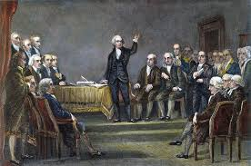
Origion:
Political philosophy can be traced to ancient Greece nearly 2,500 million years ago.
In classical period of Greek civilization the major focus of political philosophy was
“ What the ideal society was like?
“ Relationship between state , individuals and governance
Main Philosophers include Plato and Aristotle

Slide 34
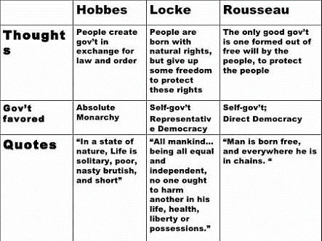
Out of the Renissance the focus expanded to include the nature of political obligation.
Philosophers include Hobbes , Locke and Rosseau.

Slide 35
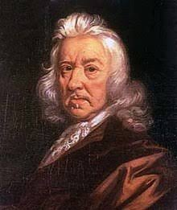

Slide 36
QUESTIONS REALTED TO POLITICAL PHILOSOPHY:
What is government
Why are governments needed
What is ideal form of government
Which economic system is best ( capitalistic one , socialistic one or mix)
AT what point in history did people agree upon the “need” of government .
What makes government legitimate
What rights and freedom should a government protect
What duties do citizens owe to legitimate government , if any..
How society should build up
How one should act within a society
Questions about State , Government , Politics , liberty , justice and the reinforcement of a legal code by Authority.

Slide 37
Theories and Problems of Political Philosophy

Slide 38
Theories of Political Philosophy
1) Realism: Realism is school of thought in international relation theory .
In realism , states are the central actors in international politics rather than individuals.
That states in international political system are rational as their actions maximize their own self-interest and all states desire power , so that they can ensure their own self-preservation.
Realism is one of the dominant strains of thoughts in modern foreign policy.

Slide 40
2) Communism: In this political theory, process of abolishing ownership of the means of production, which in societies dominated by capitalism mode of production, are owned by individual, states or other collecting bodies.
It is the transfer of ownership from private capitalist hands to the collective hands of producers in the form of communes.
People would have access to things ‘from each according to his ability, to each according to his need.

Slide 41
3) Liberalism: Liberalism is political philosophy based on ideas of liberty and equality.
It supports ideas such as freedom of speech , freedom of religion , gender equality and international cooperation.
4) Conservatism: It is political philosophy, that favours tradition(in the sense of religious, cultural and beliefs) in the face of external forces for change.

Slide 43
Problems of Political Philosophy
The fundamental problem of political philosophy is that: ‘Why should anyone obey the state or why do anyone obey the state’.
The other question which is often
confused with justification
of obedience is: ‘How the state
and its law came into existence’.
It has been debated how a
citizen

Slide 44
is under moral obligation to obey the state and what makes it reasonable and sensible for one to obey the state.
The widely accepted answer to the above is that the citizen is obliged to obey the laws of the state because the state has sovereign authority.
The citizens are obliged to obey those orders.
There is the question of moral obligation too. The laws of state are intended to protect one’s interest along with those of other people.

