Slide 1
Motivating and Rewarding Employees by Tariq Ghayyur Lecturer, Department of Education, UOS

Slide 2
Learning Objectives
Define and explain motivation
Compare and contrast early theories of motivation
Compare and contrast contemporary theories of motivation
Discuss current issues in motivating employees

Slide 3
What is Motivation?

Slide 4
What is Motivation?
Motivation
The process by which a person’s efforts are energized, directed, and sustained toward attaining a goal
Individuals differ in motivational drive
Overall motivation varies from situation to situation

Slide 5
How Do you Motivate Your Employees?
•Say “Thank You”
•Notice When Someone is Doing the Right Thing
•Get to Know Employees
•Professional Development Opportunities
•People Support What They Help Create
•All Staff Deserve Recognition
•Group Recognition is as Important as Individual Recognition
•Have Fun!

Slide 6
Three Elements of Motivation
This definition has three key elements:
Energy - a measure of intensity or drive.
Direction - effort channeled in a direction that benefits the organization.
Persistence - when employees persist in putting forth effort to achieve those goals.
Notes:
This definition has three key elements: energy, direction,
and persistence.4
The energy element is a measure of intensity or drive. A motivated person puts forth
effort and works hard. However, the quality of the effort must be considered as well as its
intensity. High levels of effort don’t necessarily lead to favorable job performance unless
the effort is channeled in a direction that benefits the organization. Effort that’s directed
toward, and consistent with, organizational goals is the kind of effort we want from employees.
Finally, motivation includes a persistence dimension. We want employees to persist in
putting forth effort to achieve those goals.

Slide 7
Who’s this ?

Slide 9
Abraham Maslow
He described how different needs have greater priority than others. When he did, he found that our needs can be understood better by arranging them in the order of their importance, in our lives.

Slide 10
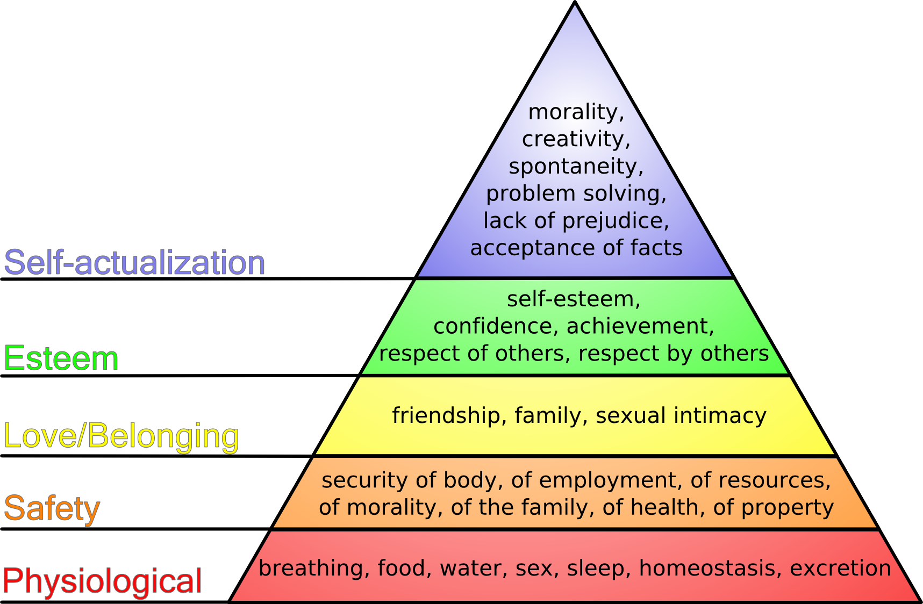

Slide 11
What Is Maslow’s Hierarchy of Needs Theory?
Maslow was a psychologist who proposed that within every person is a hierarchy of five needs:
Physiological needs - air, food, drink, shelter, warmth, sex, sleep, etc.
Safety needs - protection from elements, security, order, law, limits, stability, etc.

Slide 12
What Is Maslow’s Hierarchy of Needs Theory?
3. Belongingness and Love needs - work group, family, affection, relationships, etc.
4. Esteem needs - self-esteem, achievement, mastery, independence, status, dominance, prestige, managerial responsibility, etc.
5. Self-Actualization needs - realizing personal potential, self-fulfillment, seeking personal growth and peak experiences.

Slide 13
Who is this ?

Slide 14
What Are McGregor’s Theory X and Theory Y?
Douglas McGregor was a Management professor at the MIT Sloan School of Management He also taught at the Indian Institute of Management Calcutta
McGregor is best known for proposing two assumptions about human nature:
Theory X
The assumption that employees dislike work, are lazy, avoid responsibility, and must be coerced to work
Theory Y
The assumption that employees are creative, enjoy work, seek responsibility, and can exercise self-direction

Slide 15
Who this ?

Slide 16
What Is Herzberg’s Two-Factor Theory?
Frederick Herzberg’s an American psychologist who became one of the most influential names in business management.
Herzberg’s Motivation-Hygiene Theory, also known as the two-factor theory proposes that:
Intrinsic factors are related to job satisfaction
Extrinsic factors are associated with job dissatisfaction

Slide 17
What Is Herzberg’s Two-Factor Theory?
Hygiene Factors
Factors that eliminate job dissatisfaction but don’t motivate.
Motivators
Factors that increase job satisfaction and motivation

Slide 18
What Is Herzberg’s Two-Factor Theory?
Hygiene or Dissatisfies:
Motivators or Satisfiers:
Pay and Benefits
Company Policy and Administration
Relationships with co-workers
Supervision
Achievement
Recognition
Work Itself
Responsibility
Promotion
Growth

Slide 20
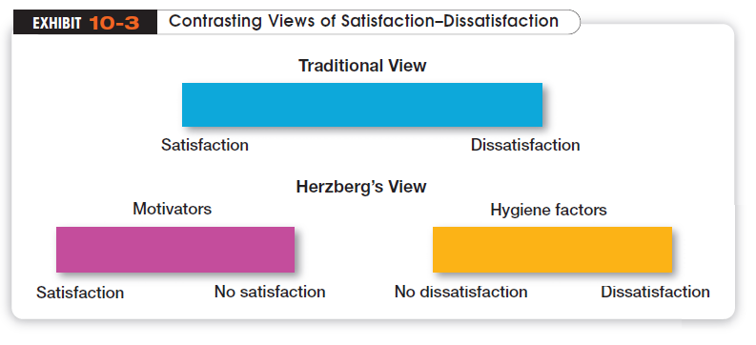

Slide 21
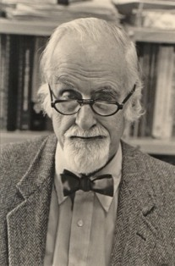
Who is this?

Slide 22
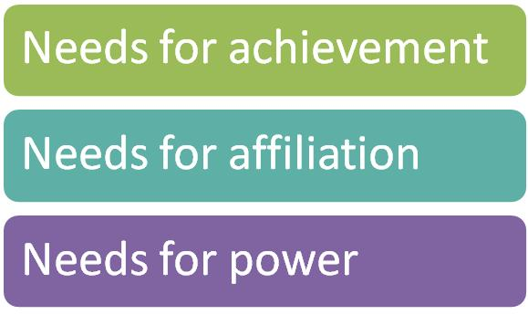
David C. McClelland
was an American psychological theorist. Noted for his work on need theory.

Slide 23
What Is McClelland’s Three-Needs Theory?
Three acquired needs are major motives at work
1-Need for Achievement (nAch)
The drive to succeed and excel in relation to a set of standards
person is 'achievement motivated' and achievement, attainment of realistic but challenging goals, There is a strong need for feedback as to achievement and progress, and a need for a sense of accomplishment.

Slide 24
What Is McClelland’s Three-Needs Theory?
2-Need for Power (nPow)
The need to make others behave in a way that they would not have behaved otherwise
person is 'authority motivated'. This driver produces a need to be influential, effective and to make an impact. There is a strong need to lead and for their ideas to prevail. There is also motivation and need towards increasing personal status and prestige.

Slide 25
What Is McClelland’s Three-Needs Theory?
3-Need for Affiliation (nAff)
The desire for friendly and close interpersonal relationships
person is 'affiliation motivated', and has a need for friendly relationships and is motivated towards interaction with other people. The affiliation driver produces motivation and need to be liked and held in popular regard. These people are team players.

Slide 26
Motivating a Diverse Workforce
Compressed Workweek
A workweek in which employees work longer hours per day but fewer days per week
Flexible Work Hours (flextime)
A scheduling system in which employees are required to work a certain number of hours per week but are free, within limits, to vary the hours of work

Slide 27
Motivating a Diverse Workforce (cont.)
Job Sharing
When two or more people split (share) a fulltime job
Telecommuting
A job approach in which employees work at home but are linked by technology to the workplace

Slide 28
Rewarding Employees

Slide 29
Designing Appropriate Rewards Programs
Open-Book Management
An organization’s financial statements are shared with all employees
Employee Recognition Programs
Programs that consist of personal attention and expressions of interest, approval, and appreciation for a job well done
Pay-for-Performance Programs
Variable compensation plans that pay employees on the basis of some performance measurement

Slide 30
Additional Suggestions for Motivating Employees
Recognize individuals
Match people to jobs
Use goals
Make goals attainable
Individualize rewards
Link rewards to performance
Don’t ignore money

