Slide 1
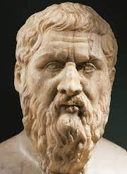
“PLATO, Platoon” “ARISTOCLE” what ever you call Him He will be Great
An Introduction to PLATO

Slide 2
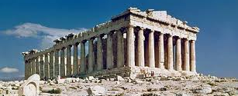
Introduction
Student of Socrates
Birth 427 BC
Death 347 BC
Aristocles …… The Best Glory
Family
Plato
Wrestler
Wide Knowledge

Slide 3
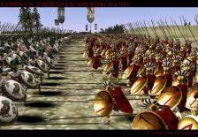
Early life
War between Athens and Spartans
Cratylus
Was a radical proponent of Heraclitean philosophy and influenced the young Plato.

Slide 4
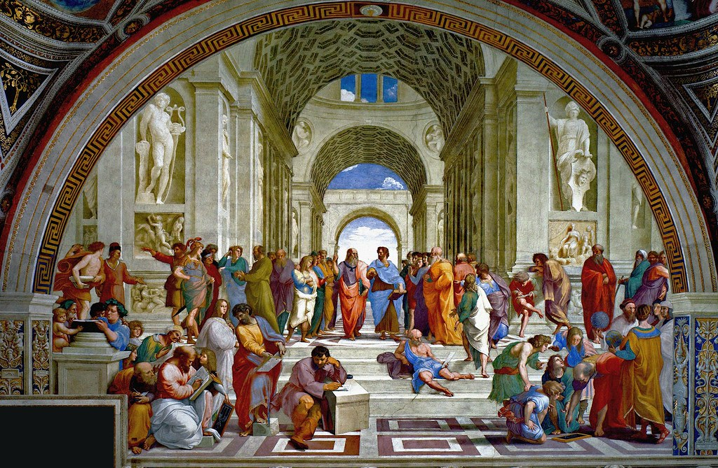
Academy
Acadmus
Philosophy Based
In 387 BC

Slide 5
Athens

Slide 6
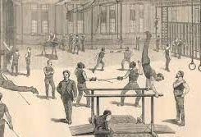
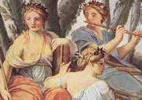
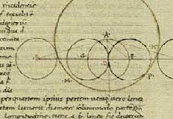
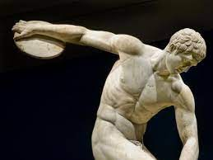
Subjects
Mathematics
Philosophy
Sports
Metaphysics
Gymnastics
Epistemology
Logic

Slide 7
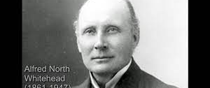
“The safest general characterization of European Philosophy tradition is that it consists of a series of footnotes to PLATO” Alfred North Whitehead

Slide 8
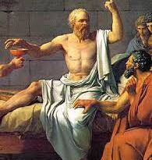
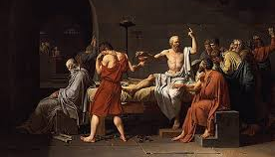
Socrates and Plato
“Socrates sentenced to death by drinking hemlock 399 BC”

Slide 9
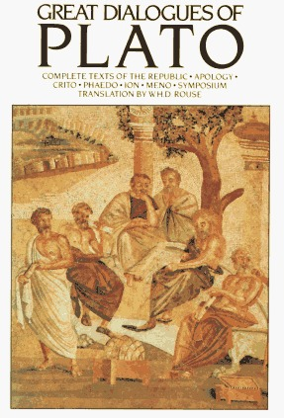
Holistic philosopher
Plato was a first holistic philosopher in that sense. He was a genius.
Platonic Dialogue
Main hero in dialogues was Socrates

Slide 10
Epistemology
Theory of knowledge

Slide 11
A debate between Heraclitus and Parmenides
Heraclitus
Change
Parmenides
No change

Slide 12
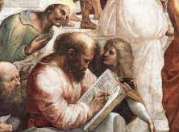
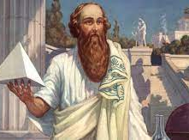
Pythagoras and Plato “The world is number”

Slide 13
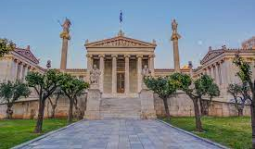
“Let no man enter who does not know geometry” Plato
Axiomatic Truth
Ideal world
Parmenidean world
Like Mathematics
Material world
Heraclitans world

Slide 14
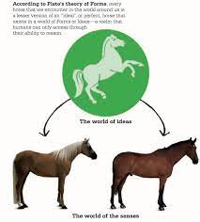
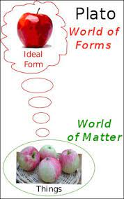
Two types of world according to Plato
World of form (Mind)
World of matter (Body)

Slide 15
Plato’s Dualism
The knowledge we is the understanding of our mind
Before our birth, our soul existed in a world of ideas
Knowledge is remembrance
Knowledge is linked with Socratic Dialectic
Virtue is knowledge
Theory of knowledge is the answer to Heraclitus and Parmenides debate

Slide 16
Ontology
Dualism Theory: Plato defends a clear ontological dualism in which there are two types of realities or worlds: the sensible world and the intelligible world or, as he calls it, the world of the Ideas.
Axiology
Socrates believed that knowledge had a vital connection to virtue, making morality and democracy closely intertwined. Socrates' student, Plato furthered the belief by establishing virtues which should be followed by all.
Epistemology
Debate between Heraclitus and Parmenides
In philosophy, Plato's epistemology is a theory of knowledge developed by the Greek philosopher Plato and his followers. Platonic epistemology holds that knowledge of Platonic Ideas is innate, so that learning is the development of ideas buried deep in the soul, often under the midwife-like guidance of an interrogator.

Slide 17
Aim of Education
man's mind is always active
greatest stress on mental development in education
the child should be kept in beautiful environment
Education aims not merely at providing information but at training the individual in his duties and rights as a citizen
the aim of education is human perfection

Slide 18
Curriculum of Education
Plato's education has its objective in the realization of truth, a truth which is comprehensive, not limited or narrow. Plato, therefore, believes that development of the mind, body and soul is essential. For this reason, he has divided the curriculum into three parts:
Bodily Development
Educational Impressions
Training in Music

Slide 19
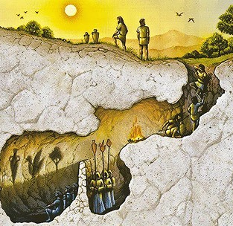
Role of Educator
greatest importance
He is like the torch bearer who leads a man, lying in a dark cave, out of the darkness into the bright light of the outside world (Allegory of the cave)

Slide 20
Education According to Classes
Plato's plan of education does not envisage uniform education for one and all
different individuals had to perform different tasks in society
Those made of gold should take up administration and government, while those made of silver were best suited for trade and defense. Others made of iron and baser metals should become laborer and agriculturists

Slide 21
Stage wise Assessment and continues Education
Plato suggested various kinds of tests to be conducted at different age levels. In the first place, primary education will be given to all between the ages of seven and twenty, following which a test shall be administered to everyone
Who failed sent to labor in the various occupations and productive trades, successful candidates will be sent to the armed forces
Again, a test; the failures will be compelled to remain in the armed forces, successful sent to join the government
Governing class will be subjected to further education in science. Later on, one from among the governing class will be elected as the philosopher administrator, occupy the highest position in the land, his word will be the law of the land. Apart from this supreme individual, all other members of the governing class will continue to receive education throughout their lives, most of this education consisting of teachings in philosophy. It is thus evident that Plato granted the highest place to philosophy in his educational scheme

Slide 22
Hope you enjoyed Plato’s life and Philosophy
Thank you

