Slide 1
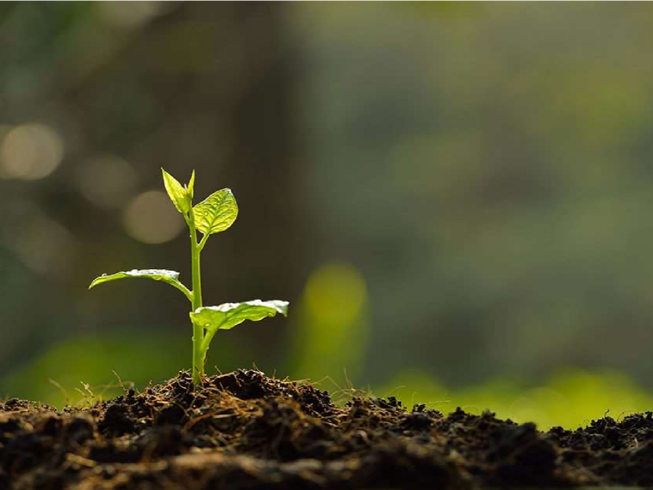
Nutrient Stress (micro nutrient stress)
Dr. Naila Farooq
Plant Growth Under Stress Environment
(SES-309)

Slide 2
Micronutrients
Micronutrients are the elements which are essential for plant growth only in very small quantities .
The Micronutrients are
B
Cl Cu Fe
Mn Mo Zn

Slide 3
BORON - B
B uptake by plant is controlled by the B level in soil solution rather than the total B content in soil
B uptake is a passive processes
It moves with water in plant tissue accumulate in the leaves

Slide 4
Deficiency :
Limited budding
Bud break
Distorted shoot growth
Short internodes increased branching
Toxicity :
Chlorotic leaf tips
Leaf necrosis
Leaf falling
An even plant death

Slide 5
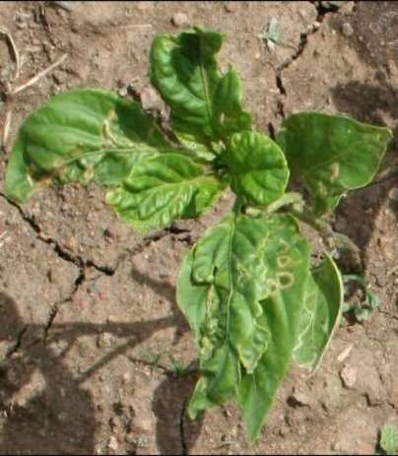
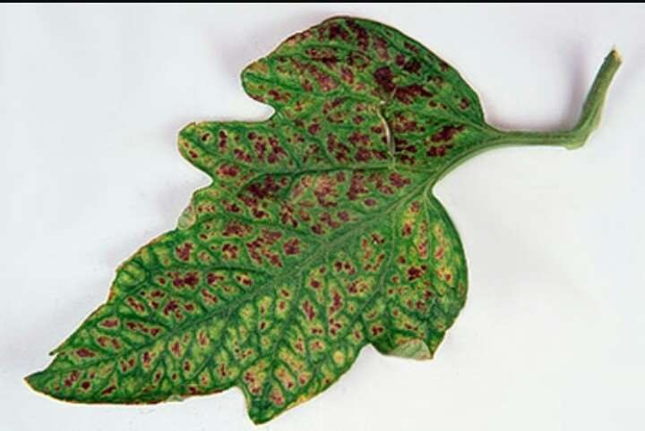

Slide 6
Chlorine - Cl
Cl is needed in small quantities and aids in plants metabolism, photosynthesis, osmosis and ionic balance within the cell
Function :
Participates in several physiological metabolism processes.
Plant growth and development.
Osmotic and stomata regulation
Evolution of oxygen in photosynthesis.

Slide 7
Diseases resistance and tolerance.
Important in the opening and closing of stomata Chloride function in cation
2.
3.
4.
balance and transport within the plant.

Slide 8
Deficiency :
Cl deficiency can occur if there is consistently less than 2ppm Chloride in the growing medium.
Chlorotic blotches with necrotic spots located between the veins or on the margin of the younger leaves.
In advance cases chloride deficiency could cause plant wilting
Toxicity :
Chloride toxicity starts as premature yellow in of leaves then in marginal or tip necrosis of older leaves

Slide 9
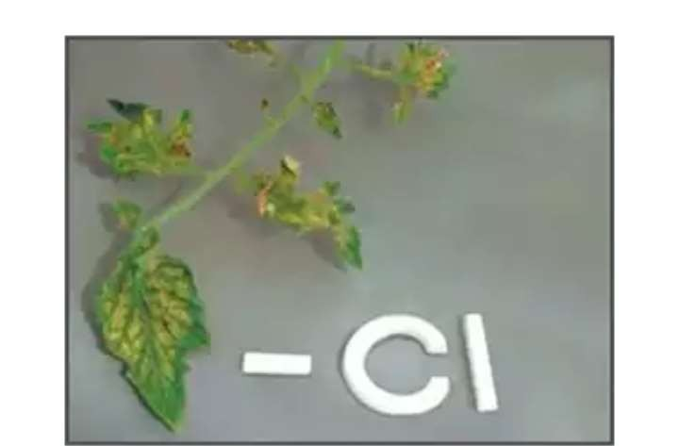

Slide 10
Cupper - Cu
Cu is essential to the plant growth. Among other things it plays a part in several enzyme productions and its key to the formation of chlorophyll.
Normal range of in the growing medium is 0.05 to 0.5 ppm.
Although cu deficiencies or toxicities rarely occure, it is best to avoid either extreme as both can have negative impact on crop.

Slide 11
Functions :
Activates some enzymes in plant which are involved in lignin synthesis and it is essential in several enzyme system.
Require in the process of photosynthesis, respiration and assist in plant metabolism of carbohydrates and proteins.
Serves flavor and colour in vegetables and flowers.

Slide 12
Deficiencies :
Deficiency symptoms occur in newer plants.
Symptoms start as chlorosis of either whole leaf or between the veins of newer leaves.
With the chlorotic areas of the leaf, small necrotic spots may form, especially on the leaf margin.
Leaves become small in size, become wilt.
Apical meristem may become necrotic and die.
Inhibit the growth of the lateral branches.

Slide 13
Toxicity :
Excess Cu can restrict root growth by burning the root tips.
Compete with plant uptake of Fe and sometimes Mo or Zn.
Reduce branching and eventually plant die.

Slide 14
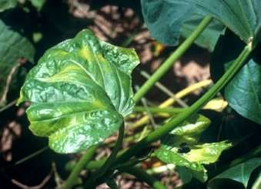
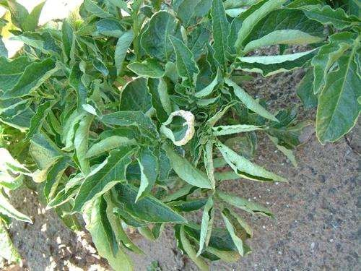

Slide 15
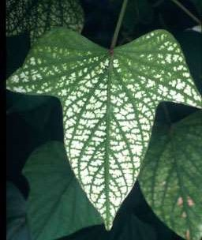

Slide 16
IR0N - Fe
Iron is very important to the health and growth of plants.
Form of absorption Ferus and Feric ions.
Iron is needed in the greatest quantity and its availability is dependent on the Ph of the growing medium.
Fe immobile

Slide 17
Functions :
Essential for chlorophyll formation.
Component of cytochromes.
Essential for N fixation
Assist in nitrate and sulphate reduction and energy production within the plant.

Slide 18
Deficiency :
Expressed as and interveinal chlorosis of the new leaves
Fe chlosis develops when soil Ph is high
Toxicity :
Occurs due to a low growing medium PH or from and excessive application of iron

Slide 19
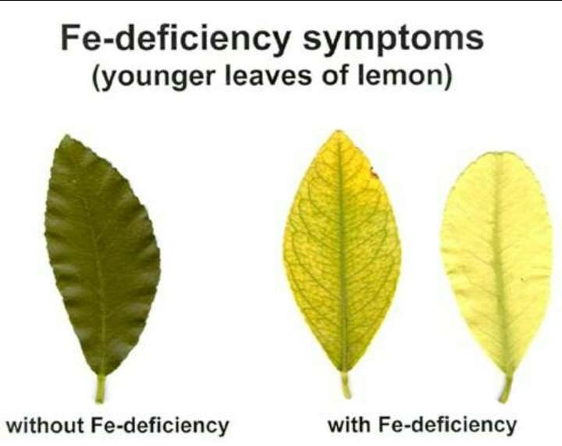

Slide 20
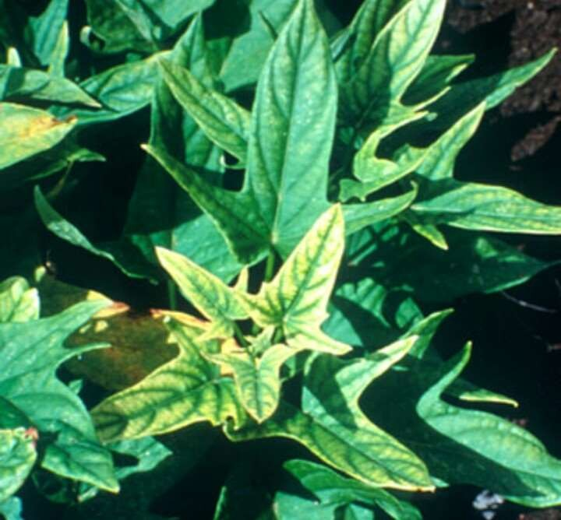

Slide 21
Manganese - Mn
Mn is required by plants in the second greatest quantity compared to iron
Absorb through the roots in the form of Mn ion
Immobile nutrient
Functions :
Required for chlorophyll synthesis
Required for Oxygen evolution during photosynthesis
Activate some enzymes systems

Slide 22
Contributor to various biological systems including photosynthesis respiration and Nitrogen assimilation
Involved in pollen germination, pollen tube growth, roots cell elongation
Resistance to root pathogeneses
Deficiency :
Similar to Fe chlorosis
Interveinal chlorosis on younger or older leaves followed by lesionso leaf shading
Restricted growth and failure to mature

Slide 23
Sunken spots that appear in the chlrotic areas between the veins
Mn deficiency can occur when the Ph of the growing medium exceeds 6.5
Toxicity :
Mn toxicity can occur if the fertilizer application rate is excessive
They can occur when the Ph of the growing media below 5.5
Burning of the tips and margin of older leaves as reddish brown sports across older leaves
Forming patches on the older leaves

Slide 24
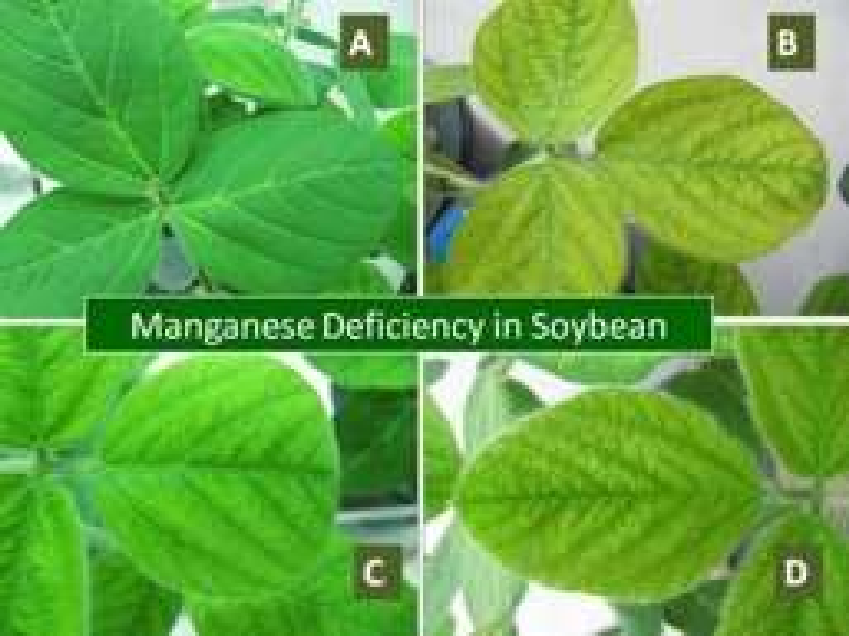

Slide 25
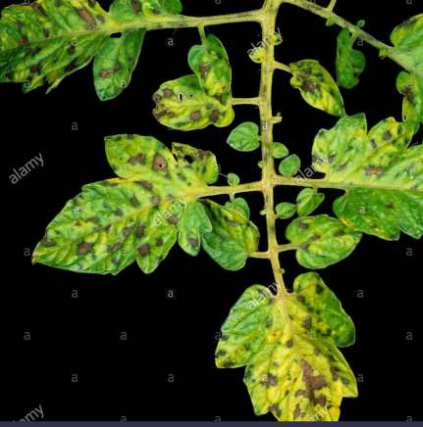
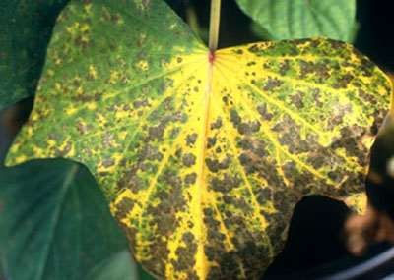

Slide 26
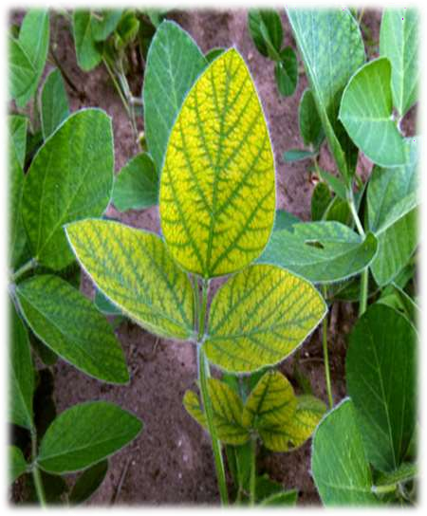
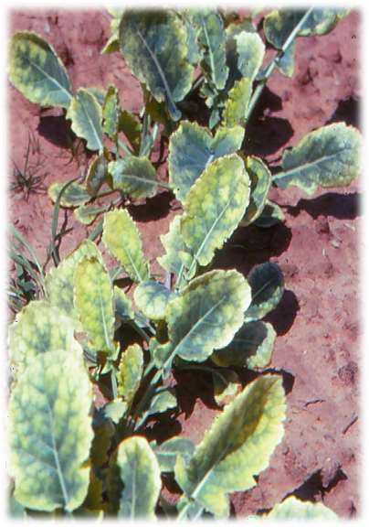

Slide 27
Molibdenum - Mo
Needed in the smallest quantities by plants.
Normal range 0.3 - 1.5 ppm
Toxicity or deficiency is not common.
Function :
Component in 2 enzymes that convert nitrate in to nitrite and then in to ammonia before it is used to synthesize amino acids with in the plant.
Needed to symbiotic N fixing bacteria in legumes to fix atmospheric nitrogen.

Slide 28
Deficiency :
Deficiency can easily resembles N deficiency.
Mobile within the plant so deficiency symptoms show up on older & middle leaves
Show up as thin chlorotic leaf margins around the leaf perimeter & then the margin become necrotic.
Whole leaf turns pale.

Slide 29
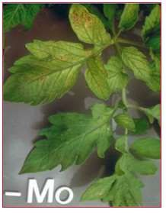
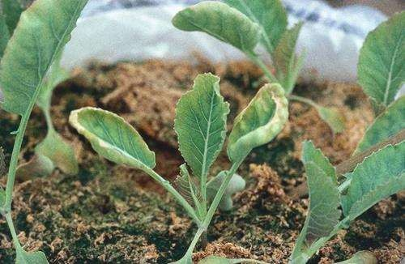
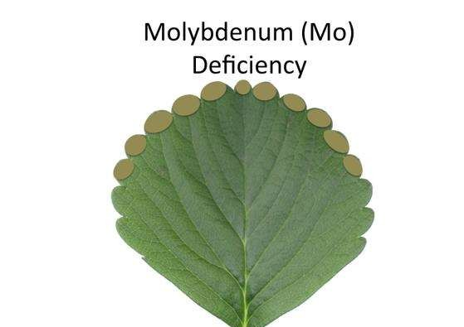

Slide 30
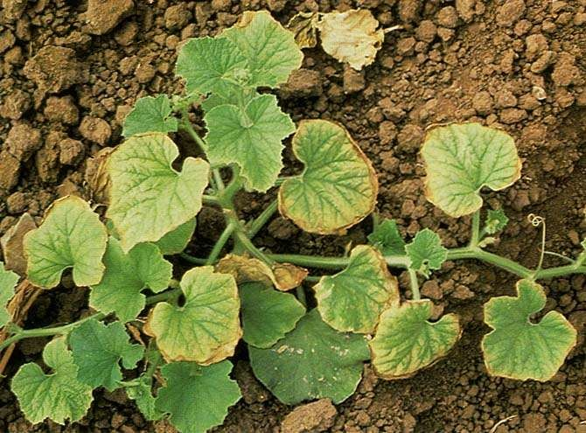

Slide 31
Zinc - Zn
Forms of absorption – Zn²⁺
Functions :
Help to plant produce chlorophyll important to photosynthesis.
A constituent of certain enzymes.

Slide 32
Deficiency :
Growth suppression, reduced internode length, rosetting
Interveinal chlorosis on young leaves.
Toxicity :
Occurs at low PH
Growth reduction, Leaf chlorosis
Mobility :
Zn is immobile in tissues.

Slide 33
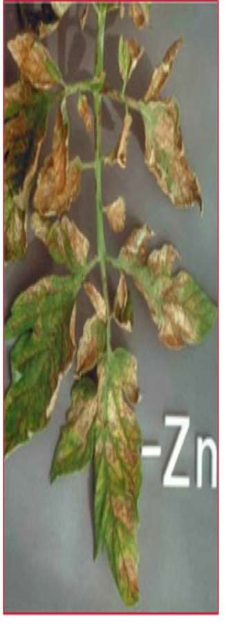

Slide 34
