Slide 1
Wind Energy (Wind Power)

Slide 2
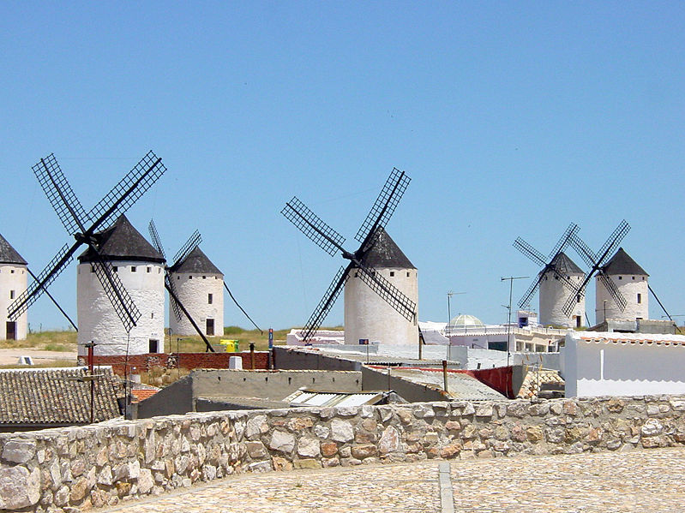
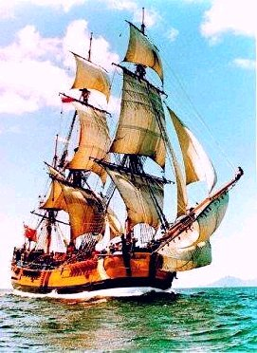
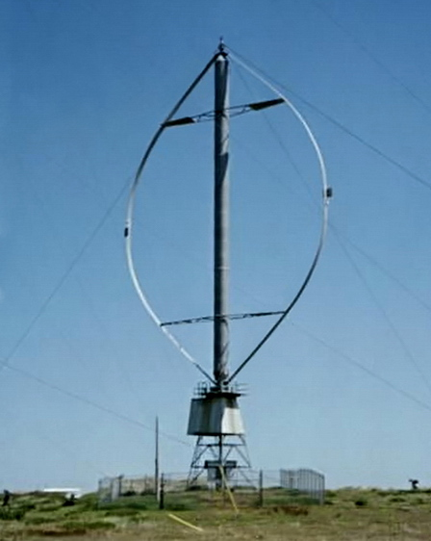
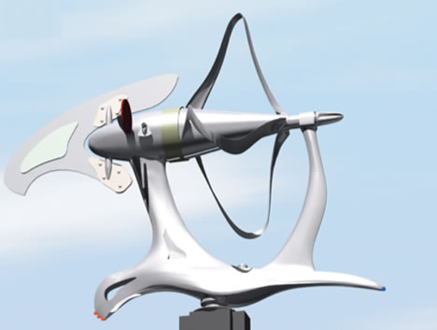
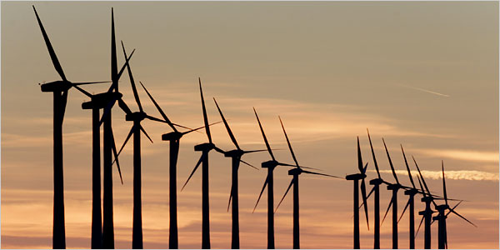
History of Wind Power
From…
and…
to…

Slide 3
Introduction
The focus on Renewable Energy Resources has increased significantly in the recent years in the wake of growing environmental pollution, rising energy demand and depleting fossil fuel resources.
Different sources of renewable energy include biomass, solar, geothermal, hydroelectric, and wind.
Among These resources wind has proved to be a cheaper alternative energy resource and hence extensive research efforts have been put to improve the technology of electricity generation through wind.
Installed wind generation capacity resource has increased from 25,000 MW to more than 200,000 MW in 10 years (from 2001 to 2010).

Slide 4
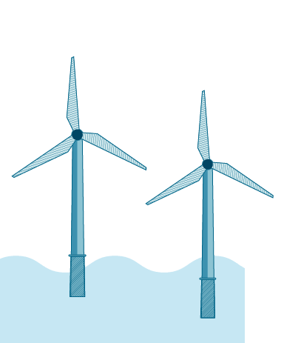
Wind Energy
Wind is a form of solar energy. Winds are caused by the uneven heating of the atmosphere by the sun, the irregularities of the earth's surface, and rotation of the earth.
Wind energy (or wind power) describes the process by which wind is used to generate electricity.
Wind energy is the most reliable and effective renewable energy resource for responding to growing demand

Slide 5
How Wind Power Is Generated:
The terms "wind energy" or "wind power" describe the process by which the wind is used to generate mechanical power or electricity.
Wind turbines convert the kinetic energy of the wind into mechanical power.
This mechanical power can be used for specific tasks such as a generator can convert this mechanical power into electricity to power homes, businesses, schools, and the like.

Slide 6
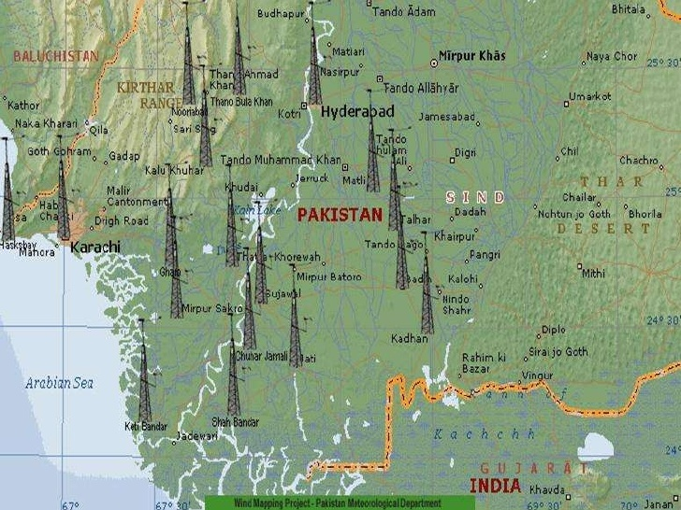
Wind Energy in Pakistan
Wind power is a form of renewable energy in Pakistan which makes up more than 6% of the total electricity production in the country. As of 2018, wind power capacity in Pakistan was 1,237 MW.
The government is looking to increase the share of renewable energy and plans to add around 3.5 GW of wind energy capacity by 2018.

Slide 7
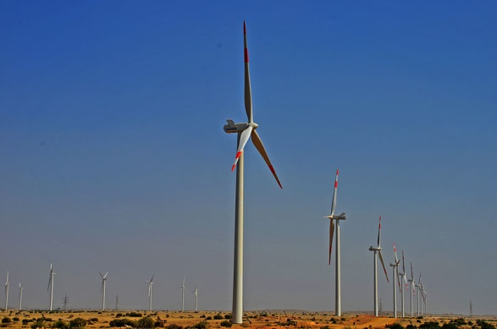
Wind Energy in Pakistan
Jhimpir Wind Farm
The Jhimpir Wind Power Plant was developed in Jhimpir, Sindh by Zorlu Energy Pakistan. The total cost of project is $136 million. Completed in 2002, it has a total capacity of 50 MW. This wind Corridor has a 50000 megawatt potential with average wind speeds over 7 meter per second. The government has announced upfront tariff and ROI of 17 percent which is highest in the world. There are 14 projects in the pipeline out of which 50 MW FFCEL project will achieve COD by mid December 2012.

Slide 8
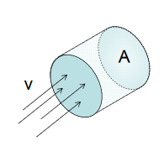
Wind Physics Available wind power
Wind power depends on:
Amount of air (volume)
Speed of air (velocity)
Mass of air (density)
Flowing through area of interest (flux)
Kinetic energy: $KE=\frac{1}{2}mv^{2}$
Power: P$=\frac{1}{2}\dot{m}v^{2}$
Particles of air have low mass, so must look at mass flow in a specific area
Fluid mechanics gives mass flow rate $\dot{m}=\frac{dm}{dt}=ρAv$
Thus power can be written as: $P=\frac{1}{2}ρAv^{3}$
Wind speed, v
Air density, $ρ$
Swept area $A=πr^{2}$

Slide 9
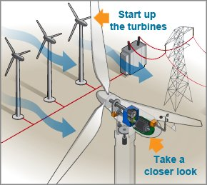
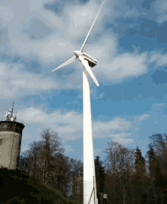
Wind Turbines
Wind turbines, like aircraft propeller blades, turn in the moving air and power an electric generator that supplies an electric current.
Simply stated, a wind turbine is the opposite of a fan. Instead of using electricity to make wind, like a fan, wind turbines use wind to make electricity.
The wind turns the blades, which spin a shaft, which connects to a generator and makes electricity.

Slide 10
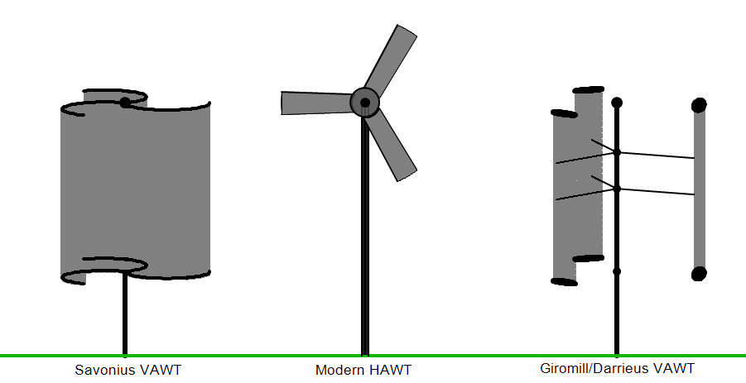
Types of Wind Turbines
Horizontal axis
Vertical-axis
Darrieus wind turbine
Savonius wind turbine

Slide 11
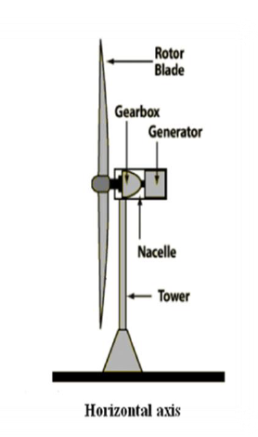
Types of Wind Turbines
Horizontal axis
Horizontal axis means the rotating axis of the wind turbine is horizontal, or parallel with the ground.
In big wind application, horizontal axis wind turbines are almost all you will ever see. However, in small wind and residential wind applications, vertical axis turbines have their place.

Slide 12
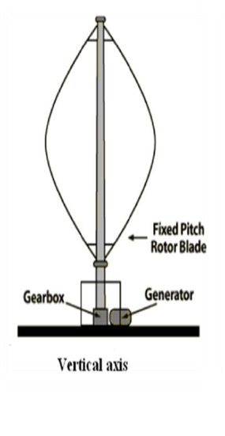
Types of Wind Turbines
Vertical axis
With vertical axis wind turbines the rotational axis of the turbine stands vertical or perpendicular to the ground.

Slide 13
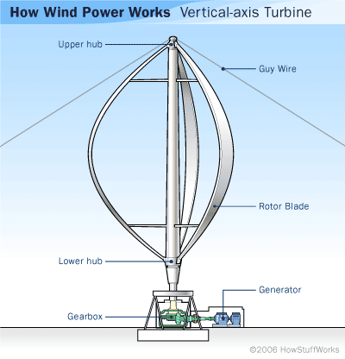
Types of Vertical Axis Wind Turbines
Darrieus wind turbine
The Darrieus wind turbine is a type of vertical axis wind turbine (VAWT) used to generate electricity from the energy carried in the wind. The turbine consists of a number of curved aerofoil blades mounted on a vertical rotating shaft or framework. The curvature of the blades allows the blade to be stressed only in tension at high rotating speeds.

Slide 14
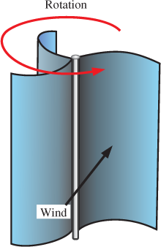
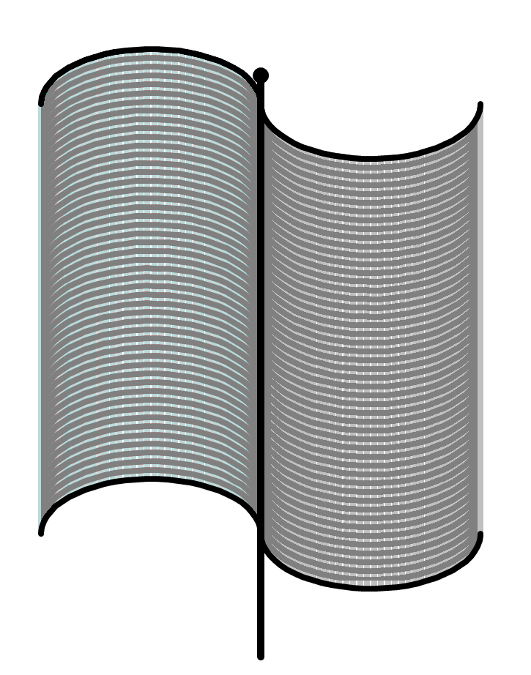
Types of Vertical Axis Wind Turbines
Savonius wind turbine
The Savonius turbine is one of the simplest turbines. Aerodynamically, it is a drag-type device, consisting of two or three scoops. Looking down on the rotor from above, a two-scoop machine would look like an "S" shape in cross section. Because of the curvature, the scoops experience less drag when moving against the wind than when moving with the wind. The differential drag causes the Savonius turbine to spin.

Slide 15
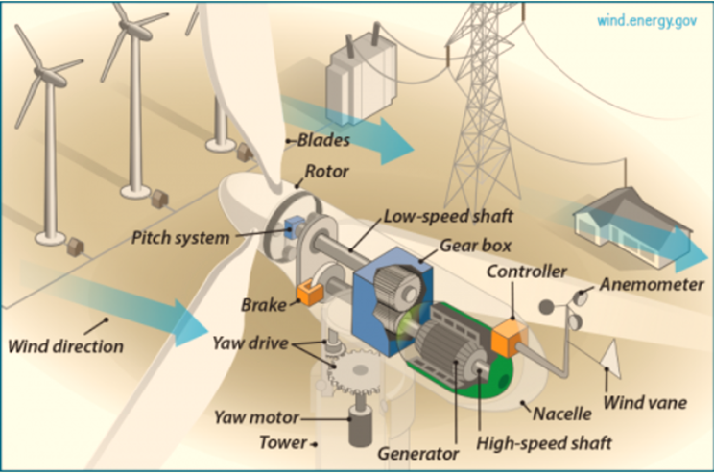
Wind Turbine Components
Yaw
Pitch
Drivetrain
Cooling unit
Nacelle
Rotor blades
Electronic controller

Slide 16
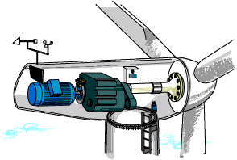
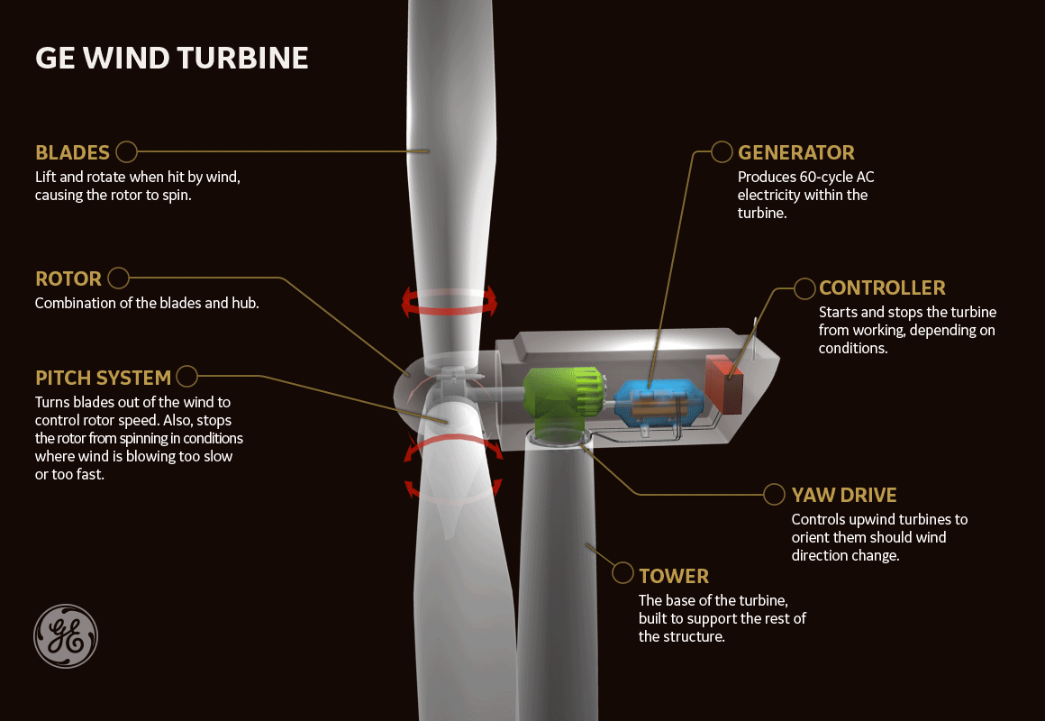
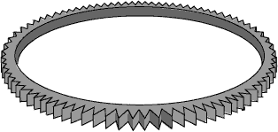
YAW
The yaw drive is an important component of the horizontal axis wind turbines' yaw system.
To ensure the wind turbine is producing the maximal amount of electric energy at all times, the yaw drive is used to keep the rotor facing into the wind as the wind direction changes.

Slide 17
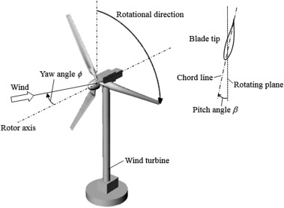
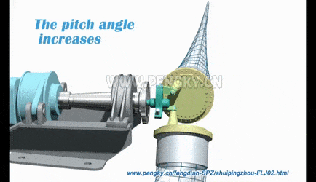
Pitch
On a pitch controlled wind turbine the turbine's electronic controller checks the power output of the turbine several times per second.
When the power output becomes too high, it sends an order to the blade pitch mechanism which immediately pitches (turns) the rotor blades slightly out of the wind. Conversely, the blades are turned back into the wind whenever the wind drops again.
The rotor blades thus have to be able to turn around their longitudinal axis.

Slide 18
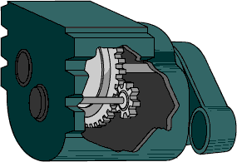
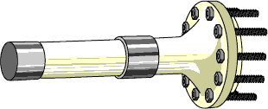
Drivetrain
The drivetrain of a wind turbine is composed of the gearbox and the generator, the necessary components that a turbine needs to produce electricity.
The gearbox is responsible for connecting the low-speed shaft attached to the turbine blades to the high-speed shaft attached to the generator.

Slide 19
Nacelle
The nacelle contains the key components of the wind turbine, including the gearbox, and the electrical generator.
Service personnel may enter the nacelle from the tower of the turbine. To the right of the nacelle we have the wind turbine rotor, i.e. the rotor blades and the hub.

Slide 20
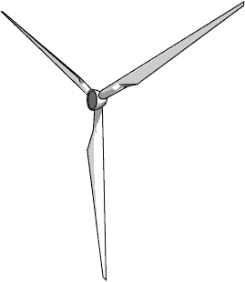
Rotor blades
The rotor blades capture the wind and transfer its power to the rotor hub. On a modern 1000 kW wind turbine each rotor blade measures about 27 metres (80 ft.) in length and is designed much like a wing of an aeroplane

Slide 21
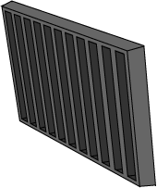
Cooling unit
The cooling unit contains an electric fan which is used to cool the electrical generator.
In addition, it contains an oil cooling unit which is used to cool the oil in the gearbox.
Some turbines have water-cooled generators.

Slide 22
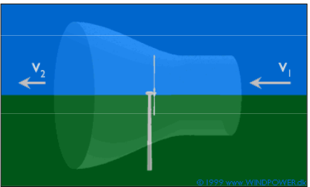
Efficiency in extracting wind power
Power coefficient, $C_{p}$, is the ratio of power extracted by turbine to the total contained in the wind resource $C_{p}=\frac{P_{T}}{P_{W}}$
Turbine power output: $P_{T}=\frac{1}{2}ρA v^{3}C_{p}$
Tip speed ratio, $λ=ωR/v$, $ω$ being rotational speed of the tip of blade having radius R and v is the velocity of air
59.3 % efficiency is the BEST a conventional wind turbine can do in extracting power from the wind.

Slide 23
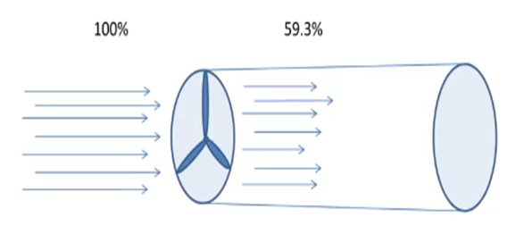
Wind Efficiency
Wind efficiency is the amount of kinetic energy in the wind that is converted to mechanical energy and electricity. Laws of physics described by Betz Limit says the maximum theoretical limit is 59.3%. The wind requires the rest of the energy to blow past the blades. This is in fact good. If a turbine trapped 100% of energy wind would stop blowing and the blades of a turbine cannot turn to produce electricity.
It is, however, not possible for any machine, at present to convert all of the trapped 59.3% of kinetic energy from wind to electricity. There are limits due to the way generators are made and engineered, which further decrease the amount of energy that is finally converted to power. The average at present is 35-45%

Slide 24
Wind Turbine Efficiency
For the wind turbine, one standard of perfection would be the ability to convert all of the power available in the wind passing through its blades, at a specific velocity, into useful mechanical power ‘
Wind Turbine Efficiency = $\frac{Shaft Power out of turbine into gear box}{wind power into turbine blades}$

Slide 25
Wind Capacity Factor
The capacity factor is the average power generated, divided by the rated peak power.
Let's take a five-megawatt wind turbine. If it produces power at an average of two megawatts, then its capacity factor is 40% (2÷5 = 0.40, i.e. 40%).
Capacity Factor = Average Output / Peak Output
Factors Improve Capacity Factor:
Wind speed
Air density
Larger and taller turbines

Slide 26
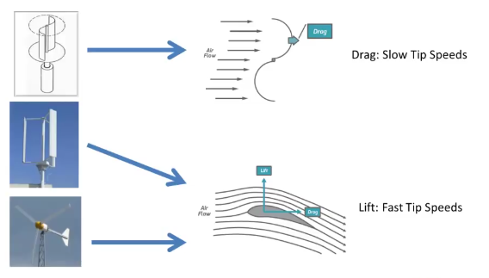
Choosing a wind turbine

Slide 27
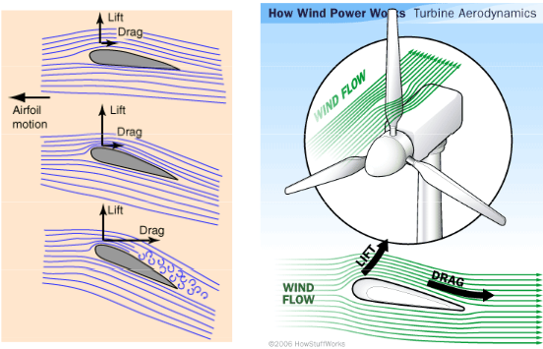
Lift and drag forces

Slide 28
Numerical
Question 1: A wind turbine travels with the speed is 20 m/s and has a blade length of 30 m. Calculate the wind power. Solution: Given: Wind speed v = 20 m/s, blade length l = 30 m, air density ρ = 1.23 kg/m^3, area A = π l^2 = π × 30^2 = 2827.43 m^2 The wind power formula is given by, P = 1/2 ρ A V^3 P = 1/2 × 1.23 kg/m^3 × 2827.43 m^2 × (20m/s)^3 P = 13.91 MW.

Slide 29
Design of Wind Turbine
Main Rotor Design Method (ideal case):
Determine basic configuration: orientation and blade number
take site wind speed and desired power output
Calculate rotor diameter (accounting for efficiency losses)
Select tip-speed ratio (higher, more complex airfoils, noise) and blade number (higher efficiency with more blades)
Design blade including angle of attack, lift and drag characteristics
Combine with theory or empirical methods to determine optimum blade shape

Slide 30
Advantages of Wind Energy
Clean & Environment friendly Fuel source
Renewable & Sustainable
Cost Effective
Industrial and Domestic Installation
Job Creation

Slide 31
Disadvantages of Wind Energy
Fluctuation of Wind and Good wind sites
Noise and aesthetic pollution
Not a profitable use of land
Threat to wildlife

