Slide 1
Layout
Layout in graphic designing refers to the arrangement of elements such as image, text, and style on a page. The layout bridges the gap between your target audience and your brand. The success of a graphic design depends on the arrangement of the elements in the proper sequence and position. The improper layout can act as the nemesis of your brand. At the same time, the right layout is just enough to attract your potential customers.

Slide 2
Graphic Design Layout Rules
A layout is the heart of any design. No matter how skilled you are there are chances that you might find it hard to try to fit the elements onto the page because they just don’t look or feel right. It is therefore extremely important to stick to these layout rules to create best logo designs. The number one rule in layout is to balance all your elements, so that the message is not distorted. You should always place your elements in the center of the page, keeping the margins on all edges. Rotational and reflection symmetry are further variations of the theme, and can add interest. Next you should always remember the rule of third. Use guides to divide your work area into an equal three-by-three grid. Place your key element where two of the axes meet to have a focal point. It’s then simple to develop the rest of the layout quite effortlessly. Another important rule of layout is unity which states that by using unity you can create a cohesive layout. If your elements are of uniform sizes, aligned to grids, are of equal dimension a viewer will subconsciously create structure and order.

Slide 3
Graphic Design Layout Template
There are various design templates that you can use for creating a visually appealing layout. You can fully customize a page by just using HTML Code that does not use the theme. Liquid layout elements at will not show header, footer, or other carried over elements but can be great for creating unity. People generally use CSS property for creating liquid template. Another famous layout template people use is tables for layout creation which is quite intuitive. You can see them almost everywhere! You don’t even need to use a separate CSS style sheet when using this template. And, the best part about them is that they don’t break. Flexbox is another layout template which is a short name for the CSS Flexible Box Layout Module. This is something new to Float template and the main idea behind the flexbox is to give a container the ability to alter its items length, width and order. You should use it if you want to fill the available space and make your layout stand out.

Slide 4
Design Layout Inspiration
The most inspirational things are often right in front of us and they often inspire us to create a unique and impressive layout. It might be the opening titles in the recent movie that you saw , a typography on a book cover, the design of a square inch, the colors of your favorite music album, etc. Imagine you’re browsing through a bookstore, soaking up covers, getting awe-inspired by their colors, their typefaces, their layouts, little details. The variety is endless, and sometimes your eyes stick onto that master piece of art shining through the sheer mass. You just need to keep your eyes open and the best kind of design layout inspiration might indeed lie where you least expect it.

Slide 5
Graphic Design Layout Techniques
There are various techniques to make your design layout appealing. Focal Point and Accent is the most important among them because emphasis is achieved by position, rhythm, typeface weights and styles. The secondary emphasis points are called accent and help in framing the layout correctly. Another technique which can make your layout stand out is positive and negative shapes. In a successful positive/negative shape relationship negative shapes are interdependent, filling the whole space in the eyes of the viewer. Further you should also take care of the grid as it is a modular compositional structure made up of verticals and horizontals that segregates the format into columns. A grid gives a layout a unified look.

Slide 6
Graphic Design Layout Principles
There are a few graphic design principles which you must follow. Alignment of elements in the layout is the basic principle which makes your layout stand out, Further, you should use simple font face, images should be of high resolution and should be big enough to capture the viewers attention. Proximity (Closeness) is another important principle which makes your layout a unity. Contrast (Gap or Difference) is also important as it creates variety in the layout.
If the elements of the layout are laid out well, and you follow all of these master tips about the layout design then you will surly create a great layout and will feel excited as your viewers eye will be led across the page. A layout is the first attraction for your readers and viewers, so make it effective and appealing today.

Slide 7
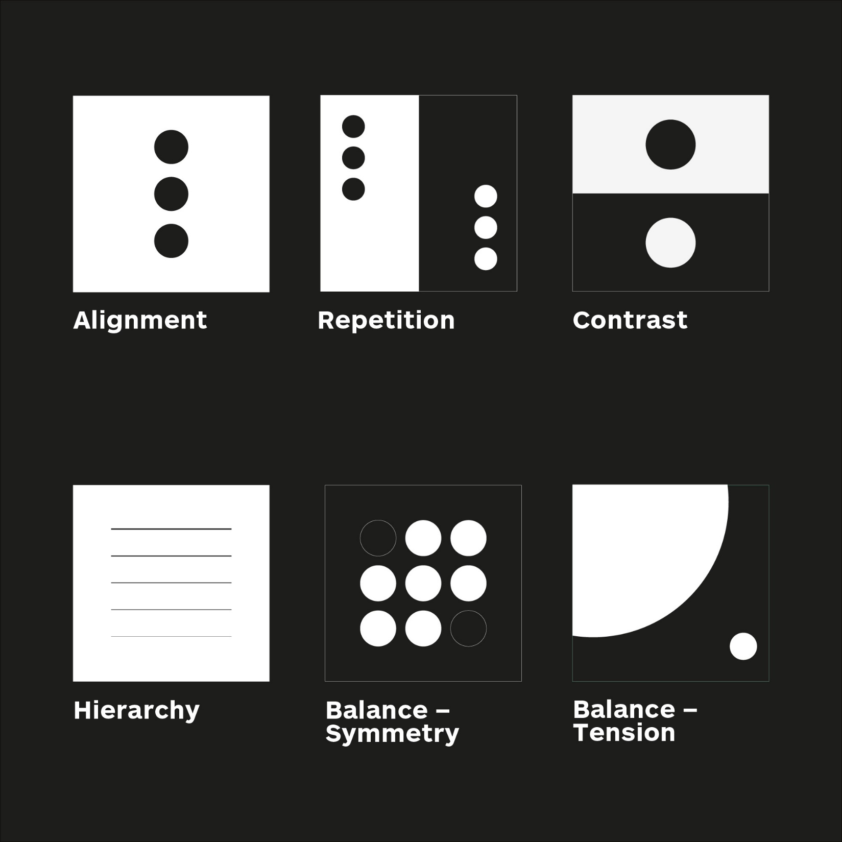

Slide 8
5 Basic Principles of Layout
What makes a “bad” design? What makes a “good” design? And how can you even tell the difference? Don’t you just know when you see it? Well, graphic design is undoubtedly about aesthetics, which can be subjective. Beauty is in the eye of the beholder, after all. There are set graphic design principles you must consider and adhere to. If those aren’t working in synergy, the whole design suffers.
Alignment
Repetition
Contrast
Hierarchy
Balance / Balance using tension

Slide 9
Alignment Alignment creates a sharper more unified design
Alignment is one of the most basic, but most important principles of design, as it allows our eyes to see order, which is quite comforting to a reader.
Ever viewed a design and not known where to look? Left, right, centered? Having a strong point of alignment within design allows our eyes to seamlessly flow through the visual message. Aligning elements with one another so that every item has a visual connection with something else on the page, tightens a design and eliminates the haphazard, messy effect which comes from random placement of elements.
Aligning elements which are not in close proximity with each other can provide an invisible connection, communicating the idea that they belong to the same piece.
Outside 2D graphic design, alignment can be observed as paintings that are hung evenly along an invisible line, how you can toggle between right/left/center alignment for paragraph text in Microsoft Word documents, or parking spots marked by even lines in a row. And if you want to see some truly horrifying alignment, check out this confusing signage in Los Angeles.

Slide 10
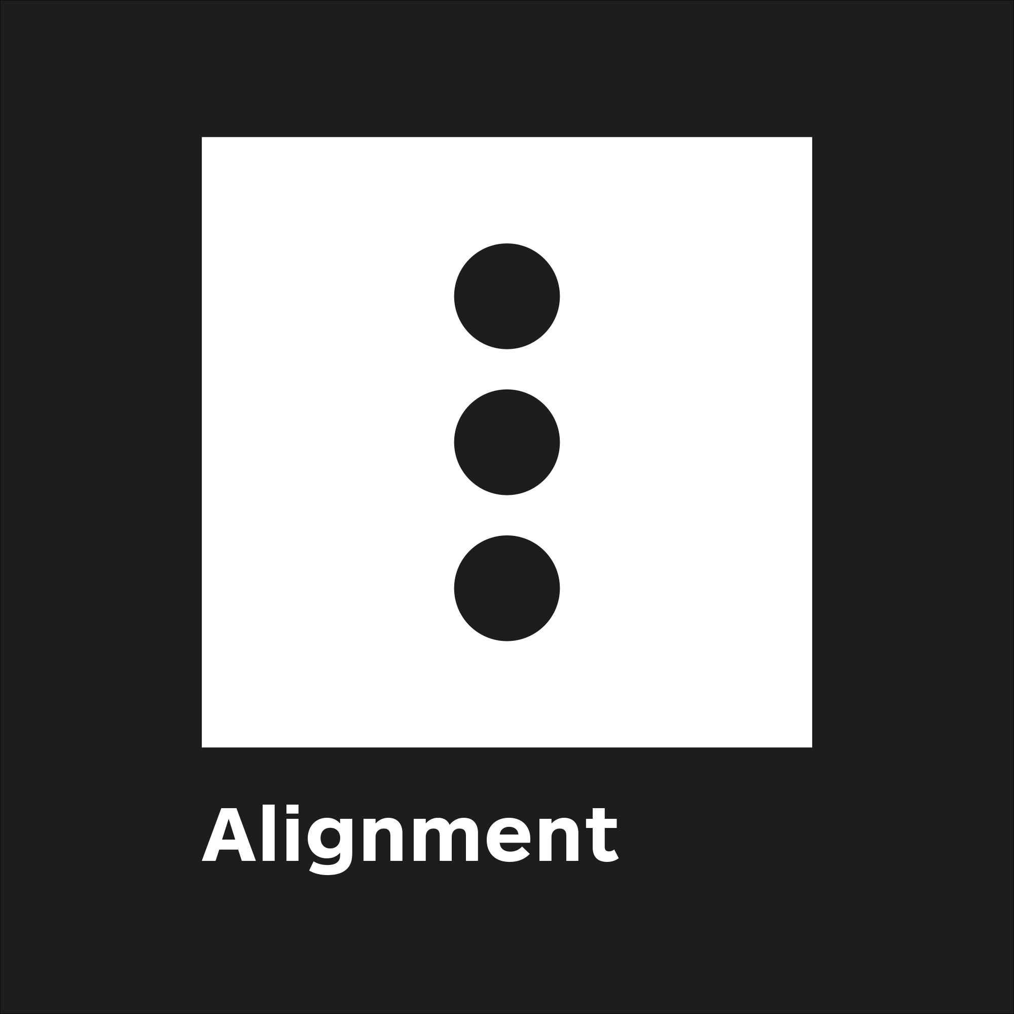

Slide 11
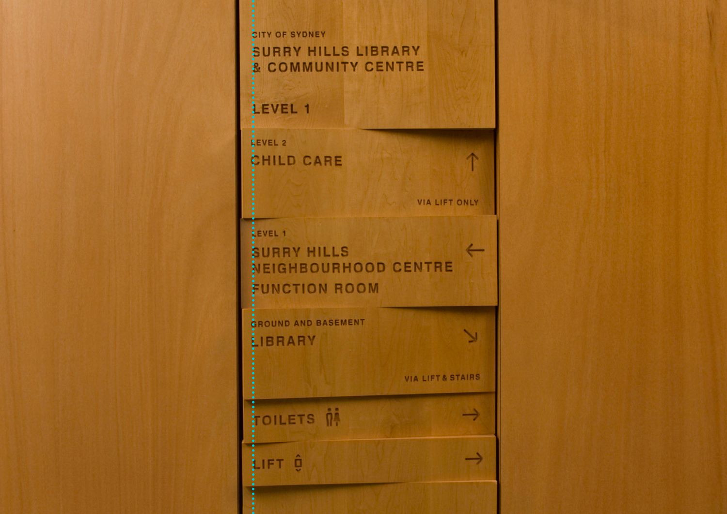

Slide 12
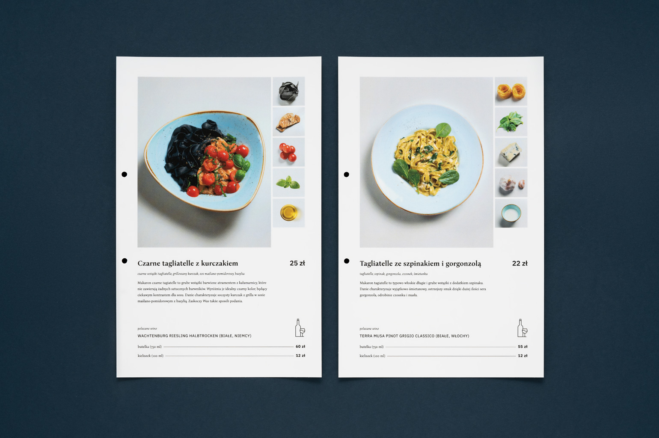

Slide 13
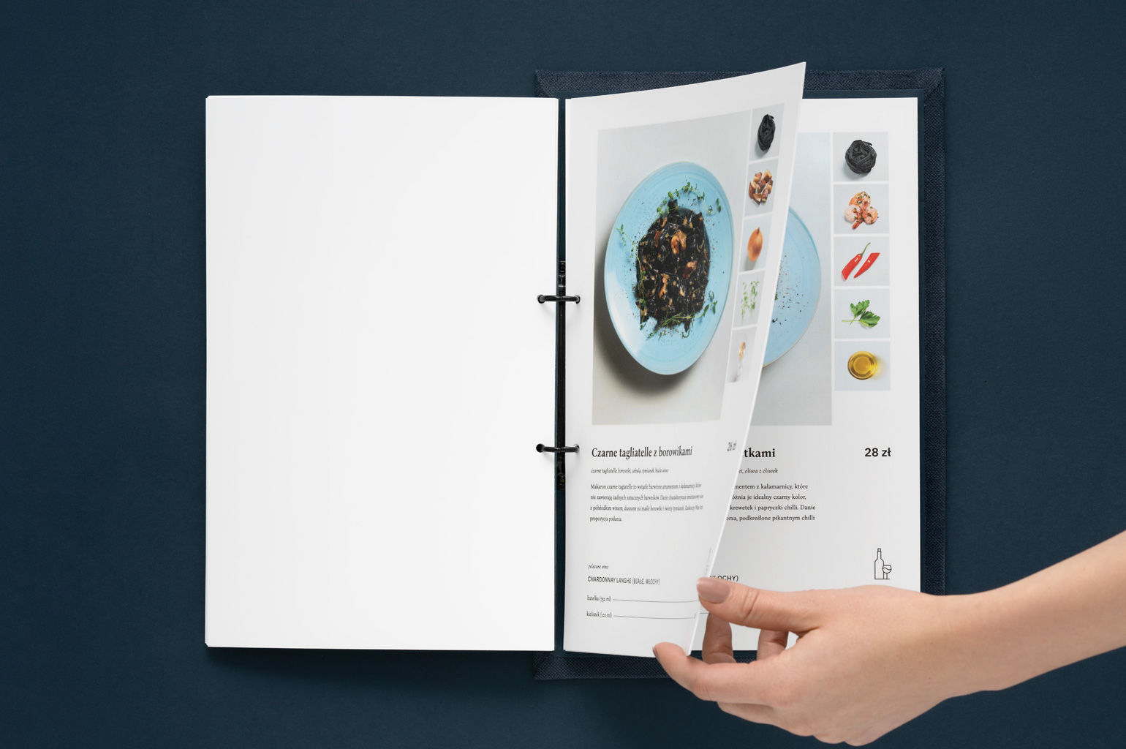

Slide 14
Repetition
Repetition strengthens a design by tying together otherwise separate parts, and as a result, creates associations.
Think of repetition as consistency. By repeating elements of a design, you immediately create a familiarity or identity. Repetition is a major factor in the unity of multiple page documents. eg. when looking at a publication, it should be immediately obvious that p.5 and p.10 belong to the same publication either by the grid, type style, font size, colour, spatial relationships, etc. Repetition can also be used to create graphic elements, such as patterns, as long as it doesn’t become overwhelming; be conscious of contrast.
Repetition helps people identify that separate things belong together. Think of it a bit like a family. Each individual in the family looks a bit different, but there are enough similarities that you can see they all related. Let’s look at some more good visual examples of repetition in graphic design.

Slide 16
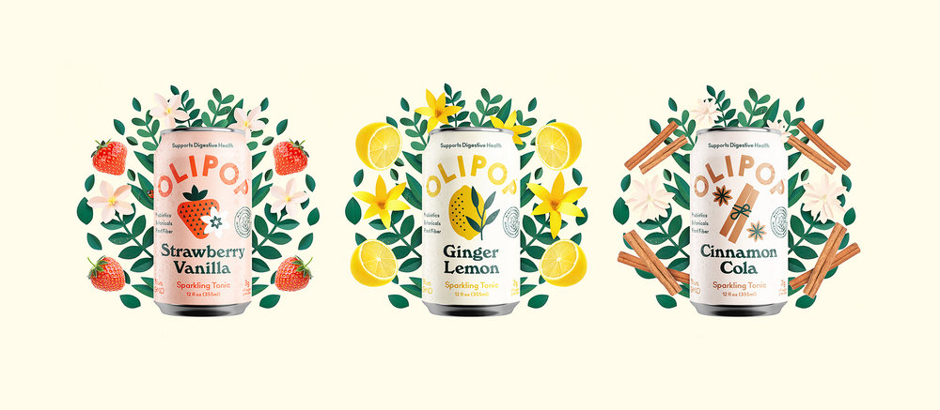

Slide 17
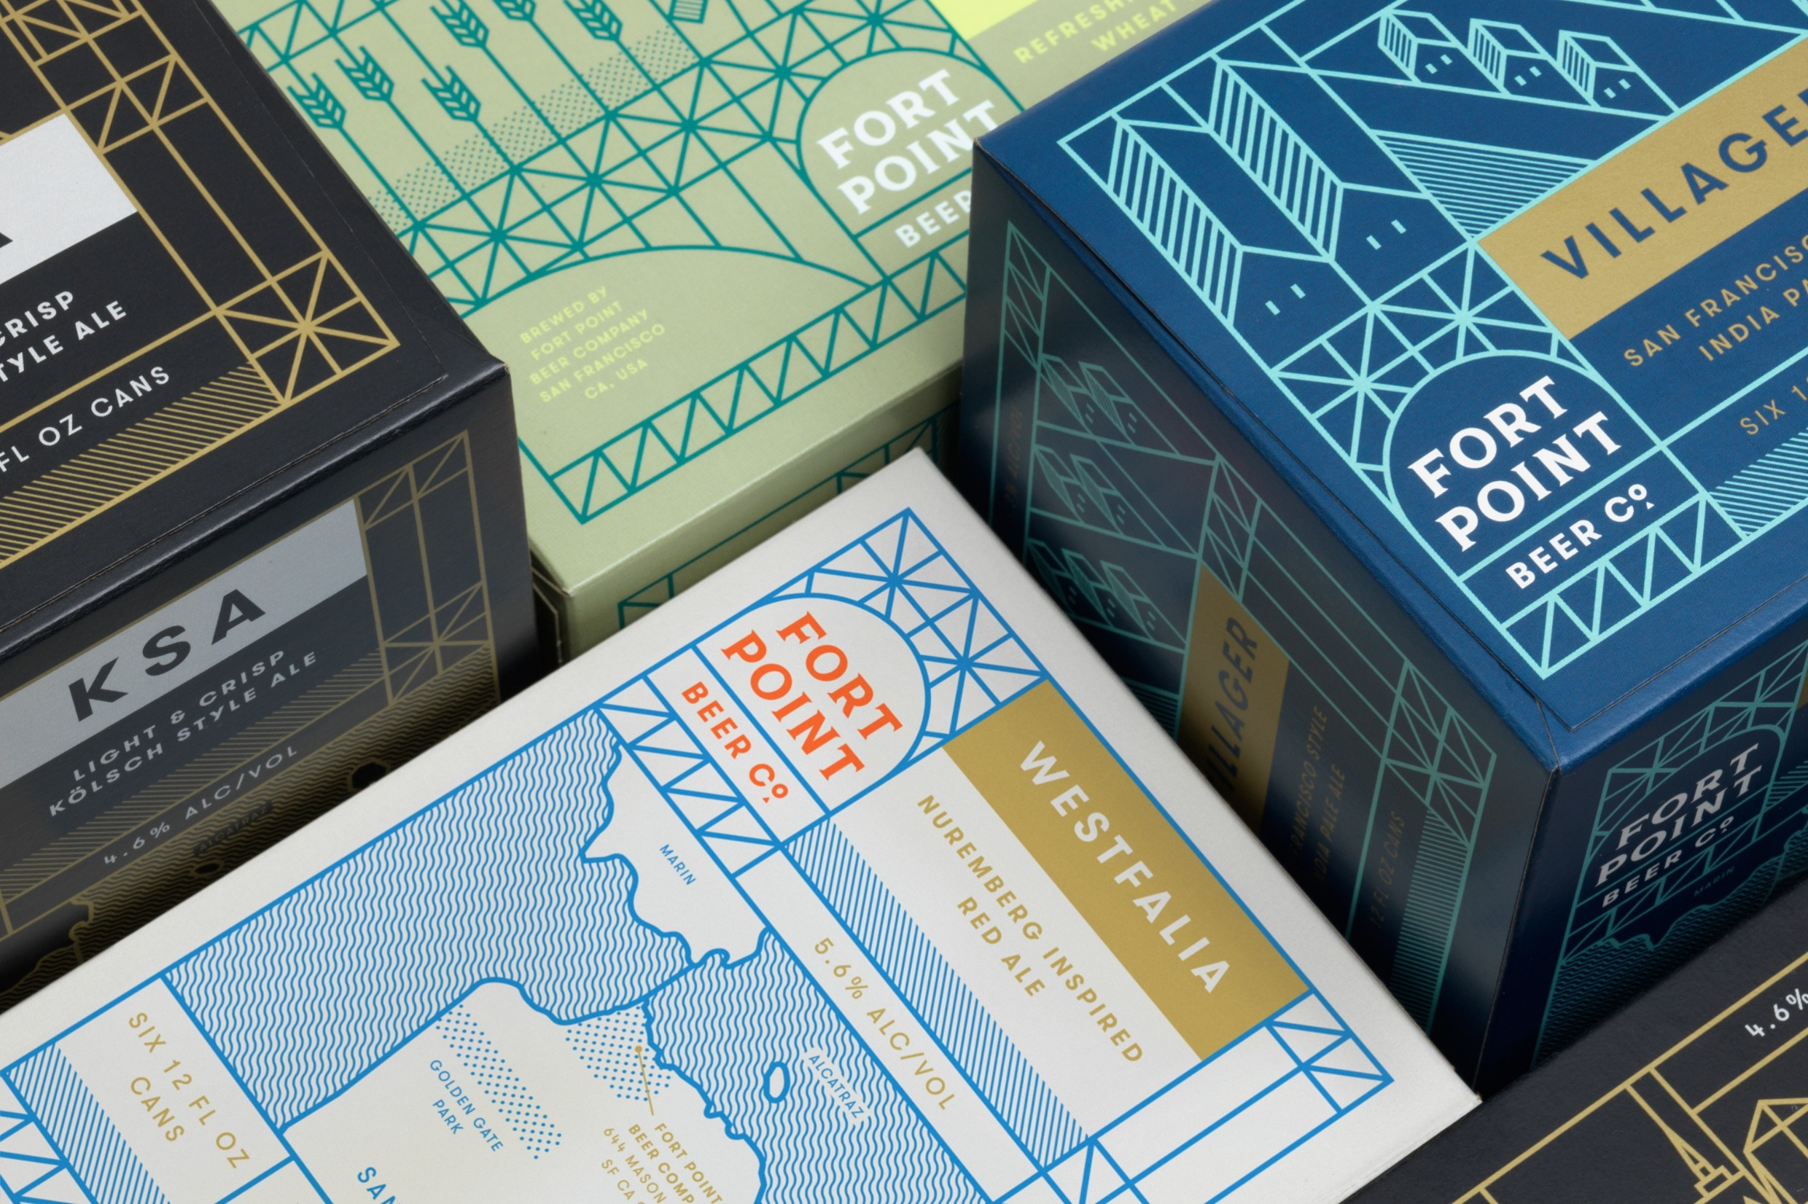

Slide 18
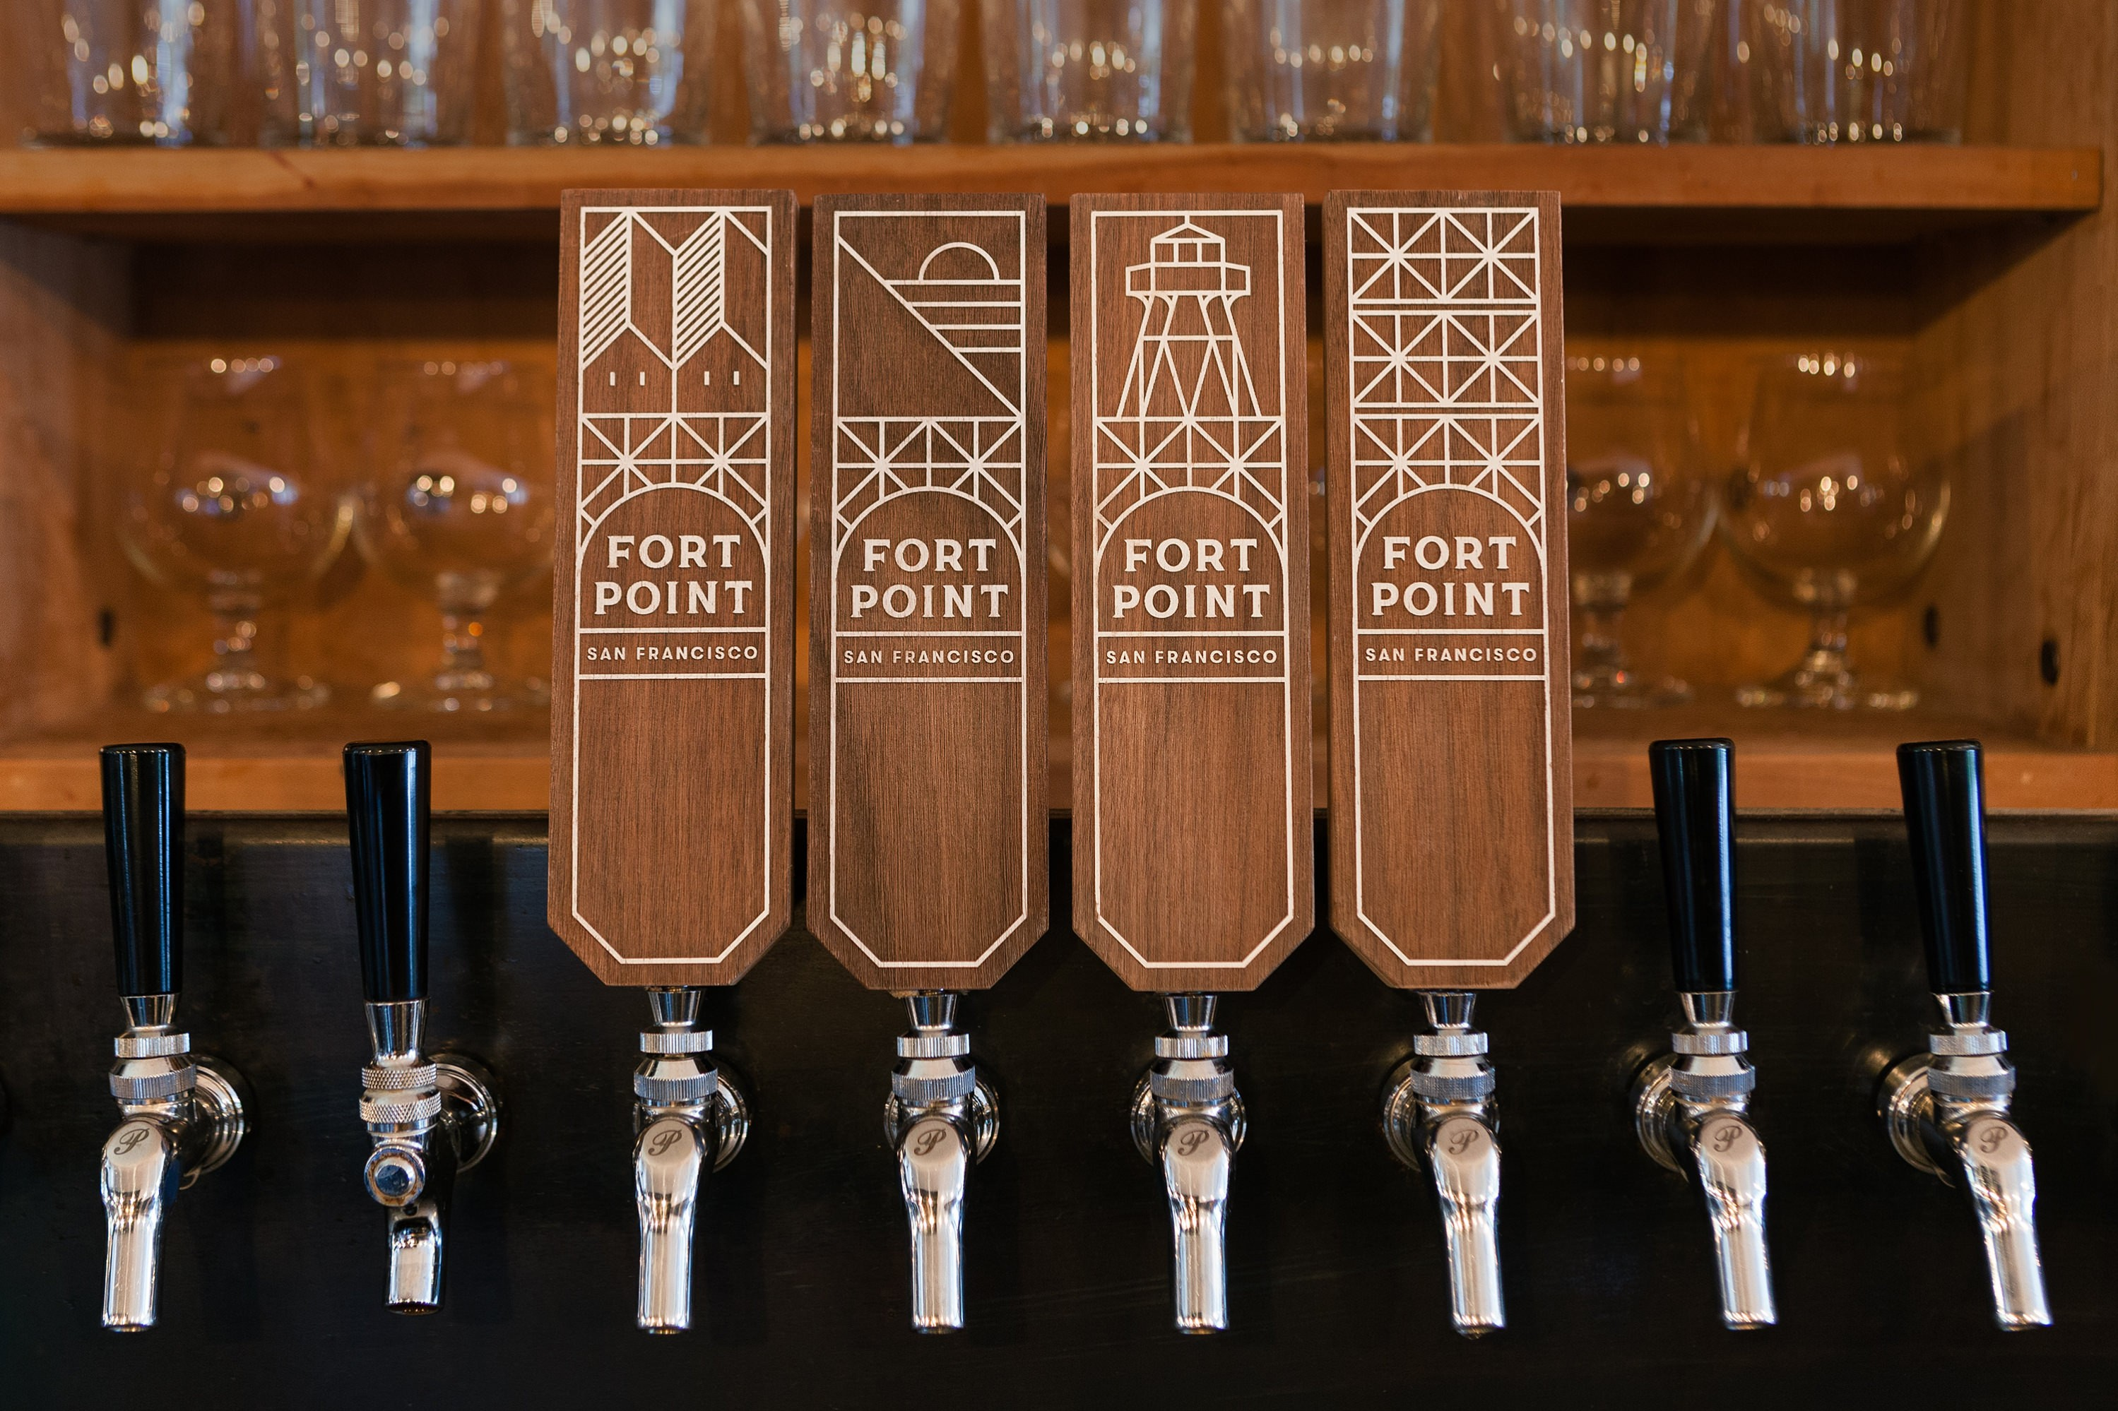

Slide 19
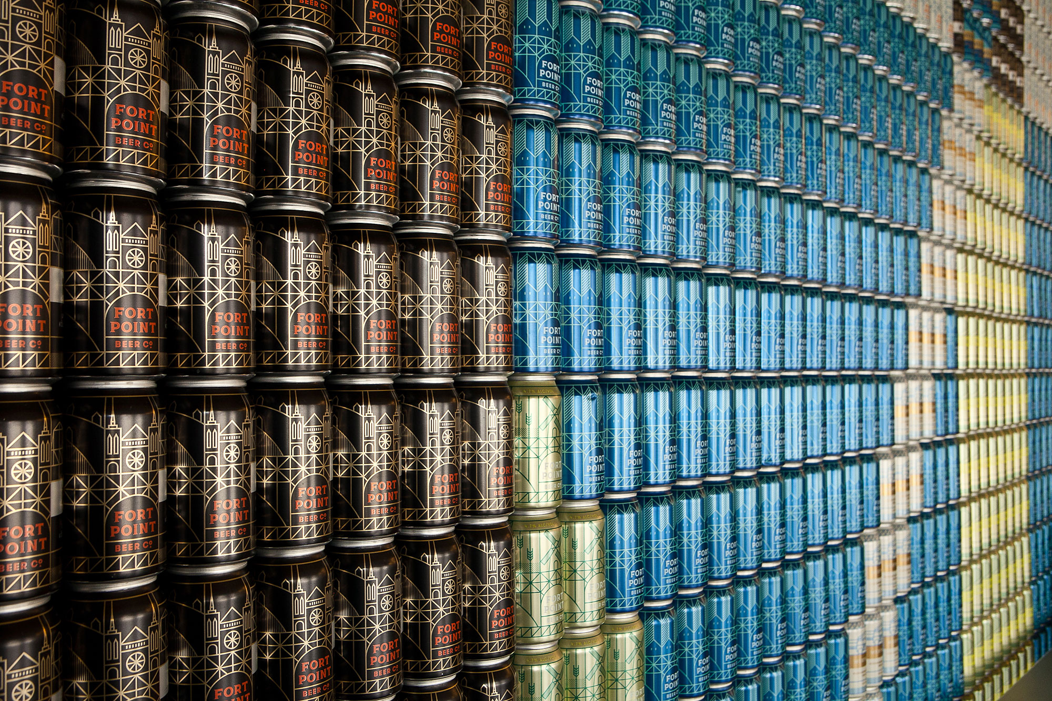

Slide 20
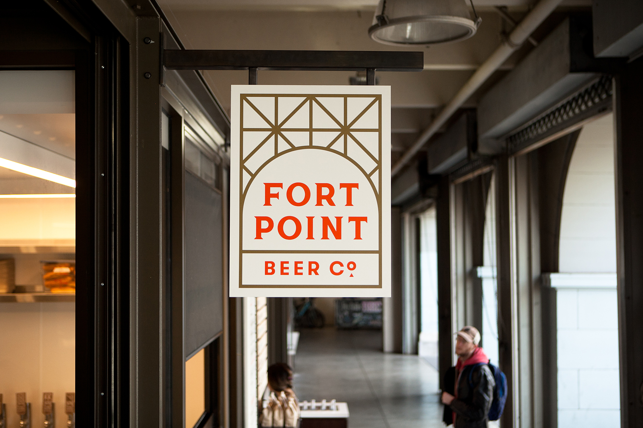

Slide 21
Contrast
Contrast is the most effective way to create emphasis and impact with your design.
Contrast is created when two elements are total opposites. For example: big/small size, classic/contemporary fonts, thin/thick lines, cool/warm colours, dark/light, smooth/rough textures, horizontal/vertical, etc.
Contrast plays a crucial part in the organization of information on a page. It gives the reader a guide on where to look first; What is the most important point? What stands out the most?
For contrast to work, it must be strong and obvious. Our eyes like contrast; don’t make differences look like a mistake. To have impact, the differences must be obvious and extreme
For example, contrast in digital design can be seen when agreeing to online terms and conditions where “I accept” is in a bold colour, while “I decline” is in a lighter colour that seems to fade away.

Slide 22
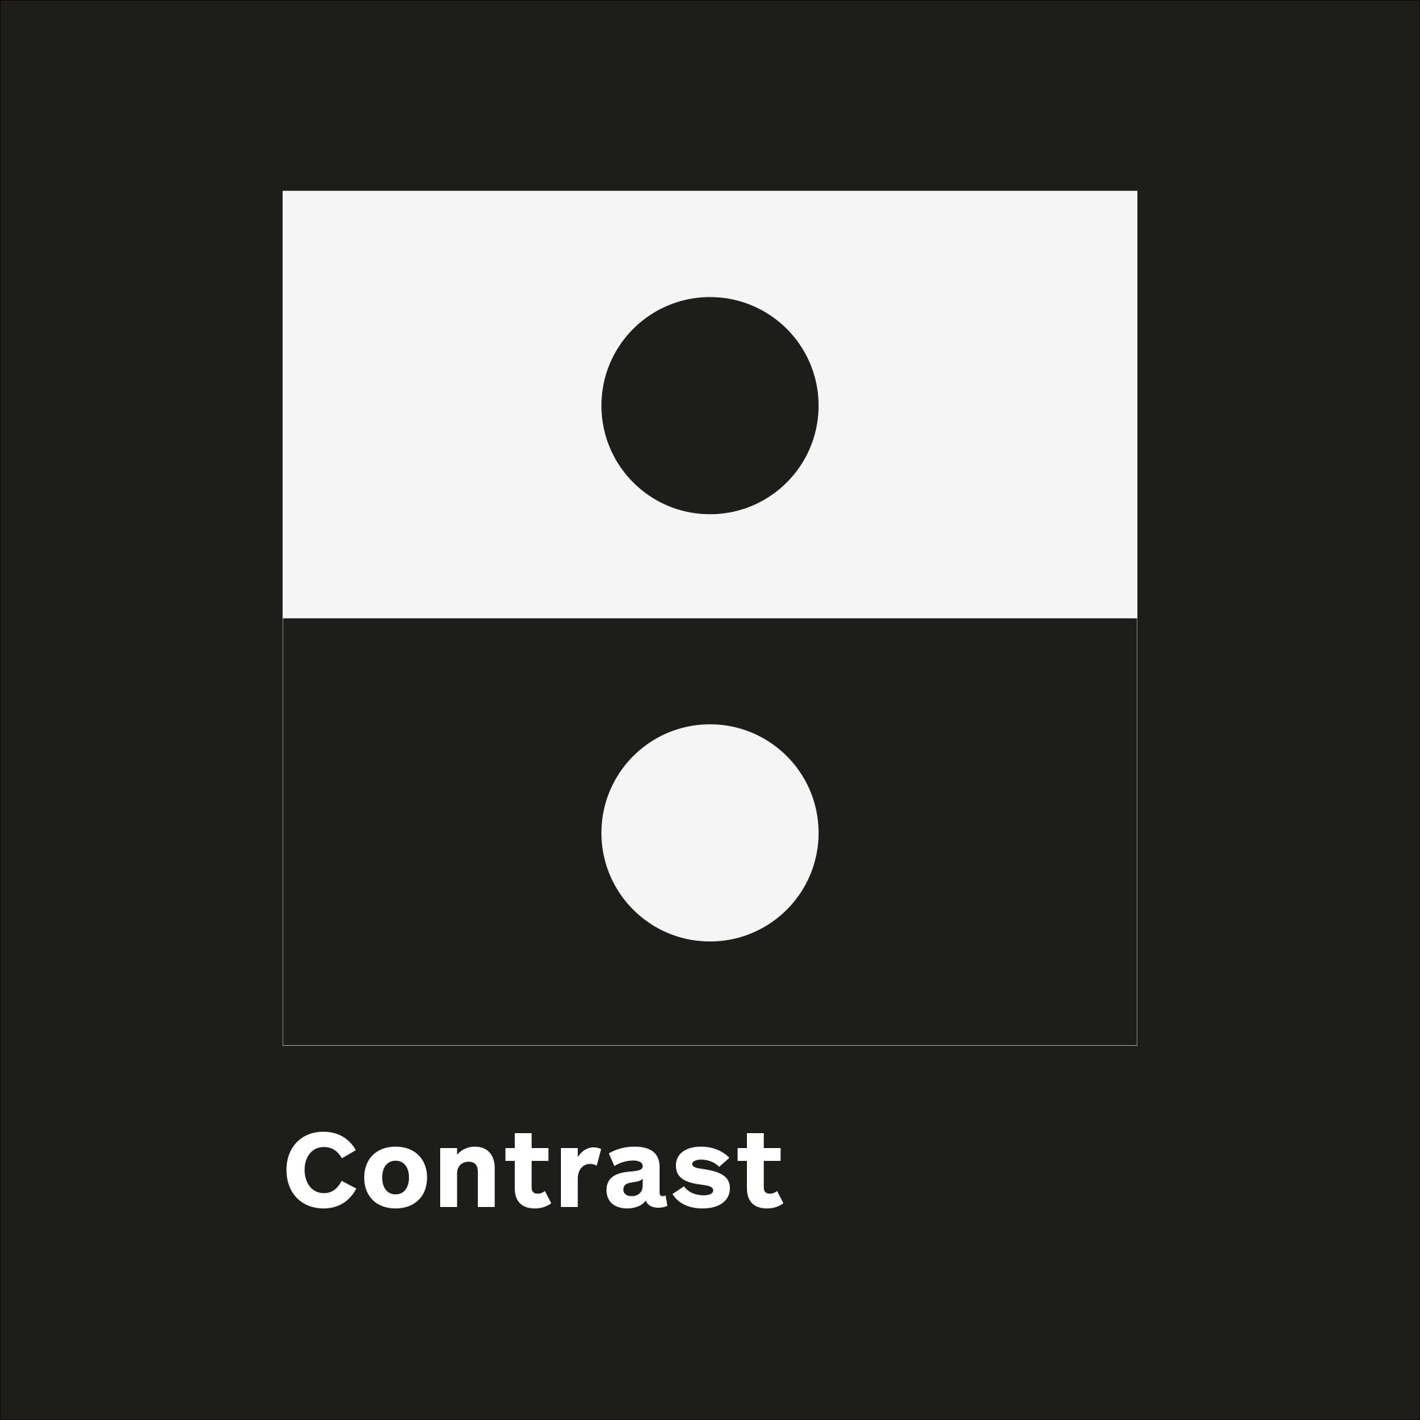

Slide 23
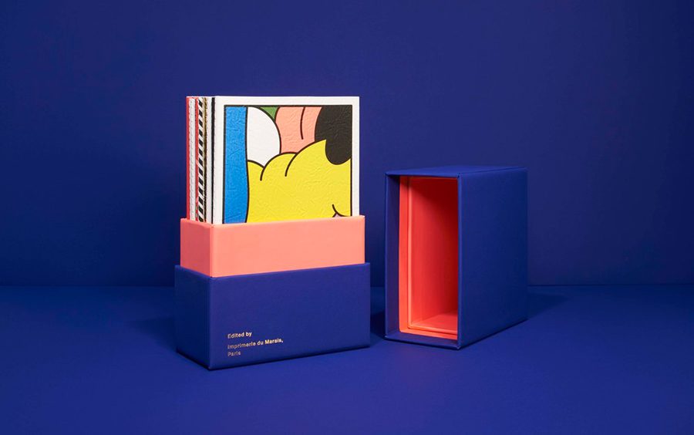

Slide 24
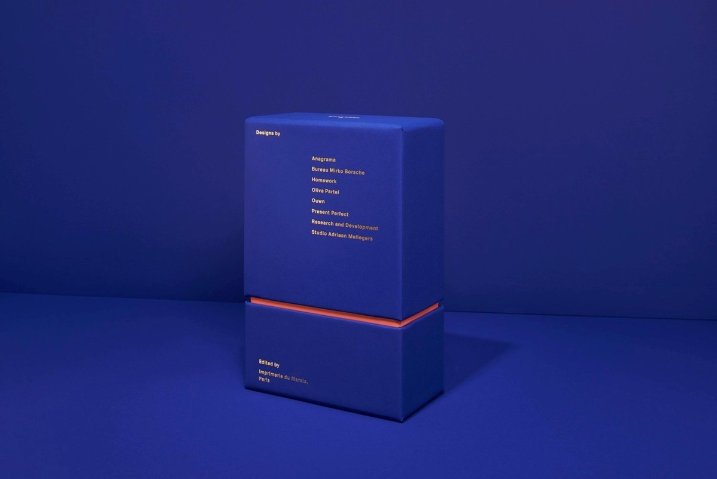

Slide 25
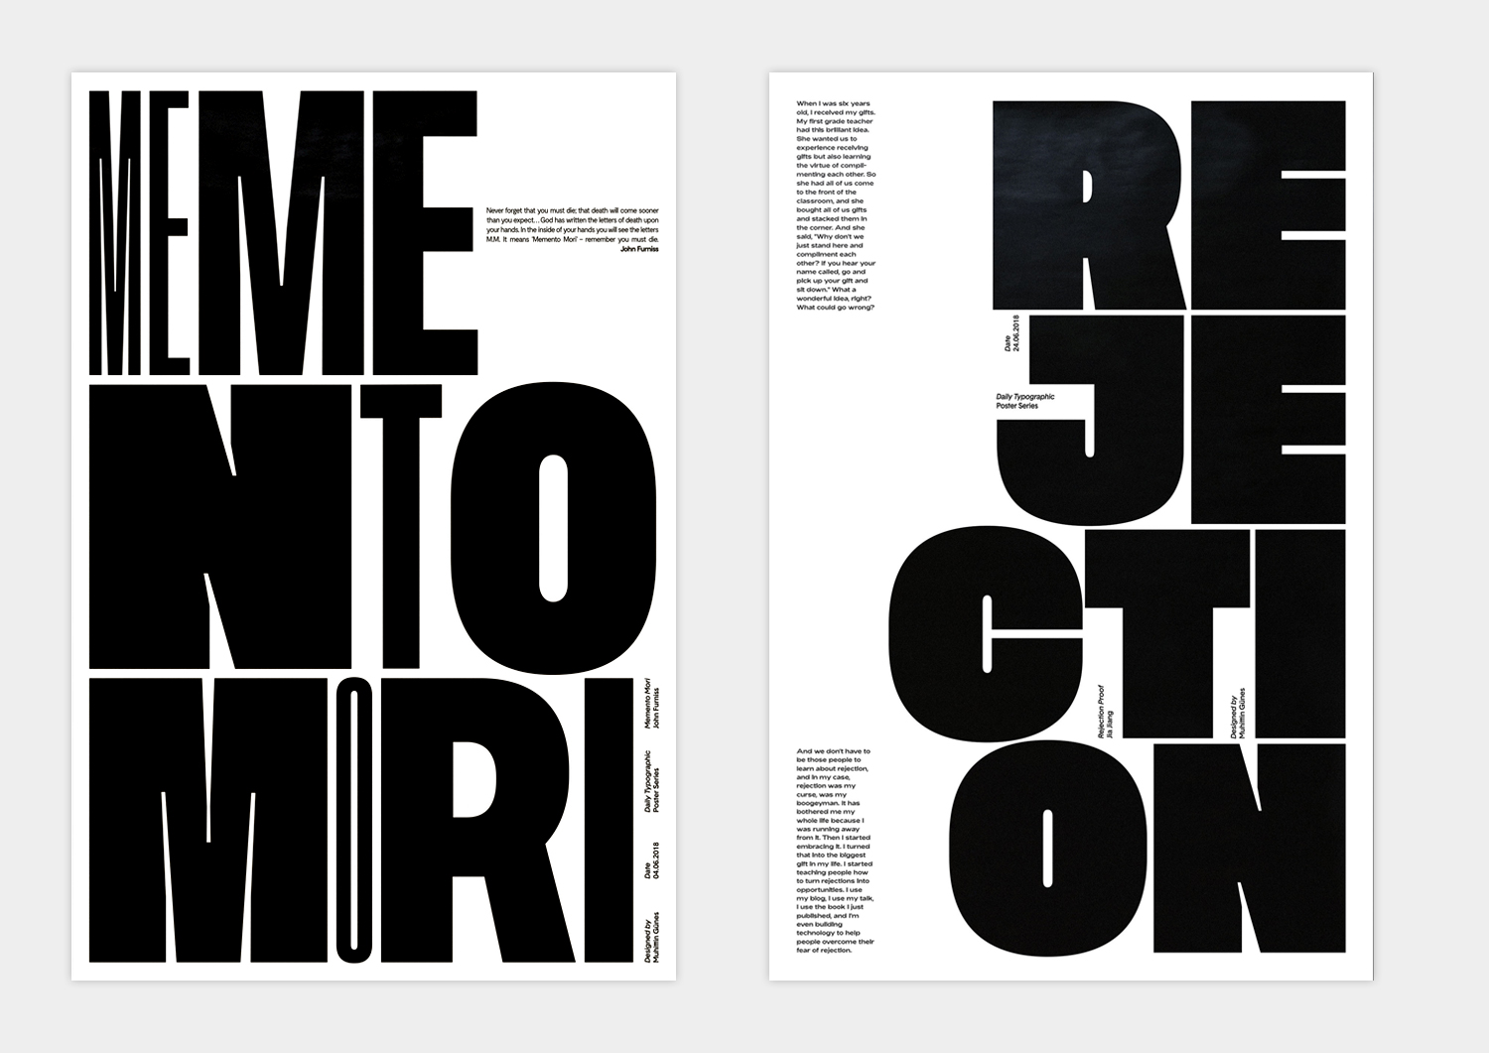

Slide 26
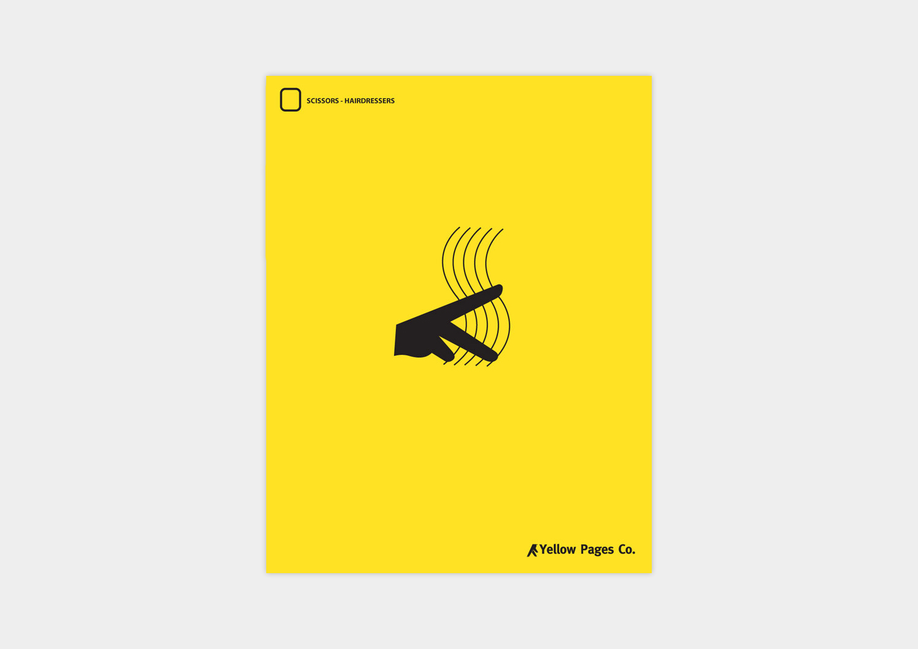

Slide 27
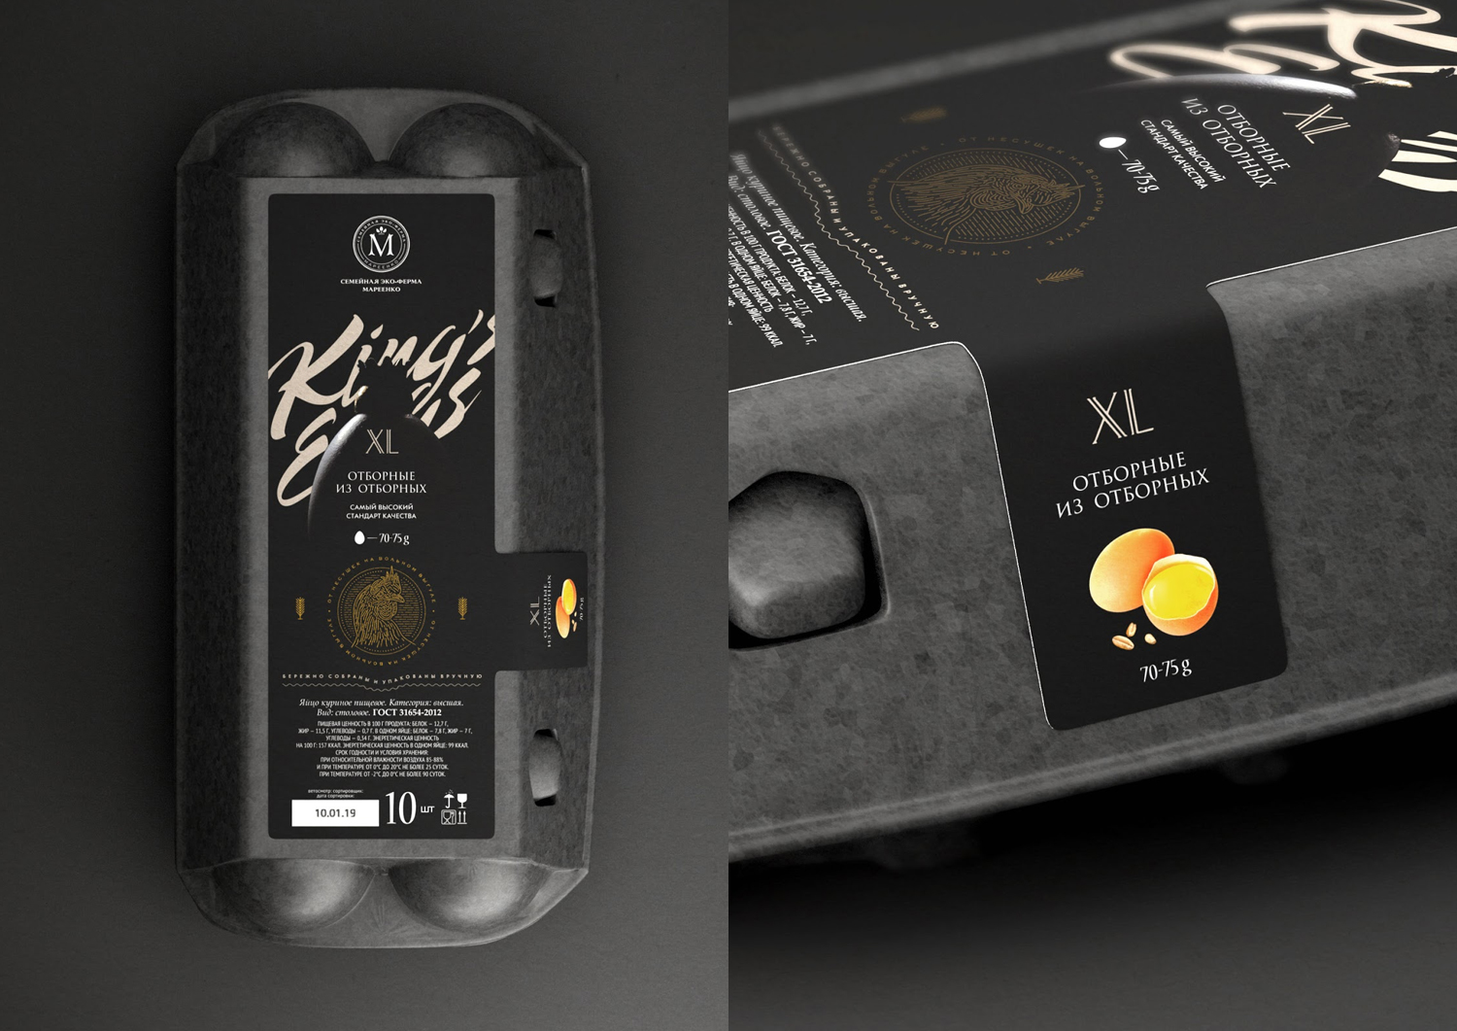

Slide 28
Hierarchy Hierarchy creates organisation
Think about it—hierarchy is usually something we think about when describing ranking in a business, or organizations like politics and the Church. It’s a system in which people or things are arranged according to their importance.
In design, hierarchy creates a visual organisation to a design and gives the reader an idea of where to begin and finish reading. Each element that is part of the design can be given a ranking of priority. eg.
Headline
Image
Subhead
Website call to action
Body Copy
A designer can then make decisions around position, size, contrast, colour etc. to ensure that the desired hierarchy is achieved.
Clients will often ask you to increase the size of lots of elements on the page as they feel that all these points are “really important”. The problem with this approach is that by doing this nothing stands out anymore.
Generally there is a single message that is more important than all others, this should stand out the most and will lead the audience into the rest of the content.

Slide 29
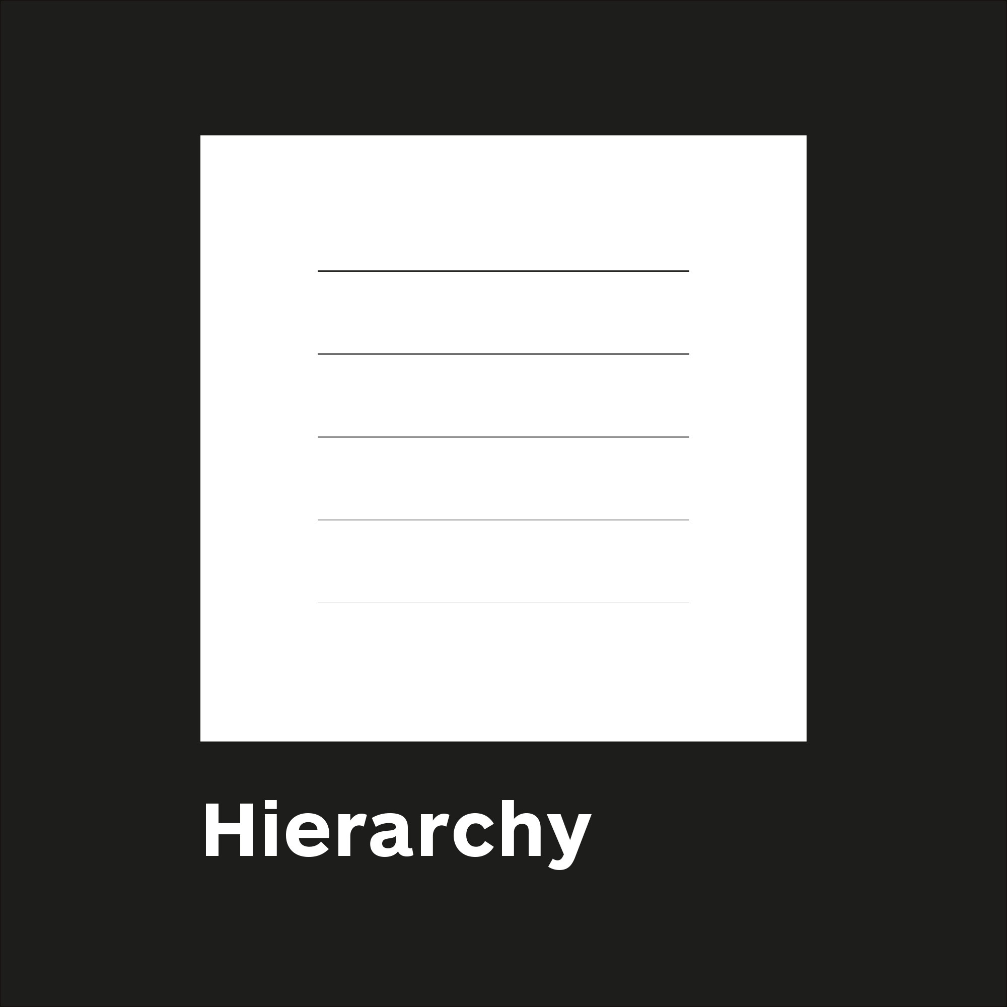

Slide 30
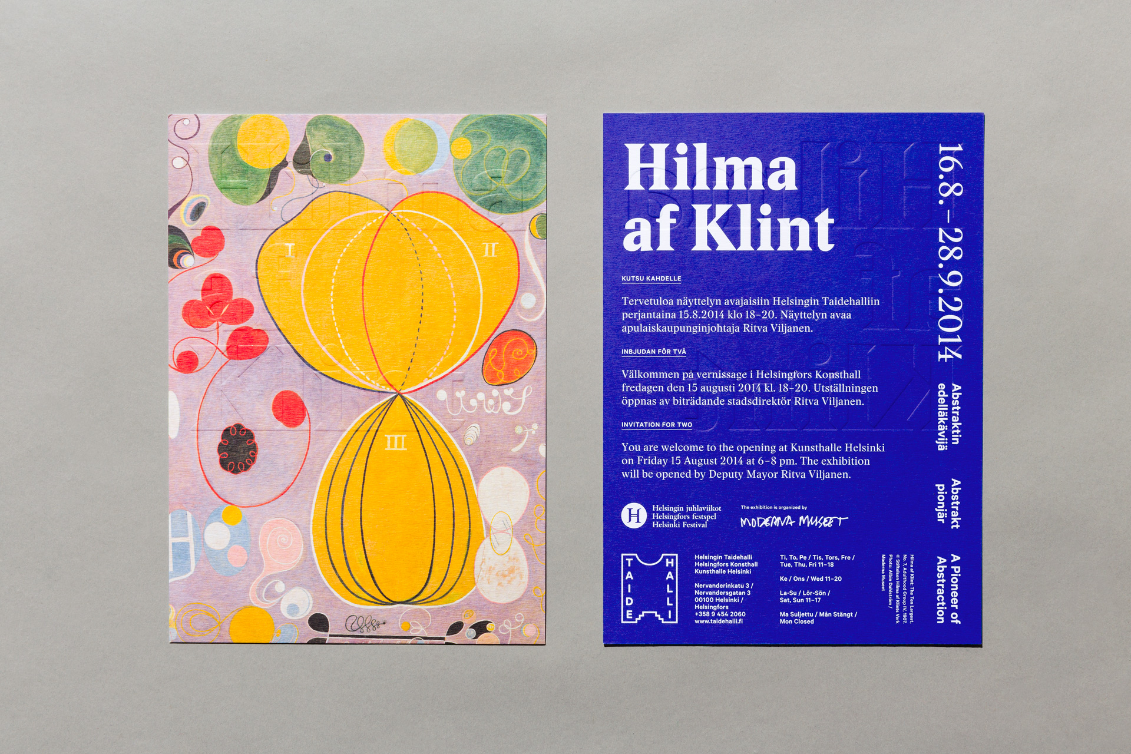

Slide 31
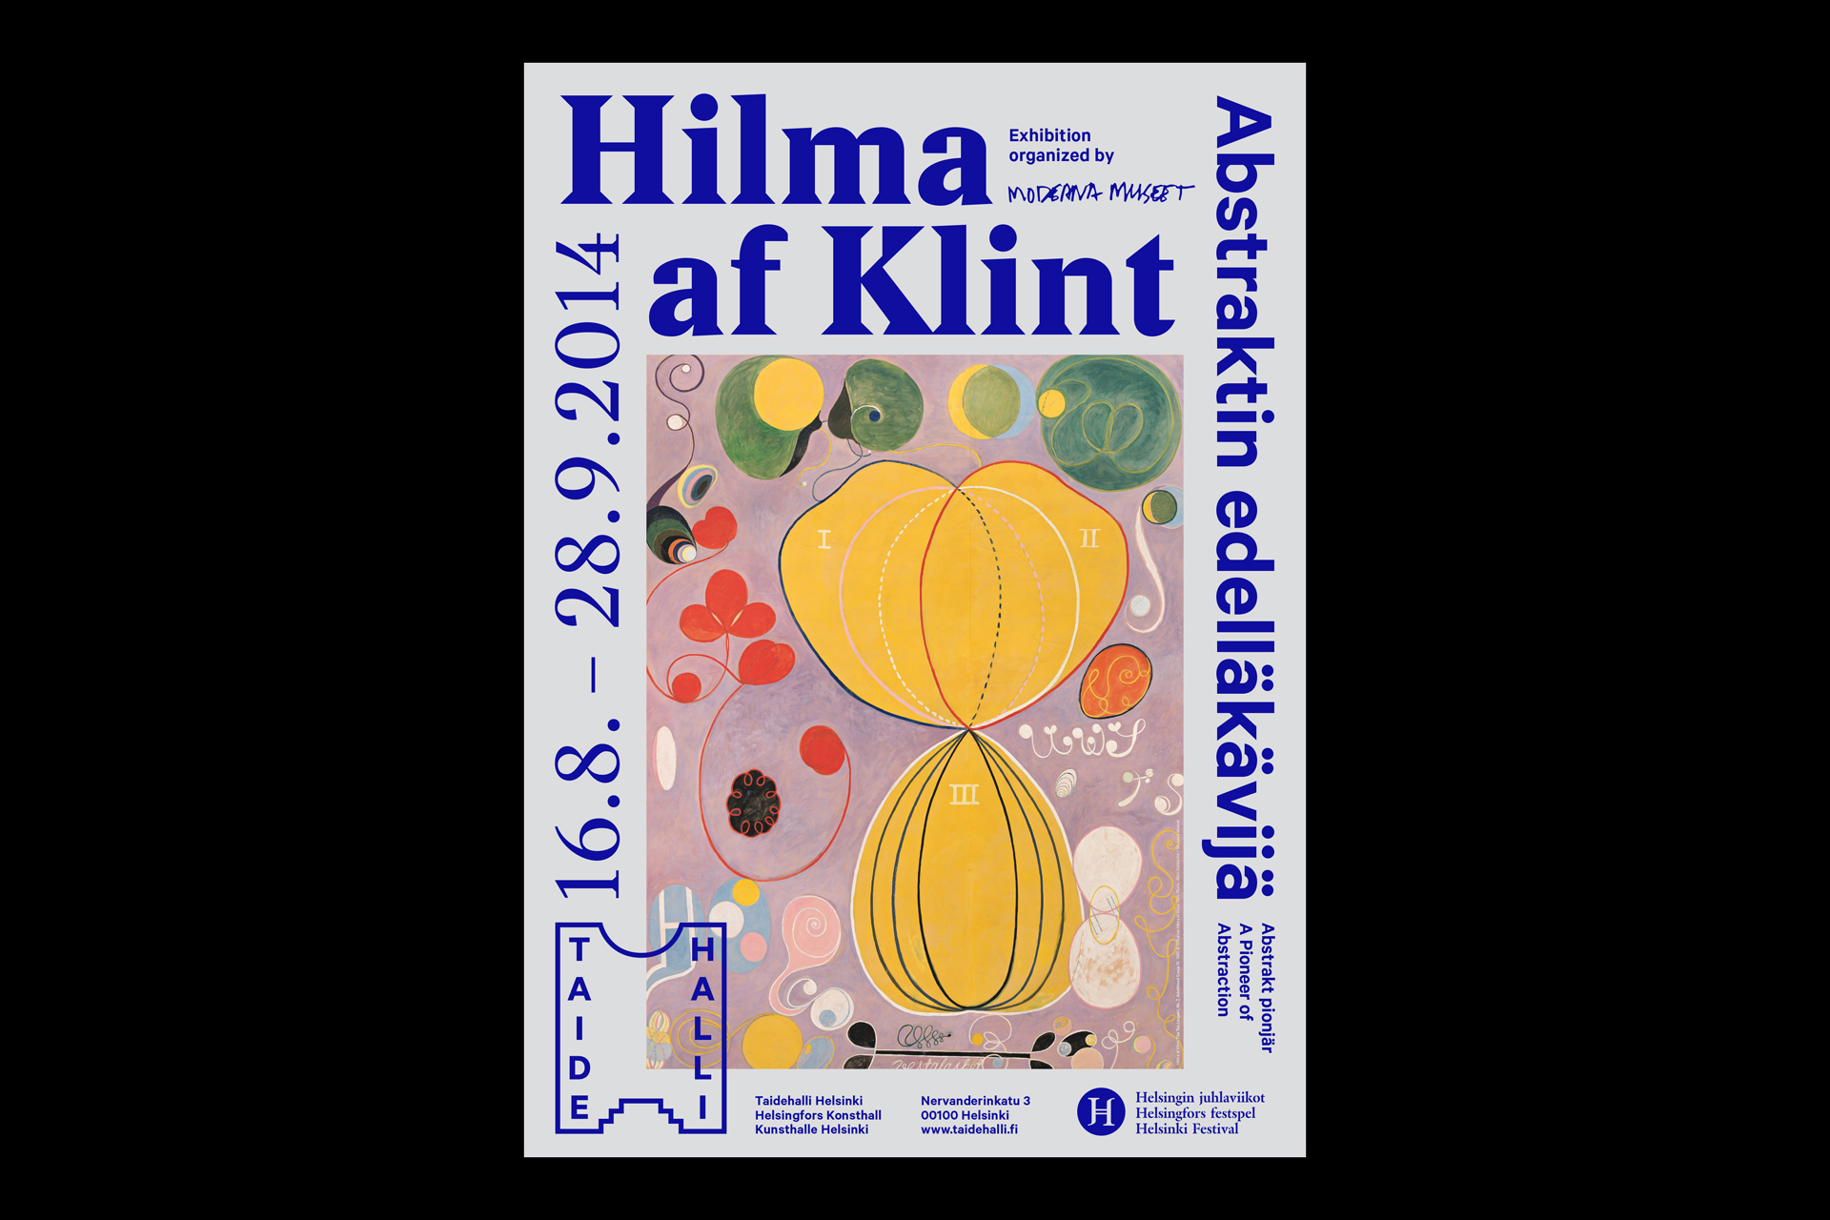

Slide 32
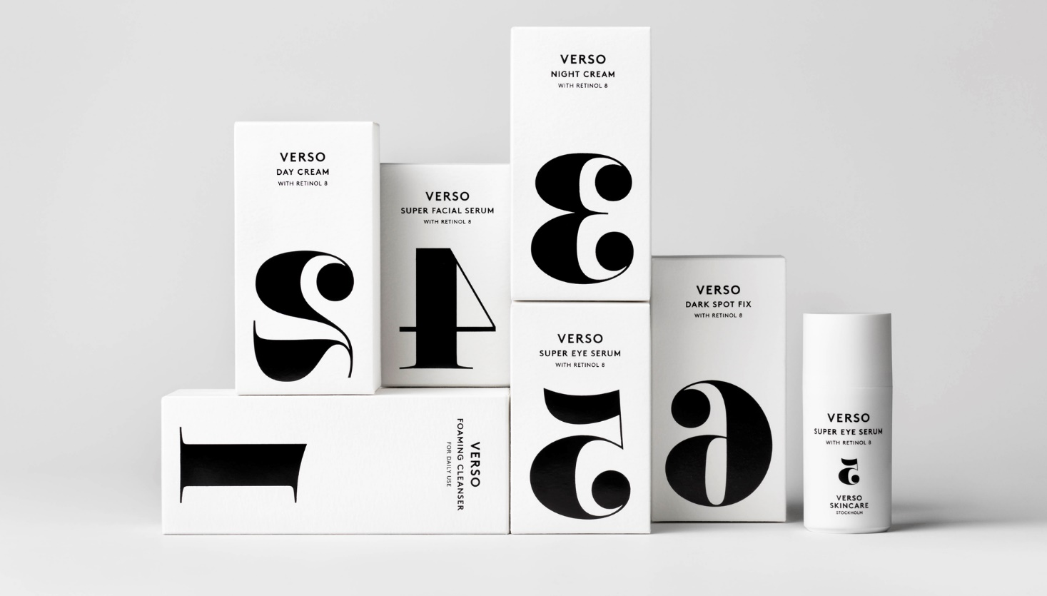

Slide 33
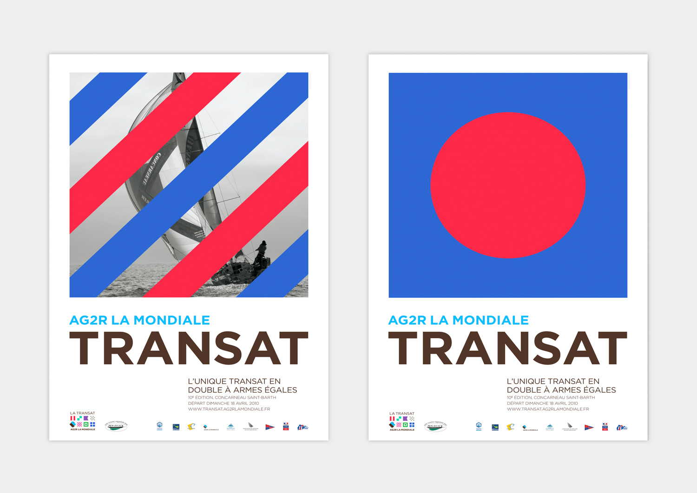

Slide 34
Balance
Balance provides stability and structure to a design, either through symmetry or tension of elements.
Balance is the weight distributed on the page by the placement of elements.
Let’s look at some good examples of balance—both symmetrical and through tension—in graphic design.
At its simplest, symmetrical balance can be created with an invisible centre line where the weight of the elements on both halves of the page is even. For example, symmetrical balance can be seen in the ying/yang symbol or in Leonardo da Vinci’s famous The Last Supper painting.
This form of symmetrical balance generally has a very traditional and harmonious feel even though, at times, it can seem stilted and boring.

Slide 35
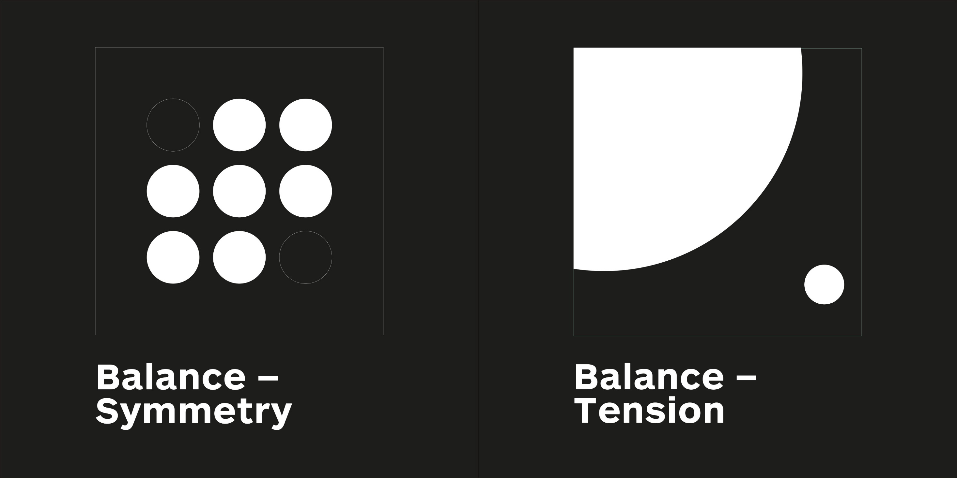

Slide 36
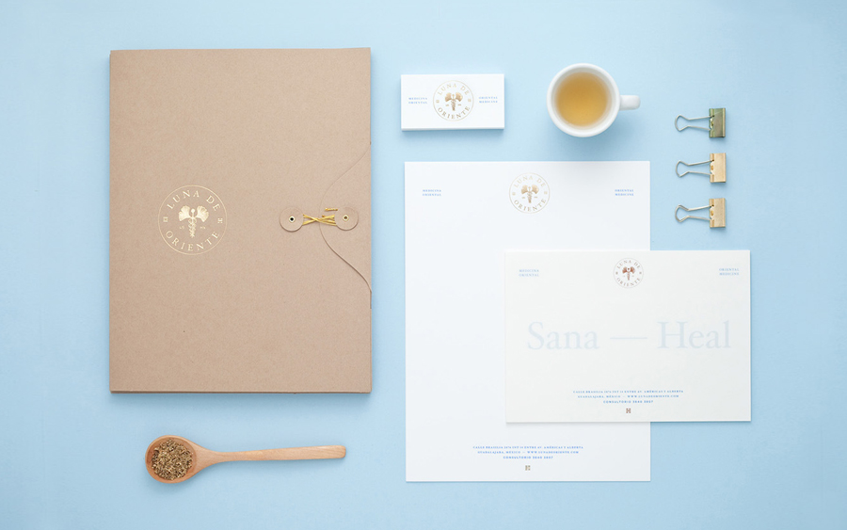

Slide 37
