Slide 1
Data Communication & Computer Network

Slide 2
Data communications refers to the transmission of this digital data between two or more computers and a computer network or data network is a telecommunications network that allows computers to exchange data. The physical connection between networked computing devices is established using either cable media or wireless media. The best-known computer network is the Internet.
Network Basic Understanding
A system of interconnected computers and computerized peripherals such as printers is called computer network. This interconnection among computers facilitates information sharing among them. Computers may connect to each other by either wired or wireless media.
There are many different ways to categorize networks. One of the most common ways is to look at the geographic scope of the network. Figure 1.2 illustrates four types of networks: local area networks (LANs), backbone networks (BNs), metropolitan area networks (MANs), and wide area networks (WANs). The distinctions among these are becoming blurry. Some network technologies now used in LANs were originally developed for WANs, whereas some LAN technologies have influenced the development of MAN products. Any rigid classification of technologies is certain to have exceptions.

Slide 3
A local area network (LAN) is a group of microcomputers located in the same general area. A LAN covers a clearly defined small area, such as one floor or work area, a single building, or a group of buildings. LANs often use shared circuits, where all computers must take turns using the same circuit. The upper left diagram in Figure 1.2 shows a small LAN located in the records building at the former McClellan Air Force Base in Sacramento. LANs support high-speed data transmission compared with standard telephone circuits, commonly operating 100 million bits per second (100 Mbps).
Most LANs are connected to a backbone network (BN), a larger, central network connecting several LANs, other BNs, MANs, and WANs. BNs typically span from hundreds of feet to several miles and provide very high speed data transmission, commonly 100 to 1,000 Mbps. The second diagram in Figure 1.2 shows a BN that connects the LANs located in several buildings at McClellan Air Force Base.
A metropolitan area network (MAN) connects LANs and BNs located in different areas to each other and to WANs. MANs typically span between three and 30 miles. The third diagram in Figure 1.2 shows a MAN connecting the BNs at several military and government complexes in Sacramento.

Slide 4
Some organizations develop their own MANs using technologies similar to those of BNs. These networks provide moderately fast transmission rates but can prove costly to install and operate over long distances. Unless an organization has a continuing need to transfer large amounts of data, this type of MAN is usually too expensive. More commonly, organizations use public data networks provided by common carriers (e.g., the telephone company) as their MANs. With these MANs, data transmission rates typically range from 64,000 bits per second (64 Kbps) to 100 Mbps, although newer technologies provide data rates of 10 billion bits per second (10 gigabits per second, 10 Gbps). MANs are discussed in detail in next topic.
Wide area networks (WANs) connect BNs and MANs,Most organizations do not build their own WANs by laying cable, building microwave towers, or sending up satellites (unless they have unusually heavy data transmission needs or highly specialized requirements, such as those of the Department of Defense). Instead, most organizations lease circuits from IXCs (e.g., AT&T, MCI, Sprint) and use those to transmit their data. WAN circuits provided by IXCs come in all types and sizes but typically span hundreds or thousands of miles and provide data transmission rates from 64 Kbps to 10 Gbps.

Slide 5
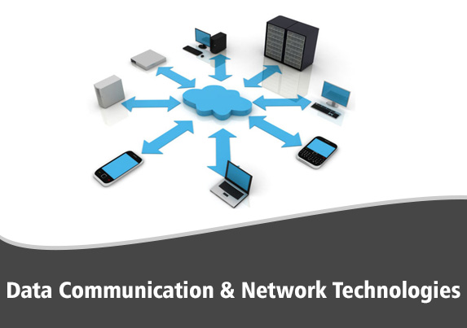
A network of networks is called an internetwork, or simply the internet. It is the largest network in existence on this planet. The internet hugely connects all WANs and it can have connection to LANs and Home networks. Internet uses TCP/IP protocol suite and uses IP as its addressing protocol. Present day, Internet is widely implemented using IPv4. Because of shortage of address spaces, it is gradually migrating from IPv4 to IPv6.
Internet enables its users to share and access enormous amount of information worldwide. It uses WWW, FTP, email services, audio and video streaming etc. At huge level, internet works on Client-Server model.
Internet uses very high speed backbone of fiber optics. To inter-connect various continents, fibers are laid under sea known to us as submarine communication cable.

Slide 6
There are many different ways in which the network layers can be designed. The two most important network models are the Open Systems Interconnection Reference (OSI) model and the Internet model.
The Open Systems Interconnection Reference model (usually called the OSI model for short) helped change the face of network computing. Before the OSI model, most commercial networks used by businesses were built using nonstandardized technologies developed by one vendor (remember that the Internet was in use at the time but was not widespread and certainly was not commercial). During the late 1970s, the International Organization for Standardization (ISO) created the Open System Interconnection Subcommittee, whose task was to develop a framework of standards for computer-to-computer communications. In 1984, this effort produced the OSI model.
The OSI model is the most talked about and most referred to network model. If you choose a career in networking, questions about the OSI model will be on the network certification exams offered by Microsoft, Cisco, and other vendors of network hardware and software. However, you will probably never use a network based on the OSI model. Simply put, the OSI model never caught on commercially in North America, although some European networks use it, and some network components developed for use in the United States arguably use parts of it. Most networks today use the Internet model, However, because there are many similarities between the OSI model and the Internet model, and because most people in networking are expected to know the OSI model, we discuss it here.

Slide 7
Internet Model:
Although the OSI model is the most talked about network model, the one that dominates current hardware and software is a more simple five-layer Internet model. Unlike the OSI model that was developed by formal committees, the Internet model evolved from the work of thousands of people who developed pieces of the Internet. The OSI model is a formal standard that is documented in one standard, but the Internet model has never been formally defined; it has to be interpreted from a number of standards.1 The two models have very much in common (see Figure 1.3); simply put, the Internet model collapses the top three OSI layers into one layer. Because it is clear that the Internet has won the "war," we use the five-layer Internet model for the rest of this topic.
Applications of Communication & Computer Network:
Computer systems and peripherals are connected to form a network. They provide numerous advantages:
Resource sharing such as printers and storage devices
Exchange of information by means of e-Mails and FTP
Information sharing by using Web or Internet
Interaction with other users using dynamic web pages
IP phones
Video conferences
Parallel computing
Instant messaging

