Slide 1
Requirements Engineering
Lecture 02,03

Slide 2
Bad Requirements
The major consequence of requirements problems is Rework .
Rework often consumes 30 to 50 percent of your total development cost
(Shull, et al. 2002; GAO 2004).
requirements errors can account for 70 to 85 percent of the rework cost (Leffingwell 1997)
.
Insufficient user involvement
Inaccurate planning
Creeping user requirements
Ambiguous requirements
Gold plating
Overlooked stakeholders

Slide 3
Stakeholders
A stakeholder is a person, group, or organization that is actively involved in a project, is affected by its process or outcome, or can influence its process or outcome.
The case of the missing stakeholder???

Slide 4
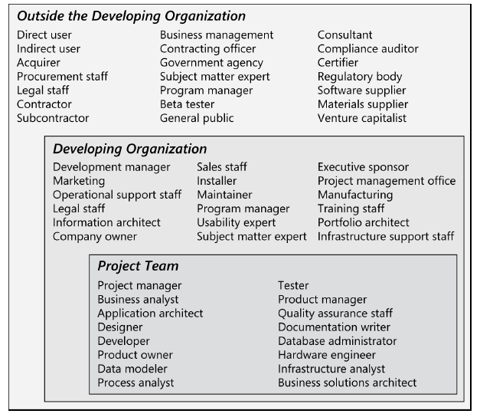
Cont.
Potential stakeholders within the project team, within the developing organization, and outside the organization.

Slide 5
Customers
Customers are a subset of stakeholders. A “customer” is an individual or organization that derives either direct or indirect benefit from a product. Software customers could request, pay for, select, specify, use, or receive the output generated by a software product.

Slide 6
Rights for Software Customers

Slide 7
Responsibilities for Software Customers

Slide 8
Identifying decision makers
There can be hundreds of decisions to make on software projects; often, they are on the critical path to being able to move ahead. You might need to resolve some conflict, accept (or reject) a proposed change, or approve a set of requirements for a specific release.

Slide 9
Cont.
The decision-making group needs to identify its decision leader and to select a decision rule, which describes how they will arrive at their decisions. There are numerous decision rules to choose from, including the following :

Slide 10
cont
The decision leader makes the choice, either with or without discussion with others.
The group votes and the majority rules.
The group votes, but the result must be agreed to approve the decision.
The group discusses and negotiates to reach a consensus. Everyone can live with the decision and commits to supporting it.
The decision leader gives authority for making the decision to one individual.
The group reaches a decision, but some individual has veto authority over that decision.

Slide 11
Q&A
.

