Slide 1
Lecture # 3

Slide 2
Occupational Health Safety & Environment
Lecture # 2,3
Classification of dangerous substances and their toxicity
Route of Entry
Skin And Eyes,
Lungs And Stomach
Occupational exposure limits
Environmental monitoring at the work place:
Measurement Techniques
Data Evaluation and Analysis

Slide 3
Classification of dangerous substances and their toxicity

Slide 4
The 9 Classes Of Dangerous Substance
Poisonous Material Causing Allergy
Explosives
Gases ( Bad Smell, Bad Taste , Harmful & Toxic)
Radiation
Chemicals ( enter Through breathing, Skin & Mouth )
Flammable Liquids
Flammable Solids
Oxidizing Substances
Toxic & Infectious Substances
Radioactive Material
Corrosives
Miscellaneous Dangerous Goods

Slide 5
Classification of dangerous substances and their toxicity

Slide 6
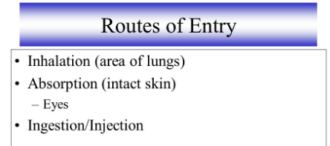
How can Chemical enter into body (Route of Entry)
In order for a chemical to harm a person's health, it must first come into contact or enter the body, and it must have some biological effect on the body. There are four major routes by which a chemical may enter the body:
Inhalation (breathing or Lungs)
Skin (or eye) contact
Ingestion or eating or stomach
Injection (Vaccination)

Slide 7
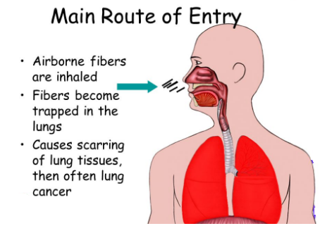
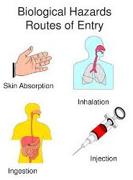
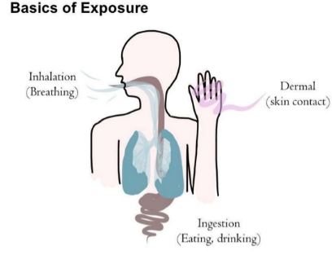

Slide 8
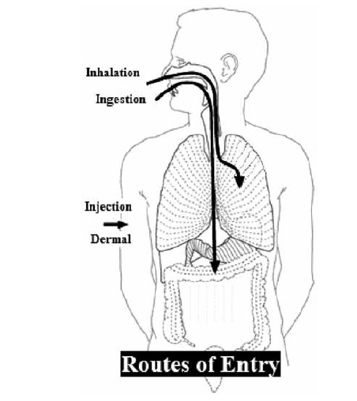

Slide 9
Route of Entry
Breathing of dirty air is the most common way that workplace chemicals enter the body. Some chemicals, when contacted, can pass through the skin into the blood stream.
The eyes may also be a route of entry. Usually, however, only very small quantities of chemicals in the workplace enter the body through the eyes. Workplace chemicals may be ingest accidentally if food, hands, or cigarettes are infected. For this reason, workers should not drink, eat, or smoke in areas where they may be exposed to chemicals.
Injection is the fourth way chemicals may enter the body. While unusual in most workplaces, it can occur when a sharp object (e.g., needle) punctures the skin and injects a chemical (or virus) directly into the blood stream.

Slide 10
Occupational Exposure Limits
What is exposure?
Exposure to a substance is uptake into the body. The
exposure routes are:
By breathing smoke, dust, gas or mist(fog)
By skin contact.
By injection into the skin.
By swallowing (eat / drink / sip)
Many thousands of substances are used at work but only about 500 substances have Workplace Exposure Limits

Slide 11
Occupational Exposure Limits
What are the occupational exposure limits?
In general, the occupational exposure limit (OEL) represents the maximum in the air absorption of a toxic substance to which a worker can be exposed over a period of time without suffering any harmful consequences.
These limits are set out by many professional organizations around the world, such as the American Conference of Governmental Industrial Hygienists (ACGIH), and the National Institute for Occupational Safety and Health (NIOSH) in the United States. They are established based on the chemical properties of the substance, experimental studies on animals and humans, toxicological and epidemiological (relating to the branch of medicine which deals with the incidence, distribution, and control of diseases.) data.
Different organizations may use different terminology for the OEL. For example, the ACGIH term for OEL is "Threshold Limit Value" (TLV) while the NIOSH term is "recommended exposure limits" (REL).

Slide 12
Occupational Exposure Limits

Slide 14
Environmental monitoring at the work place

Slide 15
Environmental monitoring at the work place
Establishes the threshold limit values for toxic and carcinogenic (having the potential to cause cancer) substances and physical agents which may be present in the atmosphere in the work environment.
In the air contaminants ( poisonous substance that makes something impure)
Physical agents –noise, illumination
General ventilation –Air supply, Air movement
Work environment measurement

Slide 16
WORK ENVIRONMENT MEASUREMENT (WEM)
The employer shall maintain and control the working environment in comfortable and healthy conditions for the purpose of maintaining and promoting the health of his workers
WEM shall mean sampling and analysis carried out in respect of the atmospheric working environment for the purpose of determining actual conditions there
WEM shall include temperature, humidity, pressure, illumination, ventilation, concentration of substances and noise
The employer shall carry out the WEM in indoor or other workplaces where hazardous work is performed and shall keep a record of such measurement which shall be made available to enforcing authority.

Slide 17
Element of Industrial Hygiene
WHAT IS OCCUPATIONAL HYGIENE?
Occupational hygiene is the discipline of bringing the level of physical, mental and social well-being of all employees to the highest, maintaining this level, revealing the health problems that may arise from the working environment and working conditions, protecting the employees against any kind of effects that may harm their health, and taking technical preventive measures against health risks in the working environment.
With occupational hygiene measurements, all physical and chemical factors in the working environment that can negatively affect the health of the employees are specified quantitatively and qualitatively.
In order to minimize the frequency occupational diseases and accidents, it is extremely important to identify the hazardous effects in the workplace

Slide 20
Work Environment Measurement
Work Environment Measurement, or WEM, is a branch of Industrial Hygiene aimed at evaluating levels of workers’ exposures from various physical and chemical hazards emanating from workplace operations and recommending appropriate control measures for the improvement of the working environment.
WEM is conducted through various sampling methodologies and/or direct measurement using direct reading instruments to:
Determine the level of harmful substances (airborne contaminants) such as but not limited to dust, mist, fumes, solvents and gases
Measure the level of physical hazards generated from various operations such as noise, heat, vibrations and radiation
Assess the illumination levels in different work areas
Evaluate the performance of the general and local exhaust ventilation installed

Slide 21
Control

Slide 22
Indoor Air Quality Monitoring
Employees need a comfortable work environment to perform at maximum efficiency. The presence of odors, dust and/or biological contaminants may seriously effect an employee’s ability to work or even contribute to adverse health symptoms.
Complaints may arise from one or more employees at a work site. Symptoms such as headache, eye throat, and irritation, dizziness, lack of energy, tiredness, allergies and congestion are typical symptoms.

Slide 23
Ventilation Systems Evaluation and Monitoring
UOS buildings are equipped with ventilation systems that may include air conditioning.
Some of these systems may not provide a sufficient level of comfort to all employees.
Complaints may arise from one or more employees at a work site. Symptoms may include headaches, eye, throat, and nose irritation, allergies and congestion, dizziness and fatigue, nausea, and general feelings of ill health.
EH&S Industrial Hygiene staff is prepared to evaluate any work site on numerous levels including the ventilation system, comfort parameters such as temperature, humidity and carbon dioxide as well as sources of airborne contaminants from within and outside the work area.

