Slide 1
Collection of seed

Slide 2
Seed collecting methodology
Seed collection requires specially trained people with tools, cloths, and other materials.
Technical personnel from DNR/MAIL know about the techniques, timing, and quality (they have received training).
There is a need for training of local people in seed collection methodologies.
Trained local people can become trainers, training their own working teams.
Contracts have to be signed by the Government with the trained local people for collection of seeds.

Slide 3
Why collect local seed?
The easiest way to grow most plant species is from seed.
The best plants to grow for revegetation are those that are local to your area.
The best way to maximize and maintain genetic diversity is to propagate from seed.
The most time, money, material and infrastructure efficient way of growing plants is from seed.
The best way to ensure you get then plants you want is to collect your own seed.

Slide 4
Some important points to consider while collecting seed
Only take 10 percent of the overall fruit crop of each plant. This will maximize the chances for natural regeneration of that plant population and minimize the loss of an important food source for native fauna.
To maximize genetic diversity of the seed collected.
always collect from a minimum of 10 plants spaced widely apart and avoid collecting from isolated individuals.

Slide 5
Conti…
Minimize damage to plants, hand strip seed or use sharp secateurs.
Never fell plants just for seed collecting. However, take advantage of storm damage to collect seed from larger trees.

Slide 6
Preparation and equipment for seed collecting
It is worthwhile preparing some valuable information before collecting seed.
1. Identify and list the species you wish to collect.
2. Research when these plants are likely to have seed ready for collecting and develop a timetable for collection.
3. Identify where there is likely to be healthy populations of the species you want to collect (always avoid collecting from single specimens).
Map these plant locations.

Slide 7
Conti…
Make sure you have obtained permission to collect.
Most of the equipment you will need for collecting small amounts of seed will be at home.
These include buckets, paper bags (envelopes), secateurs, long-handled, pruners, wool packs, gloves, pen and paper.

Slide 8
METHODS

Slide 9
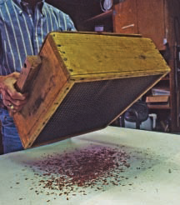
Conti…
A simple wooden box with a screened bottom and fitted with a wooden cover can be used to separate cones and seeds.

Slide 10
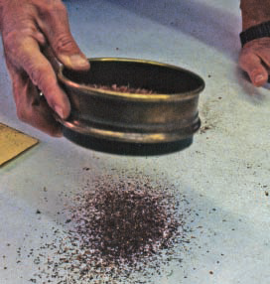
Conti…
To separate seeds and smaller impurities, use a screen that retains seeds but allows fine debris to pass through.

Slide 11
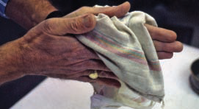
Conti…
An easy way to de-wing conifer seeds is to put them in a cloth bag and gently knead the bag and seeds.

Slide 12
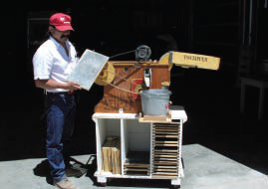
Conti…
Small-scale seed-cleaning equipment makes use of a variety of screens and air flow to separate seeds from impurities.

Slide 13
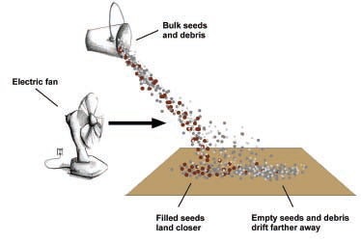
Conti…
Use a small fan to winnow non-filled seeds and wings from good, filled seeds.
Filled seeds, being heavier, will land closer to the fan while empty seeds and wings, being lighter, will land farther away.

Slide 14
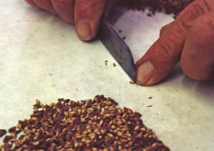
Conti…
Cut seeds in half with a knife or safety blade to see if they are filled like the seed

Slide 15
Tools for seed collection and cleaning
The following tools are needed to collect tree seeds:
Complete seed collection sets (saddles with ropes) for climbing tall conifer trees.
Rope ladders for climbing trees.
Bags for collection and transportation of the seeds.

Slide 16
Conti…
Bamboo ladders.
Iron folding ladders.
Baskets for collecting the fallen seeds.
Gloves for workers.
Tumbler.
Seed cutter.
Trays.

Slide 17
Seed storage
After cleaning of seeds:
Dry seeds in sunshine or warm area.
Place in airtight plastic bags (protection from
humidity).
Label
Protect from large variations in temperature, particularly heat.

Slide 18
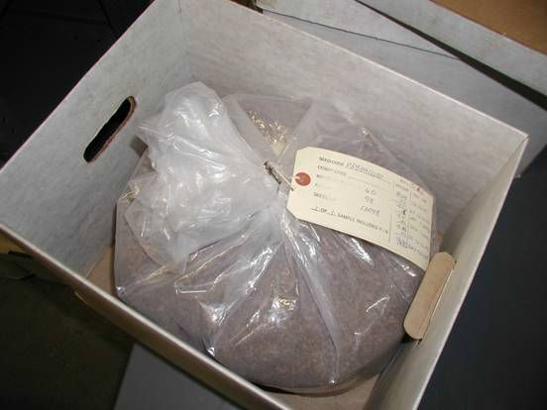

Slide 19
