Slide 1
Total Quality Management
Course Outline:
Introduction to Quality: Quality concepts, types and aspects, Significance of quality.
Commitment and Leadership: Commitment and Policy, Creating or changing the culture, effective leadership.
Quality Planning: Flow charting, process charting, purchase planning, planning for JIT.
Design for Quality: Innovation, Quality Function Deployment and the House of Quality.
Quality Related Costs: Prevention, Appraisal and Failure Costs, Models for Quality Costing.

Slide 3
Total Quality Management
Quality Measurement: Significance, Methods, Tools and Techniques
Quality Improvement: Basic Tools, Advanced Tools.
Quality Management System (ISO 9000 series): Significance, Documentations, Implementation and Certification, Audits, Expected Problems.
Environmental Management System (ISO 14000 series): Significance, Documentations, Implementation and Certification, Audits, Expected Problems.

Slide 4
Introduction to Quality
What is TQM?
TQM is the integration of all functions and processes within an organization in order to achieve continuous improvement of the quality of goods and services. The goal is customer satisfaction.
Definition of Quality:
A product or service free of deficiencies
(defect).

Slide 5
Introduction to Quality
Quality is defined as conformance to requirements, not “goodness”
The standard of something as measured against other things of a similar kind; the degree of excellence of something.
A subjective term for which each person has his or her own person has his or her own definition

Slide 6
The concept and vocabulary of quality are indefinable.
Different people interpret quality differently.
Few can define quality in measurable terms that can be proved operationalized.
The banker will answer” service”
The healthcare worker will answer “quality health care”
The hotel employee will answer “customer satisfaction”
The manufacturer will simply answer “quality product”

Slide 7
Quality Concepts
What is Quality?
ATTRIBUTES are used to describe QUALITY… examples:
Beauty
Goodness
Freshness
Expensiveness etc
because different people distinguish these attributes differently, the use of attributes to describe quality is IMPRECISE.

Slide 8
According to the Oxford Dictionary (2003), quality is defined as being
The degree of excellence of a thing
Relative nature or kind or character of a thing
Class or grade of something determined by this i.e Class A , Class B etc.
QUALITY is totality of features and characteristics of a product that bears or its ability to satisfy the states or implied needs

Slide 10
Quality Concepts
Quality
Quality Control
Quality Assurance ( Product, Customer)
Quality Management
Total Quality Management
ISO Standards for Quality

Slide 11
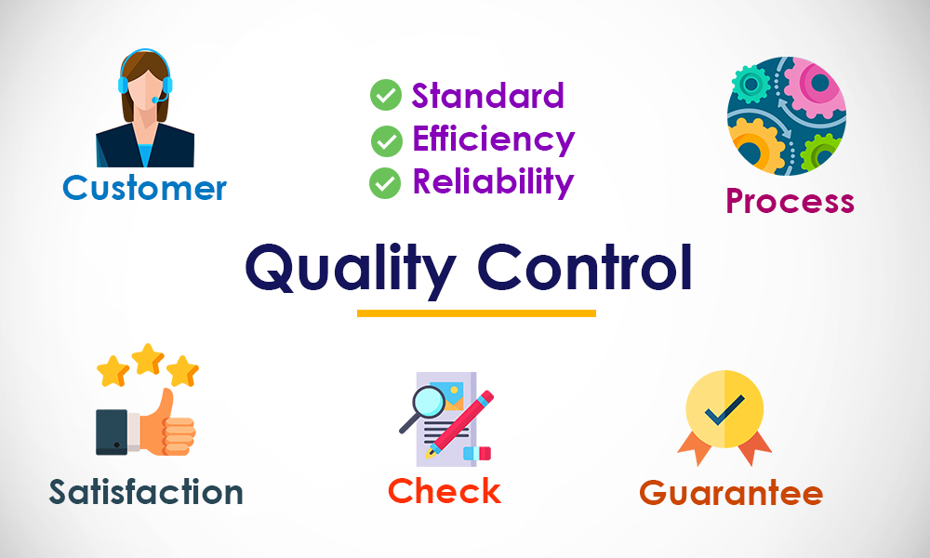

Slide 12
Dimension of Quality

Slide 13
Quality Assurance
the maintenance of a desired level of quality in a service or product, especially by means of attention to every stage of the process of delivery or production.

Slide 14
Quality Assurance

Slide 15
Quality Assurance
Quality assurance managers play a crucial role in business by ensuring that products meet certain thresholds of acceptability.
They plan, direct or coordinate quality assurance programs and formulate quality control policies. They also work to improve an organization's efficiency and profitability by reducing waste

Slide 16
Quality management
Quality management is the act of supervision all activities and tasks needed to maintain a desired level of excellence.
Quality management includes the determination of a quality policy, creating and implementing quality planning and assurance, and quality control and quality improvement.

Slide 17
Quality management
The seven quality management principles are:
Customer focus.
Leadership.
Engagement of people.
Process approach.
Improvement.
Evidence-based decision making.
Relationship management.

Slide 18
Quality Management

Slide 19
Total Quality Management
A system of management based on the principle that every member of staff must be committed to maintaining high standards of work in every aspect of a company's operations.
Total quality management (TQM) is the continual process of detecting and reducing or eliminating errors in manufacturing, streamlining supply chain management, improving the customer experience, and ensuring that employees are up to speed with training

Slide 21
What is key principles of TQM

Slide 23
