Slide 1
Binding Energy and Mass defect
Mass of an atom ˂ Masses of its constituents particles (p, n, e)
ΔM= (ZMH+NMn)-MA
Where
ΔM=Mass Defect
Z=Number of protons
MH=1.007276+0.00054858=1.00782458 amu
N=Number of neutrons
Mn=1.008665 amu
MA=Mass of atom meaured
For Deuterium
MA=2.014102 amu
Calculate mass defect for Deuterium and convert into energy?

Slide 2
Conversion Factor
1 amu=931.49 MeV
ΔM=?
=0.002388 amu
Energy for Deuterium formation=?
= 0.002388 x 931.49=2.224 MeV
When a proton captures a neutron emission of this energy takes place in the from of Gamma rays
Binding Energy
Energy released when nucleus is formed from its constituents nucleons
or
Energy required when an atom is broken to its constituents nucleons

Slide 3
Mass defect reflects stability of an atom
Mass defect α Stability of an atom
Mass defect and Binding energy are equivalent by Einstein energy equation
E= ΔM C²
Prove that 1 amu=931.49 MeV
Mass of 6.022 x10²³ atoms of C-12=12 g
Mass of 1 atom of C-12= 1.99 x10⁻²³ g
Mass of 1/12 atom of C-12=1.66 x10⁻²⁴ g
Mass of 1/12 atom of C-12= 1amu=1.66 x10⁻²⁷ kg
E=MC²
E= 1.66 x10⁻²⁷ kg x (3 x10⁸)² m/s
E= 1.492 x10⁻¹⁰ J
1eV= 1.602 x10⁻¹⁹ J
E= 1.492 x10⁻¹⁰ J /1.602 x10⁻¹⁹ J
E=9.3149 x10⁸ eV

Slide 4
E=9.3149 x10² MeV
E=931.49 MeV
Calculate mass defect and Binding energy of He and BE/Nucleon=?
P
N
⁴He
Energy
P
N
Calculate energy to bind one neutron into ⁶Li to form ⁷Li =?
Mass of ⁶Li= 6.015 amu
Mass of ⁷Li= 7.016 amu
Mass of ¹n=1.0087 amu

Slide 5
¹n + ⁶Li
⁷Li + Q
Total mass of ¹n and ⁶Li = 6.015+1.0087=7.023 amu
Mass of ⁷Li=7.016 amu
Mass defect=7.016-7.023=-0.0078 amu
Binding Energy= 0.0078x931.49=7.265 MeV
This energy is released in the from of Gamma rays and as kinetic energy of the daughter nucleus
ΔM= (ZMH+NMn)-MA
E= ΔM C²

Slide 6
BE= [(ZMH+(A-Z) Mn)-MA]C²
^{Excess Mass=?}
^{Δ = MA-A}
^{MA=Δ+A}
BE= [(ZMH+(A-Z) Mn)-(Δ+A)]C²
Calculate binding energy of using nucleide table=?
Boron Neutron Capture Therapy (BNCT):
⁹Be + ¹H ¹n + ⁹B + Q
¹n + ¹⁰B ⁴He + ⁷Li + γ + Q
$${}_{16}^{32}S,{}_{16}^{33}S,{}_{16}^{48}S$$
α
α
¹H
Q=?
01.47 MeV
0.84 MeV
0.48 MeV

Slide 7
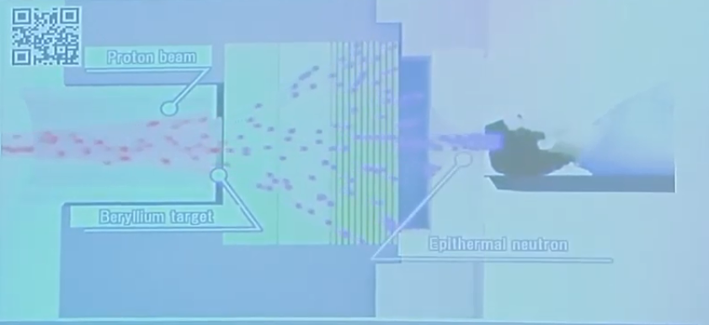
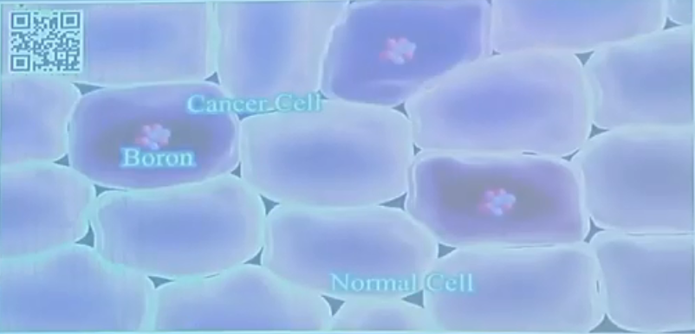
¹n + ¹⁰B ⁴He + ⁷Li + γ + Q
⁹Be + ¹H ¹n + ⁹B

Slide 8
He and Li are short length radiations and can travel only a cell path length
Q=BE (Li) + BE (He) -BE (B) - BE (n)
BE (Li)=39.244 MeV
BE (He)= 28.295 MeV
BE (B)= 64.750 MeV
BE (n)= 0 MeV
Q=2.79 MeV
Exothermic or endothermic=? Q> 0 Q˂0
Where does this energy go=?
This energy is released in the from of Gamma rays and as kinetic energy of the daughter nucleus
How much taken up by Gamma rays?
How much taken up by daughter nuclei?
How much taken up by each daughter nuclei?

Slide 9
Q=2.79 MeV
Gamma rays=0.48 MeV
Remaining=2.79-0.48=2.31 MeV
This remaining is shared by He and Li nuclei as their kinetic energy.
T(Li)+T(He)=2.31 MeV
When both nuclei of zero kinetic energy combine, the nuclei formed will have equal and opposite m
Momentum.
Li
He
n
B

Slide 10
We can also calculate distance travelled by these
nuclei within cell

Slide 11
What if we want to drive reaction in reverse? i.e.,
We need to add 2.79 MeV energy to the reactant to make this reaction possible.
How can we add this energy?
¹n + ¹⁰B ⁴He + ⁷Li
This reaction is also used in nuclear reactor as control rod (Boron control rods to capture
neutrons.
Significance of BE:
The heat liberated during formation of a compound from its element is a measure of
Stability of that compound.
Heat of formation (ΔH) α Stability of a compound
ΔH=-393 kJ/mol

Slide 12
We can convert this energy into mass by using Einstein equation E=mC2
This heat corresponds to a mass loss of 4.4 x10⁻⁹ g for each mole of CO2 (44g) formed.
All chemists believe this mass loss but there is no instrument to measure this small change in mass.
1eV= 1.6022 x10⁻¹⁹ x 6.022 x10²³ = 96.48 kJ/mol=23.045 kcal/mol
Binding energy of deuterium in kJ/mol=2.224 x10⁶x 96.48= 214.5 x10⁶ kJ/mol
Comparison of CO2 heat of formation and Deuterium binding Energy? 5.458*10⁵
Calculate heat released during following nuclear reactions
1.
2.
Q=342-160-160=22 MeV
Q=1160+801-1790=171 MeV

Slide 13
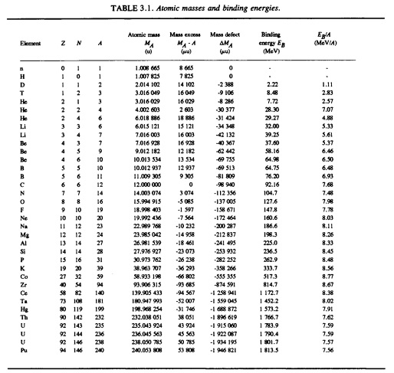
BE/Nucleon=EB/A:
BE of He per nucleon=7.07 MeV
BE of deuterium per nucleon=1.11 MeV
BE/A α Stability
Which is stable He or D=?
For most nuclei
Eb/A=5-8
To first approximation Eb/A=constant
Because
Total BE is roughly proportional to total
number of nucleon
BE  Nucleon number
BE/A is plotted against A
BE/A increase as A increases upto A≈60
then BE/A start decreasing
Nuclei with A≈60 are stable nuclei
(Fe, Ni)
For certain nuclei there are humps in the
Graph/curve showing these nuclei are
stable

Slide 14
Figure: Plot of BE/A vs A

Slide 15
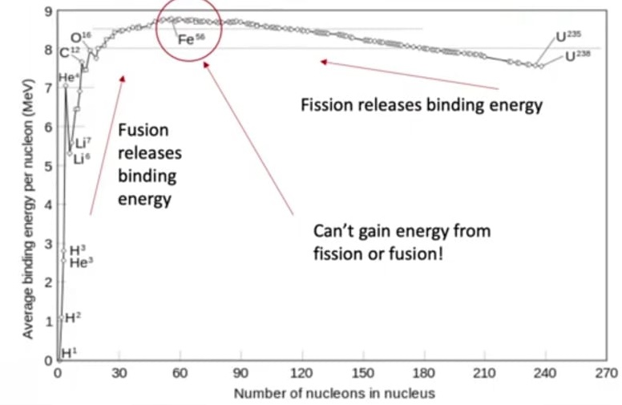

Slide 16
Fusion
Below A≈60, when two nuclei react to form a new nucleus then sum of BE/A values of reactant is
greater than BE/A of products, then a certain amount of energy is released and process
is called fusion e.g.,
BE/A (Ne)=8 Mev
BE/A of all nucleon of Ne=8*20=160 MeV
Sum of BE/A for all reactants=160+160=320 MeV
BE/A (Ca)=8.6 MeV
BE/A for all nucleon of Ca=8.6*40=344 MeV
The energy released=Sum of BE/A of products- Sum of BE/A of Reactants=344-320=24 MeV
The energy released using measured masses calculation=20.75 MeV

Slide 17
Fission:
Above A≈60, when a nucleus is broken down to two lighter nuclei, then BE/A value of reactant is
greater than sum of BE/A of products, then a certain amount of energy is released and process
is called fusion e.g.,
BE/A (U)=8 Mev
BE/A of all nucleon of Ne=8*20=160 MeV
Sum of BE/A for all reactants=160+160=320 MeV
BE/A (Ca)=8.6 MeV
BE/A for all nucleon of Ca=8.6*40=344 MeV
The energy released=Sum of BE/A of products- Sum of BE/A of Reactants=344-320=24 MeV

Slide 18
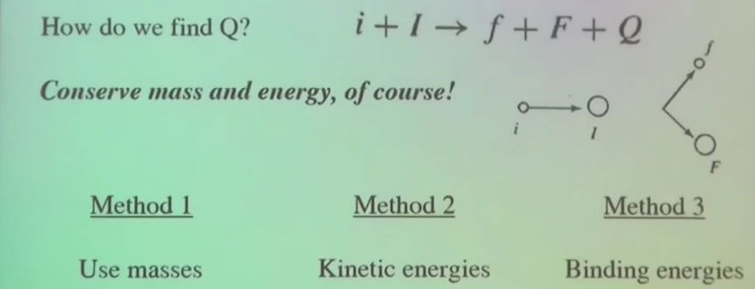
Methods to calculate energy released:
¹n + ¹⁰B ⁴He + ⁷Li + γ + Q

Slide 19
Nuclear Radius:
Nucleus occupies very small volume as compared with total volume of the atom (Rutherford)
Radius of nucleus=10⁻⁴- 10⁻⁵ x Radius of atom
Radius of atoms are of the order of pm = 10⁻¹²m
Radius of Nuclei are of the order of fm = 10⁻¹⁵m
Experiments show
Volume of nucleus  No. of nucleon present
Average calculations show, Nucleus is composed of very closely packed nucleons with a constant density
(0.2 nucleon/fm) from centre to the edge of nucleus (because we have used a
formula of sphere)
Has a nucleus uniform density=?

Slide 20
Ans: No
By bombarding nuclei with high energy e⁻ or p⁺ (≥GeV) and measuring
i) scattering angles and
ii) particle energy,
We can determine
charge and
matter density
Such experiments were carried out
Results:
Nuclei do not have uniform charge distribution
Nuclei do not have uniform matter distribution
Plots of radial distance and matter or charge distribution gives S-shaped curve
For Z>20, a uniform density of mass and charge exists over a short distance from nucleus and
core (with constant thickness of 2.5 fm independentof mass number) is surrounded by a layer of decreasing density.
e.g., For Bi, density remains uniform for 5 fm from centre and decreasing 1/10 th of the value over the
range of 2 fm
V) All nuclei are not spherical
Vi) Some are oblates and prolate around axis of rotation

Slide 21
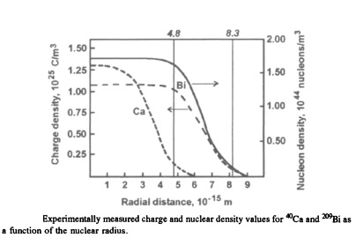
Inspite of non-uniform density and non-spherical nature of nucleus, for most purposes,
It is adequate to assume uniform density nucleus with sharp boundry.
Assuming ro=1.4 fm
⁴⁰Ca
r=1.4x10⁻¹⁵x40^{1/3}
r=4.79 fm
²⁰⁹Bi
r=8.31 fm
⁸⁰Br
r=6.0 fm
²³⁸U
r=8.7 fm
How can we calculate r0?
Experimentally determined nuclear radii are related with nucleon number for a few nuclei and value of constant r0 is determined.
This shows that radius does not change dramatically from lighter to heavier nuclei

Slide 22
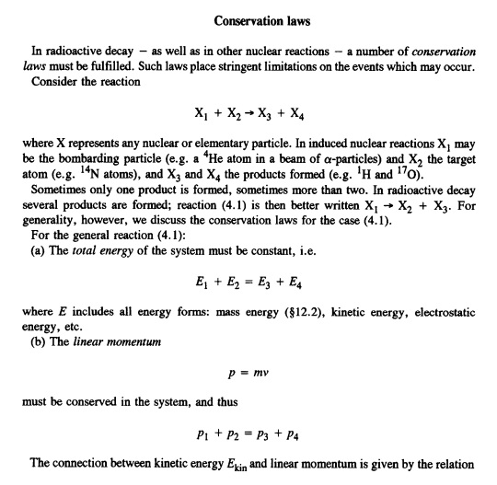

Slide 23
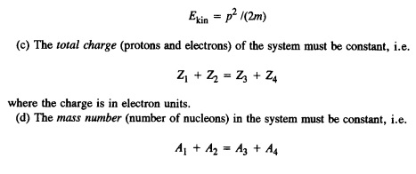
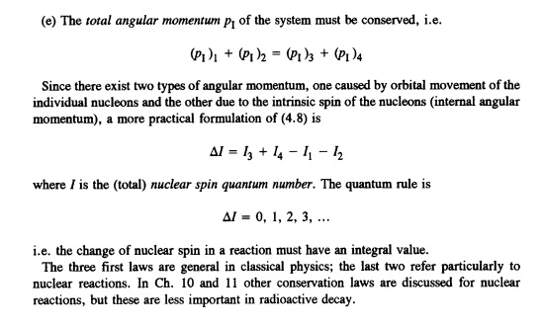

Slide 24
Liquid drop mass formula or semi-empirical liquid drop model
BE is a function of Z and A BE= f(A, Z)
Consider nucleus like a drop of liquid because a nucleus roughly takes the shape of a liquid drop.
What sort of terms can add to or decrease the stability of a given liquid drop
1. What happens to BE of a nucleus, when we add nucleons to a nucleus?
Add more nucleons, more nucleons are converted to energy and hence BE increases. By increasing A, BE increases. Lets call it volume term, as we add volume to the liquid droplet, its total BE will start to increase. So we can say BE is proportional to A i.e., number of nucleons in the liquid droplet. BE increases with A, but BE/A will be constant (show graphically). There is going to be some constant called volume constant. There is some relationship between stability gained and nucleon added but we don’t know this. One thing we are sure of is BE is proportional to A
BE/a
A

Slide 25
2. What happens to a liquid drop, when we increase volume of liquid drop. What other
parameters increase?
Surface area. Dependence of BE on surface area can be shown in terms of volume which can be shown in terms of nucleon number A. How does surface area scales to volume?
Does this term add to or decrease the stability of the nucleus?
This term decreases the stability of nucleus because nucleon on the surface are not bund to as many nucleon as of inside so this term will take a negative sign

Slide 26
3. What happens to a liquid drop, when we increase volume of liquid drop. What happens to a nucleus, when we increase nucleons in the nucleus? What parameter other than surface area?
Nucleons mean proton or neutron. What happens if we place neutrons at one place? Proton repel each other due to columbic forces. Whether this term will take a negative or positive sign, lets decide later. Up-till now, we only know that change in BE is directly proportional to No. of protons
Every proton will feel repulsive force by every other proton except by itself.
This repulsion force will be mediated by number of neutrons. There is no nucleus which contains more than one proton and no neutrons. Writing A in the denominator will increase stability.
But how volume scales with nucleon number?

Slide 27
Does this term add to or decrease the stability of the nucleus?
This term decreases the stability of nucleus because protons inside the nucleus repel each other so this term will take a negative sign
BE/A
Graph: As we increase A, nucleus will become bigger and bigger causing more columbic repulsion and thereby decreasing stability as shown by end part of curve
A

Slide 28
4. What is sort of trend in stability of a nucleus when we talk about proportionality between number of neutrons and protons?
C-12 with 6 protons and 6 neutrons is more stable. What happens with C containing only 6 protons and no neutrons? Exceptionally unstable. And what about C-24 containing 6 protons and 18 neutrons?
So there must be a sort of symmetry term showing a balance between number of protons and neutrons. So when the number of protons and neutrons are in balance especially for lighter nuclei, nucleus is getting stable and stable. So we can write some term which can relate number of protons and neutrons.
Does this term add to or decrease the stability of the nucleus?
If No. of protons and neutrons are equal then N-Z is zero and nucleus is stable. Greater is the difference between No. of protons and neutrons, greater will be instability as in case of C discussed above. So N-Z will contribute towards instability. So the term will take a negative sign.
For lighter nuclei it works good but for heavier nuclei divide denominator by A.

Slide 29
Graph: Curve will bend more than above one
5. What is effect of pairing on stability? (Introduction of pairing term)
This is not a smooth function. It is a piece wise function. It depend whether we have nuclei with Odd-odd nuclei
Even-even nuclei
Odd-even nuclei or
Even-odd nuclei.
It will add a little zigzag at the beginning of the curve and equals out at the end of curve

Slide 30
Comparison of this equation with actual binding energies of nuclei yield a set of values of above coefficients as given below.
When the calculated binding energies are compared with experimental binding energies, it is seen that for certain nuclei (nuclei containing certain number of protons and neutrons), there is a serious disagreement. These numbers are related to so called magic numbers. This deficiency lead to development of nuclear shell model.

Slide 31
Valley of β-stability:
If this semi-empirical formula is written as a function of Z by putting N=A-Z we get
This equation describes a parabola for constant value of A. We will expect for any family of isobar the masses or BE would fall upon a parabolic curve.

Slide 32
=(1.00782458*86.74699*A1)+((B1-A1)*1.008665*86.74699)
=(15.5*B1)-(16.8*(B1)^(2/3))-(0.72*((A1)^2-A1))/B1^(1/3)-((23*(B1-2*A1)^2)/B1)+34/(B1^(1/2))
=((1.00782458*86.74699*A1)+((B1-A1)*1.008665*86.74699))-((15.5*B1)-(16.8*(B1)^(2/3))-(0.72*((A1)^2-A1))/B1^(1/3)-((23*(B1-2*A1)^2)/B1)+34/(B1^(1/2)))
Conversion of MeV into amu
=(((A1*1000000*1.602E-19)/(300000000)^(2))*1000)/(1.66E-24)
A1=column with values MeV
In terms of BE
In terms of mass

Slide 33
1. Draw mass parabola for mass number 93?
2. Draw mass parabola for mass number 15?

Slide 34
In order to determine most stable isotope for a given value of A i.e., most stable isobar or isobar with maximum BE or minimum measured mass (BE is a difference of sum of masses of nucleons and measured atomic mass. Lesser the measured atomic mass for a given isobar, higher will be BE), we will use concept of maxima and minima.
(A)

Slide 35
By using below equation {derived from above (A)}, we can find value of Z for a given value of A. This equation is derived by using concept of maxima and minima
=(2*A1)/(4+(0.72/23)*(A1)^(2/3))
Determine stable isotope for A 93=?
Determine stable isotope for A 146=?

Slide 39
Odd A
Β⁻
Β⁻
Β⁻
EC
Β⁻
Β⁻
EC

Slide 40
Odd A
EC
Β⁻
EC
EC
Β⁻
EC
EC
Β⁻
EC
Β⁻
EC
EC

Slide 41
Even A
A-146
Should be part of odd
Cs 55
Ho 67
Tb 65
Β⁻
La 57
EC
EC
Β⁻
Q
Pr 59
Eu 63
EC
Dy 66
Β⁻
Ba 56
Β⁻
Pm 61
EC
Β⁻
EC
Β⁻
EC
Ce 58
Gd 64
Nd 60
Sm 62
Z

Slide 46
Unstable nuclei and radioactive decay
Half life and its measurement

Slide 47
Decay Energy
Modes of radioactive decay

Slide 48
Generalized decay diagram
Unstable nucleus
Β⁺ or EC
-decay
γ
Β⁻
¹n
Energy
Z-2
Z-1
Z
Z+1
Z+2
Z

Slide 49
Nucleus having almost all of these decay?
Ans: K-40 (only exception is alpha and neutron decay)
EC
0.05 MeV
10.32%
K-40
1.5
Β⁺
0.49 MeV
10.32%
γ
1.46 MeV
Β⁻
1.33 MeV
89.52%
1.5
Energy (MeV)
γ
1.02 MeV
EC
1.51 MeV
0.16%
Ca-40
Ar-40
18
19
20
Z

Slide 50
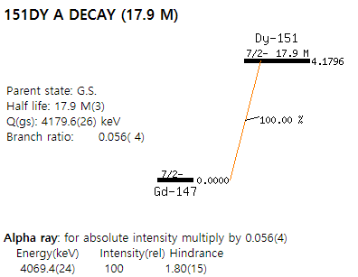
Nucleus with simplest decay diagram?
Ans: Dy (Dysprosium)-151 (only alpha decay)
Gd (Gadolinium)-147

Slide 51
Alpha-Decay

Slide 52
i
+
I
f
+
F
i
+
P
He
+
D
If the products formed are in their ground state, which is common for alpha decay, the total decay
Energy is partitioned between daughter nucleus and alpha particle. We can calculate kinetic energy for
Each product as under:

Slide 55
If the products formed are in not in their ground state, the total decay energy is partitioned between daughter nucleus and alpha particle (as already discussed), then sum of energy carried by Alpha particle, energy of excited state (where nucleus jumps) and energy emitted in the form of gamma rays will be equal to 4.202.
Lets have a look on the decay diagram of U-238.

Slide 56
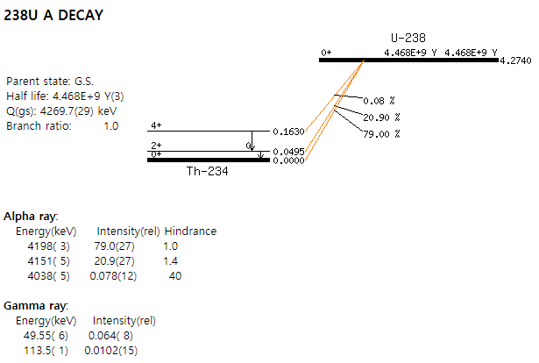
This energy is partitioned into
two parts as discussed earlier i.e.,
as KE of alpha particle and recoil or
daughter nucleus.
Out of 4.274 MeV, 4.202 MeV energy is supposed to be carried by Alpha particle if U-238 directly decays to ground state of Th-234. But in case, U-238 decays to any excited state of Th-234, then sum of energy carried by Alpha particle, energy of excited state (where nucleus jumps) and energy emitted in the form of gamma rays will be equal to 4.202.
1. e.g. when U-238 decays from 0 spin state to +4 spin state of Th-290, the energy carried by Alpha particle will be 4.202-0.1630=4.039 MeV and energy emitted in the form of gamma rays when Th-234 jumps from +4 spin state to +2 spin state will be 0.1630-0.0495=0.1135 MeV=113.5 KeV .
Energy of alpha particle+Energy of gamma rays+Energy of excited state where transition ends=4.39MeV+0.1135 MeV+0.0495 MeV=4.202 MeV
2. When U-238 decays from 0 spin state to +2 spin state of Th-290, the energy carried by Alpha particle will be 4.202-00.0495=4.1525 MeV and energy emitted in the form of gamma rays when Th-234 jumps from +2 spin state to +0 spin state will be 0.0495-0.0000=0.0495 MeV=49.5 KeV .
Energy of alpha particle+Energy of gamma rays+Energy of excited state where transition ends=4.1525 MeV+0.0495 MeV+0.0000 MeV=4.202 MeV

Slide 57
Age of the earth
Construct radioactive series?
The natural radioactive series indicate that al U-238 present in the nature world will be converted to lead. Thus a naturally occurring Uranium mineral is associated with some non-radioactive lead formed from Uranium. The rocks on the earth are assumed to be formed from magma i.e., molten rocks. It was then the radioactive U in the rock must have started decaying. Therefore, by estimating the ratio of Pb-236/U-238 by weight, the age of rock and hence that of the earth can be found out. Half life of U-238 is 4.49*10⁹ years.
Based on above equation, for every U-238 grams of Uranium decayed, 206 grams of lead must be present in the sample of rock. This age estimation is based on the assumption that initial radioactive material, the final stable nucleus and all the members of decay series remain in the rock and Pb-206 present in the rock is the product of U-238 decay.

Slide 58
Lets have a look on the decay diagram of K-40.
EC
0.05 MeV
10.32%
K-40
Β⁺
0.49 MeV
0.001%
γ
1.46 MeV
Β⁻
1.33 MeV
89.52%
Energy (MeV)
γ
1.02 MeV
EC
1.51 MeV
0.16%
Ca-40
Ar-40
18
19
20
Z

Slide 59
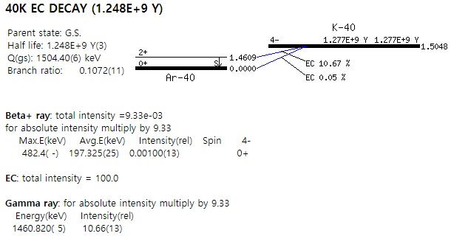
Decay energy released
1.5048-1.4609=0.0439 MeV.
When electron jumps from excited to ground state
the energy is released in the form of gamma rays.

Slide 60
We know that electron (negatron and positron do not constitute the nucleus. How then they are emitted from the nucleus? They are created by the nucleus only at the time of decay/emission. When a nucleus has excess of neutrons than required for a stable nucleus then it will be unstable due to deficiency of protons. Such a nucleus will achieve stability by changing its neutrons into protons
Beta-Decay
Daughter nucleus thus formed is shifted one place to the right in the periodic table. Parent atom has Z proton and Z electrons. But the daughter atom has Z+1 proton and Z electrons. Since electron number in the daughter nucleus remains the same i.e., Z while proton number is Z+1 and so is the nuclear charge, so daughter nucleus will carry a charge of +1.

Slide 61
The energy Q is shared by beta particles and antineutrino. The energy carried away by beta particles varies from zero to a maximum value. This energy is nor carried by the daughter nucleus unlike alpha particle decay where a part of energy is carried by daughter nucleus because it is larger in size and mass than beta particle and antineutrino.
While electrons emitted through internal conversion are mono-energetic i.e., all electrons emitted have same energies. Consider the transition from GS B-12 to GS C-12 which is 97.22% probable (in the example given on left). The energy released will be 13.3693 MeV which is partitioned between Beta particle and antineutrino. How much kinetic energy is carried by Beta particle?
Ans: From zero to 13.3693 MeV
13.3693 MeV
This energy over here seems to be one-fourth of the maximum energy released i.e., 3.325 MeV. This energy is carried by maximum number of Beta rays emitted while 10 MeV energy is carried out by maximum antineutrinos emitted. Like wise we can calculate energy carried out by Beta particle and antineutrino at any point of the graph.
Such a spectrum can be drawn for any beta decay process. This spectrum was the main evidence for the presence of antineutrino and was explained 40 years before the discovery of neutrino. It was thought that there must be some particles which carry away energy which is not carried by beta particles.
Number of neutrons can also be decreased by neutron emission. It simply decreases the neutron number by one without changing the atomic number

Slide 62
Some Notable Beta decay
Cobalt-60, produced by neutron irradiation of ordinary cobalt metal in a reactor, is a high activity gamma ray emitter, emitting 1.17 and 1.33 MeV gamma rays with an activity of 44 TBq/g (about 1100 Ci/g). The main reason for its wide use in radiotherapy is that it has a longer half-life, 5.27 years, than many other gamma emitters. However this half life still requires cobalt sources to be replaced about every 5 years.
Radioisotopes produced gamma rays in the megavolt range, but prior to World War II virtually the only radioisotope available for radiotherapy was naturally occurring radium (producing 1-2 MeV gamma rays), which was extremely expensive due to its low occurrence in ores. In 1937 the price of radium was one million dollars per gram in 2005 dollars, and the total worldwide supply of radium available for beam radiotherapy (teletherapy) was 50 grams.
The first patient to be treated with cobalt-60 radiation was treated on October 27, 1951, at Victoria Hospital in London, Ontario.[2] In 1961 cobalt therapy was expected to replace X-ray radiotherapy.[3]. In 1966, Walt Disney's lung cancer was treated with this procedure, but could not prevent his death.

Slide 64
Some Notable Beta decay
https://en.wikipedia.org/wiki/Brachytherapy

Slide 65
Mo-99
https://www.google.com/search?q=half+life+of+tc-99m&rlz=1C1CHBF_enPK891PK891&oq=half+life+of+Tc-99&aqs=chrome.1.0l8.10186j0j7&sourceid=chrome&ie=UTF-8

Slide 67
Carbon Dating

Slide 68
Willard Libby, Noble laurate

Slide 71
Law of radioactive decay
Radioactive materials decay

Slide 75
Positron Decay
We know that electron (negatron and positron do not constitute the nucleus. How then they are emitted from the nucleus? They are created by the nucleus only at the time of decay/emission. When a nucleus has excess of protons than required for a stable nucleus or stable N/P ratio then it will be unstable due to deficiency of neutrons. Such a nucleus will achieve stability by changing its protons into neutrons
Daughter nucleus thus formed is shifted one place to the left in the periodic table. Parent atom has Z proton and Z electrons. But the daughter atom has Z-1 proton and Z electrons. Since electron number in the daughter nucleus remains the same i.e., Z while proton number is Z-1 and so is the nuclear charge, so daughter nucleus will carry a charge of -1.
If an electron is also emitted then the total charge is balanced. Since electron is not emitted so an electron is written on the product side to balance the charge

Slide 76
Electron Capture
A nucleus which is deficient in neutrons decays by positron emission or electron capture (98% K-capture).
If Z ˂ 30, then positron emission
If Z > 30, then electron capture
If Z=30-80 then both compete
If sufficient energy of 1.022 MeV is not available for positron emission, EC will be the only process. By electron capture, a proton after capture of electron is converted into a neutron.
Daughter nucleus thus formed is shifted one place to the left in the periodic table because one proton decreases so as the atomic number. Parent atom has Z proton and Z electrons. Now the daughter atom has Z-1 proton and Z-1 electrons because an electron is captured by a proton so both proton and electron decrease by one unit. So daughter nucleus will be neutral. So no need to add electron on product side like positron. So Q equation will be simple.
No other change is involved during EC, except from the emission of X-rays which are produced by the rearrangement of outer electrons. The emission of X-rays is the characteristics of the daughter nucleus.

Slide 77
10%
90%

Slide 78
Daughter Recoil
Parent nucleus
 or β particle emission
Daughter nucleus
Excited state
Gamma emission
or nuclear de-excitation
Daughter nucleus
Ground state

Slide 79
Gamma Emission and internal conversion
De-excitation can also occur by method of internal conversion. This is possible when two levels have same total angular momentum and gamma transition is forbidden by selection rule i.e., can not take place between two same angular momentum states. Under such conditions the excited nucleus may interact with an orbital electron in such a way that the excitation energy is transformed to the orbital electrons, which is emitted if excitation energy is greater than the binding energy oe electron. This type of conversion is called internal conversion. Electron from the internal conversion are mono-energetic that is all have same energy and thus differ from the electrons of beta-decay having energies zero to maximum. This is possible as the wave function of the electron is not zero inside the nucleus. Since the k-shell electrons are closes to the nucleus so these are usually emitted.
How will spectrum of energies of conversion electron look like?
Ans: The conversion electrons will produce a series of mono-energetic lines and not continuous spectrum of different energies like beta-electrons.

Slide 81
Isomeric Transition
Nuclei having excited levels but do not decay instantaneously are called isomeric nuclei. Or we can say that daughter nuclei with some what stable level (like metastable state). Metastable state is an excited state a bit stable that excited state. The various excited levels are called isomeric levels. They decay either by gamma emission or by internal conversion. The transitions leading to de-excitation from such levels is called isomeric transition (IT). The decay of Co-60 by isomeric transition is shown below. The half life of this isomeric level is 10.6 min.
^{60m}Co
10.6 min
IT (0.059 MeV)
⁶⁰Co

Slide 87
Spontaneous Fission

Slide 88
Rare mode of Decay

Slide 89
Decay Scheme and isotopic chart

Slide 93
Secondary process in an atom

Slide 97
Closed Decay energy cycles

