Slide 1
Stored grain pests
Dr. M. Asam Riaz
Assistant Professor
Entomology, College of Agriculture, University of Sargodha, Sargodha, Pakistan

Slide 2
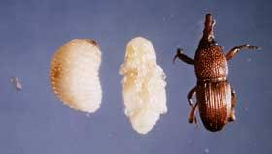
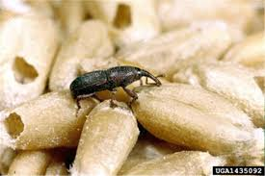
Ent-202 Agricultural insect pests and their management 3(2-1)
Insect pests of Stored grains Rice Weevil (Sitophilus oryzae, Curculionidae; Coleoptera
Attack on stored grains rice, wheat, maize, etc
Adult: head snout like structure
Dark brown with four brownish spots on FW
Larvae
Grubs dirty white with brown head
Damage:
Larvae make a tunnel and enter the grains and feed inside tunnel
Eat less but destroy more

Slide 3
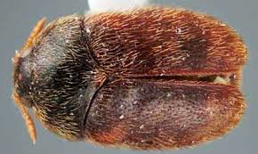
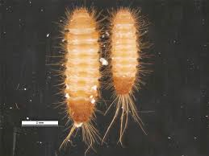
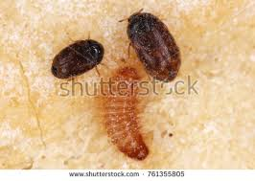
Ent-202 Agricultural insect pests and their management 3(2-1)
Insect pests of Stored grains Khapra beetle Trogoderma granarium Dermestidae; Coleoptera
Attack on stored grains
Adult: Small dark brown and covered with fine hairs
Wings present but don’t fly
Larvae
Grubs yellowish white
Damage:
Larvae feed on upper 50cm layer of grains
Larvae feed on grain and convert grains into frass

Slide 4
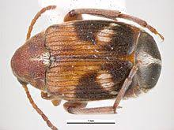
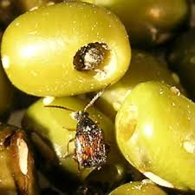
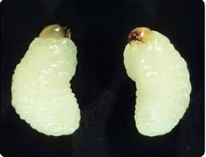
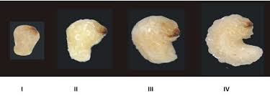
Ent-202 Agricultural insect pests and their management 3(2-1)
Insect pests of Stored grains Dhora beetle Callosobruchus chinensis, Bruchidae; Coleoptera
Attack on stored grains like grams
Adult: reddish brown
Larvae
Grubs dirty white
Remain inside the seeds
Damage:
Adult does not cause any damage
Larvae damage by feeding within a single seed
Larvae eat the grains completely from inside leaving shell behind
Damaged grains converted into flour and produces smell (cant be consumed)

Slide 5
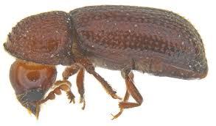
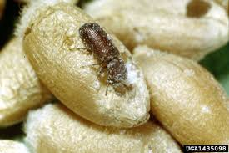
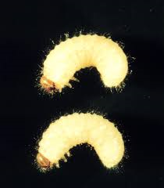
Ent-202 Agricultural insect pests and their management 3(2-1)
Insect pests of Stored grains Lesser grain borer (Rhyzopertha dominica, Bostrichidae; Coleoptera
Attack on stored grains
Adult: Dark brown
Small cylindrical body
Larvae
Larvae dirty white with light brown head
Damage:
Both Adults and larvae damage to grains
Adults and larvae feed by making irregular holes on them
Adults produce frass (on which larvae feed)
Eat less and spoil more
Control:
Dry grains before storage
Store grains in clean godowns
Fill all cracks and crevices
Spray the floor and ceiling, gunny bags with fenvalerate or permethrin (0.2%) before storage
Fumigate the grains with alumimium phosphide (1tablet /ton)

Slide 6
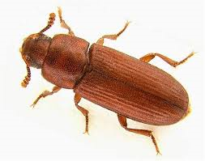
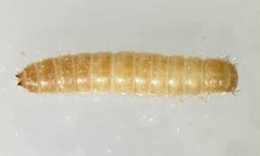
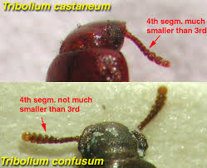
Ent-202 Agricultural insect pests and their management 3(2-1)
Insect pests of Stored grains Red flour beetle (Tribolium castaneum; Tenebrionidae; Coleoptera
Attack on stored grains
Adult: reddish brown
Club shaped antennae
Larvae
Larvae are reddish yellow and hairy
Damage:
Both Adults and larvae damage to flour
More damage in monsoon season
Larvae and adult found hidden/concealed in flour
Flour turns mouldy and greyish, having pungent smell (unfit for consumption)

