Slide 1
Virus Classification
Virus classification is the process of naming viruses and placing them into a taxonomic system similar to the classification systems used for cellular organisms.
Viruses are mainly classified by phenotypic characteristics, such as morphology, nucleic acid type, mode of replication, host organisms, and the type of disease they cause.
The formal taxonomic classification of viruses is the responsibility of the International Committee on Taxonomy of Viruses (ICTV) system, although the Baltimore classification system can be used to place viruses into one of seven groups based on their manner of mRNA synthesis.
Specific naming conventions and further classification guidelines are set out by the ICTV.

Slide 2
Virus Classification
The International Committee on Taxonomy of Viruses began to devise and implement rules for the naming and classification of viruses early in the 1970s, an effort that continues to the present.
The ICTV is the only body charged by the International Union of Microbiological Societies with the task of developing, refining, and maintaining a universal virus taxonomy.
The system shares many features with the classification system of cellular organisms, such as taxon structure.
However, some differences exist, such as the universal use of italics for all taxonomic names, unlike in the International Code of Nomenclature for algae, fungi, and plants and International Code of Zoological Nomenclature.

Slide 3
Levels of Classification
Viral classification starts at the level of realm and continues as follows, with the taxonomic suffixes in parentheses:
Realm (-viria)
Subrealm (-vira)
Kingdom (-virae)
Subkingdom (-virites)
Phylum (-viricota)
Subphylum (-viricotina)
class (-viricetes)
Subclass (-viricetidae)
Order (-virales)
Suborder (-virineae)
Family (-viridae)
Subfamily (-virinae)
Genus (-virus)
Subgenus (-virus)
Species

Slide 4
Classification Criteria
The viruses are mainly classified by phenotypic characteristics such as:
Morphology
Structure of capsid
Presence or absence of envelope
Size of virion
On the basis of form they are classified into 4 groups
Filamentous viruses are long and cylindrical e.g. TMV
Isometric (or icosahedral) viruses are roughly spherical e.g. poliovirus
Enveloped viruses have membranes surrounding capsid e.g. influenza virus
Head and tail viruses have isometric head and filamentous tail e.g. T4

Slide 5
Forms of Viruses

Slide 6
Classification Criteria
Nucleic acid type
DNA viruses have genome in the form of DNA e.g. poxvirus.
RNA viruses have RNA as genetic material e.g. influenza virus.
Retroviruses are the viruses which transform their single stranded RNA into double stranded DNA e.g. HIV.
Gemini viruses have single stranded DNA as their genome e.g. begomovirus.

Slide 7
Classification Criteria
Type of host
Host structures the virus infects
Bacteriophages: infect bacteria e.g. T4
Plant viruses: infect plants e.g. TMV
Animal viruses: infect animals e.g. HIV
Dermotropic: infect the skin cells
Neurotropic: infect nerve cells
Viscerotropic: infect organ of digestive tract of the host
Pneumotropic: infect respiratory system of the host
Type of disease they cause
Symptoms of disease e.g. Tobacco mosaic virus
Place where the disease first reported e.g. Ebola virus
Mode of replication

Slide 8
Classification Systems
Viruses are classified generally based on:
Classical system
Based on host or physical or chemical characteristics of the viruses.
E.g. animal, plant viruses (Holmes classification) or enveloped, naked viruses etc.
Genomic
Based on genome of the viruses.
E.g. Baltimore classification or DNA, RNA viruses etc
Serology
Based on diagnostic virology.
Viruses in this classification have significant antigenic differences but perhaps very little genetic or biological differences exist among them.

Slide 9
Holmes Classification
Holmes (1948) used Carl Linnaeus's system of binomial nomenclature to classify viruses into 3 groups under one order, Virales.
He classified viruses on the basis of the type of the host the virus infected.
They are placed as follows:
Group I: Phaginae (attacks bacteria)
Group II: Phytophaginae (attacks plants)
Group III: Zoophaginae (attacks animals)

Slide 10
Baltimore Classification
Baltimore classification (first defined in 1971) is a classification system that places viruses into one of seven groups depending on a combination of their nucleic acid (DNA or RNA), strandedness (single-stranded or double-stranded), sense, and method of replication.
Named after David Baltimore, a Nobel Prize-winning biologist.
These groups are designated by Roman numerals.
classifying viruses according to their genome means that those in a given category will all behave in a similar fashion, offering some indication of how to proceed with further research.

Slide 11
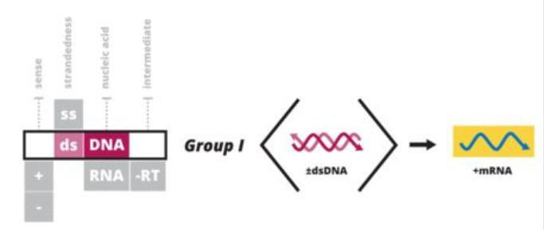
Baltimore Classification
Viruses can be placed in one of the seven following groups:
Class I
Double stranded DNA viruses
Production of mRNA and genome replication occurs as it would from the host genome.
e.g. Adenoviruses, Herpesviruses, Poxviruses

Slide 12
Baltimore Classification
Class II
Single stranded DNA viruses (+ strand or "sense“ strand DNA)
Form a double stranded DNA intermediate during replication.
RNA polymerase require double stranded DNA as template.
e.g. Parvoviruses

Slide 13
Baltimore Classification
Class III
Double stranded RNA viruses
Cells do not have RNA polymerase.
RNA polymerase catalyze the formation of RNA from DNA template.
Require specific RNA dependant RNA polymerase.
RNA polymerase synthesize plus strands of RNA and then use them as template to make more – strands of RNA
e.g. Reoviruses

Slide 14
Baltimore Classification
Class IV
(+) single stranded RNA viruses (+ strand or sense RNA or mRNA-in virology, mRNA is said to be positive configuration and its complementary is negative configuration)
Require virus specific and RNA dependant RNA polymerase
RNA polymerase synthesize minus strands of RNA and then use them as template to make more + strands of RNA.
e.g. Corona viruses, Picornaviruses, Toga viruses

Slide 15
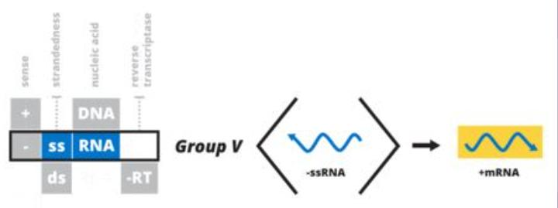
Baltimore classification
Class V
(−) single stranded RNA viruses (− strand or antisense) RNA
Cells do not have RNA polymerase.
RNA polymerase catalyze the formation of RNA from DNA template.
Require specific RNA dependant RNA polymerase.
RNA polymerase synthesize plus strands of RNA and then use them as template to make more - strands of RNA
e.g. Orthomyxoviruses, Rhabdoviruses

Slide 16
Baltimore Classification
Class VI
Single stranded RNA-RT viruses (+ strand or sense) RNA with DNA intermediate in life-cycle
Single stranded RNA genome that replicates with DNA intermediate.
Require reverse transcriptase to copy the information found in RNA to DNA.
e.g. Retroviruses

Slide 17
Baltimore Classification
Class VII
Double stranded DNA-RT viruses DNA with RNA intermediate in life-cycle
Double stranded DNA genome that replicates with RNA intermediate.
Require reverse transcriptase.
Production of mRNA and genome replication occurs as it would from the host genome.
e.g. Hepadnaviruses

Slide 18
References
Lefkowitz, E. J. Dempsey, D. M. Hendrickson, R. C. Orton, R. J. Siddell, S. G. Smith, D. B. (January 2018). “Virus taxonomy: the database of the international committee on Taxonomy of Viruses (ICTV)” (p708-717).
“The International Code of Virus Classification and Nomenclature ICTV.” Retrieved 2 September 2020.
Mallapaty, Smriti, (30 July 2020). “Should virus-naming rules change during a pandemic? The question divides virologists.” (584).
“Virus Taxonomy: 2019 release” International Committee on Taxonomy of Viruses. Retrived26 April, 2020.
“Baltimore Classification of Viruses” Molecular Biology Web Book Retrieved on 2008-08-18.

