Slide 1
Measurememt scales
Student : MUhammad Zulqatfain Khan (M. Com I Regular)
Lecturer : Miss Habiba MUSTAFA
Subject : Quantitative Techniques & Statistical Interference

Slide 2
OUTLINE
INTRODUCTION
DEFINITION
CHARACTERISTICS OF SCALES OF MEASUREMENT
TYPES OF SCALES OF MEASUREMENT
NOMINAL SCALE
ORDINAL SCALE
INTERVAL SCALE
RATIO SCALE
SUMMARY
REFERENCES

Slide 3
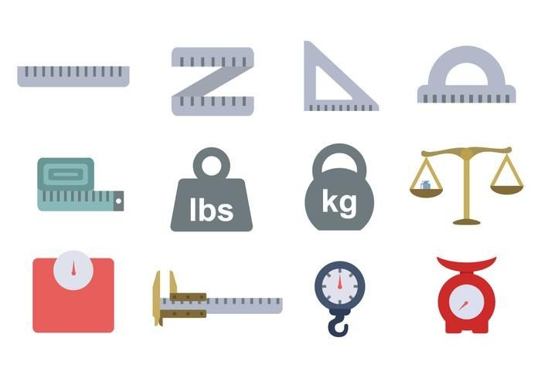
Introduction
Psychologist Stanley Smith Stevens developed the best-known classification with four levels, or scales, of measurement: nominal, ordinal, interval, and ratio.
The term Measurement Scale is derived from two words in statistics.
Measurement: is defined as the process of recording observations collected as part of a research.
Scaling: is the procedure of assigning objects to numbers or semantics according to the specified rules.

Slide 4
Scales of Measurement
Definition:
“Levels or scales of measurement refer to ways in which variables/numbers are defined and categorized.
Each scale of measurement has certain properties which in turn determines the appropriateness for use of certain statistical analyses.”

Slide 5
Characteristics of scales of measurement
Identify
Magnitude
Equal Intervals
Absolute Zero

Slide 6
TYPES OF Scales of Measurement
There are four scales of measurement:
Nominal Scale
Ordinal Scale
Interval Scale
Ratio Scale

Slide 7
Key terms
Qualitative Data: It is the non-numerical information which cannot be counted, measured or easily expressed in the form of numbers.
Quantitative Data: It is the information which can be expressed numerically. Quantitative data expresses a certain quantity, amount, or range.

Slide 8
Nominal scale

Slide 9
Nominal scale
Definition: the nominal scale is a scale of measurement that is used for identification purposes.
Nature:
It is the coldest and weakest level of data measurement among the four. It is also very much qualitative in nature.
Sometimes known as categorical scale, it assigns numbers to attributes for easy identity. These numbers are however not qualitative in nature and only act as labels.

Slide 10
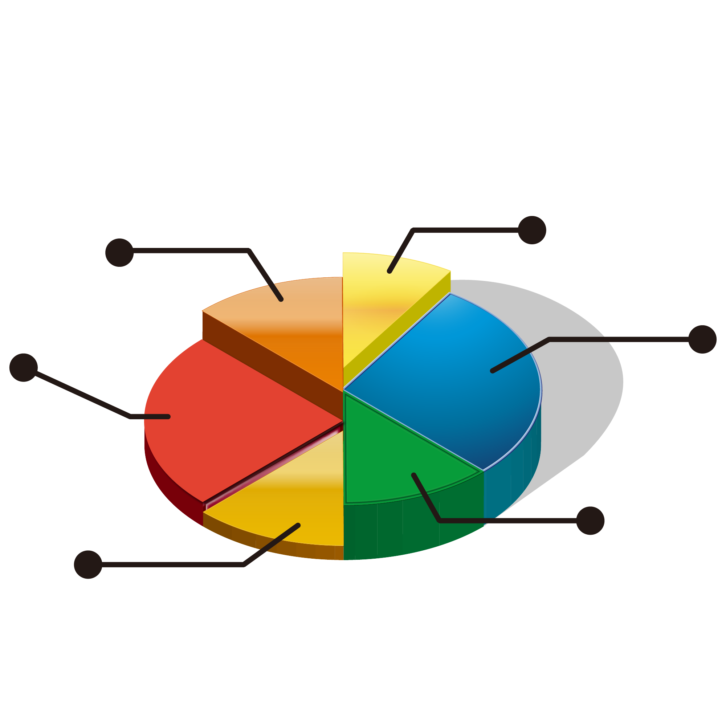
Nominal scale
Analysis:
The only statistical analysis that can be performed on a nominal scale is the percentages and mode.
It can be analyzed graphically using a bar chart and pie chart.

Slide 11
Nominal Scale
Eample:
In the example below, the measurement of the popularity of a political party is measured on a nominal scale.
Which political party are you affiliated with?
PTI
PML-N
PPP
Labeling PTI as “1”, PMLN as “2” and PPP as “3” does not in any way mean any of the attributes of any party are better than the other. They are just used as an identity for easy data analysis.

Slide 12
ORDINAL scale

Slide 13
Ordinal scale
Definition:
Ordinal Scale involves the ranking or ordering of the attributes depending on the variable being scaled.
Nature:
The attributes on an ordinal scale are usually arranged in ascending or descending order sometimes like a ranking. Ordinal data is qualitative in nature.
Application:
Ordinal scale can be used in market research, advertising, and customer satisfaction surveys. It uses qualifiers like very, highly, more, less, etc. to depict a degree.

Slide 14
Ordinal scale
Analysis:
We can perform statistical analysis like percentile and median using the ordinal scale, but not mean. However, there are other statistical alternatives to mean that can be measured using the ordinal scale.
Example:
A software company may need to ask its users:
How would you rate our app?
Excellent, Very Good, Good, Fair, Poor, Very Poor
(The attributes in this example are listed in descending order.)

Slide 15
Interval scale

Slide 16
Interval scale
Definition:
The interval scale of data measurement is a scale in which the levels are ordered and each numerically equal distances on the scale have equal interval difference.
Difference between Interval and Ordinal Scale (Nature):
It is like an extension of the ordinal scale, with the main difference being the existence of equal intervals.
Unlike ordinal scale, interval scale is quantitative in nature.
With an interval scale, you have a clear distinction between the intervals of the data. You can see the extent at which A is larger than B. Also, unlike ordinal and nominal scale, arithmetic operations can be performed on an interval scale.

Slide 17
Interval Scale
Analysis:
Almost all statistical analysis are applicable when calculating interval data, including mean, mode, median etc.
Applications:
It is used in various sectors like in education, medicine, engineering, etc. Some of these uses include calculating a student's CGPA, measuring a patient's temperature, etc.
Example:
A common example is measuring temperature on the Fahrenheit scale. It can be used in calculating mean, median, mode, range, and standard deviation.

Slide 18
Ratio scale

Slide 19
Ratio scale
Definition:
Ratio Scale is the peak level of data measurement. It is an extension of the interval scale, therefore satisfying the four characteristics of measurement scale; identity, magnitude, equal interval, and the absolute zero property.
Nature:
This level of data measurement allows the researcher to compare both the differences and the relative magnitude of numbers. Some examples of ratio scales include length, weight, time, etc.
Ratio scale is quantitative in nature.

Slide 20
Ratio scale
Market Application:
With respect to market research, the common ratio scale examples are price, number of customers, competitors, etc. It is extensively used in marketing, advertising, and business sales.
Analysis:
The ratio scale of data measurement is compatible with all statistical analysis methods like the measures of central tendency (mean, median, mode, etc.) and measures of dispersion (range, standard deviation, etc.).

Slide 21
Ratio scale
Example:
A survey that collects the weights of the respondents.
Which of the following category do you fall in? Weigh…
more than 100 kgs
81 - 100 kgs
61 - 80 kgs
40 - 60 kgs
Less than 40 kgs

Slide 22
OUTLINE

Slide 23
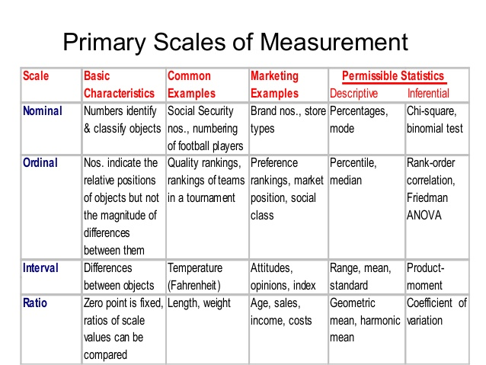

Slide 24
References:
The Learning Strategies Center. (2016). Introduction to measurement and strategies, 6. Retrieved from www.lsc.cornell.edu
Market Research Guy. (2020, October 5). Types of Data & Measurement Scales: Nominal, Ordinal, Interval and Ratio. Retrieved from www.mymarketresearchmethods.com/types-of-data-nominal-ordinal-interval-ratio/
Formplus Blog. (2019, November 14). 7 Types of Data Measurement Scales in Research. Retrieved from www.formpl.us/blog/measurement-scale-type

