Slide 1
Rheumatoid Arthritis

Slide 2
DEFINITION:
A chronic inflammatory disease of unknown etiology marked by a symmetric,peripheral polyarthritis.
it’s a systemic autoimmune disease resulting in variety of articular and extraarticular manifestation
Notes:
Rheumatoid arthritis (RA) is a chronic multisystem disease of unknown cause. Although there are a variety of systemic manifestations, the characteristic feature of established RA is persistent inflammatory synovitis, usually involving peripheral joints in a symmetric distribution. The potential of the synovial inflammation to cause cartilage damage and bone erosions and subsequent changes in joint integrity is the hallmark of the disease. Despite its destructive potential, the course of RA can be quite variable. Some patients may experience only a mild oligoarticular illness of brief duration with minimal joint damage, but most will have progressive polyarthritis with marked functional impairment

Slide 3
CLINICAL FEATURES
Symptoms:
Difficulty in performing ADL.
Constitutional symptoms
Signs:
Morning Stiffness,tenderness,pain on motion,limitation of motion,extra-articular manifestations,deformity.

Slide 4
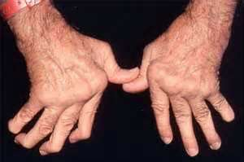
"Z" deformity
Notes:
With persistent inflammation, a variety of characteristic joint changes develop. These can be attributed to a number of pathologic events, including laxity of supporting soft tissue structures; damage or weakening of ligaments, tendons, and the joint capsule; cartilage degradation; muscle imbalance; and unopposed physical forces associated with the use of affected joints. Characteristic changes of the hand include
‘ hyperextension of the first interphalangeal joint and flexion of the first metacarpophalangeal joint with a consequent loss of thumb mobility and pinch. ‘

Slide 5
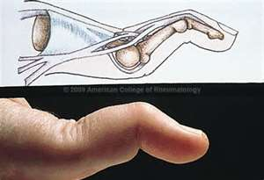
swan-neck deformity
Notes:
hyperextension of the proximal interphalangeal joints, with compensatory flexion of the distal interphalangeal joints (swan-neck deformity);

Slide 6
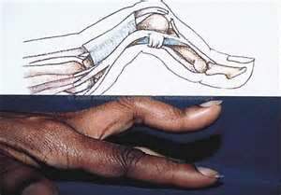
boutonnière deformity
Notes:
flexion contracture of the proximal interphalangeal joints and extension of the distal interphalangeal joints (boutonnière deformity); and (

Slide 7
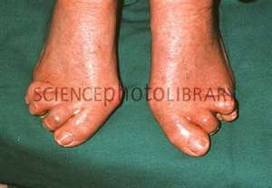
Eversion at Subtalar Joint
Notes:
Typical joint changes may also develop in the feet, including eversion at the hindfoot (subtalar joint), plantar subluxation of the metatarsal heads, widening of the forefoot, hallux valgus, and lateral deviation and dorsal subluxation of the toes

Slide 8
Doesn’t just affect the joints
EXTRA-ARTICULAR
MANIFESTATIONS

Slide 9
Extra-Articular Manifestations
Sicca Features: Xerostomia & Xerophthalmia
Raynaud’s Phenomenon
Neuropathy: Carpal Tunnel Syndrome
Rheumatoid Nodules
Pleural Effusions
Rheumatoid Vasculitis
Notes:
RA is a systemic disease with a variety of extraarticular manifestations. It is estimated that as many as 40% of patients may have extraarticular manifestations, and in ~15% these are severe. On occasion, extraarticular manifestations may be the major evidence of disease activity and source of morbidity. As a rule, these manifestations occur in individuals with high titers of autoantibodies . Although the frequency of patients with severe extraarticular manifestations appears to be declining, these patients have an increased mortality compared to other persons with RA or age-matched normal controls

Slide 10
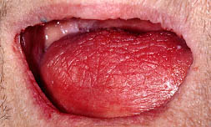
Xerostomia (Dry Mouth)

Slide 11
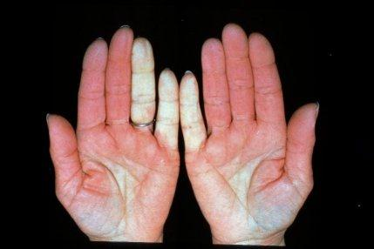
Raynaud’s Phenomenon

Slide 12
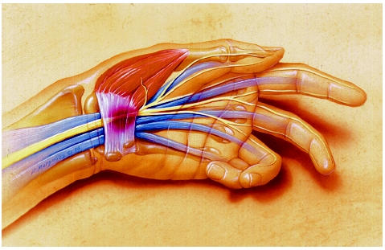
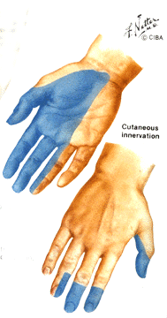
Carpal Tunnel Syndrome

Slide 13
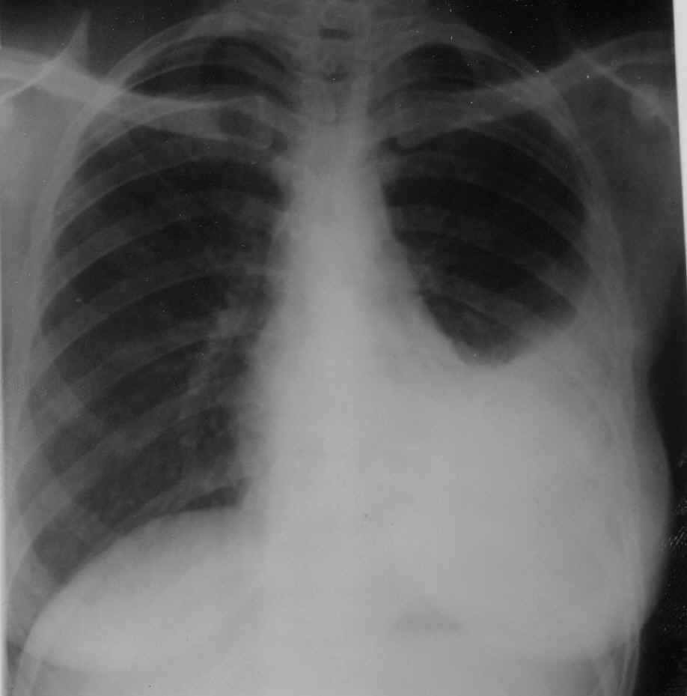
Pleural Effusion
Notes:
Pleuropulmonary manifestations, which are more commonly observed in men, include pleural disease, interstitial fibrosis, pleuropulmonary nodules, pneumonitis, and arteritis

Slide 14
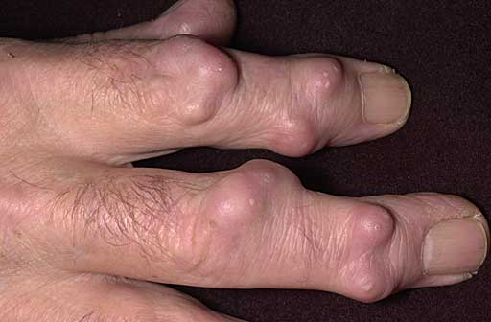
Rheumatoid Nodules
Notes:
Rheumatoid nodules may develop in 20–30% of persons with RA. They are usually found on periarticular structures, extensor surfaces, or other areas subjected to mechanical pressure, but they can develop elsewhere, including the pleura and meninges. Common locations include the olecranon bursa, the proximal ulna, the Achilles tendon, and the occiput

Slide 15
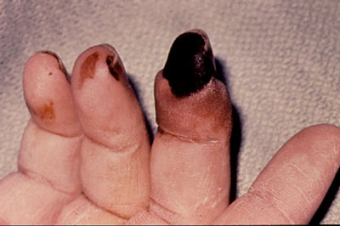
Rheumatoid Vasculitis
Notes:
Rheumatoid vasculitis , which can affect nearly any organ system, is seen in patients with severe RA . rheumatoid vasculitis can cause polyneuropathy and mononeuritis multiplex, cutaneous ulceration and dermal necrosis, digital gangrene, and visceral infarction.

Slide 16
American College Of Rheumatology Criteria
Joint involvement score
1 large joint (LJ) 0
2-10 (LJ) 1
1-3 small joints(SJ) 2
4-10(SJ) 3
>10joints(atleast 1 SJ) 5
LJ=shoulder,elbow,hip,knee,ankle;SJ=MCP,PIP,thumb IP,wrist

Slide 17
ACR Criteria
Serology:
negative RF and negative ACPA 0
Low +RF and low +antiCCPab 2
(<3times UNL)
High +RF and high +antiCCPab 3
(>3times UNL)
UNL-upper normal limit

Slide 18
ACR Criteria
Acute phase reactants:
normal CRP and ESR 0
Abnormal CRP or ESR 1
Duration of symptoms:
<6weeks 0
>6weeks 1
Definite RA if score>or=6

Slide 19
Work
Cooking
Dressing
Bathing
Grooming
Cleaning
Pleasure
Shopping
Notes:
Functional status
In the Rheumatology Clinic we use a Health Assessment Questionnaire (HAQ)
Dressing, Bathing, Grooming
Cooking, Cleaning, Shopping
Mobility – Walking and Standing
Working
Social Activities & Sports
Rank the Functional Status (IMPORTANT)
Mild, Moderate, or Severe

Slide 20
Why is Early Treatment Important?
Joint Damage Occurs EARLY
93% of patients with less than 2 years of disease have radiographic abnormalities
Rate of radiographic progression is higher in the first 2 years of disease
Disability Occurs EARLY
50% out of work at 10 years
Increased MORTALITY
With severe disease
EARLY Treatment has Long-Term Beneficial Effects

Slide 21
General Principles
The goals of therapy of RA are
(1) relief of pain,
(2) reduction of inflammation,
(3) protection of articular structures,
(4) maintenance of function, and
(5) control of systemic involvement
Notes:
The goals of therapy of RA are (1) relief of pain, (2) reduction of inflammation, (3) protection of articular structures, (4) maintenance of function, and (5) control of systemic involvement.
Since the etiology of RA is unknown, the pathogenesis is not completely understood, and the mechanisms of action of some of the therapeutic agents employed are uncertain, therapy remains somewhat empirical. None of the therapeutic interventions is curative, and therefore all must be viewed as palliative, aimed at relieving the signs and symptoms of the disease.

Slide 22
Management
interdisciplinary approach
Rest
Splinting
Exercise
orthotic and assistive devices
Education of the patient and family
Notes:
Management of patients with RA involves an interdisciplinary approach, which attempts to deal with the various problems that these individuals encounter with functional as well as psychosocial interactions. A variety of physical therapy modalities may be useful in decreasing the symptoms of RA.
Rest ameliorates symptoms and can be an important component of the total therapeutic program.
In addition, splinting to reduce unwanted motion of inflamed joints may be useful.
Exercise directed at maintaining muscle strength and joint mobility is also an important aspect of the therapeutic regimen.
A variety of orthotic and assistive devices can be helpful in supporting and aligning deformed joints to reduce pain and improve function.
Education of the patient and family is an important component of the therapeutic plan to help those involved become aware of the potential impact of the disease and make appropriate accommodations in lifestyle to maximize satisfaction and minimize stress on joints

Slide 23
Pharmacologic Therapy
Analgesics
NSAIDs
Glucocorticoids
DMARDs
Anticytokine therapy
Notes:
Medical management of RA involves five general approaches. The first is the use of nonsteroidal anti-inflammatory drugs (NSAIDs) and simple analgesics to control the symptoms and signs of the local inflammatory process

Slide 24
Analgesics
Topical
Capsaicin
Diclofenac
Oral
Tylenol
Opiods

Slide 25
NSAIDs
Pros:
Analgesic, Antipyretic, Anti-inflammatory
Cons:
Don’t alter disease progression
Ineffective in Erosive disease
GI/Ulcers
Hepatotoxicity
Nephrotoxicity
AIN
Bleeding – antiplatelet
Rash
Aseptic meningitis

Slide 26
Corticosteroids
Decrease cytokines
Slow Joint Inflammation
Insomnia
Emotional lability
Fluid retention
Weight gain
HTN
Hyperglycemia
Osteoporosis
Bisphosphonates: >5mg/d for >3months
Cataracts
Avascular necrosis
Myopathy
Psychosis

Slide 27
Systemic glucocorticoid therapy
Provide effective symptomatic therapy (7.5mg)
Recent evidence suggests that low-dose glucocorticoid therapy may retard
the progression of bone erosions
have a long-term protective effect against bone damage.
Notes:
Systemic glucocorticoid therapy can provide effective symptomatic therapy in patients with RA. Low-dose (<7.5 mg/d) prednisone is a useful additive therapy to control symptoms. Moreover, recent evidence suggests that low-dose glucocorticoid therapy may retard the progression of bone erosions and that an initial course of low-dose glucocorticoids may have a long-term protective effect against bone damage. Monthly pulses with high-dose glucocorticoids may be useful in some patients and may hasten the response when therapy with a DMARD is initiated. Finally, a course of low-dose oral glucocorticoids combined with DMARD therapy can be beneficial in controlling signs and symptoms rapidly and affording long-term retardation of bone erosion.

Slide 28
DMARDs
Methotrexate
Sulfasalazine
Hydroxychloroquine (Plaquenil)
Leflunomide (Arava)
Gold
Azathioprine (Imuran)
Cyclosporin
cyclophosphamide
Notes:
¶ Azathioprine, cyclosporine, minocycline and gold were considered but not included in these guidelines due to their infrequent use in RA and/
or lack of new data since 2012.

Slide 29
Combining DMARDs
DMARDs all work slightly differently
Never truly know how a patient will respond to an individual DMARD
Most clinicians now agree that combinations of DMARDs are more effective than single agents
This is now supported by some research

Slide 30
Combination therapy (using 2 to 3) DMARDs at a time works better than using a single DMARD

Slide 31
Methotrexate
Dihydrofolate reductase inhibitor
Well tolerated, Mono/Combo
Onset: 6-12 weeks
Metabolism: Liver
Clearance: Kidneys
Monitoring:
Baseline:CXR, PFTs, HIV, HBV/HCV
CBC, LFTs Q4-8 weeks
Caution with CRI
Nausea
Mucosal ulcerations
Fatigue & Flu-like symptoms
BM Toxicity
Hepatotoxicity
Treat with Folic acid, 1 mg/d

Slide 32
Leflunomide
Derm - rash, alopecia
Diarrhea
BM toxicity
Hepatotoxicity
Inhibits dihydrooratate dehydrogenase
Dec. activated T-cells
Onset: rapid
Efficacy: ≤6 weeks
Monitoring:
CBC, LFTs
Notes:
Recommendations for optimal followup laboratory monitoring intervals forcomplete blood count, liver transaminase levels, and serum creatinine levels for patients with rheumatoid arthritis receiving disease-modifying antirheumatic drugs*
<3 months 3–6 months >6 months
Hydroxychloroquine None after baseline§ None None
Leflunomide 2–4 weeks 8–12 weeks 12 weeks
Methotrexate 2–4 weeks 8–12 weeks 12 weeks
Sulfasalazine 2–4 weeks 8–12 weeks 12 weeks
* More frequent monitoring is recommended within the first 3 months of therapy or after increasing
the dose, and the outer bound of the monitoring interval is recommended beyond 6 months of therapy.

Slide 33
Azathioprine
Corticosteroid-sparing
Monitoring:
CBC Q1-2 months
AST/ALT
Infection
BM Toxicity
Hepatitis
Malignancy

Slide 34
Cyclophosphamide
Alkylating agent
Monitoring:
CBC, UA monthly
Yearly UA +/- Cytology
Alopecia
Nausea
Infection
BM suppression → pancytopenia
Infertility – pretreat women with Leuprolide
Renal: hemorrhagic cystitis, bladder malignancy – treat with acrolein
Oral more toxic than IV

Slide 35
Anticytokine therapy
Anti-TNF alpha agents
Etanercept
Infliximab
Adalimumab
IL-1 receptor antagonist (Anakinra)
Non TNFiIL-6 receptor antagonist (toclizumab)
*T-cell costimulation blocker (abatacept)
*anti-CD-20 Ab(rituximab)
Notes:
Biologics
*TNFi biologic or non-TNF biologic (excludes anakinra).§
*TNFi biologics
Adalimumab, certolizumab pegol, etanercept, golimumab, or infliximab.
*Non-TNF biologics
Abatacept, rituximab, or tocilizumab (excludes anakinra).§
* Anakinra was considered but not included in these guidelines due to its infrequent use in RA and lack of new data since 2012.

Slide 36
TNF-a Inhibitors
Anti-inflammatory
Block TNF-α (proinflammatory cytokine)
Etanercept, Adalimumab (SQ), Infliximab (IV)
Very expensive:
> $15,000/patient
Combo therapy with MTX
Injection site reaction
Infection
Reactivated TB
Infliximab
infusion reaction
Pancytopenia
Autoantibody/SLE-like
Exacerbate CHF
Malignancy – lymphoma

Slide 37
RHEUMATOID ARTHRITIS AND PREGNANCY
RA in pregnancy either
improves(50-60%)
flares up or
remains active
Treatment has to be modified to not only make patient comfortable but also avoiding risk to the fetus.
Drugs to be avoided are
methotrexate

Slide 38
RA & Pregnancy
*leflunomide
*NSAIDS and aspirin
*steroids
Biological DMARDs:safest HCQ
Pregnancy outcome
Medication and breastfeeding

