Slide 1
SALT STRESS/ SALINITY STRESS
Dr. Naila Farooq
Plant Growth Under Stress Environment
(SES-309)

Slide 2
Salt Accumulation in soils impairs plant function and soil structure
The effects of salts in the soil we distinguish between high concentration of Na+ referred to as Sodicity , and high concentration of total salts referred to as Salinity.
The high sodium ion concentration of a saodic soil can not only injure plants directly but also degrade the soil structure, decreasing porosity and water permeability.
In the field , the salinity of soil water or irrigation water is measured in terms of its electrical conductivity or in terms of osmotic potential.

Slide 3
Cont...
The conductivity of a water sample is due to the ions dissolved in it.
In the united states the salt content of the headwaters of the Colorado river is only 50 mg/lit,but about 2000 km down streem,in southern california, the salt content of the Sam River reaches about 900 mg / lit, enough to preclude growth of Some salt- sensitive crops, such as maize.

Slide 4
Physiological Effects On Crop Growth And Development
On Growth...
Decreased rate of leaf growth after an increase in soil salinity is primarily due to the osmotic effect of the salt ground the roots.
Increase in soil salinity causes leaf cells to loose water.
Reductions in cell elongation and also cell division lead to slower leaf appearance and smaller final size.

Slide 5
Germination
Seed germination in saline condition is affected by three ways..
Increased osmotic pressure of the soil solution which restricts the absorption and entry of water into the seeds.
Certain salt constituents are toxic to the embryo and seedlings. Anions like carbonate, nitrate , cloride , sulphide ions are more harmful to Seed germination.
Salt stress hampers the metabolism of stored materials.

Slide 6
Vegetative Growth
During vegetative stage , salt induced water stress causes closure of stomata leads to reduction in carbon dioxide assimilation and transpirtation.
Reduced turgor potential affects the leaf expansion.
Beacuse of reduction in leaf area , light interception is reduced photosynthetic rate is affected which coupled with spurt in respiration, resulting into reduced biomass accumulation.

Slide 7
Photosynthesis
Accumulation of high concentration of sodium and chloride ions in chloroplast, photosynthesis is inhibited.
Since photosynthetic electron transport appears relatively insensitive to salts, either carbon metabolism or photophosphorylation may be affected.
Photosynthetic enzyme or the enzymes responsible for carbon assimilation are very sensitive to the presence of NaCl.

Slide 8
Nitrogen Metabolism
The key enzyme, nitrate reductase is very sensitive to NaCl.
One of the amino acids, glycinebetaine shows increased trend with increase in salinity in perennial halophytes and Atriplex Sps.
Proline is an alpha amino acid, accumulates in large amounts as compared to all other amino acids in salt stressed plants.

Slide 9
Osmotic Effects And Specific ion Effects
Dissolved solutes in the rooting zone generate a low osmotic potential that lowers the soil water potential.
The general water balance of plants is thus affected because leaves need to develop an even lower water potential to maintain a "downhill" gradient of water potential between the soil and the leaves.
During soil desiccation a finite amount of water can be obtained from the soil profile by the plant, causing over decreasing water potentials.

Slide 10
In addition to the plant responses to low water potential, specific ion toxicity effects also occur when injurious concentrations of ions - particularly sodium, chloride or sulphide ions accumulate in cells.
An abnormally high ratio of sodium to potassium ions and high concentrations of total salts inactivate enzymes and inhibit protein synthesis.
At high concentration, sodium can displace calcium from the plasma membrane of cotton root hairs, resulting in a change in plasma membrane permeability that can be detected as leakage of potassium from the cells.

Slide 11
Plants Use Different Strategies to
Avoid Salt Injury
Plants minimize salt injury by excluding salt from meristems, particularly in the shoot, and from leaves that are actively expanding and photosynthesizing.
The Casparian strip imposes a restriction to the movements of ions into the xylem.
Sodium ions enter roots passively, so root cells must use energy to extrude sodium ion actively back to the outside solution.
By contrast, Chloride is excluded by negative electric potential across the cell membrane, and the low permeability of root plasma membranes to this ion.

Slide 12
cont...
Although some plants, such as mangrooves, grow in saline environments with abundant water supplies, the ability to acquire that water requires that they make osmotic adjustments to obtain water from the low- water- potential external environment.
Many halophytes exhibit a growth optimum at moderate levels of salinity, and this optimum is correlated with the capacity to accumulate ions in the vacuole, where they can contribute to the cell osmotic potential without damaging the salt- sensitive enzymes.

Slide 13
Ion Exclusion
In terms of metabolic energy, use of ions to balance tissue water potential in a saline environment clearly has a lower energy cost for the plant than use of carbohydrates or amino acids, the production of which has a significantly higher energy cost.
NaCl is the most abundant salt encountered by plants under salinity stress, transport systems that facilitate compartmentation of Na+ into the vacuole are critical.
Both Calcium and potassium affect intracellular sodium concentrations.

Slide 14
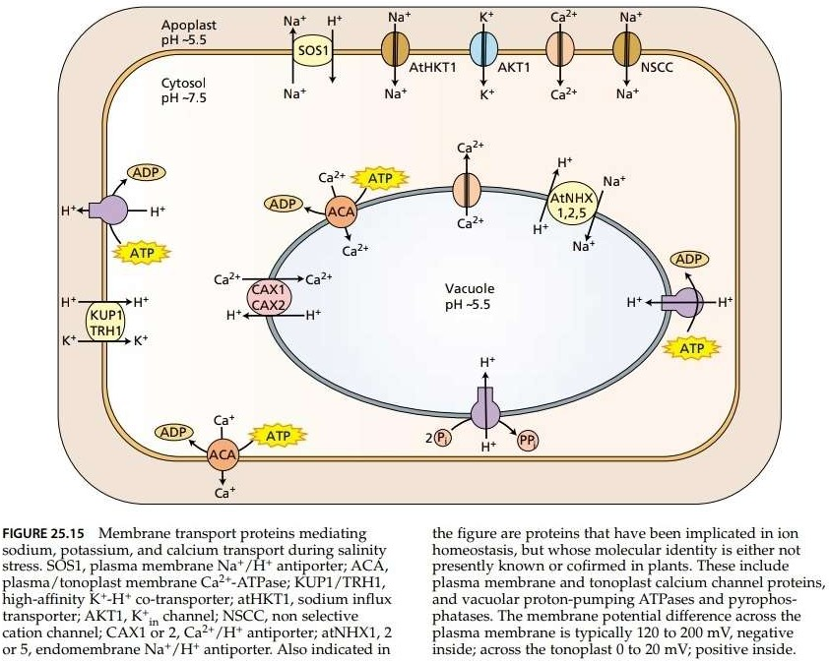

Slide 15
Sodium is Transported across the Plasma Membrane and the Tonoplast
Hydrogen pumps in the plasma membrane and tonoplast provide the driving force for secondary tonoplast of ions.
Activity of these pumps is required for the secondary transport of excess ions associated with plant responses to salinity stress.
This is indicated by findings showing that the activity of these hydrogen pumps is increased by salinity, and induced gene expression may account for some of this up- regulation.

Slide 16
cont...
Energy dependent transport of sodium ion from the cytosol of plants cells across the plasma membrane is mediated by the gene product of the SOS1 ( Salt Overlay Sensitive 1) gene that function as sodium- hydrogen antiporter.
The SOS1 antiporter is regulated by the gene products of at least two other genes, referred to as SOS2 and SOS3.
SOS2 is a serine/ threonine kinase that is apparently activated by Calcium through the function of SOS3, a calcium- regulated protein phosphatase.

Slide 17
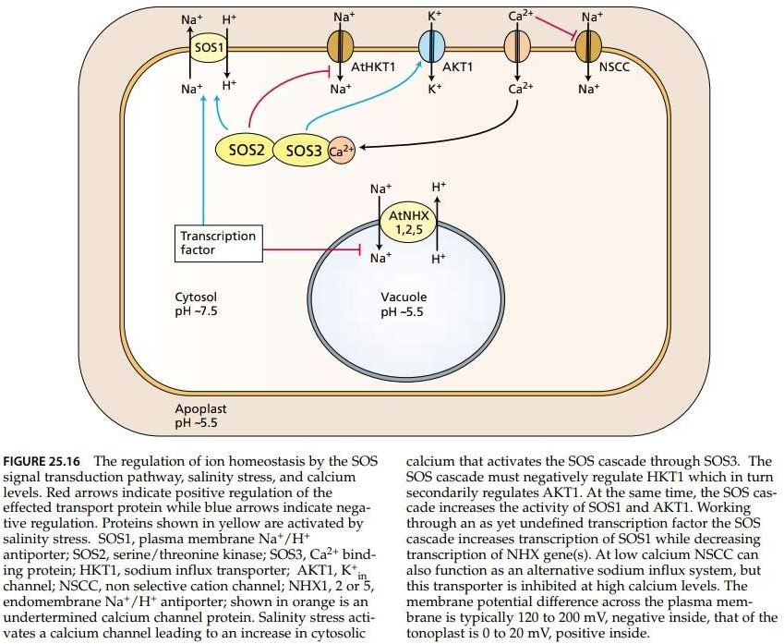

Slide 18
cont...
Vacuoler compartmentation of sodium results in part from the activity of a family of sodium- hydrogen antiporters such as Arabidopsis AtNHX1.
Transgenic Arabidopsis and tomato plants overexpressing the gene that encodes AtNHX1 exhibit enhanced salt tolerance.
These molecular findings are another example of the wealth of new information emerging from studies on transgenic plants, gene sequencing, and protein characterization.

Slide 19
References
Plant Physiology
- by Taiz & Zeiger
https: // www.slideshare.net

