Slide 1
MEASURE OF CENTRAL TENDENCY
Applied Statistics

Slide 2
Measures of central tendency
Measure of central tendency provides a very convenient way of describing a set of scores with a single number that describes the “PERFORMANCE” of the group.
It is also defined as a single value that is used to describe the “CENTER” of the data
There are three commonly used measure of central tendency. There are the following
MEAN
MEDIAN
MODE

Slide 6
Measures of central tendency

Slide 10
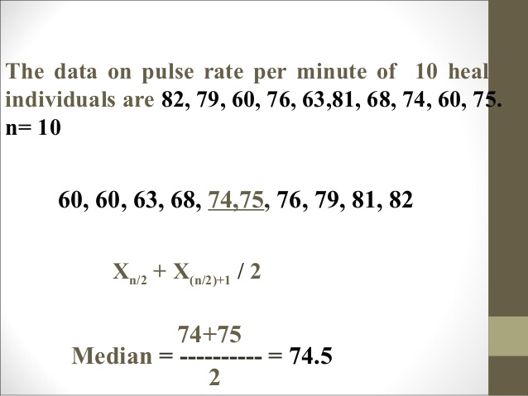

Slide 11
COMPUTATION of median for GROUP DATA

Slide 14
ASSIGNMENT

Slide 15
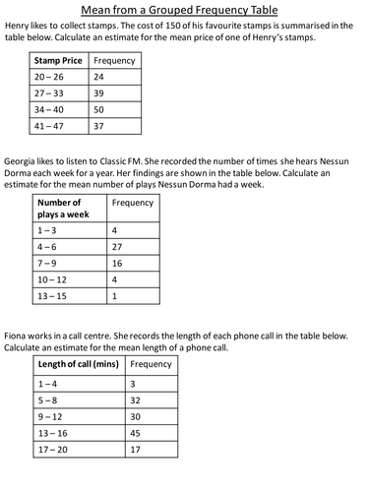

Slide 16
Thank you
Madeeha Rahim
Visiting Lecturer
Statistics

