Slide 2
WHAT IS PROFESSION.

Slide 3
Regular activity performed for…

Slide 4
A profession is an occupation that is viewed by society as a profession on the basis of it characteristics, development, or power.

Slide 8
AUTONOMY

Slide 9
Accountability

Slide 12
Profession

Slide 13
Profession
A paid occupation, especially one that involves prolonged training and a formal qualification
(http://www.oxforddictionaries.com/definition/english/profession assessed on 23/4/12)

Slide 14
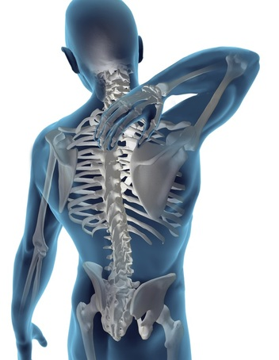
PROFESSION
a type of job that requires special education, training, or skill
the act of declaring or saying something openly
the people who work in
a particular profession
(http://www.merriam-webster.com/
dictionary/profession) assessed on 23/4/12

Slide 15
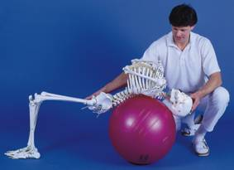
Professional
A member of a profession
A well-educated workers who enjoy considerable work autonomy and who are commonly engaged in creative and intellectually challenging work
(www.wikipedia.org)

Slide 17
Professionalism
Professionalism is the internalized conceptualization of expected professional obligations 1, attributes 2, interactions, attitudes, values3, and role behaviors in relation to individual patients and clients and society as a whole.
1:A legal agreement specifying a payment or action and the penalty for failure to comply
2: scheme
3:belief

Slide 18
Professionalism may be collective (practiced by the profession as a whole) or individual.

Slide 19
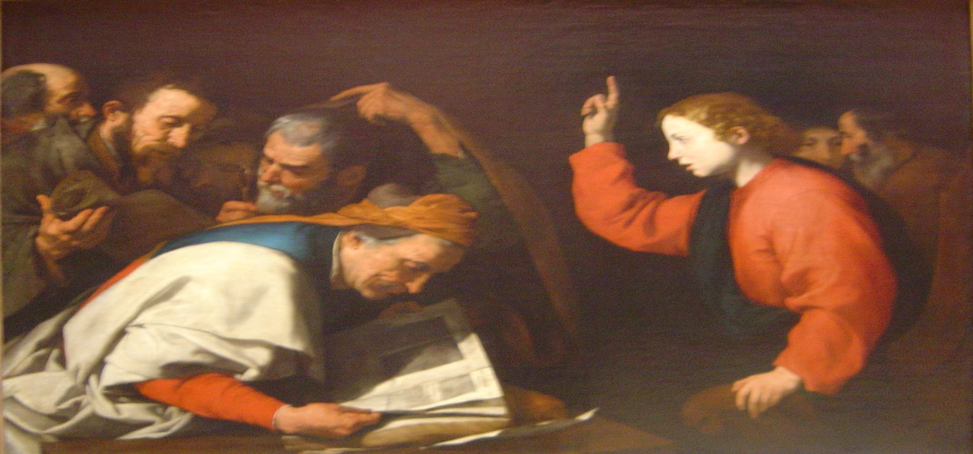
HISTORY
Ancient
Greek & Romans
Latin ‘profiteor’ : Profess a belief
Medieval and early modern tradition recognised only three professions: divinity, medicine, and law—the so-called "learned professions
Divinity: Study of Christians and other theologies
Theology is the systematic and rational study of concepts of God and of the nature of religious truths
(http://en.wikipedia.org/wiki/Profession)

Slide 20
WHAT SOCIOLOGY SAYS ABOUT PROFESSION??

