Slide 1
Week 3

Slide 2
Lecture Contents
Operations on Processes
Interprocess Communication
IPC in Shared-Memory Systems
IPC in Message-Passing Systems
Examples of IPC Systems
Threads Overview
Advantages

Slide 3
Lecture Objectives
Describe how processes are created and terminated in an operating system, including developing programs using the appropriate system calls that perform these operations.
Describe and contrast interprocess communication using shared memory and message passing.
Identify the basic components of a thread, and contrast threads and processes
Describe the benefits and challenges of designing multithreaded applications

Slide 4
Operations on Processes
Mechanism provided by System for
Process Creation
Process Termination

Slide 5
Interprocess Communication
Processes within a system may be
independent or cooperating
Advantages of cooperative processes:
Information sharing
Computation speedup
Modularity
Convenience
Cooperating processes need interprocess communication (IPC)
Two models of IPC
Shared memory
Message passing

Slide 6
Chapter 4

Slide 7
Threads
Motivation
Why Light Weight

Slide 8
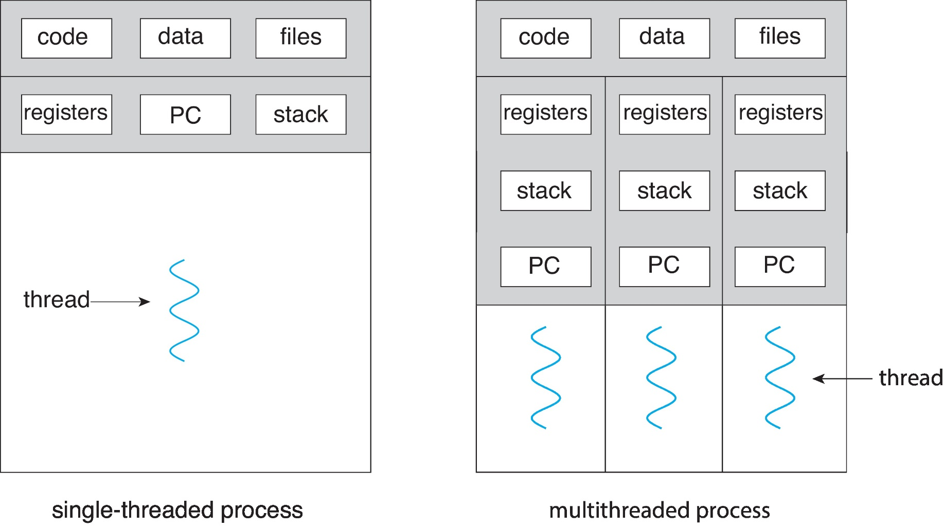
Single and Multithreaded Processes

Slide 9
Threads
Benefits of Threads
Multicore Programming
challenges

Slide 10
Lecture Material
Slides of chapter 3 & 4 can be found from the given link
https://codex.cs.yale.edu/avi/os-book/OS10/slide-dir/index.html

