Slide 1
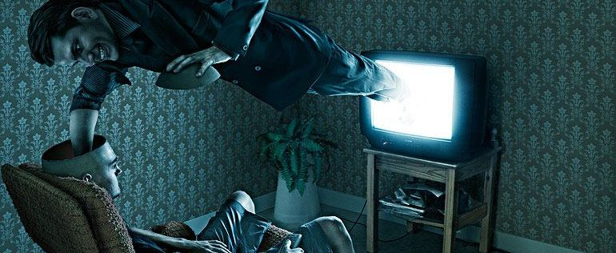
Cultivation Theory by Gerbner and Gross
By Qaisar khan

Slide 2
Cultivate means
Nurturing
Growing
developing
“ Perception is stronger than reality”

Slide 3
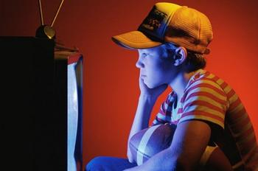
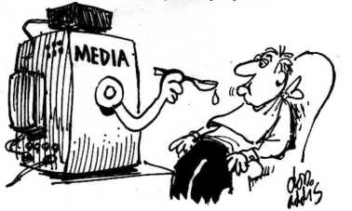
Cultivation Theory
television is responsible for our perception
TV holds on the way you perceive real world situation

Slide 4
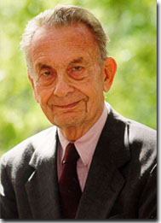
Cultivation Theory
Georg Gerbner and his Colleague at Annenberg school of communication in 1977.
TV as a social agent
studying the effect of TV exposure.

Slide 6
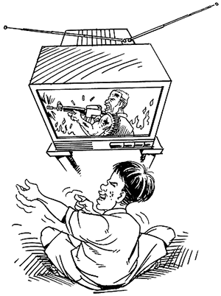
High and light TV Viewers
High viewers four hours or more daily
Light viewers who watch TV Less than four hours
The basis of cultivation theory is that heavy television viewing "cultivates" perceptions of reality consistent with the television portrayal of the world.

Slide 7
Impacts of TV on Viewers
Cultivation differential
Gerbner annual survey targeted four attitude.
Chances of Involvement with violence
Fear of walking alone at night
Perceived activity of police
General mistrust of people

Slide 8
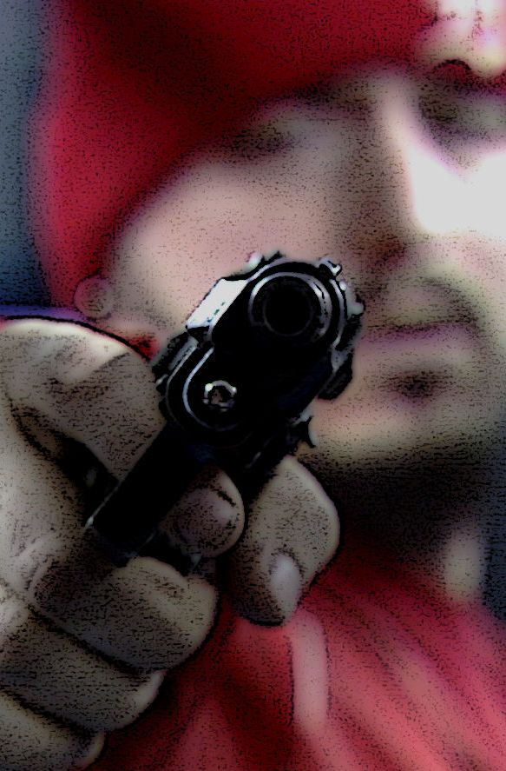
Chances of Involvement with violence,
light viewing link of violence
heavy viewing link of violence
Actual crime statistics indicate that one out of thousand is more realistic.

Slide 9
Fear of walking alone at night,
people with heavy viewing habits tends to over estimate criminal activities, believing it to be ten times worse then it really is.

Slide 10
Perceived activity of police ,
People with heavy viewing habits believe that 5 percent of society is involved in law enforcement,
people with light viewing habits estimate a more realistic 1 percent.

Slide 11
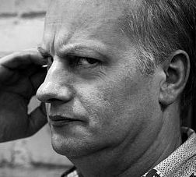
General mistrust of people .
People with heavy viewing habits are suspicious of other peoples motives.
heavy TV viewers are getting a heightened sense of insecurity from television,
MEAN WORLD SYNDROME
Gerbner calls this cynical mind set the mean world syndrome (the world is filled with mean people and we can never trust a soul)

Slide 12
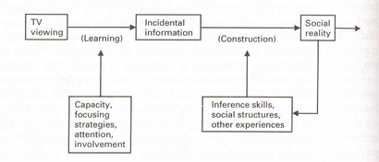
MODEL OF CULTIVATION
‘The more we live with TV, the more invisible it becomes’( Chandler 1995).
Watching TV changes the viewer’s attitudes rather than behavior.
The exposure to television overtime will shape viewer’s perceptions of reality.
Having long term effects which are small, gradual, indirect but significant.

Slide 13
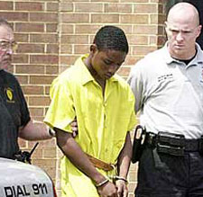
EXAMPLES Quoted;
Grand Theft Auto’s victim
“Life’s like a video game.
You’ve got to die sometime.”
Devin Moor 2005
Figure 4. Reproduced from: Miller 2005

Slide 14
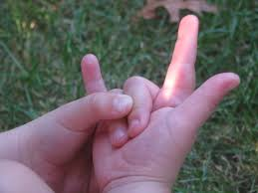
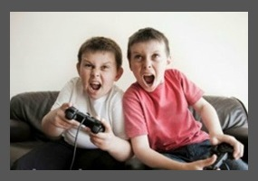
Examples from Pakistan
Pakistan image on international media
Stereotype
Pakistani dramas
Violated games and cartoons (doremon)
Spider man Hand gesture example

Slide 15
Criticism on Gerbner theory
Hawkins and Pingree research focused on” demographic conditions like age and viewing habits and psychological conditions that included cognitive ability and perception of television reality”.
Hawkins and Pingree (1981) measured TV viewing in terms of different genres of programming and found different effects for the different types of programs
The results of their research indicated that “age or cognitive ability determined cultivation
Hughes (1980) and Hirsch (1980) reanalyzed Gerbner's research using the same techniques Gerbner used.
Hughes reexamined the researched demographics of sex, age and income by introducing confounding variables such as hours worked per week, income and church attendance.
After reanalyzing Gerber’s data using those confounding variables, Hughes (1980) and Hirsch (1980) discovered the relationship between fear and frequency of television viewing behaviors disappeared.

Slide 16
Addition of Two new Concepts
In response to Hirsh’s criticisms, Gerbner has revised cultivation theory,
He added to additional concepts
Mainstreaming
Resonance
These concepts take account of the fact that heavy television viewing has different outcomes for different social groups.

Slide 17
Mainstreaming
Mainstreaming is defined as creating uniform messages to appeal to a wide audience,
Mainstreaming is television's ability to stabilize and homogenize views within a society. If television programs from Saturday morning cartoons to primetime dramas feature extensive violence, then viewers may come to believe violence is common.
Eg
9/11 incident image of muslim
Paris attack
High income and low income

Slide 18
Example of main streaming by movie
THE purge

Slide 19
Resonance
Resonance: “the extent to which something is similar with personal experience”
Many viewer have had at least one first handed experience with physical violence, armed robbery, fight, military combat, or a lover’s quarrel that become vicious, the actual trauma was bad enough .
He thinks that a repeated portrayal on the TV screen can cause the viewer to replay the real life experience over and over in his life or her mind.
Eg
Criminal enactment programs (crime petrol)
Woman and man heavy viewers and light
Car example of turning

Slide 20
Conclusion
The addition of mainstreaming and resonance to cultivation theory is a substantial modification of the theory, the theory no longer claims uniform, across the board effects of television on all heavy viewers, it now claims that television interact with other variables in ways such that television viewing will have strong effect on some sub groups of persons and not on other.

Slide 21
References:
Gerbner, Gross, Morgan, & Signorielli, 1980, p. 14; Severin & Tankard, 1997, p. 299).
Cohen, J.,& Weimann, G. (2000). Cultivation revisited: Some genres have some effects on some viewers. Communication Reports, 13(2), 99.
Gerbner, G., Gross, L, Morgan, M., & Signorielli,N. (1986). Living with television: The dynamics of the cultivation process. In J. Bryant & D. Zillman (Eds.),
Werner J. Severen, James W. Tankard. Je, Communication Theories p. 250
http://www.ou.edu/deptcomm/dodjcc/groups/02B2/Literature_Review.html
24h.com, 2010, ‘Van hoa game online co phai qua xa xi?’, <http://hn.24h.com.vn/tin-game/van-hoa-game-online-co-phai-qua-xa-xi-c471a309421.html>
ABC News, 2011, ‘Oslo, Norway, Bombing and Camp Shooting’, video recording, http://www.youtube.com/watch?v=nDPD-zub84U&feature=relmfu
Calumet, 2010, ‘About Gerbner’, purdue.edu, <http://lass.calumet.purdue.edu/cca/gmj/fa02/about-gerbner.htm>
Chandler, D 1995, ‘Cultivation Theory: an Overview’, Aberystwyth University, UK.
Cmonstar95, 2007, ‘Banned Wii Games’, video recording, <http://www.youtube.com/watch?v=rRVhquzo4bU>

Slide 22
References:
Grooverider, 2007, ‘Video game violence Controversy – Arcade game banned’, video recording, <http://www.youtube.com/watch?v=D2xgIPRDp5g&playnext=1&list=PL4AEB5EA43B42E6B5>
Leung, R, 2009, ‘Can a video game lead to murder?’ CBS news, <http://www.cbsnews.com/stories/2005/03/04/60minutes/main678261.shtml>
Miller, K 2005, ‘Communication theories: perspectives, processes, and contexts’, 4th edn, McGraw-Hill, USA.
Miller, R, 2005, ‘Alabama GTA trial will go forward’, Joystiq, <http://www.joystiq.com/2005/12/14/alabama-gta-trial-will-go-forward>
Shrum, LJ 2004, ‘The Psychology of Entertainment Media Blurring the Lines Between Entertainment and Persuasion’, 10th edn, Lawrence Erlbaum Associates Inc., New Jersey.
Twisted Stars, 2010, ‘Iris is a Go’, image, <https://twistedstars.wordpress.com/2009/07/18/iris-is-a-go/>
Wall paper sweet, 2009, ‘SNSD poster’, image, <http://wallpapersweet.com/view-snsd_poster-other.html >
ZProjectKoreaZ 2007, ‘Korean KFC Commercial Jeon Ji Hyun’, video recording, <http://www.youtube.com/watch?v=H7ZikuVM4I0&NR=1>

