Slide 1
Topic: Simple Linear Regression

Slide 2
What is Regression?
Many business decisions involve the relationship between two or more variables. E.g., what determines sales levels? •
Regression analysis is used to develop an equation showing how the variables are related.
The variable being predicted is called the dependent variable and is denoted by y. The variables used to predict the value of the dependent variable are called the independent variables and are denoted by x.
The average relationship between a dependent and independent variable is called a regression.
The dependent variable is assumed to be random variable whereas the independent variables are assumed to have fixed values.

Slide 3
Dependent Variable
A variable intended to be estimated or predicted is termed as dependent variable. The dependent variable also called the regressand, the predictand, response or explained variable. It is denoted by ‘’ Y ‘’.
Independent variable
Independent Variable
A variable on the basis of which the dependent variable is to be estimated is called independent variable. The independent variable is also called regressor, predictor or explanatory variable. It is denoted by ‘’ X ‘’.
Example
If we want to estimate the heights of children on the basis of their ages, the heights would be dependent variable and the ages would be independent variable.

Slide 4
Regression Line/Equation
In agricultural research we are often interested in describing the change in one variable (Y, the dependent variable) in terms of a unit change in a second variable (X, the independent variable). Regression is commonly used to establish such a relationship. A simple linear regression takes the form of $\hat{Y}=a+bX$
In the above equation of regression we noted that a regression has two parameters a and b. Where a is the intercept of the regression line and b is the slop parameter.
Formulas for finding the values of a and b are given below
$$b=\frac{n\sum{XY}−\sum{X}\sum{Y}}{n\sum{X^{2}}−{(\sum{X)}}^{2}}$$
and
$$a=\overline{Y}−b\overline{X}$$
Here
$\sum{XY}$( sum of the multiplication of X and Y)
$\sum{X}$( sum of X) $\sum{Y}$( sum of Y)
n is the total number of variables.

Slide 5
Regression Line/Equation
If X is the independent variable and Y is the dependent variable, then the relationship described by a straight line $\hat{Y}=a+bX$ is called a regression line which is used to find a linear relationship of the two variables. For example, the relation between Celsius and Fahrenheit scales (temperatures) given by F = 32 + 1.8C is a linear relation.
In the above equation of regression we noted that a regression has two parameters a and b. Where a is the intercept of the regression line and b is the slop parameter.
Formulas for finding the values of a and b are given below
$$b=\frac{n\sum{XY}−\sum{X}\sum{Y}}{n\sum{X^{2}}−{(\sum{X)}}^{2}}$$
and
$$a=\overline{Y}−b\overline{X}$$
Here
$\sum{XY}$( sum of the multiplication of X and Y)
$\sum{X}$( sum of X) $\sum{Y}$( sum of Y)
n is the total number of variables.

Slide 6
Types of Regression relationships
The relation of X and Y depends upon the value of b. So following are the different types of relationship exist in regression
Positive relation
If the value of b is positive then there will be positive relation between X and Y, which means if X increase Y increase and if X decrease Y also decrease.
Negative relation
If the value of b is negative then there will be negative relation between X and Y, which means if X increase Y decrease and if X decrease Y increase.
No relation
If the value of b is zero then there will be no effect of X on Y.

Slide 7
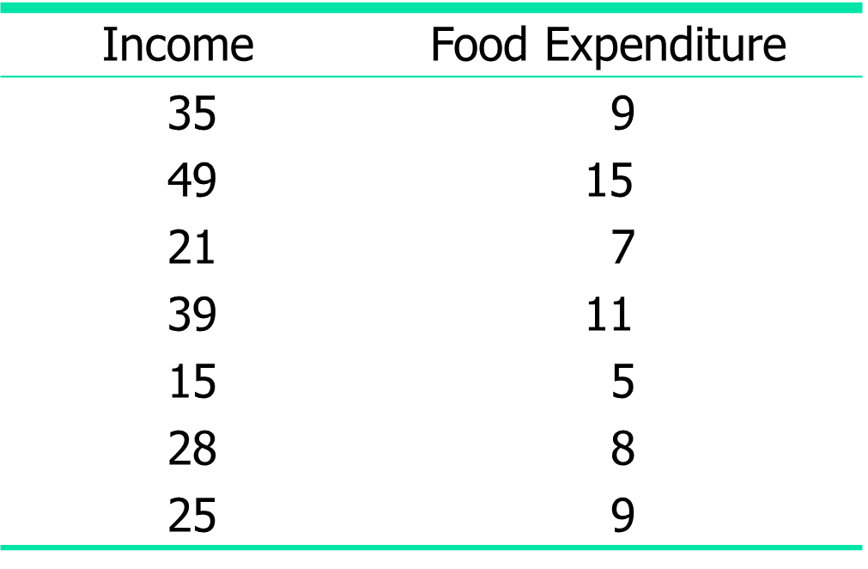
Numerical example
Incomes (in hundreds of dollars) and Food Expenditures of Seven Households:
Find the regression equations

Slide 8
Solution
The first thing to start the solution is to look at the formulas of a and b. So for the solution of b we proceed as follows
Income x | Food Expenditure y |  | xy | x²
35 49 21 39 15 28 25 |  | 9 15 7 11 5 8 9 | 315 735 147 429 75 224 225 | 1225 2401 441 1521 225 784 625
Σx = 212 |  | Σy = 64 | Σxy = 2150 | Σx² = 7222

Slide 9
So according to formula of b we need the following sums
$\sum{XY}= ?$
$\sum{X}$= ?
$\sum{Y}=?$
$\sum{X^{2}}$= ?
${(\sum{X)}}^{2}$= ?
Where n = 10
So to find all the above sum we proceed as follows

Slide 10
Put all the values in the formula
$$b=\frac{7\left(2150\right)−(212)(64)}{7\left(7222\right)−{(212)}^{2}}$$
$$b=\frac{1482}{5610}$$
$$b=0.26$$
To find the value of a first we need $\overline{X} and \overline{Y }. So these can be calculated as$
$$\overline{X}=\frac{\sum{X}}{n}=\frac{212}{7}=30.28$$
$$\overline{Y}=\frac{\sum{Y}}{n}=\frac{64}{7}=9.14$$
Now the value of a can be find as
$$a=9.14−\left(0.26\right)\left(30.28\right)$$
$$a=1.26$$

Slide 11
So finally the regression equation can be written as
$$\hat{Y}=1.26+0.26X$$
As the value of b (slope) is positive so we can say that as the value of X (income) increase, the value of Y (food expenditure) also increase. It means that there is positive relation between food expenditure and income..

Slide 12
Task
The owner of retailing organization is interested in the relationship between price at which a commodity is offered for sale and quantity sold. The following sample data have been collected.
Price | 25 | 45 | 30 | 50 | 35 | 40 | 65 | 75 | 70 | 60
Quantity sold | 118 | 105 | 112 | 100 | 111 | 108 | 95 | 88 | 91 | 96
Using the above data determine the equation for the estimated regression line.
Note:
Solve this question right now and send the solution.

