Slide 1
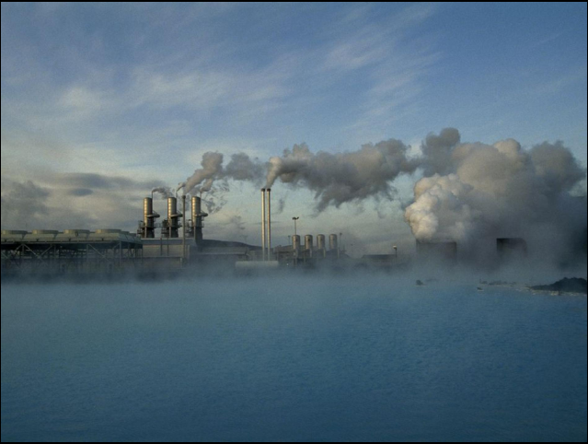
Geothermal Energy

Slide 2
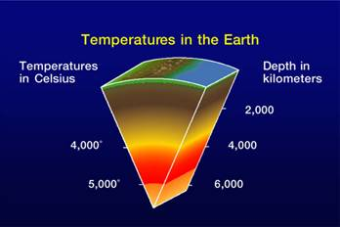
What is Geothermal Energy?
“Geothermal energy, form of energy conversion in which heat energy from within Earth is captured and harnessed for cooking, bathing, space heating, electrical power generation, and other uses”

Slide 3
Geothermal Energy
It's clean and sustainable.
It’s a renewable energy source because heat is continuously produced inside the earth.
Geothermal energy has been used for thousands of years in some countries for cooking and heating. It is simply power derived from the Earth’s internal heat. This thermal energy is contained in the rock and fluids beneath Earth’s crust. It can be found from shallow ground to several miles below the surface, and even farther down to the extremely hot molten rock called magma.

Slide 4
A geothermal power station in Iceland that creates electricity from heat generated in Earth's interior.

Slide 5
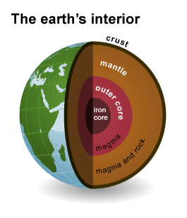
How Geothermal Energy is used?
Heat has been radiating from the centre of the Earth for some 4.5 billion years. At 6437.4 km (4,000 miles) deep, the centre of the Earth hovers around the same temperatures as the sun's surface, 9932°F (5,500°C)

Slide 6
How Geothermal Energy is used?
Heat from Earth’s interior generates surface phenomena such as lava flows, geysers, fumaroles, hot springs, and mud pots.
The heat is produced mainly by the radioactive decay of potassium, thorium, and uranium in Earth’s crust and mantle and also by friction generated along the margins of continental plates.
The subsequent annual low-grade heat flow to the surface averages between 50 and 70 milli watts (mW) per square metre worldwide.

Slide 7
How Geothermal Energy is used?
In contrast, incoming solar radiation striking Earth’s surface provides 342 watts per square metre annually
Geothermal heat energy can be recovered and exploited for human use, and it is available anywhere on Earth’s surface.
The estimated energy that can be recovered and utilized on the surface is 4.5 × 10⁶ hex joules, or about 1.4 × 10⁶ terawatt-years, which equates to roughly three times the world’s annual consumption of all types of energy.

Slide 8
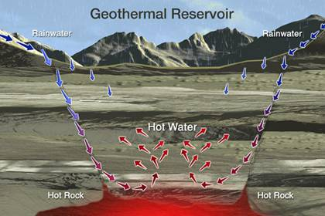
These underground reservoirs of steam and hot water can be tapped to generate electricity or to heat and cool buildings directly.

Slide 9
Uses:
Geothermal energy use can be divided into three categories:
Direct-use applications
Geothermal heat pumps (GHPs)
Electric power generation

Slide 10
1. Direct uses:
Probably the most widely used set of applications involves the direct use of heated water from the ground without the need for any specialized equipment
range between about 50 and 150 °C (122 and 302 °F). Such low-temperature geothermal water and steam have been used to warm single buildings, as well as whole districts where numerous buildings are heated from a central supply source.

Slide 11
Examples:
large-scale snow melting
industrial applications
milk pasteurization
swimming pools
balneological (therapeutic) facilities at spas, greenhouses, and aquaculture ponds

Slide 12
2. Geothermal heat pumps:
Geothermal heat pumps (GHPs) take advantage of the relatively stable moderate temperature conditions that occur within the first 300 metres (1,000 feet) of the surface to heat buildings in the winter and cool them in the summer. In that part of the lithosphere, rocks and groundwater occur at temperatures between 5 and 30 °C .
At shallower depths, where most GHPs are found, such as within 6 metres (about 20 feet) of Earth’s surface, the temperature of the ground maintains a near-constant temperature of 10 to 16 °C (50 to 60 °F).

Slide 14
Geothermal heat pumps:
Consequently, that heat can be used to help warm buildings during the colder months of the year when the air temperature falls below that of the ground.
Similarly, during the warmer months of the year, warm air can be drawn from a building and circulated underground, where it loses much of its heat and is returned.

Slide 15
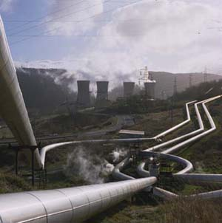
3. Electric power generation
.
To produce geothermal-generated electricity, wells, sometimes a mile (1.6 kilo meters) deep or more , are drilled into underground reservoirs to tap steam and very hot water that drive turbines linked to electricity generators.
The first geothermally generated electricity was produced in Larderello, Italy, in 1904.
Larderello Geothermal power plant

Slide 16
Electric power generation:
Depending upon the temperature and the fluid (steam) flow, geothermal energy can be used to generate electricity. Geothermal power plants can produce electricity in three ways.
Dry steam geothermal power generation
Flash steam geothermal power generation
Binary-cycle geothermal power generation

Slide 17
Dry steam cycle

Slide 18
These types are the oldest types of geothermal power plants, the first one was built back in 1904 in Italy
These plants use dry steam that is naturally produced in the ground
This steam travels from the production well to the surface and through a turbine, and after transferring its energy to the turbine it condenses and is injected back into the Earth
Because this type of power plant requires the highest temperatures they can only be used where the temperature underground is quite high, but this type requires the least fluid flow.
Dry steam cycle

Slide 19
One of dry steam plants at The Geysers in California

Slide 21
Flash steam cycle

Slide 22
These types are the most common due to the lack of naturally occurring high-quality steam.
In this method, water must be over 180°C, and under its own pressure it flows upwards through the well.
This is a lower temperature than dry steam plants have. As its pressure decreases, some of the water "flashes" to steam, which is passed through the turbine section.
The remaining water that did not become steam is cycled back down into the well, and can also be used for heating purposes. The cost of these systems is increased due to more complex parts, however they can still compete with conventional power sources.
Flash steam cycle

Slide 24
Binary cycle

Slide 25
Binary cycle. The lighter brown is vaporized butane, while darker brown is liquid butane

Slide 26
Binary cycle:
Binary power plants are expected to be the most commonly used type of geothermal power plant in the future, as locations outside of the known hot spots begin to use geothermal energy.
This is because binary cycle plants can make use of lower temperature water than the other two types of plants. They use a secondary loop (hence the name "binary") which contains a fluid with a low boiling point, such as pentane or butane.
The water from the well flows through a heat exchanger which transfers its heat to this fluid, which vaporizes due to its low boiling point. It is then passed through a turbine, accomplishing the same task as steam.

Slide 28
Environmental Effects And Economic Costs:
The environmental effects of geothermal development and power generation include the changes in land use associated with exploration and plant construction, noise and sight pollution, the discharge of water and gases, the production of foul odours, and soil subsidence.
Most of those effects, however, can be mitigated with current technology so that geothermal uses have no more than a minimal impact on the environment.
In addition, GHPs have a very minimal effect on the environment, because they make use of shallow geothermal resources within 100 metres (about 330 feet) of the surface.

Slide 30
Environmental Effects And Economic Costs:
In closed-loop systems the ground temperature around the vertical boreholes is slightly increased or decreased; the direction of the temperature change is governed by whether the system is dominated by heating (which would be the case in colder regions) or cooling (which would be the case in warmer regions).
With balanced heating and cooling loads, the ground temperatures will remain stable. Likewise, open-loop systems using groundwater or lake water would have very little effect on temperature, especially in regions characterized by high groundwater flows.

Slide 31
Environmental Effects And Economic Costs:
Its base load is available 24 hours per day, 7 days per week whereas solar and wind are available only about one-third of the time.
In addition, the cost of geothermal energy varies between 5 and 10 cents per kilowatt-hour, which can be competitive with other energy sources, such as coal.
The main disadvantage of geothermal energy development is the high initial investment cost in constructing the facilities and infrastructure and the high risk of proving the resources. (Geothermal resources in low-permeability rocks are often found, and exploration activities often drill “dry” holes—that is, holes that produce steam in amounts too low to be exploited economically.)

Slide 32
Geothermal power plants :
Here are listed the some largest geothermal power plants in the world below. Each have turned a unique geological feature of our planet into an economical, and relatively environmentally friendly, means to power industries, homes, and modern societal infrastructure.

Slide 33
The Geysers Complex, CA, USA:
The Geysers Complex, located in the Mayacamas Mountains, 72 miles north of San Francisco, California, USA, is the largest geothermal field in the world.
The complex, and its 22 geothermal power plants therein, has a combined installed capacity of 1,520 MW.
The power generated from the Geysers helps meet the electricity needs for California's Sonoma, Mendocino, and Lake counties.

Slide 34
The Geysers Complex, CA, USA (1,520 MW capacity)

Slide 35
Cerro Prieto Station, Mexico:
The Cerro Prieto Geothermal Power Station is a large complex comprised by several geothermal power stations located near Mexicali, in the Baja California region of Mexico.
The installed capacity for this complex is 720 MW, making it the third largest in the world

Slide 36
Cerro Prieto Station, Mexico (720 MW capacity)

Slide 37
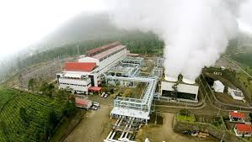
Darajat Station, Indonesia:
The Darajat Geothermal Power Station, has an installed capacity to generate 260 MW of electricity.
Three power plants in the station generate electricity that serves the Bali and Java provinces of the island nation.
Darajat Station, Indonesia

Slide 38
Geothermal Energy Zones of Pakistan
Geothermal energy resources of Pakistan are classified on their distribution in specific tectonic zones and also on the basis of thermometry and mode of occurrence such as sedimentary basins distribution. The geothermal energy resources of Pakistan or their origin in specific Tectonic Zones or Sedimentary Basins could be classified into three zones:
1. The Northern Himalayan Region
2. The Sedimentary Basins of Pakistan
3. The Chagai Volcanic Arc of Baluchistan

Slide 41
Geothermal Energy Potential for Power Generation:
Pakistan is producing more than 80% electricity using fossil fuels like furnace oil, diesel oil, natural gas and gasoline. About 15% electricity is produced from hydropower, nuclear and wind resources.
Geothermal energy resource available in all the province of Pakistan could be used for power generation, heating & cooling of buildings, supply of hot water, direct use applications which will reduce its dependence on imported fossil fuels.

Slide 42
Pakistan can overcome the energy shortage to a significant level by harnessing renewable energy resources, such as, geothermal energy.
Majority of the geothermal hot springs and mud volcanoes exists within the seismic belt of Pakistan. Therefore, the country has viable geothermal energy manifestations.
Several hot springs in Gilgit and Hunza region are originated due to the collision of Indian Plate with Eurasian Plate.

Slide 43
Similarly, various geothermal reservoirs exist in Northeast to Southeast narrow belt along Indus basin margin.
Presently the co-produced hot waters from the oil & gas wells are being drained out in dry streams, or re-injected in the wells or evaporated after heating using natural gas.
Keeping in view the coproduced, geo pressured, hydro thermal and deep geothermal energy resources available all over Pakistan the preliminary potential for power generation has been estimated at about 100,000. MW

Slide 44
Preliminary Estimates of Geothermal Energy Resources of Pakistan

