Slide 1
Collection and Reception of Milk
Dr Farzana Siddique

Slide 2
Contents
Milk Collection
Introduction
Starting a milk collection center
Selection a site for collection center
Hygiene of milk during collection
Chilling of milk during collection
Transport
Milk reception
Quality tests
Measurements
Storage

Slide 3
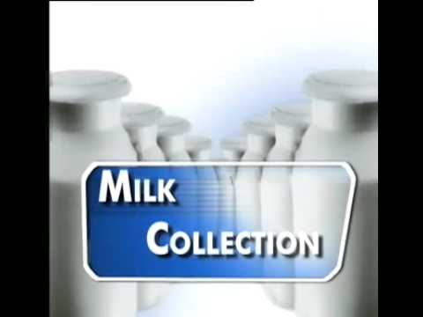

Slide 4
Milk Collection
Milk collection is often one of the first activities of milk producer groups.
Once the milk from several group members is collected in a central location, the milk can be processed or transported to processing centers or markets.
Milk should be collected within four hours of milking.

Slide 5
Starting a milk collection center
A decision should be made on the number and sites of collection centers that are needed in the area covered by the group.
Many factors influence this decision:
number of milk producers
milk volume of each producer
total volume of milk
time to transport the milk
distance from members to the collection center
distance from the collection center to the processing center or market

Slide 6
Selecting a site for a collection center
In selecting the ideal site for a collection center, consider the following points:
reliable supply of clean water
close to the road
accessible for all milk transport vehicles
close to other buildings
good drainage
easy to construct a building or a shade
the area should not be dusty
preferably, there should be electricity

Slide 7
Hygienic milk collection
Hygiene at all stages of milk collection and processing is very important for the quality and shelf life of dairy products. Important points for good hygiene are:
use clean containers and equipment
use containers that are easy to clean with a wide opening
keep the milk covered and in the shade;
transport the milk as quickly as possible after milking
cool as quickly (4°C or below)
try to avoid any delays in milk collection.

Slide 8
Keeping the milk cool
The milk should be chilled to + 4 °C immediately after milking and be kept at this temperature.
If the cold chain is broken somewhere along the way, e.g. during transportation, the microorganisms in the milk will start to multiply.
This will result in the development of various metabolic products and enzymes.

Slide 9
Milk Transport
There are many ways to transport the milk
This could be by truck, rail, boat, bicycle, animal or foot. The group has to decide on the most appropriate way to transport milk in order to keep the transport costs as low as possible.
The advantage of transporting milk in small containers is that poor quality milk is not mixed with good.
Milk transport from the farm to the collection center or processing center should always be as quick as possible to prevent spoilage of the milk.

Slide 10
Hygienic milk transport is also important
Clean the containers used for transport every time rinse with cold water first.
Then scrub with a brush and warm water containing detergent and rinse again with cold water.
Sterilize with boiling water and dry the containers (preferably in the sun).

Slide 11
Milk Reception

Slide 12
Tests for checking the quality
The most important and basics tests that are firstly performed are:
Temperature(4-10℃)
pH
COB ( clots on boiling)
The clot-on-boiling test is simple, quick and cheap. Place test tubes with 5 ml of milk for up to 4 minutes in boiling water or in a flame. Examine the tubes and reject the milk if you can see the milk clotting.

Slide 13
APT (alcohol precipitate test)
Take equal quantity of milk and ethyl alcohol solution in a test tube. Gentle shake or rotate the test tube. Then observe if clots are present then test is positive and milk is rejected.
If the result of these tests are negative then we accept the milk and perform further tests.

Slide 14
Further tests are:
Taste and smell test
Cleaning check
Sediment test
Somatic cell count(if greater than 200000 then milk is rejected)
Total plate count(if greater than 100000 then milk is rejected)
Protein content
Fat content( this is done by Gerber method)
Freezing point
Acidity(This test measures the lactic acid in the milk)

Slide 15
Adulteration tests
These are used to check whether the milk is adultered or not by using the following adulterants
Urea (to increase TSS of milk and to mask the acidity)
Detergent(to give foamy appearance)
Sorbitol(to increase SNF)
Sucrose(to increase solid content)
Boric acid( to mask the acidity)

Slide 16
COB, APT and taste and smell test are used to accept the milk.
While fat content test is used for the pricing of milk.

Slide 17
Measurement of Milk
Measurement of milk is done
By weight
By volume

Slide 18
By weight
Tank containing milk is measured on weighing balance.
Then measure the empty tank by taking the milk out of it.
Both weights are subtracted to obtain the measurement of milk by weight.

Slide 19
By volume
By volume measurement of milk is mostly preferred in industries.
Instrument for the measurement of milk by volume is attached to tanks. If milk is coming in churns we transfer the milk into that tanks by which volume of milk is measured easily.

Slide 20
Milk storage
Just after measuring milk is stored.
The tanks in which milk is stored is called silos.
And temperature kept is 4℃

