Slide 1
KINESIOLOGY
CHAPTER 1
MECHANICAL PRINCIPLES
Dr.Atif Malik
DPT(KEMU)
M.S Neuromuscular PT

Slide 2
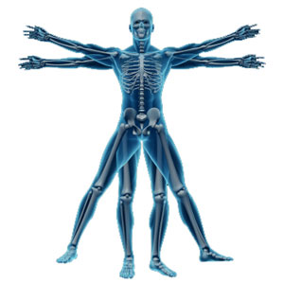
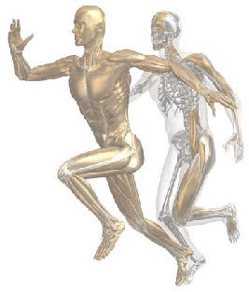
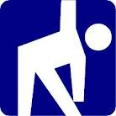

Slide 3
Kinesiology
The study of the anatomy, physiology, and mechanics of body movement, especially in humans
Kinesiology, also known as human kinetics, is the scientific study of human movement. Kinesiology addresses physiological and mechanical mechanisms.

Slide 4
OBJECTIVE
To apply the mechanical principles on human body movements.
At the end of this lecture you will be able to understand
Force .
Composition of force.
What is point of application of force.
Resolution of forces.
Principles of compounding forces.
Tension.

Slide 5
FORCE
“Force is an agent which alters the state of rest of a body or its uniform motion in a straight line.”

Slide 6
Composition of force
Direction of force :
represented by the direction of the arrow.
2) Magnitude of force :
represented by the length of the arrow.
3) Point of application:
by tail of arrow

Slide 7
Compounding of forces
Two forces acting in same direction and at a common point?
Two equal forces acting at a common point and in opposite directions?
Two unequal forces acting at a common point and in opposite direction?

Slide 8
Tension
“System of forces tending to separate parts of the body combined with equal and opposite forces which hold the parts together.”
Unit:
NEWTON

Slide 9
MECHANICS OF POSITION
GRAVITY
CENTRE OF GRAVITY
LINE OF GRAVITY
BASE
EQILIBRIUM
FIXATION AND STABILIZATION

Slide 10
GRAVITY
“Gravity is the force by which all bodies are attracted to earth.”
NEWTON’S EXPLANATION:
Force of attraction existed between all material objects and the magnitude of attraction was
Directly proportional to MASS of each body
Inversely proportional to SQUARE DISTANCE between the bodies

Slide 11
Direction of gravitational attraction of earth?
“towards the centre of earth and acts continuously”

Slide 12
Force of gravity on human body
What will happen if the gravity is un opposed?
Who opposes the force of gravity?
What if the opposing force is greater then force of gravity?

Slide 13
If un opposed the person will fall to the ground
Effects of the gravity can be counterbalanced when a force equal and opposite to it is employed e.g.
support of plinth
buoyancy of water
isometric muscle contraction

Slide 14
If opposing force is greater then gravity
Movement will occur in the direction of that force
Examples: Heel standing
Can be raised from ground by the contraction of
calf muscles. (force greater then gravity).
As long as the force remains equal to gravity.
Heel will be lowered to ground if m/s relaxes.

Slide 15
Anti-gravity muscle
In erect position the balance is maintained by the integrated action of many m/s.
Predominantly extensors.
True relaxation can only occur under conditions in which the m/s are no longer required to work against the effects of gravity.

Slide 16
CENTER OF GRAVITY
Of a rigid body is the point through which the earth’s attraction effectively acts whatever the position of the body i.e. the point through which line of action of weight acts.
Examples:
Uniform rod: exactly half-way along its length.
Irregular body: Plumb line method
Centre of gravity may lie outside the body e.g. ring

Slide 17
COG of human body
In anatomical position.
Vicinity of 2nd sacral vertebrae.
NOTE:
Its position may vary according to the anatomical structure of the individual.
Reason: greater amount of weight they carry in upper half of the body.

Slide 18
IMPORTANT:
Direct support at the COG of human body is not possible and its exact position is merely of interest in assessing the distance between COG and point of support.
Location of gravity will vary with the different postures assumed by the body.

Slide 19
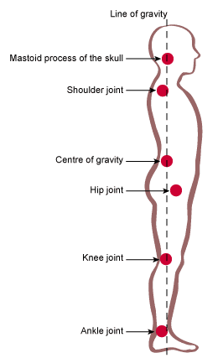
LINE OF GRAVITY
Line of gravity is an imaginary line which passes through the centre of gravity.
FUNDAMENTAL STANDING POSITION:
LOG passes through
vertex
2nd sacral vertebrae
point between the feet (level
with the transverse tarsal joints).

Slide 20
NOTE:
Relationship of the body structures to the LOG is subject to considerable variation in accordance with individual differences in posture and anatomical structure.

Slide 21
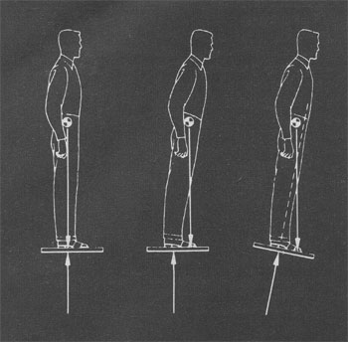
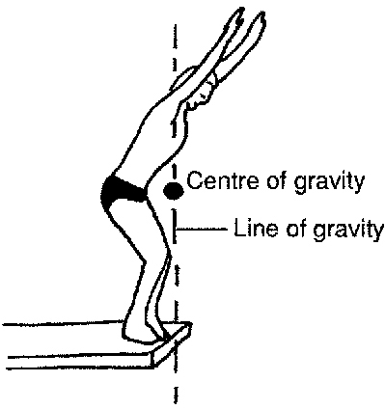
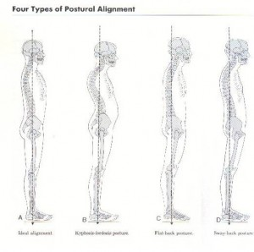

Slide 22
On average when posture is good LOG passes through
Mid-cervical vertebrae
Mid-lumber vertebrae
In front of thoracic vertebrae.
External ear and point of shoulders are in same frontal plane and lie lateral to the LOG.
Central axis of knee and ankle joint lie poster-lateral

Slide 23
BASE
Applied to a rigid body, is the area by which it is supported.
Examples:
Cube : face on which it rests.
Chair : area bounded by the lines joining the legs.
Lying : posterior aspect of the whole body forms
the base.
Stride standing : area as wide as the feet.

Slide 24
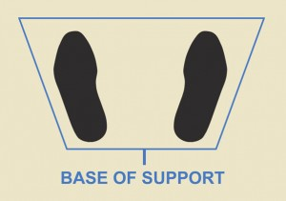
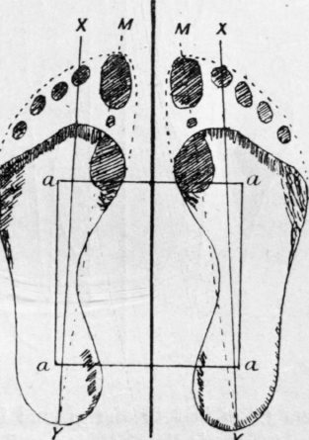
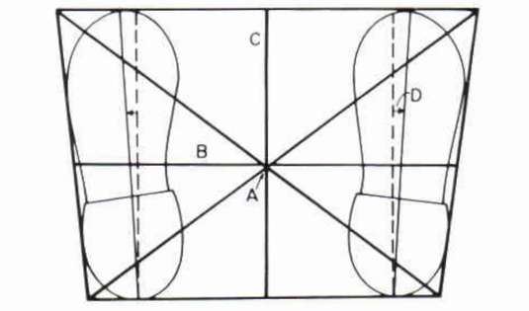

Slide 25
Equilibrium
“ when the forces acting upon the body are perfectly balanced and the body remains at rest or uniform motion.”

Slide 26
Types of equilibrium
There are three types of equilibrium
Stable equilibrium
Unstable equilibrium
Neutral equilibrium

Slide 27
Stable equilibrium
If the forces acting upon the body at rest tend to restore it to its original position after it has been displaced.
Important:
The condition of equilibrium is most stable when
COG is as low as possible
LOG falls near the centre of extensive base.

Slide 28
Unstable equilibrium
If a body is given an initial displacement and the forces acting upon it increase the initial displacement, however small the latter may be , the body is said to be in unstable equilibrium.
Reason:
very small displacement cause the line of gravity to fall outside the base.
Important :
COG as high as possible
Small base

Slide 29
Most unstable when
COG is raised.
LOG falls near the margin of the base.

Slide 30
Neutral equilibrium
If in spite of displacement of a body , the height and position of COG remains same in relation to the base.
e.g. ball moves on a plane surface.

Slide 31
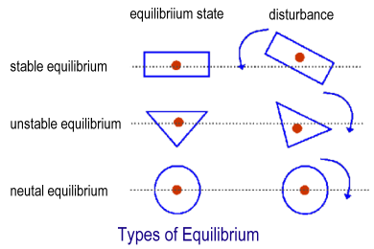

Slide 32
Stability of human body
Greatest in lying position
Becomes progressively less stable as the COG is raised and the base is reduced e.g. sitting and standing positions.

Slide 33
Fixation and stabilization
Fixation :
state of immobility.
Stabilization:
relative immobility.
Types of fixation:
Active fixation.
Passive fixation.

Slide 34
Active fixation :
obtained by the co contraction of muscles.
Passive fixation :
By manual or mechanical.
manual pressure.
straps.
sandbags.

Slide 35
Importance of fixation
Preventing movements in joints.
e.g. maintaining posture or for localizing movement to specific joint.
Improve efficiency of muscles by fixing their origin.
Localize movement in performance of passive movement.

Slide 36
Stabilization:
Suitable background for activity by stabilization of areas which are not required to take part in movement.
To increase its efficiency or to maintain balance.

Slide 37
Fractures, joint injuries and disease necessitating long-term immobility will require?

Slide 38
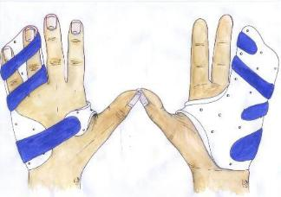
Fixation by mechanical means
Splint age
Balanced traction
Operative measures
e.g. bone grafting or plating .

