Slide 1
Enterprise Resource Planning Systems

Slide 2
Process map
A process map, also known as a cross-functional flowchart or swim lane diagrams, is used by many organizations seeking to document, analyze, streamline, and redesign business activities.
Benefits:
Defining the “as is” business process and clarifying the changes necessary to transform the present process into the “to be” process.
Determining whether “as is” measures are appropriate.
Promoting awareness of employees’ responsibilities.
Showing the impact a certain role’s performance has on upstream and downstream activities in the process.
Highlighting workflow inefficiencies.
Identifying opportunities to streamline and improve processes.
Pinpointing internal controls that need to be tested during an audit.

Slide 3
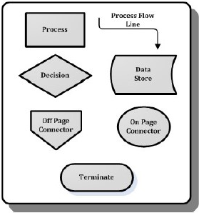
Process map symbols
Activities (or events): transform inputs into outputs
Decision points: yes/no (positive/negative) outcome that depicts the alternatives
Process flow lines: connect symbols and are labeled with the type of information flowing into or out of the activities
Data stores: support the process
Termination: points at which the process ends
On-page connector: reduce clutter on a page
Off-page connector: when processes span multiple pages
Notes:
http://www.hts.stevenwood.com/ics2o/cos/units/3/activity1/flowchart_symbols.htm

Slide 4
gathering information for process map
Group interview method – all people involved in the process are interviewed as a
group
Employs a skilled facilitator to promote and focus the discussions, questioning conventional wisdom and providing an unbiased, objective point of view.
One-on-one interview method – each person involved in the process is interviewed separately
Less effective than the group interview method.
Walkthrough – physically reviewing a process in scope
To confirm if a documented process is accurately.

Slide 5
guidelines for developing a process map
Have a defined purpose for mapping a process and explain it to those participating. Identify the scope of the process.
(Avoid the mistake of making the scope too broad.)
Agree on the level of detail to be displayed.
Determine the roles participating in the process,
– Roles become horizontal bands called swim lanes.
Determine the trigger, the event that must occur to get the process started,
– The trigger should be in the first swim lane.
Events should move left to right/top to bottom to indicate the passage of time.

Slide 6
guidelines for developing a process map
Write a description of the data, information, or physical flow on the process flow line. The information being exchanged is entered on the process flow lines.
Decision descriptors should end with a question mark, and the process flow lines coming out of the decision are labeled with outcomes.
The last swim lane is reserved for the information systems that support the process.
Use active verbs for activity descriptions such as “enter,” “inspect,” or “input.” Activities such as “send” and “receive” can generally be excluded because these activities are represented by the process flow lines (that is, the flow of data into a rectangle means that the data/ information/goods has been sent by a sender and received by the recipient).

Slide 7
guidelines for developing a process map
Do not combine completely separate/unrelated steps in an activity.
Ask questions within the decision symbols. Label the decision outcomes with “yes” or “no” or similar. Put decisions in the swim lane of the role making the decision.
Capture information about which systems or ERP modules support the process and note their names within activity or decision symbols.

Slide 8
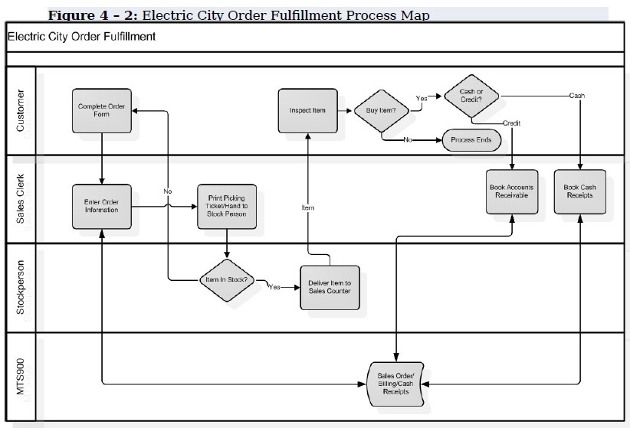
process map example

Slide 9
hints for constructing process map
Make sure every area of the map contains approximately the same amount of effort.
Start with a high level process map, then use a detailed documentation worksheet to back up activities.
Take notes while mapping and create a glossary of acronyms.
Use humps when flow lines intersect on the process map.
Allow swim lanes to retain the same role throughout the map even if the map spans multiple pages.
Terminate the process in the swim lane where the process ends.

Slide 10
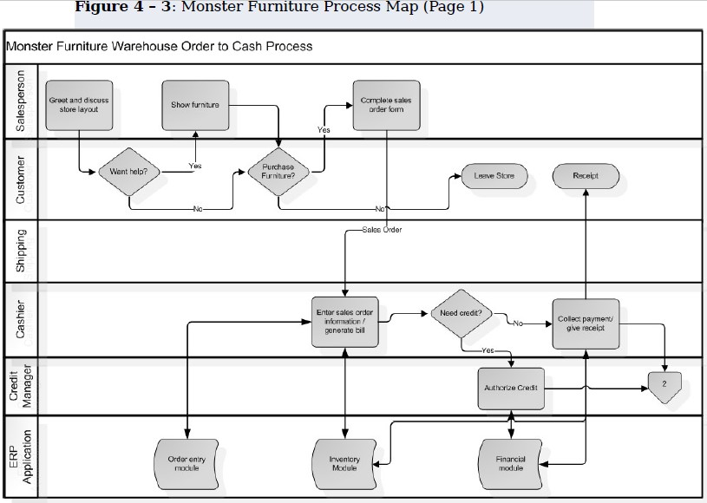
advanced process map example

Slide 11
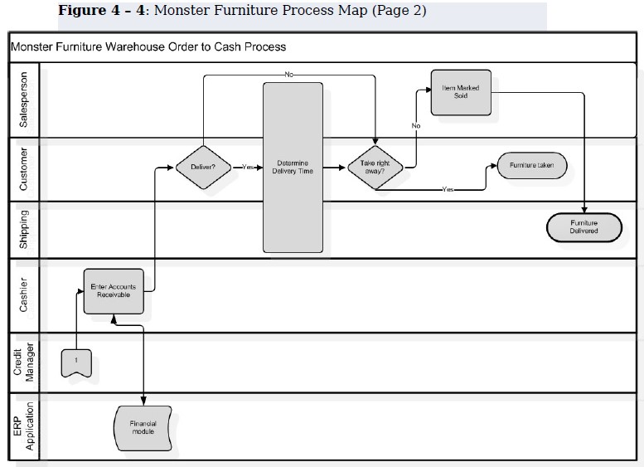
advanced process map example

Slide 12
process problems to uncover
Handoffs – transferring of responsibility from one role to another
– Provides the opportunity for mistakes, miscommunications, and delay.
Bottlenecks – a number of process flows lead to a single activity.
– Limit the performance or capacity of the entire system, delaying or completely stopping the process.
Rework – people spending time on fixing errors or remediating problems.
Role ambiguity – people not knowing what they are responsible for and others do
– Eliminating confusion among the participants in the process.
Data duplication – flows that point to and from information systems can be analyzed, to identify the extent to which the necessary data and the activities that create or use the data can be shared among the organization’s many processes.

Slide 13
process problems to uncover
Cycle time – the time consumed during process flow from start to finish i.e. how long is it and how long should it be?
– Should be at the heart of performance measurement.
Flow time – time between activities can be measured to identify substantial contributors to delay and under-utilization.
Non value-added steps – looking at processes from the customer’s point of view provides focus on roles or activities that add little or no value.
Unnecessary or repetitive steps – process flows that dead end with sub-optimal results or wind back around to the same event or role a number of times.

Slide 14
problem decision issues to uncover
Authority ambiguity –clearly defines who owns the decision
– Eliminate a potential source of confusion.
Decision necessity – when decision point output flows lead toward the same or similar events, the process may include unnecessary decisions that may generated unwarranted delays.
Decisions too early – when decision point output flows continue for a long time before encountering subsequent events, the decision point may, in fact, be made too early.
– Leads to unnecessary downstream complications
Decisions too late – when decision point output flows lead to errors or rework, decision points might need to be moved to earlier to provide quality assurance or confirmation of customer.

Slide 15
developing “to-be” process
What activities are in scope that we can change and what activities are out of scope that we cannot change?
Who is the customer? What is the customer willing to pay for? What does the customer receive?
What are the most important value-added steps?
What level of performance does the customer expect? How well are we satisfying the customer? How can we increase customer satisfaction?
What is our first interaction with the customer that starts the process? Where do our processes end and which endings are optimal?

