Slide 1
COMPOUND BARS
(for finding individual loads)

Slide 2
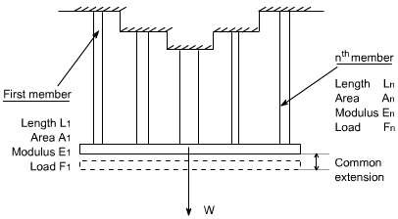
Compound bars
When an external load W is applied to such a compound bar it is shared between the individual component materials in proportions depending on their lengths, areas, and Young’s module.

Slide 3
Let F_{n} is the force in the nth bar and A_{n} and L_{n} are its cross - sectional area and length.
Consider , a compound bar consisting of n bars, each having a different length and cross sectional area and each being of a different material.
Let all bars have a common extension ‘x' i.e. the load is positioned to produce the same extension in each member.

Slide 4
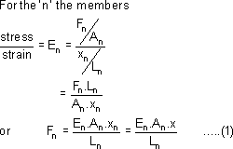

Slide 5
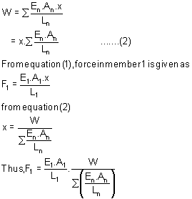
Let W be the total load, the total load carried will be the sum of all loads for all the bars.
•

Slide 6
The above expression will be writen as
if the length of each individual bars in same then, we may write as

