Slide 1
Introduction to p block elements
ANAM MATEEN

Slide 2
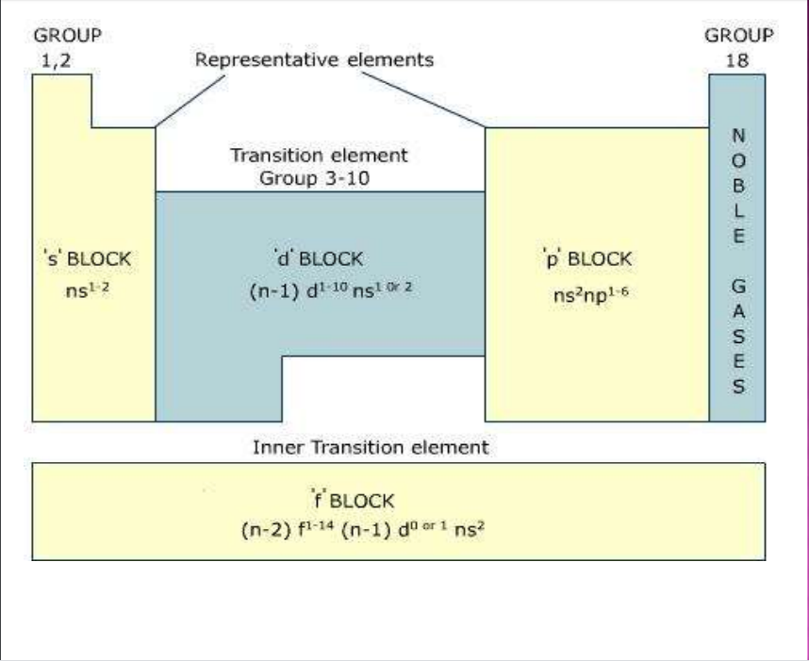

Slide 7
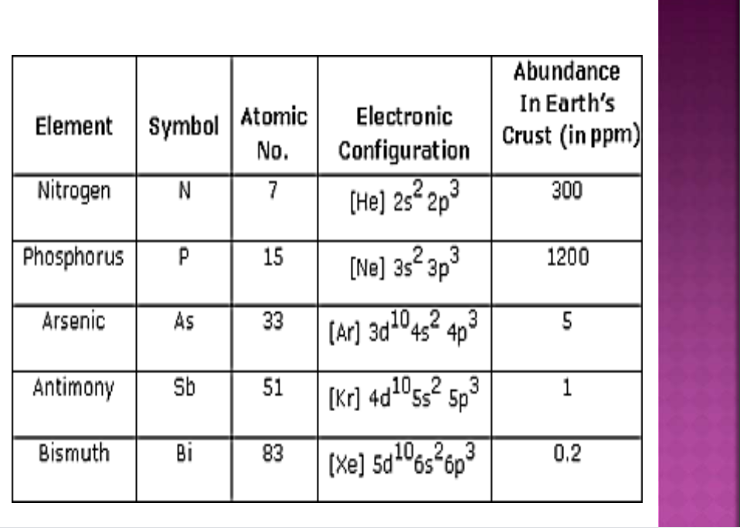

Slide 17
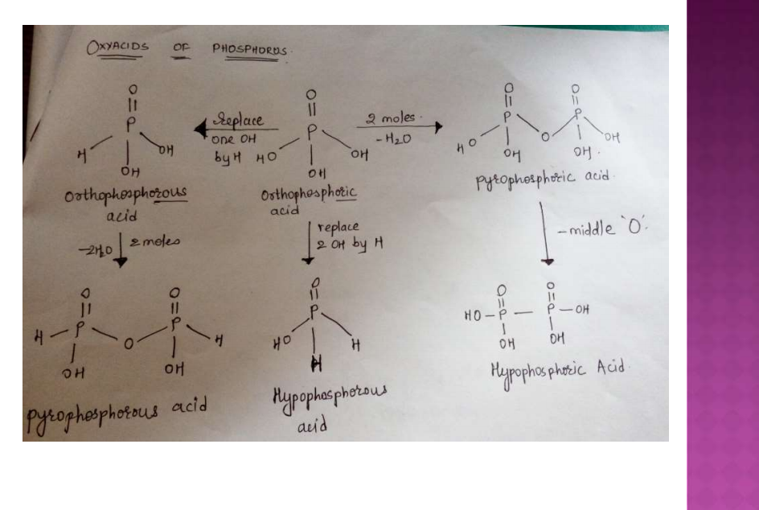

Slide 22
