Slide 1
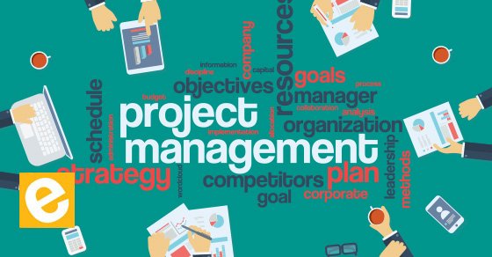
PROJECT MANAGEMENT
By: Saba Ashraf
Noon Business School, University of Sargodha

Slide 2
Outline
What is project?
Major characteristics of a project
Difference between project and routine work
Introduction to project management
Significance of project management
Project constraints
Stages of project life cycle

Slide 3
What is Project?
Project Management institute (PMI) defines it as;
“A project is a temporary endeavour undertaken to create a unique product, services or result.”
In other words;
A project is an activity performed to create something unique or to achieve certain goals in particular period of time.

Slide 4
Major characteristics of a project:
Defined objective
Defined life span
Involvement of several departments and professionals
Unique deliverables
Specific time and cost

Slide 5
Examples:
Polio eradication project by Govt. of Pakistan
Apple launching new phone
Warner bros releasing new film.
World’s 3rd largest mosque by Bahria Town.
Training programs at Noon Business School

Slide 6
Project vs. Routine Work
PROJECT | ROUTINE WORK
Involves investigating, compiling, arranging, and reporting information Manager given the task of investigating and comparing automated customer service software. | Defined within the range of a department’s function. Manager prepares monthly reports identifying customer contact trends (complaints, inquiries, suggestions)
Activities involved in project phases are related to one another and to the desired end result. | Routines for recurring tasks performed in particular department are related to the activities that define and distinguish that department only
Project goals and deadlines are specific. The customer service manager is told to compare prices and features of the software, make a recommendation, and complete a report within three months. | Recurring tasks may be managed with departmental goals in mind, but these goals tend to remain fixed or move forward only with time

Slide 7
Project vs. Routine Work
Project | Routine Work
 | Department’s routine goals and deadlines extend from one month to another.
The desired result is identified. For her project, the customer service manager is expected to deliver a conclusive report. It’s a one-time assignment, not one that will recur each month. | Routines are aimed not at one outcome but at the maintenance of processes. The routine reports her department generates will still be produced as a maintenance function of her department.

Slide 8
Project Management
It is about knowing exactly what your goals are, how are you going to achieve them, what resources you will need, and how long will it take to achieve a certain goal.
It is important for everyone involved to be aware of purpose and end results of the project.

Slide 9
Why Project Management is crucial?
Strategic alignment
Leadership
Clear focus and objectives
Realistic project planning
Quality control
Risk management

Slide 10
Project Constraints

Slide 11
1. Quality
One of the major constrains for every project.
Slightly apart from other three but all three in classic triangle are interrelated.

Slide 12
2. Time
How long will it take to deliver the project?
Estimate project time as accurately as possible
Make appropriate schedules for the project
Rely on both research and past experience
Prepare yourself for potential delays, change requests, risks, and uncertainties.

Slide 13
3. Cost
Stakeholder’s major concern, COST!
Budget estimates need to be presented in a range.
Estimate costs with thoroughly researched market rates for goods and services you need.
Estimate your budget by considering all costs: labor, material, factory, equipment, administrative, software, contractors, etc.
Estimate costs with vendor bids and ranges.
Look at costs and budgets for similar past projects inside and outside your organization.
Stick closely to the estimated budget.

Slide 14
4. Scope
There should be a set of guaranteed deliverables.
You may list a set of deliverables that could be created if budget and schedule allow.
Likewise, you may indicate which deliverables on the scope can be omitted or cancelled, if time or cost grow too constrained.

Slide 15
5. Resources
Who and what is required to do the work.
If necessary resources are not available, time to deliver will increase. This may also increase project cost, because alternate resources if available, may be more expensive than planned.

Slide 16
6. Risks
Foresee failures at every step of a project, and prepare for them accordingly.
What if a supplier fails to deliver?
What if we lose any number of resources due to illness or transfer?
What if the market takes a huge swing?
What if our competitor launches a similar product at the same time?

Slide 17
The Project Life Cycle
INITIATING
Goals
Specification
Tasks
Resposibilties
PLANNING
Schedules
Budgets
Resources
Risks
Staffing
EXECUTING
Status Reports
Changes
Quality
Forecasts
CLOSING
Delivering project to the customer
Redeploying project resources
Post-project reviews

