Slide 1
Tobacco Mosaic Disease (TMD)

Slide 2
Description
1st reported plant virus. Interesting fact about TMV is that due to its cylindrical nature it can be incorporated into battery electrodes. It is the most stable virus with wide survival range.

Slide 3
History and Importance:
In 1886 Adolph Meyer described that mosaic disease can be transferred between plants.
In 1992 Ivanovsky reported about its filterable nature.
In Martinus Beijerinick named this as Tobacco mosaic virus (TMV).
It infects tobacco, tomato, cucumber and many greenhouse crops.
It is thermostable virus (can survive at high temperature).
Yield losses up to 55%.
Deteriorated quality leads to low market price.

Slide 4
Etiology
Causal organism: Tobacco mosaic virus (TMV)
Genus: Tobamovirus
Genome: ssRNA

Slide 5
Symptoms
Foliage show mosaic (alternate green and yellow patches) symptoms.
Leaves fern like with pointed appearance.
Dark green areas of the mottle appear elevated looking like blister like.
Leaves give distorted and cholorotic appearance.
Shoe string appearance on leaves.
Leaves show wrinkle*, crinkle* and twist*.
*wrinkle: slight line on surface.
*Crinkle: many lines/streaks on a particular area leading to a slight fold.
Twist: a bent on leaf surface.

Slide 6
Symptoms
Pointed Appearance
Mosaic Symptoms

Slide 7
Symptoms
Dark green areas of the mottle appear elevated looking like blister like.

Slide 8
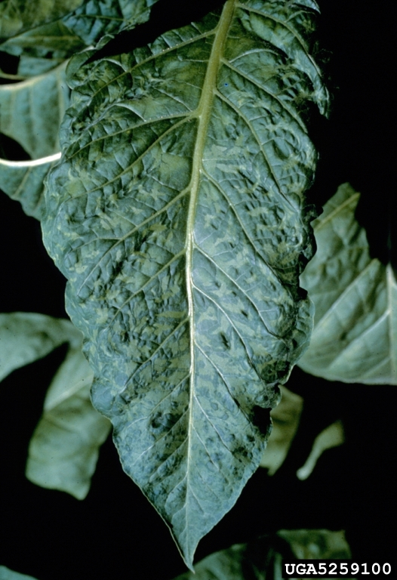
Symptoms
Shoe string appearance
on leaves

Slide 9
Transmission
Mechanical means.
Human handling.

Slide 10
Disease cycle
TMV preserved in nature in herbaceous (does not have wood) and woody plants.
Overwinters in plant stacks, plant debris, soil, seed surface, seed beds, clothes, manufactured tobacco like cigarette and Cigar. Enters through wounded tissues. Systemically spread through plasmodesmata.

Slide 11
Epidemiology
Temperature: 28-32°C
Relative humidity: 44-56%

Slide 12
Management:
Use clean and healthy seed (Because infected seeds lead to systemic movement of TMV during whole life cycle of the plant).
Uncontaminated soil for seed production (Soil should be properly sanitized to rule out all the hidden points of the virus).
Crop rotation with maize and wheat (This will help in reducing the virus inoculums by breaking its life cycle due to non-availability of the host plants).
Spray skimmed milk.
Field sanitation and Rouging.
Avoid contamination of hands while working in the fields.

