Slide 1
Insect Pests of Vegetables
Dr. M. Asam Riaz
Assistant Professor
Entomology, College of Agriculture, University of Sargodha, Sargodha, Pakistan

Slide 2
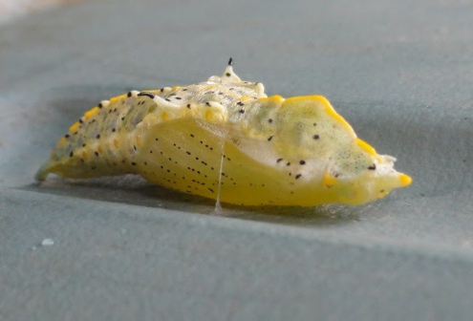
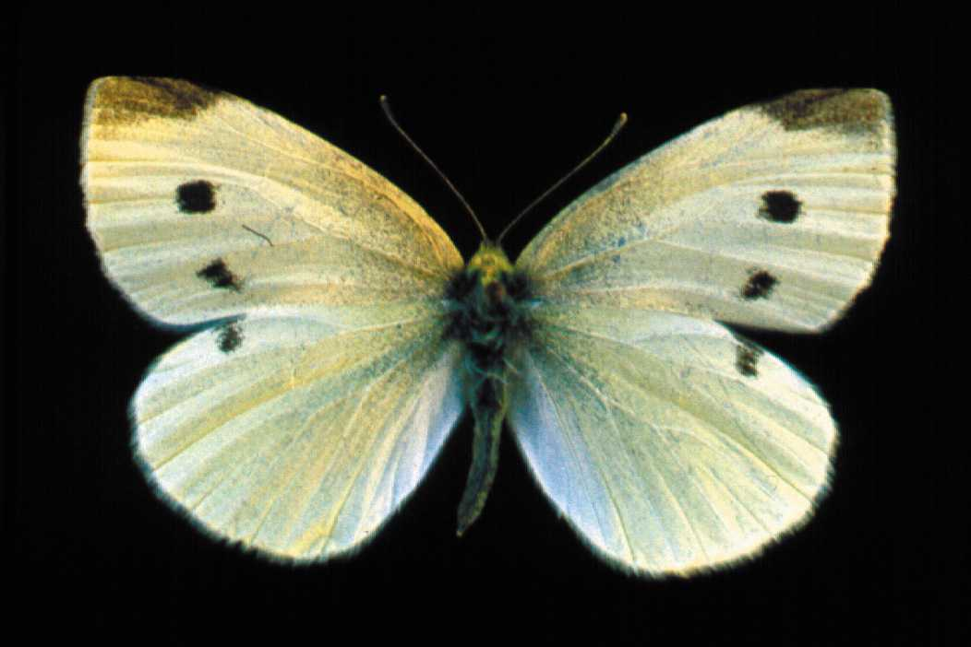
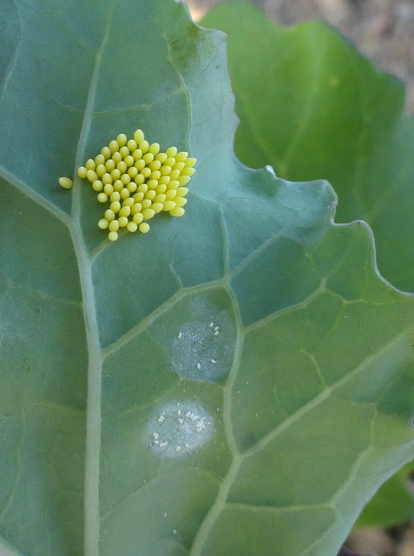
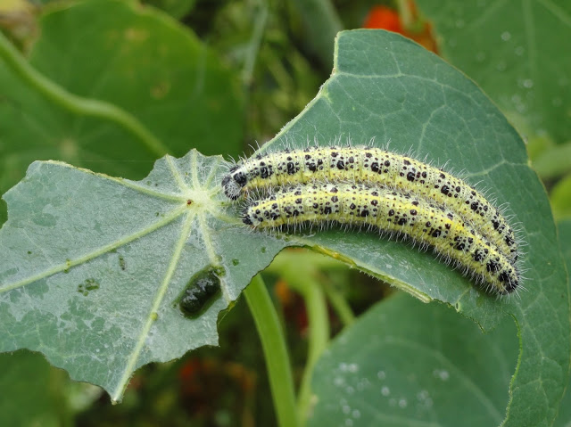
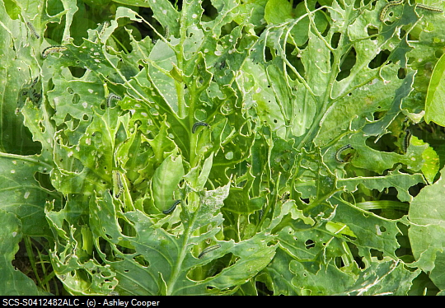
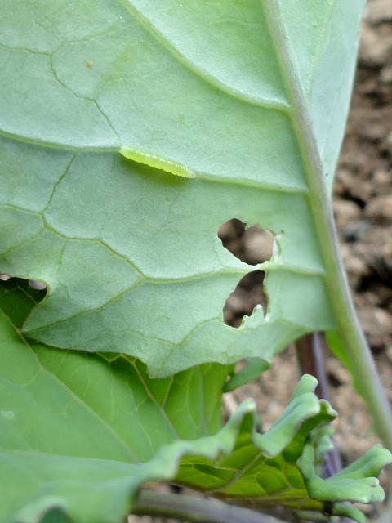
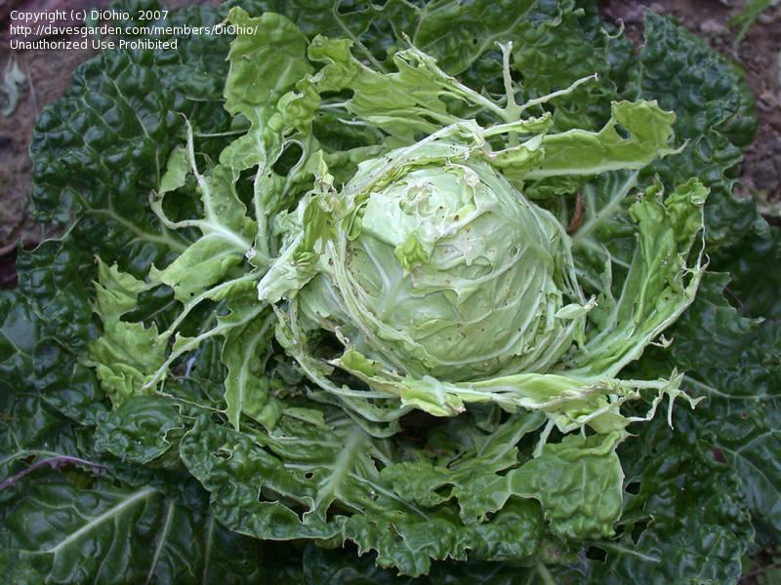
Cabbage butterfly (Pieris brassicae: Pieridae: Lepidoptera)
Host plants: Major pest of cabbage and other cruciferous plants
Identification
Adult: Yellowish white (female with 2 black spots on upper side of forewings while in males on lower side of forewings.
Eggs: Pale white or yellowish in color 200-400 eggs laid singly or in batches) on leaf undersides.
Larva/grub: Creamy white or yellowish with black spots
Pupa: Creamy white
Life history:
Life cycle: About 1.5 months
Adult: 1 month
Larvae: 2-3 weeks
No. of generations: 2-3
Damage:
Active period: November to April (in hilly areas May to Nov.)
Catterpillars feed gregariously on plant leaves and heads.
Attacked plant bears abnormal plant head and ultimately a lower market price.
Control:
Destruction of crop stubbles.
Cypermethrin 300ml/abamectin/ Spinosad

Slide 3
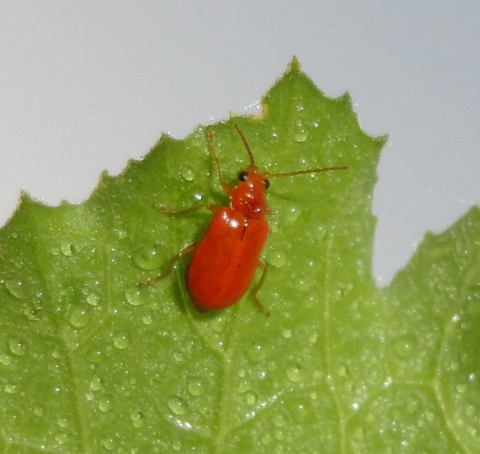
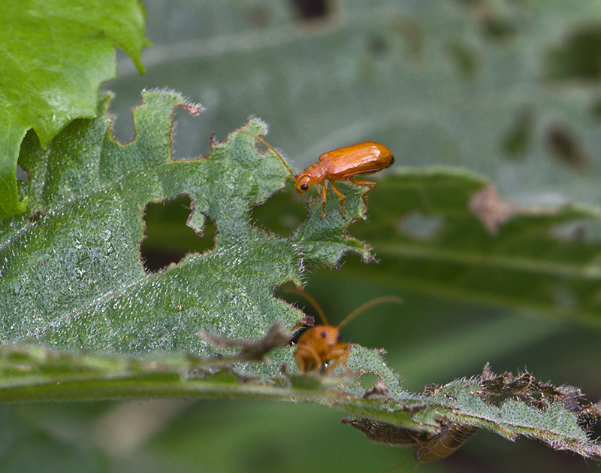
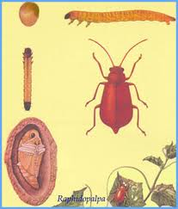
Red pumpkin beetle (Aulacophora foveicollis: Chrysomelidae: Coleoptera
Host plants: Major pest of cucurbits such as pumpkin (cucurbita pepo) Tinda (Citrullus vulgaris), ghia tori (Luffa aegyptica), cucumber and melon.
Identification
Eggs: Oval; yellow (300 eggs singly or in batches) in moist soil near plant base. 6-15 days
Larva/grub: Creamy white or yellowish; bore into the root,underground stem and sometime fruit touching the soil. 13-25 days
Pupa: Creamy white;
pupate in thick walled earthen chambers in soil;
7-17 days
Adult: brilliant orange Red ; ventral surface black
Overwinters as adult in crop stubble/soil
Damage:
Adult feed on leaves
and larvae feed by boring into the root or underground stem and fruits
Control:
Deltamethrin 250 ml/A
Dichlorvos (thunder/DDVP 50EC) 500 ml/A

Slide 4
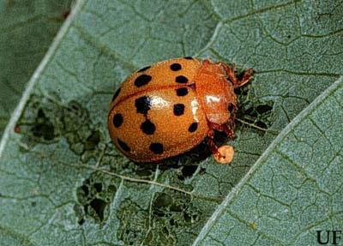
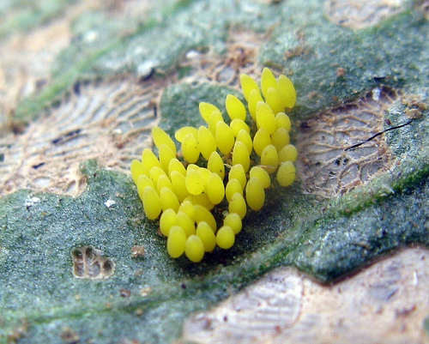
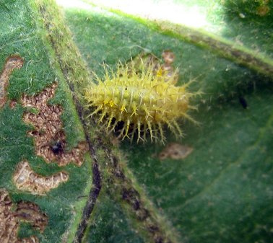
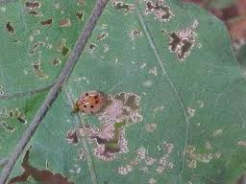
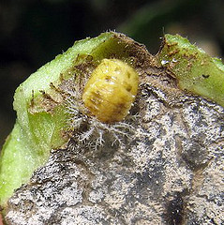
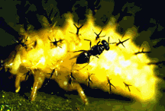
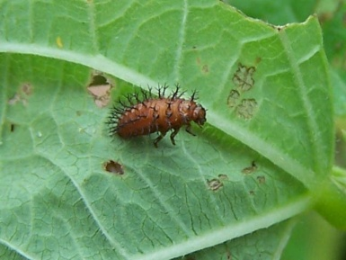
Hadda beetle (Henosepilachna chrysomelina: Coccinellidae: Coleoptera)
Host plants: Plants of solanaceous family ( brinjal, tomato and potato) cucurbitaceous
Identification (Spotted stem borer)
Eggs: Singly laid eggs (in clusters of 20-30), Yellowsih cigar shaped eggs on underside leave upper sides. (about 400 eggs) hatching in 3 days
Larvae/grub: Yellosih; spiny; feed on lower epidermis; 7-17 days
Adult: deep red, FW with (7-14 black prominent spots on dorsal side); tip is pointed; hibernate as adult
Damage:
Both adult and Larval feeding on upper and lower leaf sides making them sieved-like/lace-like
and ultimately drying and falling of leaves.
Control:
Destruction of crop stubbles/damaged leaves/eggs.
Biological control by Pediobius foveolatus; P. epilachnae (larval/pupal parasitioid wasp)
Chemical control:
Cypermethrin+curacron (Polytrin-C 440 EC) 500ml/A
lambda-cyhalothrin
abamectin

Slide 5
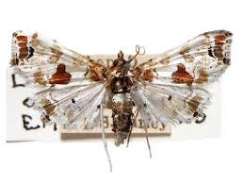
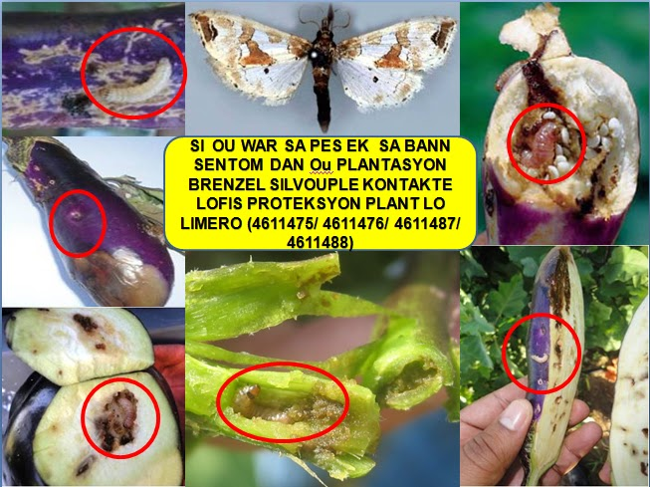
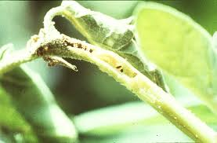
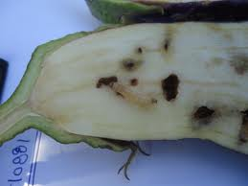
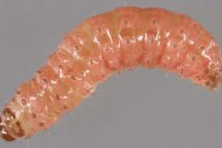
Brinjal Fruit-borer (Leucinodes orbonalis: Pyralidae: Lepidoptera
Host plant: feed on solanaceous plants/green pods of peas
egg: creamy white eggs 80-120; singly or batches on underside of leaves, stem, flower bud, 3-6 days
Larvae:creamy white when young; light pink when grown; hibernate as larvae; larvae bore into tender shoot near growing points, flower buds, or fruits (4-6 fruits by one larvae); 9-28 days
Pupae: pupation in tough silken cocoons among fallen leaves; 6-17 days
Adult: white with black spots on the dorsum of thorax and abdomen;
wings white with a pinkish or bluish tinge;
FW has number of black/brown spots
small hair along apical and anal margin
2-5 days
Damage:
Terminal shoot is attacked and killed
Bore into the fruits
Control:
Deep ploughing after harvesting
Destroy affected shoots and fruits
Avoid continuous brinjal sowing
Biological:Bracon spp
Chemical
Betacyfluthrin (Bulldock 25EC) 200ml/A
Lufenuron (Match 50 EC) 200 ml/A
Cypermethrin 200-250 ml/A

Slide 6
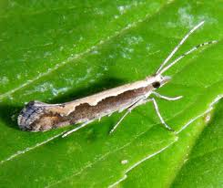
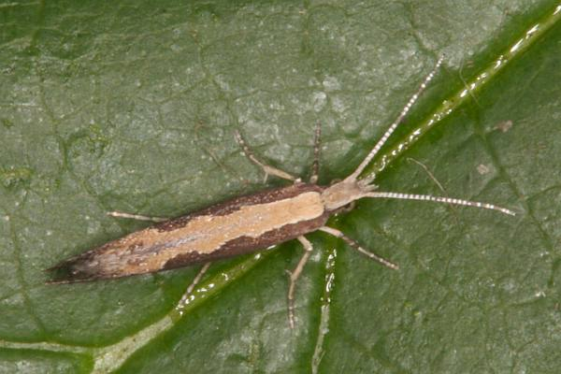
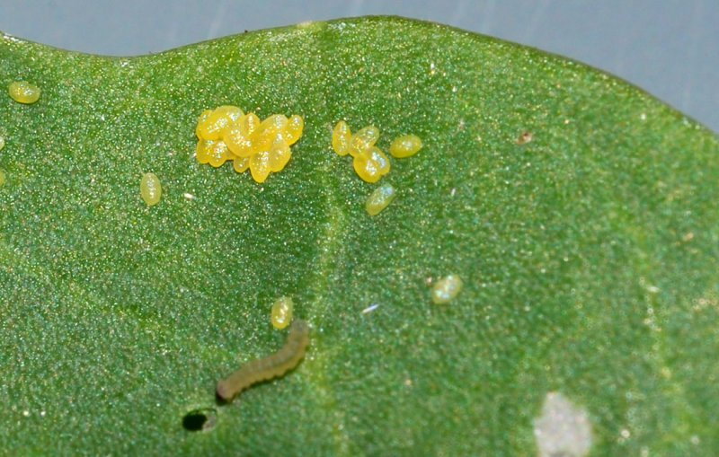
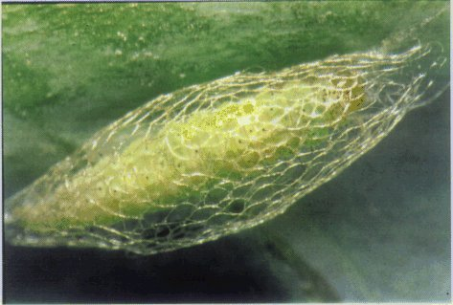
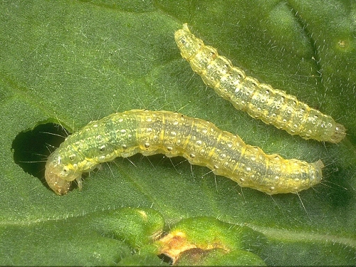
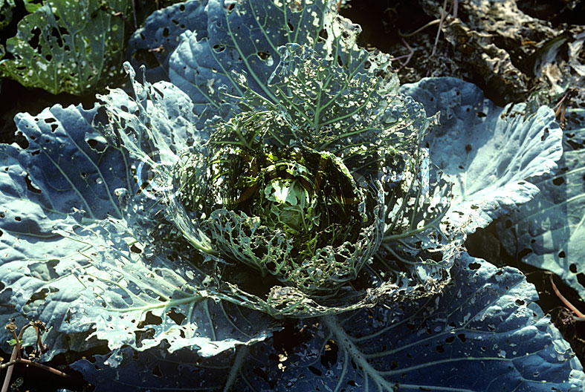
Diamondback Moth (Plutella xylostella: Plutellidae: Lepidoptera)_Cabbage moth
Host plants: Major pest of cabbage and other cruciferous plants
Identification
Adult: Greyish brown forwings with gloden strip on the dorsal side.
Eggs: Pale or yellowish white in color 20-350 eggs laid singly or in batches) on leaf undersides.
Larva: Pale or yellowish green (hang out by a silken thread when disturbed)
Pupa: Yellowish green , found in cocoon
Life history:
Life cycle: About 1 to 1.5 months
Adult: 3 weeks
Larvae: 1-2 weeks
Pupa: 1 week
No. of generations: many overlapping generations per annum
Damage:
Active period: March to Nov. (maxi. Damage August/Sept.)
Caterpillars feed gregariously on plant leaves and heads,
leaving leaf skeleton behind.
Control:
Eradication of other crucifer hosts before
cabbage crop sowing.
Light trap (mass capturing of adult moths
Different parasitoid and predatory insects
Cypermethrin/abamectin/ Spinosad

