Slide 1
Chapter#5 INPUT

Slide 2
INPUT
What is input?
Input is any data and instructions entered into memory
What are input devices?
An input device is any hardware component that allows user to enter data and instructions

Slide 3
Keyboard
Many people use a keyboard as one of their input device. A keyboard is an input device that contains keys users press to enter data and instructions into the computer. Desktop computer keyboard typically have 101 to 105 keys. For smaller computers like notebook computers contain fewer keys about 85 keys. Typing area includes letters of alphabets, numbers, punctuations marks, function keys, arrow keys media controls and additional keys. Many desktop computer keyboards have numeric keypad on right side of keyboard.

Slide 4
Cont.
Mostly all the keyboards have toggle keys. A key that switches between two states each time a user presses the key. Like NUM LOCK, CAPS LOCK and SCROLL LOCK.
Desktop computer keyboards often attach via a cable or wirelessly. A wireless keyboard is a battery-powered device that transmits data using wireless technology, such as radio waves or infrared light waves. Laptops have built in keyboards on the top of the system unit

Slide 5
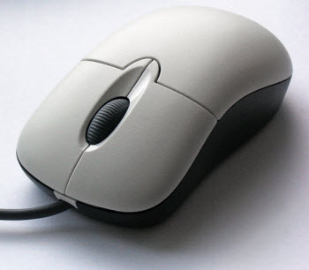
Pointing devices
A pointing device is an input device that allows a user to control a pointer on the screen. Pointer is a small symbol showing on the screen. Whose location and shape changes as user move a pointing device.
Mouse
A mouse is a pointing device that fits under the palm of your hand comfortably. With the mouse user control the movement of the pointer, often called curser.

Slide 6
operation | Mouse action | example
point | move the mouse until the pointer on desktop is positioned on item of choice | position the pointer on screen
click | press and release the primary/left mouse button | select/deselect the program
Right-click | press and release secondary/right mouse button | display a shortcut menu
Double click | quickly press and release left button of mouse twice without moving mouse | start/open a program/file
Triple click | quickly press and release left button of mouse three times without moving mouse | select a paragraph
Drag | point to an item, hold down the left button, move the item to desired location and release the button | move the object from one location to another
Rotate wheel | rotate the wheel forward/backward | scroll vertically

Slide 7
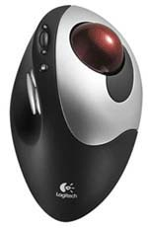
Trackball
A trackball is a stationary pointing device with a ball on its top or side. The ball of trackball is about the size of Ping-Pong ball. To move the pointer using a trackball, you rotate the ball with your thumb, finger or the palm of your hand. The trackball requires frequent cleaning because it picks up oils from fingers and dust from the environment.

Slide 8
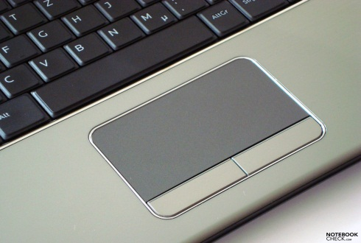
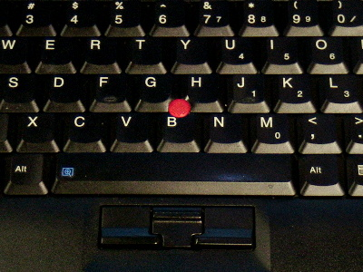
Touchpad
a touchpad is a small, flat, rectangular pointing device that is sensitive to pressure and motion. Slide your finger tip across the surface of the pad. You can perform actions such as clicking.
Pointing stick
a pointing stick is a pressure sensitive pointing device shaped like a pencil eraser that is positioned between keys on a keyboard. You push the pointing stick with a finger

Slide 9
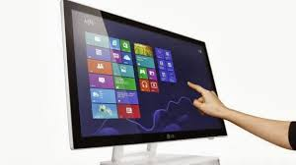
Touch screen
A touch screen is touch sensitive display device. User can interact with these devices by touching the area of screen. Because touch screens requires a lot of arm moments. With some smart phones, portable media players and other personal mobile devices you can touch the screen to perform different tasks.
Pen input
A stylus is a small metal or plastic device that looks like a tiny ink pen but uses pressure instead of ink. A digital pen, which is slightly larger than stylus

Slide 10
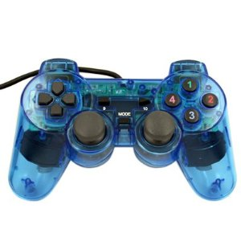
Controllers for gaming players
Video games and computer games use game controller as the input device that directs movement and actions of on-screen objects.
Gamepads
A gamepad, which is held with both hands, controls the movement and actions of players or objects in video games or computer games. On gamepad, user press buttons with their thumbs or move stick in various directions.

Slide 11
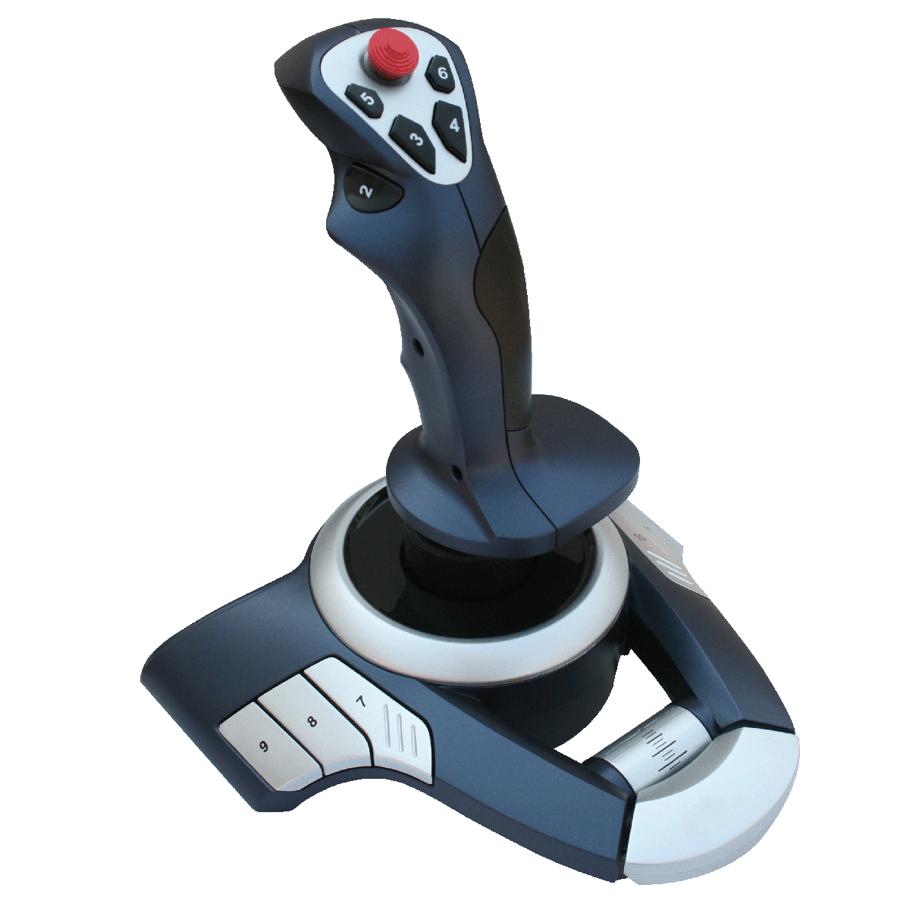
Joysticks and wheels
A joystick is a handheld vertical lever mounted on a base. You move the lever in different directions to control the actions of player. The lever usually includes buttons, called triggers that you press to initiate certain events.
A wheel is a steering-wheel-type input device. Users turn the wheel to simulate driving a car, truck or other vehicle. Most wheels also include foot pedals for acceleration and braking actions.

Slide 12
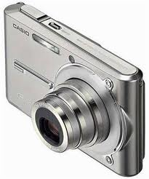
Voice input
Voice input is the process of entering input by speaking into microphone. And watch the spoken words appear on the screen as they talk. Voice recognition is also called speech recognition that recognize a vocabulary of programmed words, which can change
Digital cameras
A digital camera allows users to take pictures and store the photographed images digitally instead of on traditional film. Some cameras have internal memory otherwise memory stick/ memory card is used for storing pictures. Users can view photographed images immediately though a small screen.

Slide 13
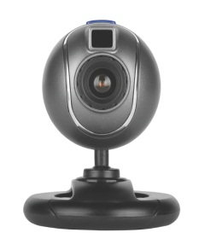
Digital cameras can connect with computer to transfer pictures and also connect with printer to print images via wirelessly or through a cable.
Resolution is the number of horizontal and vertical pixels in a display device. A pixel is the smallest element in an electronic image. The greater the number of pixels, the better quality of the image.
Web cams
A webcam is also called a PC video camera. During a video telephone call, both parties see each other as they communicate over the internet. Some notebook computers have built-in web cams and others are attached to computer with cable.

Slide 14
Scanners and reading devices
The devices that can capture data directly from a source document are called scanners.
Optical scanners: a light sensing input device that reads printed text and graphics and then translates the result into a form of computer can process.

Slide 15
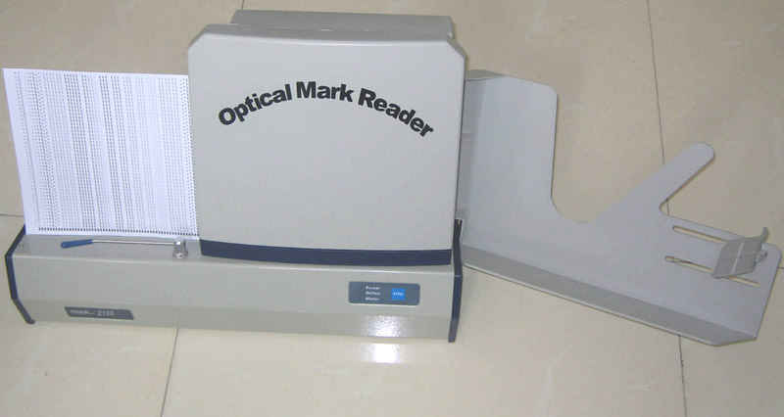
OMR (optical mark recognition)
It is a technology that reads hand-drawn marks such as small circles or rectangles. A person places these marks on a form, such as test, survey, or questionnaire answer sheet. OMR first records the correct answers based on patterns of light. The scans the remaining documents and matches their patterns of light against the answer key sheet.

Slide 16
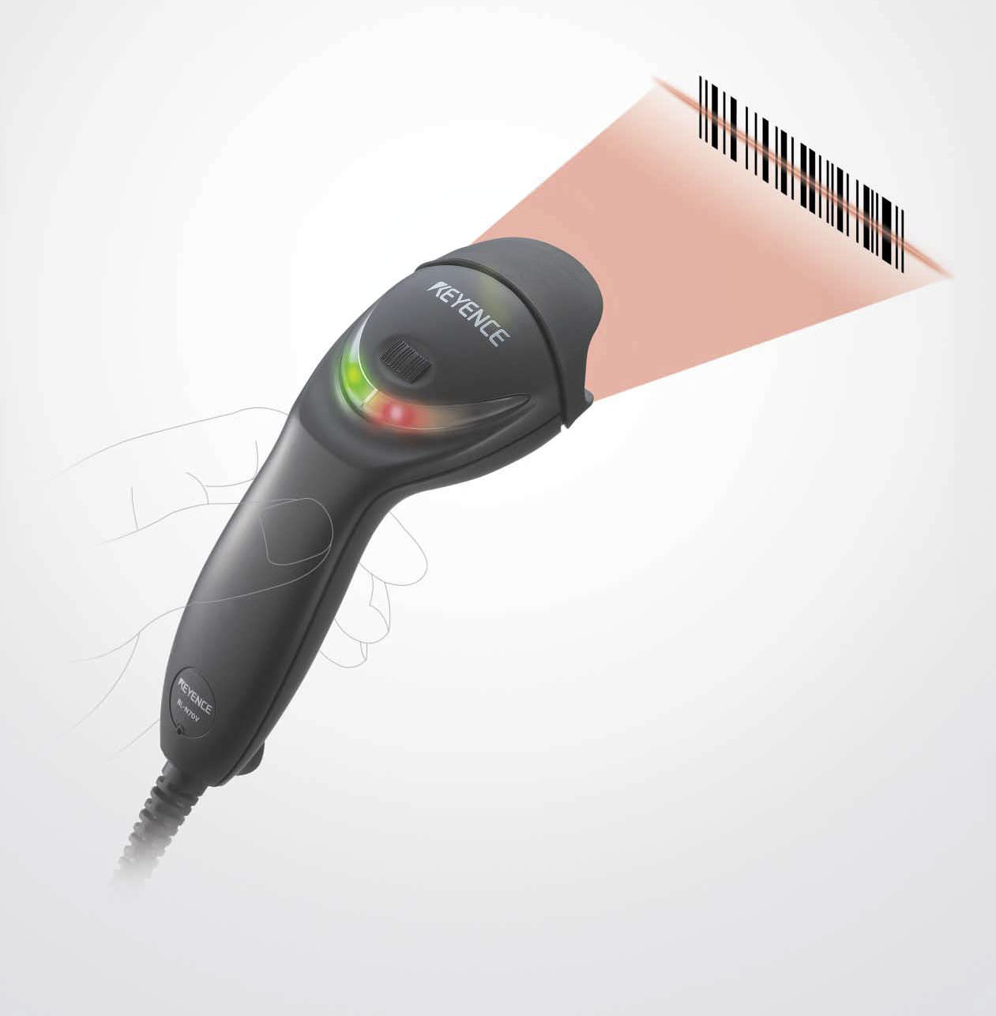
Bar code readers
An optical reader that uses laser beams to read bar codes by using light patterns. A bar code is an identification code that consists either of a set of vertical lines and spaces of different widths. The barcode represents data that identifies the manufacturer and the item.

Slide 17
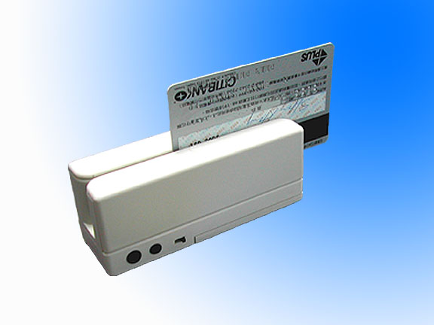
Magnetic stripe card readers
That reads the magnetic stripe on the back side of credit cards. The stripe divided into three horizontal tracks, contains information identifying you and card issuer. Some information stored in stripe includes your name, account number, expiration date and country code. The information on magnetic stripe is used to make payments

Slide 18
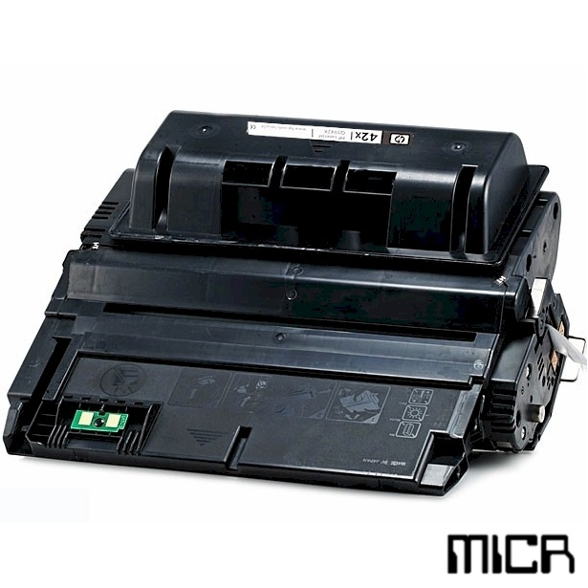
MICR readers
MICR readers convert MICR characters into a form the computer can process. The banking industry exclusively uses MICR for check processing. Each check in your checkbook has precoded MICR characters beginning at the lower-left edge. That represents bank-routing number, account number and check number.

Slide 19
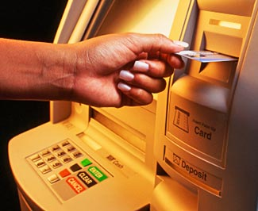
Automated teller machine
An ATM is a self-service banking machine that connects to a host computer through a network. Using an ATM, people withdraw cash, check balance, transfer funds or deposit money. Some ATMs have touch screens. To access a bank account, you insert a plastic bankcard in ATM. ATM asks you to enter password, called PIN (personal identification number) which verifies that you are the holder of the bankcard.

Slide 20
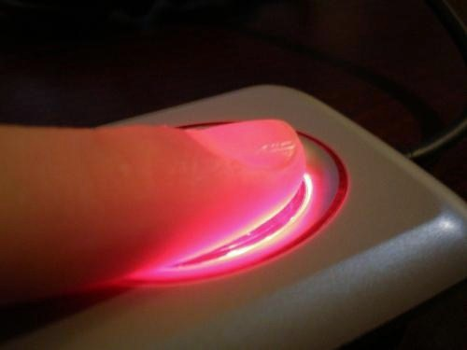
Biometric input
A technology of authenticating a person’s identity by verifying a personal characteristics.
A biometric device translate a personal characteristics into digital code that is compared with a code already stored in computer.
Finger print reader is most widely used biometric device these days.
Face/signature/voice/ eye retina/ hand geometry recognition are other ways of biometrics.

