Slide 1
Mechanics-I
UOS Sub Campus Bhakkar

Slide 13
Figure 2-6a is an x(t) plot for an elevator cab that is initially
Stationary , then moves upward (which we take to be the positive
direction of x), and then stops. Plot v(t).

Slide 30
Fig.2-8

Slide 33
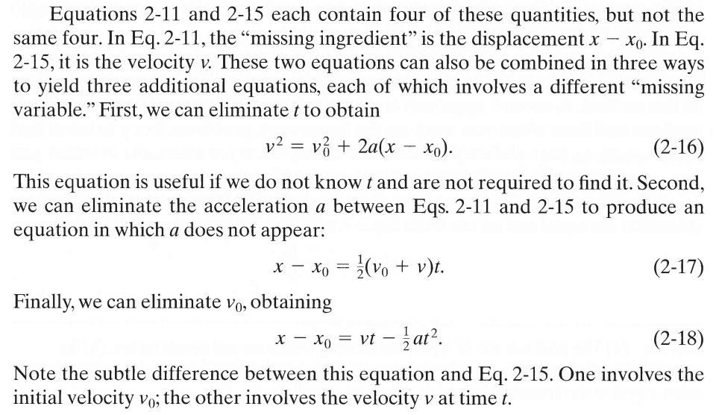

Slide 38
Comments:woodpecker is about 70 times the acceleration magnitude of Colonel Stapp in Fig. 2-7 and certainly would have been lethal to him. The ability of a woodpecker to withstand such huge acceleration magnitudes is not well understood, but there are two main arguments. (1) The woodpecker's motion is almost along a straight line. Some researchers believe that concussion can occur in humans and animals when the head is rapidly rotated around the neck (and brain stem), but that it is less likely in straight line motion. (2) The woodpecker's brain is attached so well to the skull that there is little residual movement or oscillation of the brain just after the impact and no chance for the tissue connecting the skull and brain to tear.

Slide 39
Fig.2-9

Slide 45
If you tossed an object either up or down and could somehow eliminate the effects of air on its flight, you would find that the object accelerates downward at a certain constant rate. That rate is called the free-fall acceleration, and its magnitude is represented by g. The acceleration is independent of the object's characteristics, such as mass, density, or shape; it is the same for all objects.
Two examples of free-fall acceleration are shown in Fig. 2-10 which is a series of stroboscopic photos of a feather and an apple. As these objects fall, they accelerate downward-both at the same rate g. Thus, their speeds increase at the same rate, and they fall together.
Fig.2-10

Slide 51
Fig.2-11

Slide 60
Fig.2-13

