Slide 1
SEX DETERMINATION

Slide 2
What is sex?
The sum of the structural and functional differences by which the male and female are distinguished, or the phenomena or behaviour dependent on these differences.

Slide 3
SEX DETERMINATION
The genetic or environmental process by which the sex of an individual is established.
Any process that establishes and transmits the specification of sexual status of an individual organism.

Slide 4
MECHANISMS OF SEX DETERMINATION

Slide 5
Genotypic sex determination
Males and females have different alleles or even different genes that specify their sexual morphology
In animals this is often accompanied by chromosomal differences, generally through combinations of
XY (XX/XY sex-determination system)
ZW (ZW sex-determination system)
XO (XX/XO sex determination)
ZO chromosomes
UV chromosomes
Haplodiploidy

Slide 7
XX/XO (Protenor) mode of sex determination
Depends on random distribution of the chromosome into half of the male gametes.
Presence of two X chromosomes in the zygote = female offspring
Presence of only one X chromosome = male offspring

Slide 8
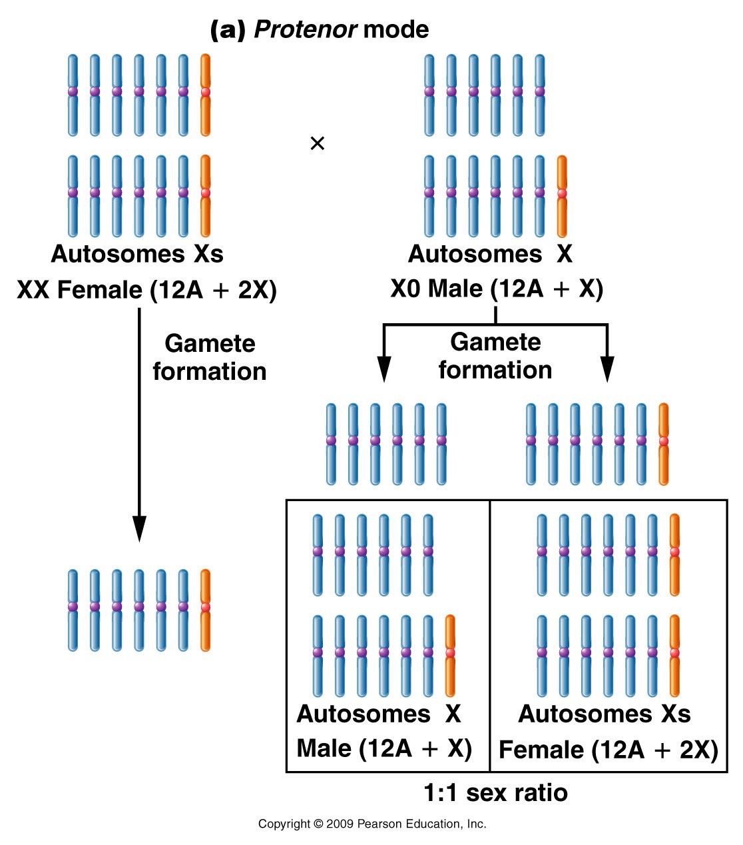
Figure 7.5a
Notes:
Figure 7-5a (a) The Protenor mode of sex determination where the heterogametic sex (the male in this example) is XO and produces gametes with or without the X chromosome; (b) The Lygaeus mode of sex determination, where the heterogametic sex (again, the male in this example) is XY and produces gametes with either an X or a Y chromosome. In both cases, the chromosome composition of the offspring determines its sex.

Slide 9
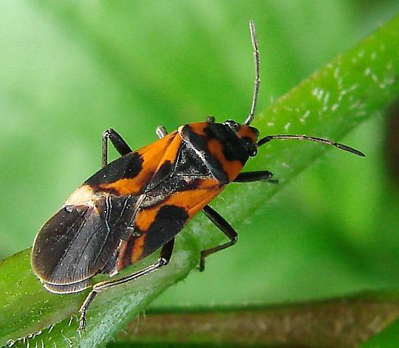
XX/XY (Lygaeus) mode of sex determination:
female gametes all have an X chromosome
male gametes have either an X or a Y chromosome
Zygotes with two X chromosomes (homogametous) = female offspring
Zygotes with one X and one Y chromosome (heterogametous) = male offspring

Slide 10
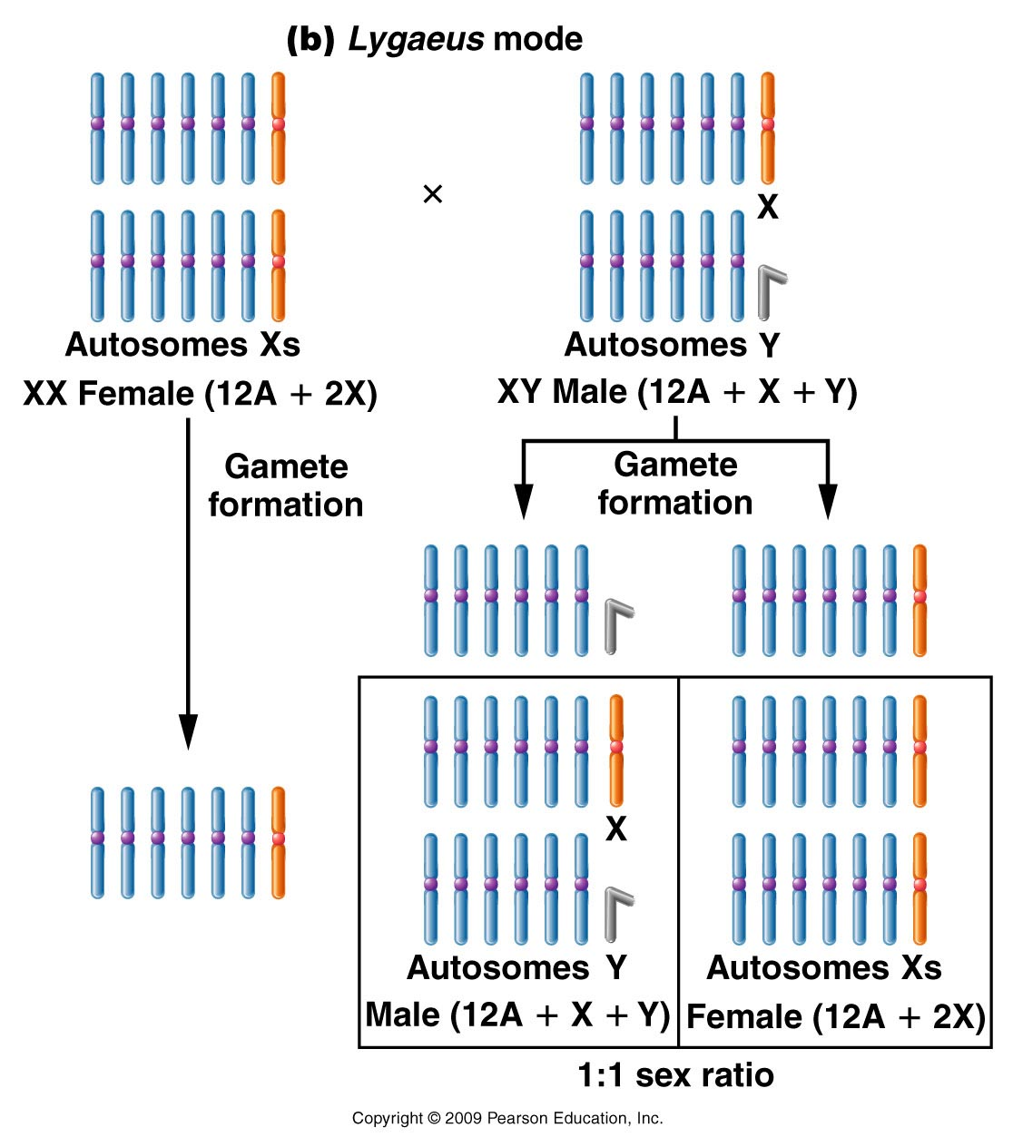
Figure 7.5b
Notes:
Figure 7-5b (a) The Protenor mode of sex determination where the heterogametic sex (the male in this example) is XO and produces gametes with or without the X chromosome; (b) The Lygaeus mode of sex determination, where the heterogametic sex (again, the male in this example) is XY and produces gametes with either an X or a Y chromosome. In both cases, the chromosome composition of the offspring determines its sex.

Slide 11
Contd..
Sex chromosomes play a decisive role in the inheritance and determination of sex.
Two methods:
Y chromosome mechanism (e.g., humans and other mammals)
X chromosome-autosome balance system (e.g., Drosophila, Caenorhabditis elegans nematode)

Slide 12
Contd..
Some species (including humans) have a gene SRY on the Y chromosome that determines maleness; others (such as the fruit fly) use the presence of two X chromosomes to determine femaleness

Slide 13
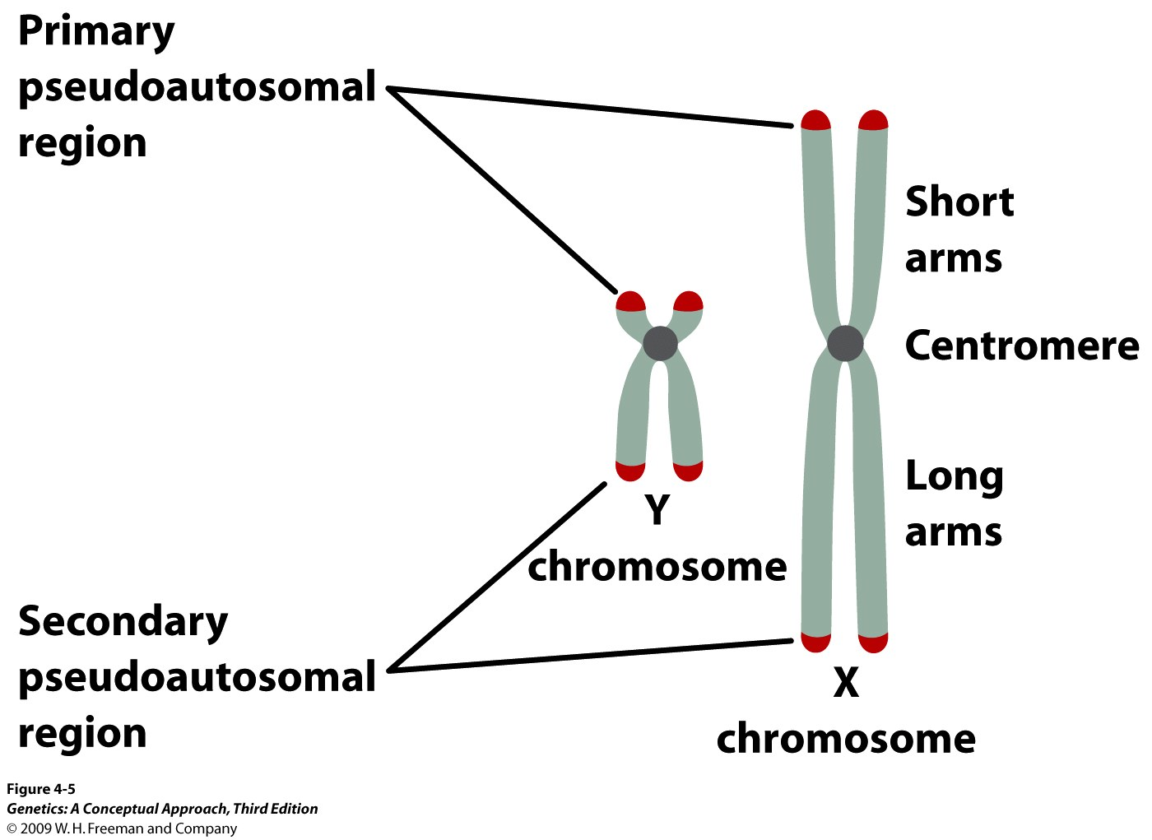

Slide 14
The Y Chromosome
The Y chromosome doesn’t have a lot of genes on it, but it encodes the important gene that determines the male phenotype:

Slide 15
Contd..
Testis determining factor (SRY gene): SRY stands for sex region Y. It encodes testis determining factor, which directs the embryonic gonads to develop into testes and begin secreting the male hormones testosterone and Mullerian Inhibiting Substance.

Slide 16
Male development in mammals
Mullerian Inhibiting Substance: Suppresses the formation of female ductal structures (uterus, Fallopian tubes, etc.)
Testosterone: Promotes the formation of male ductal structures (vas deferens, etc.) and associated sex glands (e.g. prostate) as well as the external genitalia.

Slide 17
Male development in mammals
Development of the male phenotype requires first and foremost the presence of an active SRY gene to direct formation of the testes, which will then drive formation of the appropriate ductal structures and external genitalia.
Development of the male phenotype in mammals is all about suppressing the female phenotype.

Slide 18
Male development in mammals
If the organism does not have an active SRY gene, which encodes testis determining factor, it will develop into a female, even though it is genetically male.

Slide 19
Contd..
If the organism does not have an active MIS gene, Mullerian (female) ductal structures will form, but the external genitalia will be normal. An affected individual is usually sterile because the testes do not develop normally and the presence of female ducts interferes with sperm transport.

Slide 20
Male development in mammals
If an individual has a mutation such that the testes do not secrete testosterone or the testosterone receptor is non-functional, the internal structures and gonads will develop into male structures, but the external genitalia will be female. These individuals are sterile and will not go through puberty.

Slide 21
The Conclusion
Male development in mammals is directed at every step. If there is a loss of direction, the subsequent development will follow the female pathway.

Slide 22
Dosage Compensation
Dosage compensation is the mechanism that keeps females (XX) from expressing twice as much of X-chromosome genes as males (XY), who have only one X chromosome.
Both sexes are rendered roughly equal by inactivation of one X chromosome in females.

Slide 23
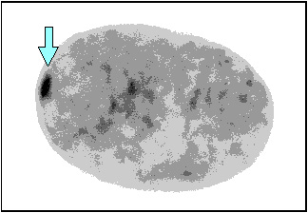
Barr Bodies
A Barr body is, simply, the extra, inactivated X chromosome.

Slide 24
Barr Bodies
No Barr bodies are observed in Turner (XO) females.
One Barr body is observed in Klinefelter (XXY) males and normal (XX) females.
All but one X chromosome is inactivated and are visible as Barr bodies in extra-X (XXX, XXXX, XXXY, etc.) individuals.

Slide 25
Dosage compensation is incomplete
Individuals with Klinefelter, Turner and extra-X syndromes are not perfectly normal, though.
There are two probable explanations:
First, the extra X chromosomes may not be inactivated right away and therefore may influence development prior to inactivation.

Slide 26
Dosage compensation is incomplete
Second, Barr bodies may not be completely inactivated such that the extra X chromosomes may produce over-expression of some X-linked genes at different times.

Slide 27
X-Inactivation
It is thought that early in embryonic development, X-inactivation occurs randomly (maternal or paternal chromosome is not targeted) in somatic cells of females.
Once inactivation has occurred, though, the same X chromosome will be inactivated in progeny cells after mitotic cell division (i.e., if the maternal X chromosome was inactivated in the progenitor, the maternal X chromosome will be inactivated in the daughter cells).

Slide 28
Calico cats: X-inactivation in action
In cats, base coat color is encoded on the X chromosomes.
Male cats have only one X chromosome, so can only express one base color.
Females have two X chromosomes, so can express two base colors. For example, say the sire of a kitty contributed the black gene and the dam contributed the red gene.

Slide 29
Calico cats: X-inactivation in action
Hair follicles derived from embryonic cells in which the maternal chromosome was inactivated will grow black hairs (express the paternal gene).
Hair follicles derived from embryonic cells in which the paternal chromosome was inactivated will grow red hairs (express the maternal gene).
Tortoiseshell cats do not have white patches, which is controlled by a separate gene.

Slide 30
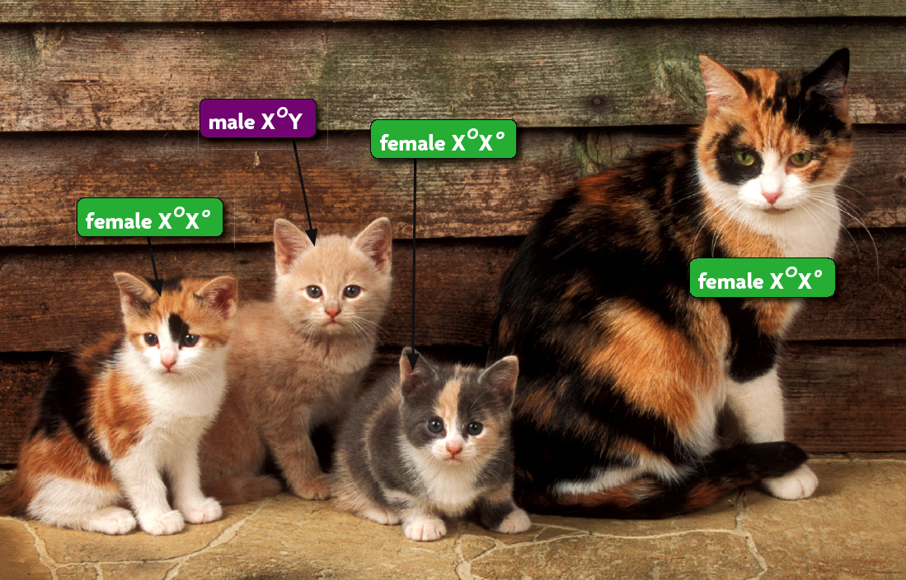

Slide 31
The Mechanism of Inactivation
Remember DNA methylation? That plays an important role in X-inactivation.
Now, I introduce you to another, more important player.

Slide 32
The Mechanism of Inactivation
There is a large gene on the end of the p-arm of the X chromosome thought to be a primary driver of inactivation.
It is called the X-inactive specific transcript (Xist), and expression of this transcript from an X chromosome results in inactivation of that chromosome.

Slide 33
Xist is a strange gene
The Xist gene is big, over a million bases long.
The RNA is not translated, and is thought to be a structural component of the inactivation process by physically associating with the inactive chromosome.

Slide 34
Evidence for the Y chromosome mechanism
Y chromosome confers maleness and determines sex.
Verified by studies of non-disjunction aneuploidy:
XO “Turner Syndrome”
Female
Sterile
1/10,000 (most XO fetuses die before birth).
XXY “Klinefelter Syndrome”
Male
1/1000
XYY-Male with above average height, fertility problems.
XXX-Female, normal though sometimes less fertile.

Slide 35
Cont..
In mammals, the default pathway of sexual development is female.
What this means is that an embryo will develop as a female unless chemical signals are present that indicate it should develop as a male.

Slide 36
Cont…
Remember Klinefelter and Turner syndromes?
It is the presence of the Y chromosome that determines maleness.
So, no matter how many extra X chromosomes are present in Klinefelter syndrome, the individual is always male. And in Turner syndrome, a single X chromosome is sufficient to determine femaleness.

Slide 37
UV sex chromosomes
In some Bryophyte and some algae species, the gametophyte stage of the life cycle, rather than being hermaphrodite, occurs as separate male or female individuals that produce male and female gametes respectively. When meiosis occurs in the sporophyte generation of the life cycle, the sex chromosomes known as U and V assort in spores that carry either the U chromosome and give rise to female gametophytes, or the V chromosome and give rise to male gametophytes

Slide 38
The Ratio of X Chromosomes to Sets of Autosomes Determines Sex in Drosophila

Slide 39
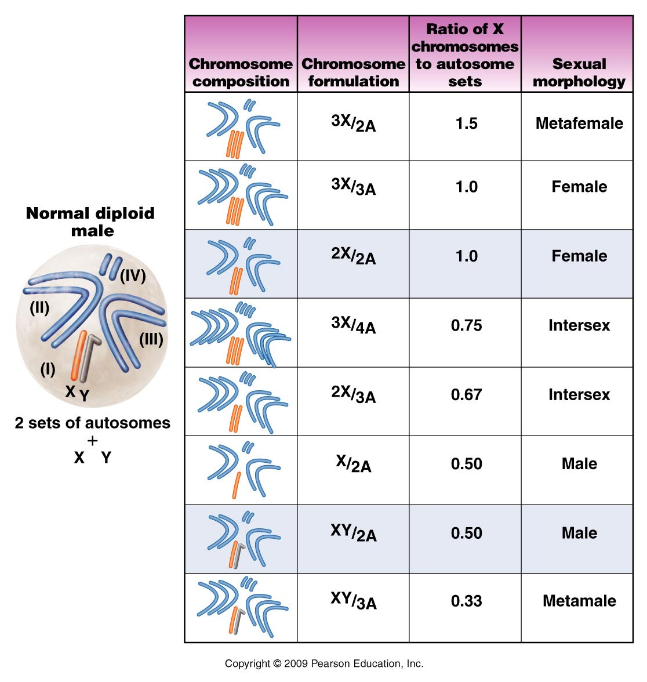
Figure 7.15

Slide 40
ZZ/ZW sex determination:
females are the heterogametic (ZW) sex
males are the homogametic (ZZ) sex
Birds, snakes, butterflies, some amphibians, and fishes

Slide 41
Haplodiploidy system:
Haploid set – male
Diploid set – female
Bees, wasps, and ants

Slide 42
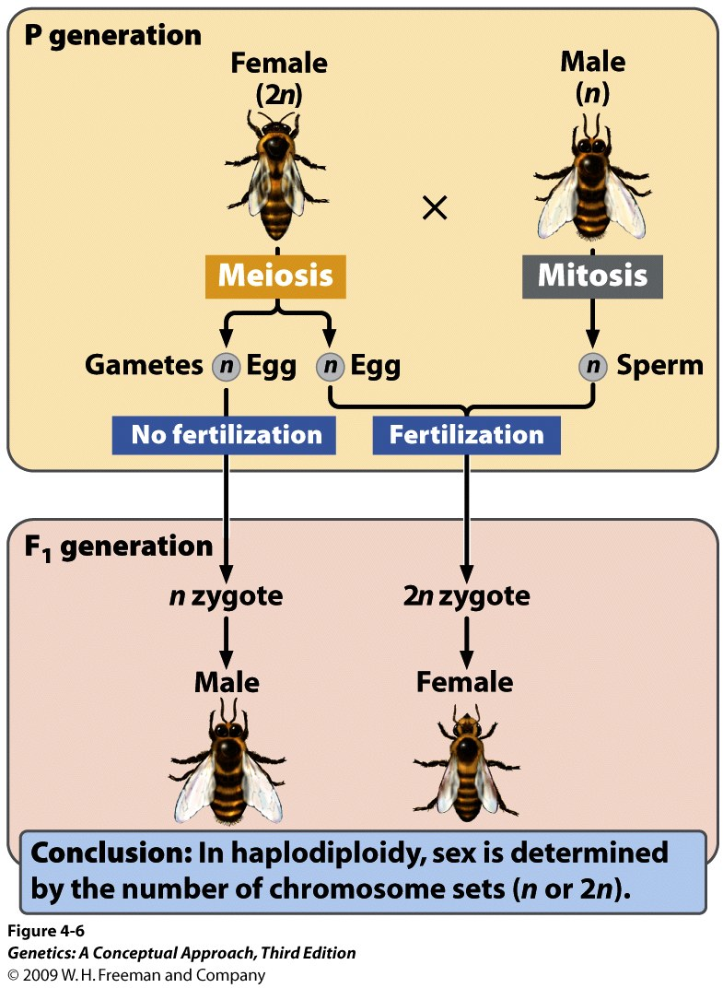

Slide 48
Non-genetic sex-determination systems
Environmental variables (such as temperature)
Social variables (e.g. the size of an organism relative to other members of its population)

Slide 49
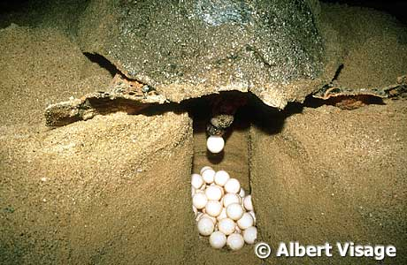
Temperature-dependent sex determination
Sex is determined by environmental variables (such as temperature)
e.g., Turtles use temperature
> 32°C produces females
< 28°C produces males

Slide 50
Other factors
In tropical clown fish, the dominant individual in a group becomes female while the other ones are male.
In the marine worm (Bonellia viridis), larvae become males if they make physical contact with a female, and females if they end up on the bare sea floor.

