Slide 1
ANTIMICROBIAL RESISTANCE
M.MUDASSIR NAWAZ
Notes:
ANTIMICROBIAL RESISTANCE

Slide 2
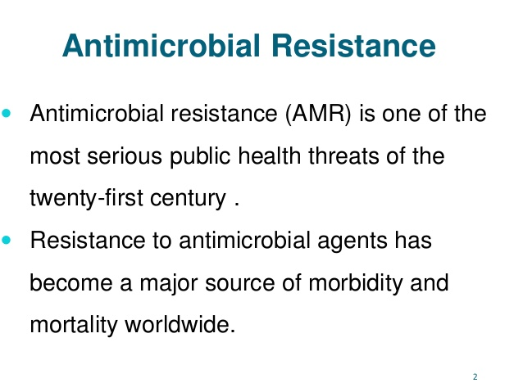

Slide 20
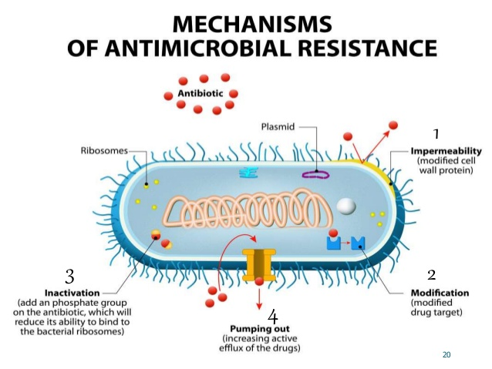

Slide 40
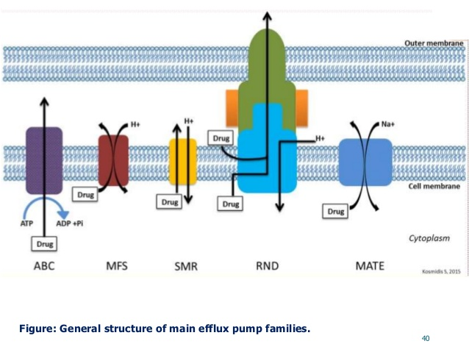

Slide 42
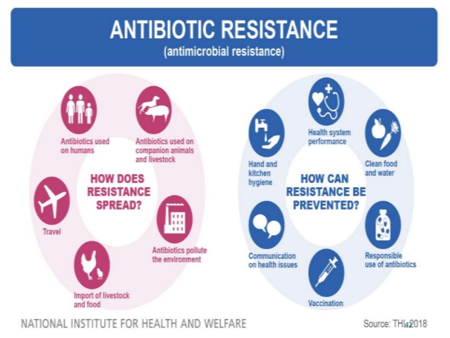

Slide 43
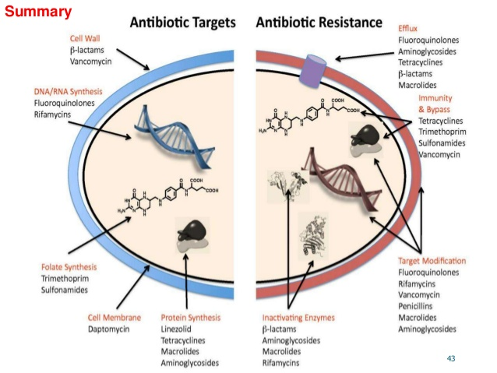

Slide 44
