Slide 1
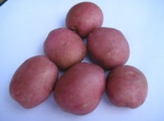
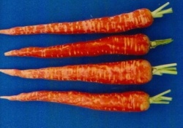
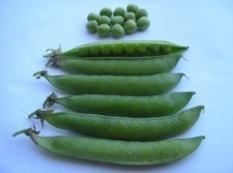
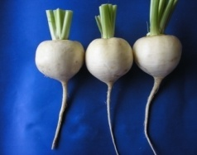
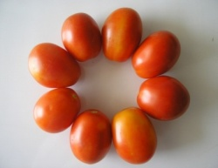
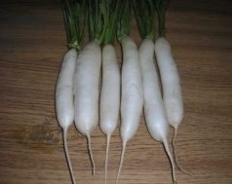
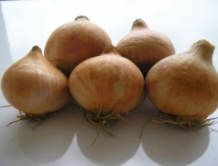
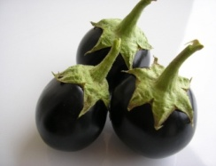
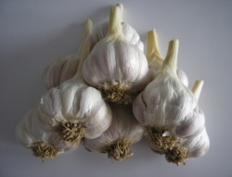
Horticulture?
HORT-201
University College of Agriculture,
University of Sargodha

Slide 2
Plant
Propagation

Slide 3
Propagation
Art and science of multiplication of individual or group of plants
Perpetuation of plants is called propagation
It involve development of one into several plants
Development of new individuals

Slide 4
Successful plant propagator must know the knowledge of
Genetic
Growth characteristics
Adaptability to climate
Soil
Principles and limitations of each mode of propagation

Slide 5
Establishment of nursery
Very important for high quality orchard
Should be raised in controlled conditions
Should be located in important production area
Soil should be deep, fertile. Well drained and free from soil born pathogens
Adequate water supply
Easily accessible
Skilled labour
Equipment's and fertilizers, fungicides
According to need, the nursery should have lath house, green house, seed germinator and mist propagation
Seedling and rootstock material
Resources to provide bud wood.

Slide 6
Methods of propagation
1) Sexual Propagation
2) A sexual propagation

Slide 7
Sexual Propagation
Multiplication of plants by seeds
Polyembryony
Zygotic seedling
Nucellar seedling

Slide 8
Advantages of Seed propagation:
Seedling trees generally live longer
Bear more heavily
harder than vegetative propagated trees.
Seedlings are comparatively cheap, and can be more easily raised than vegetative propagated materials
Plants which are difficult to propagate, e.g., Guava, papaya and phalsa by vegetative method can only be propagated by seed.
Polyemryony; more plant from single seed
Breeding of hybrids through seeds
New varieties and in raising seedling to be used as rootstock for vegetative propagation

Slide 9
Disadvantages of seed propagation:
seedling trees are not uniform in their growth,
yielding capacity, fruit quality compared with
asexually propagated plants.
Seedling trees are not usually true to type and show variation.
Seedling trees take more time to come to bearing than grafted plants

Slide 10
Preparation for Sowing
Collection of seed
Storage of seed
Pre-germination seed treatments
Sowing

Slide 11
Collection of seed
Reliable sources
Good fruit and quality characteristics
Fully mature
Taken from healthy and vigorous plants with a high degree of disease resistance

Slide 12
Storage of seed
Seed of evergreen plant lose viability soon after extraction
Should be sown without prolonged storage
If necessary to store
Washed, surface dried and mix with an equal part of ground charcoal (burned wood)
Packed in suitable wooden or metallic container
Stored in a dry, cool place at temperature(3 to 13 ⁰C)

Slide 13
Pre-germination seed treatment
Apple, pear, peach plum and cherry
Seed need certain period of rest after extraction before they will germinate
Stratification
The must be stored with alternate layers of moist sand, at a controlled cold temperature and suitable moisture conditions before sowing
Scarification
Scarification
Altering the seed coat by breaking, cracking or chemically to make it permeable to water and gases

Slide 14
Seed Sowing
Sowing containers are filled with potting mixture of equal parts of top soil, sand and well rotted leaf mold or FYM
In nurseries
Seed sown in line 10 cm apart
Sowing depth 2 to 3 times the diameter of the seed
Seeds are covered with sand or leaf mold and water after sowing

Slide 15
Asexual propagation
It is called with different names
Asexual propagation
Vegetative propagation
Clonal propagation (Cloning. A plant population that is propagated vegetatively from a single original stock is called a clone.)
Asexual propagation is reproduction by means of vegetative parts of the plant such as
Stem
Roots
Shoots
Leaves
Corms
Buds
Suckers
Rhizomes
Tubers

Slide 16
It involves the use of any part of the plant, other than seed i.e. vegetative parts –hence vegetative propagation. The vegetative organs of many plants have the capacity (ability) for regeneration
,

Slide 17
Advantages:
Asexually propagated progeny are identical to their parents in all respects
Low headed
Bear earlier
Uniformity in fruit quality

Slide 18
Dis-advantages:
No, new variety can be evolved
More expensive than seed propagation
Vegetative propagated plants are comparatively short lived
Vegetative propagated plants are comparatively less hardy and vigorous
Transmit viral diseases from plant to plant
Need skilled labour

Slide 19
Methods of asexual propagation
Layering
Cuttings
Grafting
Buddings

Slide 20
Layering
Layering means rooting of shoots, stem or branches while they are still attached to the parents
Blackberry and strawberry are produced natural layering
The young plant continues receiving nutrition from the parent plant
Layering can be carried out in the spring or late summer months

Slide 21
Different methods of layering
Tip layering
This methods involves shoot tips which are buried 3-5 cm in the soil to encourage the development of fibrous roots
After which the root tip portion are separated as individual plant
Blackberry

Slide 22
Air layering or marcottage
Locally known as ghooti
Common in guava and litchi
In those areas where high rainfall is abundant and humidity very high
A cut or ring is made on the mature and healthy vigorously growing branch just below a node
A very small stone is pushed slightly into the cut to prevent the two sides from reuniting

Slide 23
Then cut is covered with sphagnum moss or wrapped with a mixture of sawdust and mud
A pot is hung just above the layering so that water drips on it and keeps it moist
When you are using sphagnum moss and polyethylene as wrapping material then no need for water drips
Plastic film allows the gases but does not allow moisture to escape

Slide 24
This helps the retention of moisture by the moss without interfering in respiration
Rubber stripes are used to tie the ends of the polyethylene enclosing the moss
Suitable time is spring when lot of humidity in the air
Roots developed with in three to four months
Layers are carefully removed from parent plants and wraps are removed
The layers are then placed in pots containing well decayed leaf mold or soil mixed with well rotted FYM

Slide 25
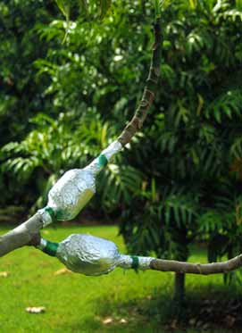
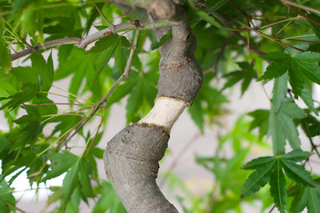
Air layering or marcottage

Slide 26
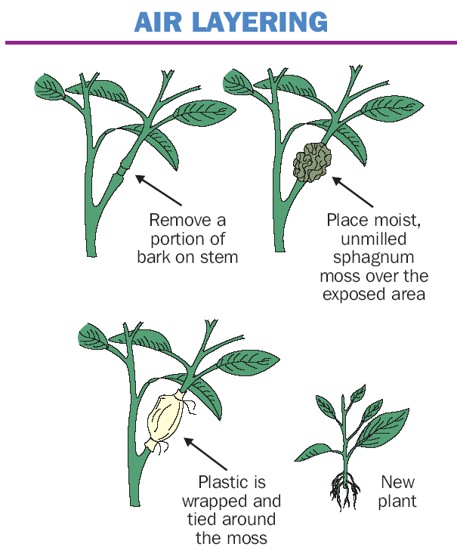
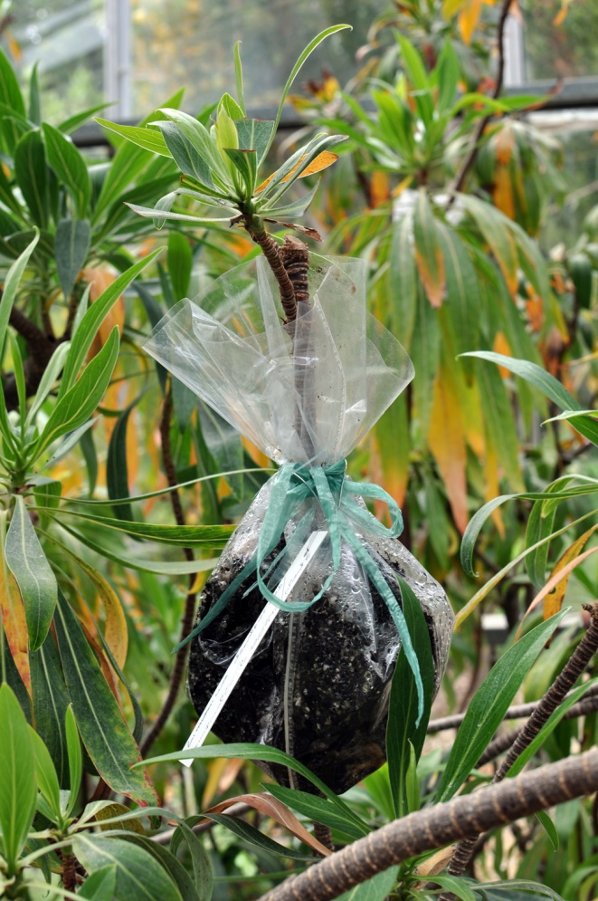

Slide 27
Ground or simple Layering
In ground layering, instead of wrapping, the rigged or notched portion is buried in the ground or in the prepared pots
After two months, a half cut is made in the parent branch just below the layering
If no wilt is noticed, it indicates that the new layer has developed roots
The layering is separated and set out as an independent plant

Slide 28
Serpentine or compound layering
With some species which give long and flexible branches
The shoot to be layered is covered with soil at several places to encourage rooting at more than one point
This method is known as serpentine layering

Slide 29
Mound or stool layering
This technique involves cutting down the parent to ground level
The stubs or stools are earthed up to encourage the growth of shoots
Emerging shoots are earthed up gradually until one-third to one-half of their length is covered with soil
The growth of shoot is completed in darkness results in etiolation (blanching)
This etiolation induces development of roots at the basal ends
These are detached and transplanted in nursery
This method used in mango, guava dwarfing rootstocks of apple

Slide 30
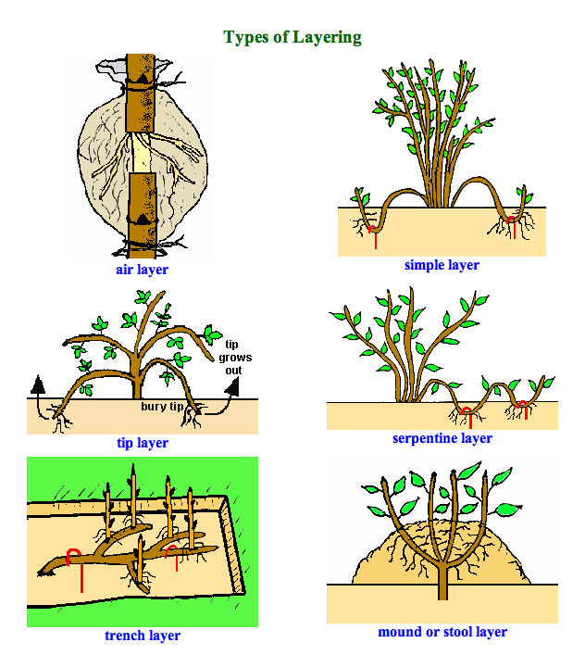

Slide 31
What is the difference between a sucker and an offset of plant?
An offset is a short thick runner like branch which produces a new plant at its tip and a sucker is lateral branch arising close to the ground level, traveling underground for some distance, turning up at its end and producing a new plant.
The difference between stolon and runner
stolon is a shoot that grows along the ground and produces roots at its nodes; a runner while runner is a long stolon sent out by a plant (such as strawberry), in order to root new plantlets.

Slide 32
Cutting
Cutting is a piece of a plant: a shoot, root, leaf or a tiny piece of meristem
Cutting have capacity to produce roots and shoots
Any detached plant part that can regenerate missing parts making a complete plant.
Most important means of propagation
Grapes
Guava
Lemon
Limes
Roses

Slide 33
ROOT CUTTING
Roots cut into pieces (10-25cm long)
Planted horizontally in beds or pots
e.g. perennial shrubs, guava, apple, pear, cherry & persimmon
But not common in Pakistan

Slide 34
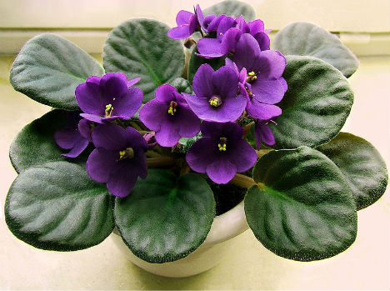
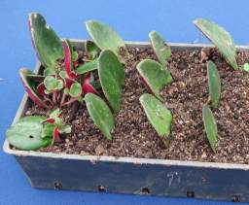
Leaf Cutting
African violets, begonias, jade and peperomia

Slide 35
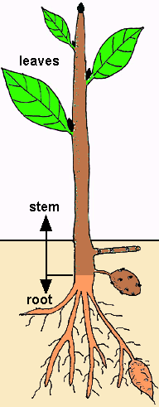
Leaf cuttings
Leaf bud, leaf petiole,
leaf blade leaf section
Stem cuttings
Hardwood, semi-hardwood, cane, rhizome
Tuber, root cutting and tuberous root
Types of Cutting

Slide 36
STEM CUTTINGS

Slide 37
Soft-wood cuttings (SWC)
Soft-wood cuttings, as the name suggests, are taken when the stem is still soft and succulent in spring or early summer, and generally consist of terminal portions of the shoots. Sometimes middle and basal portions are also used, provided they are soft and sappy.
Soft-wood cuttings are mostly used to propagate flowering shrubs and guava.
Cuttings of guava from terminal shoots root easily in misty conditions.

Slide 38
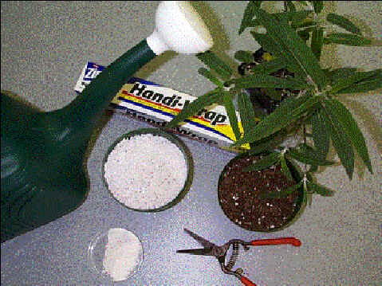
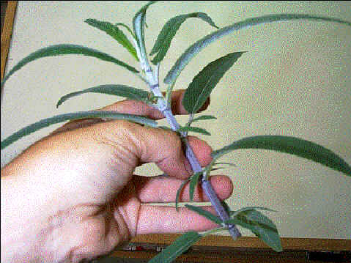
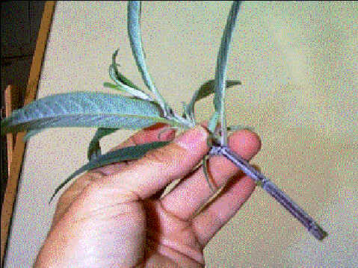
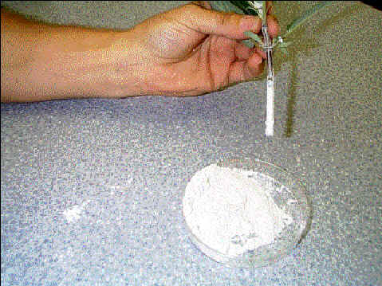

Slide 39
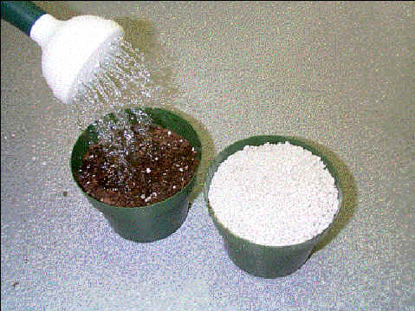
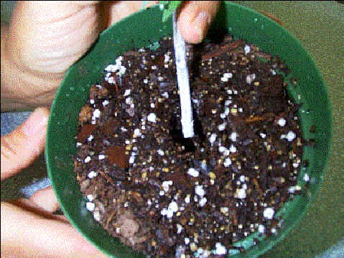
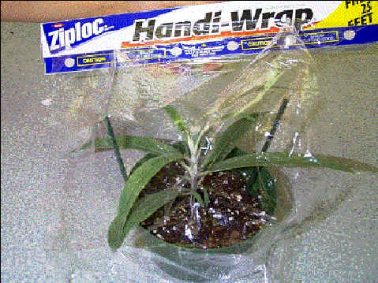
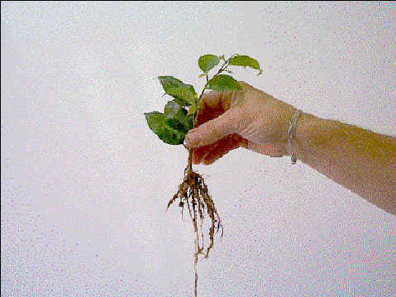

Slide 40
Hard wood Cuttings
Taken from previous season’s mature growth
When stem has shed leaves and is hard
Cut the mature wood varying from 18-25 cm in length
The upper cut, about 5 cm from node, is made at a right angle, to reduce the size of wound
The cutting are planted 15 cm from each other in rows 30 cm apart
generally two thirds of hard wood cutting and one half soft wood cuttings inserted into the soil

Slide 41
The beds or pots are kept moist by daily irrigation
Root growth is favored by a soil temperature of 18-21 ⁰C
In evergreen; early spring or the rainy season
Deciduous; dormant season
Fig
Grapes
Plum
Sweet limes

Slide 42
PGRs
IAA
IBA
NAA
Aqueous solution or powder of about 0.01% or 1000 ppm

Slide 43
Division
Division involves separating vegetative parts like rhizomes, offsets, runners or suckers from the parent plant and establishing them as independent plants
Strawberries by runners
Date palm by suckers
Banana by suckers and rhizomes
Pineapple by offsets and crown

Slide 44
Offshoots; lateral shoot or branch that develops from the base of the main stem
Corms; swollen stem with distinct nodes and internodes enclosed by the dry, scale like leaves as gladiolus
Crown; it is the part of the plant which remains at the surface of ground from which new shoots are produced
Runner; It is a stem that develops from the axil of the leaves at the crown of the plant
Sucker; it is a shoot that arises from adventitious bud on a root

Slide 46
Grafting
Grafting is a process by which two different plants are united so that they grow as one.
When a piece of stem or branch carrying more than one bud is used, the process is known as grafting
In this process scion and rootstock unite due to cambium cell division

Slide 47
Grafting TERMS
Rootstock
The basal part
Provides roots system
Absorption of nutrients and moisture
Scion
Provide the top
Fruit bearing surface
Synthesized food

Slide 48
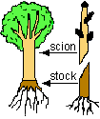

Slide 49
Scion
Rootstock

Slide 50
Reasons for Grafting:
To insert a different variety of desired on part of the limbs of trees
Obtain benefits of certain rootstocks

Slide 51
Benefits:
Disease resistant rootstocks
Stronger root systems
Dwarfing capabilities

Slide 52
Requirements for Success
Stock and Scion must be compatible
Cambium layers must match
True to true type
Desirable yield and fruit characteristics
Buds should be mature, well developed

Slide 53
Grafting methods

Slide 54
Inarching or approach grafting's
Unlike other grafting methods, scion is attached with parent plant
Mostly used in mango
One year old plant is planted in 12 inches deep and 8 wide at the top
Potting of seedling is usually done one month ahead of actual
Spring and raining season is best
inarching operation
A slanting cut of 5cm long and 2 cm deep
At a height of 15-20 cm
Similar cut is made on scion
Brought together and tied them with plastic film

Slide 55
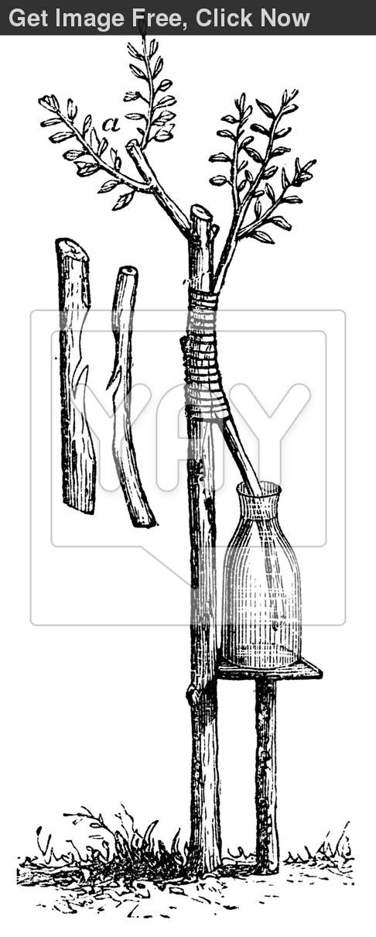

Slide 56
The union takes place with in three to four months
When graft is still attached to the parent
First cut 5 cm below the graft union
This process from incision to removal is completed with in 7 to 10 days
After removing kept under shade for about two weeks
Four to six months in the nursery then planted in the field

Slide 57
Wedge or cleft grafting
This method is used
Deciduous fruits and top-working inferior older trees of inferior varieties
Rootstock 1.25 to 5.0 cm thick even larger
Cut at the top
Vertical split 5-8 cm deep in the center of the stub
Scion which contain three bud
Interested into rootstock

Slide 58
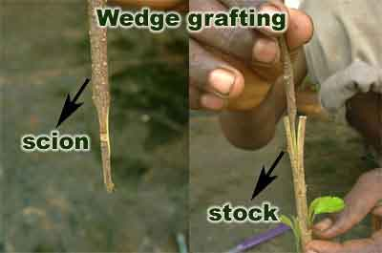

Slide 59
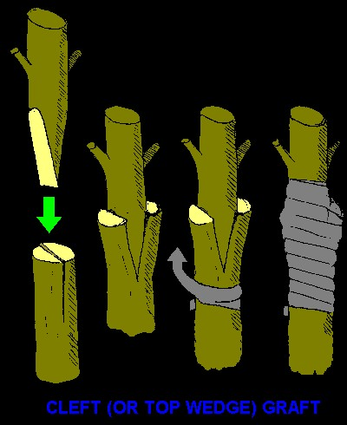

Slide 60
Splice Grafting
A slanting cut about 10 cm long is made at the basal end of scion
Which is placed on a corresponding cut made on the rootstock seedlings
At a height of 30-45 cm from ground level
then tied together
Three week to three months
Mango--- Philippines
Apples ----- Brazil

Slide 62
Tongue grafting
Scion and rootstock cut exactly as splice grafting
Tongue shape slits are made on scion and rootstocks
The secondary cut slit or cut are half the original slanting cuts
Then brought together, firmly interlocked
The graft wound are waxed over, with or without tying

Slide 63
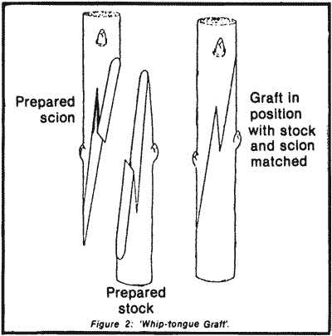

Slide 64
Bark Grafting
Unlike in the cleft grafting
The stub of the stock is not cut horizontally
Instead, several scions with their basal ends trimmed as wedges are inserted between bark and the wood
The operation is done during spring when the bark can be loosened more easily

Slide 65
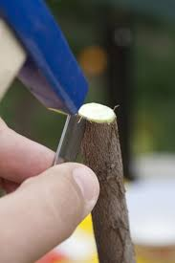
Bark grafting

Slide 68
Bridge grafting
Bridge grafting is practiced to save valuable trees and damaged trunks
To prepare the tree trunk for bridge grafting damaged part is trimmed back to healthy tissues by removing dead or torn bark from the affected parts
Bridge grafting is best performed during early spring when the bark can be lifted easily
Scions of sufficient length to bridge over the damaged area are taken
One long slanting cut is made on each end of the scion, both cuts on the same side

Slide 69
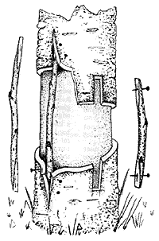

Slide 70
Veneer grafting
Most common on guava and mango
Graft wood 10 cm in length is removed from the scion and grafted on stock seedling at a point having almost the same girth as that of scion

Slide 71
Side grafting
Vigorous rootstock are selected
12-13 cm long mature stick is taken from scion of desired variety
Their leaves are removed
Two to third year old stock tree planted in orchards
A longitudinal cut of 5-8 cm is made like a wedge

Slide 72
An oblique cut is made in the stock at an angle of 20-30 degrees and about 2.5 cm deep and scion is inserted in the cut portion and gently pushed down until it is fixed in the bark
Both spring (March and April) and autumn (August-September)
90 % success during spring

Slide 73
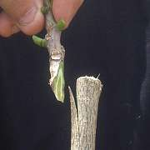
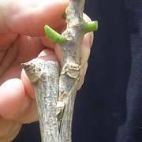
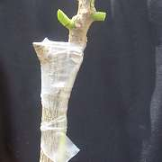

Slide 74
T grafting
A T-shaped cut is made in the stock bark, into which
The scion is inserted and firmly wrapped waxed tape.
Graft union is covered with polyethylene

Slide 75
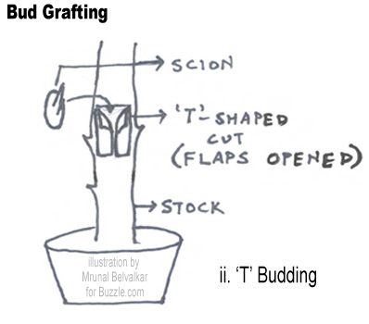

Slide 76
Top working
This method practiced is to dehorn the tree branches or main limbs to within 25 cm or so for the main trunk of the tree
Early spring
The stumps become reading for grafting during summer or autumn months

Slide 77
Since in plains there is danger of sunburn injury, the naked trunks are protected by whitewashing
In order to provide shade until the new top is established, sometimes a few of weaker branches are left and dehorned
Complete changeover of the top may extend over more than one season

Slide 78
Budding

Slide 79
Budding
Actually a form of grafting
A single bud is used as a scion
Budding is quicker

Slide 80
Shield or T-budding
Most common in
Citrus, Ber, apple, loquat and roses
A narrow shield of bark 3-4 cm in length, bearing a single node is removed
A vertical cut of 3-4 cm in length is made on rootstock
A horizontal cut about 1.25-1.5 cm long is made at the top, so cut resembles the letter “T”

Slide 81
Some time inverted T cut is made in Raining areas to avoid moisture
The bud is inserted under the bark, which has been loosed from the wood
Bud should be wrapped to hold bud and to exclude air and moisture
Bud union take four weeks to complete
When sprouts grown about 10 cm. then rapped material is removed

Slide 82
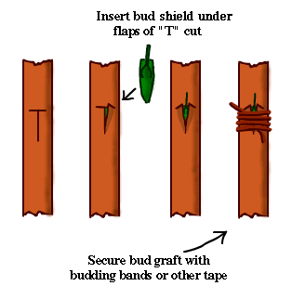

Slide 83
Chip Budding
Very similar to T-budding
A single bud with large piece of wood is placed on a corresponding cut made on the stock and tied firmly
Advantage: wood can be dormant, bark doesn’t have to slip
Widely used for grapes

Slide 84
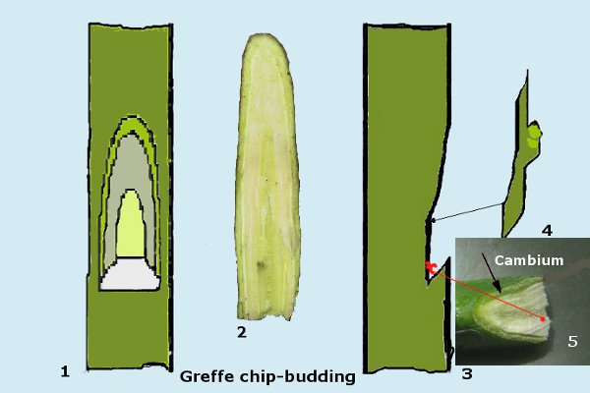

Slide 85
Ring buddings
In this method, a ring of bark 1.5-2.0 cm in length
Containing a well-developed bud is loosened on the scion shoot
gently pulled out from the thinner end of the shoot
The top of the seedling is removed and the bark is peeled off downward to a point
Where the ring of the bark bearing the bud fits tightly
No tying is necessary in ring budding
This method used in ber, mulberry, peach and plum

Slide 86
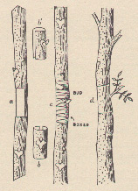

Slide 87
Flapped or patch buddings
A rectangular or square flap of bark on the stock is loosened on three sides
The corresponding bud is inserted underneath the loosened flap of bark
The flap is then placed over the bud and wrapped
It takes about two months for bud sprouts
Then wrapping material is removed
Mngo and guava

Slide 88
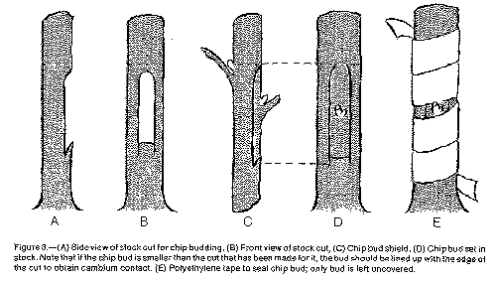

Slide 89
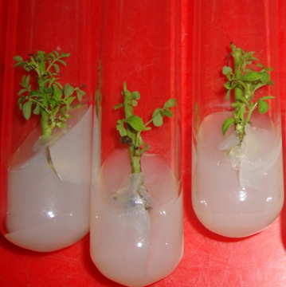
Tissue culture

Slide 90
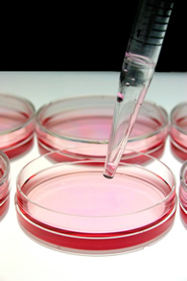
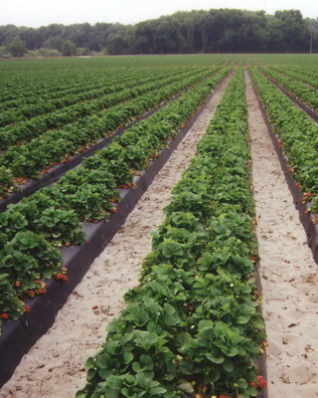
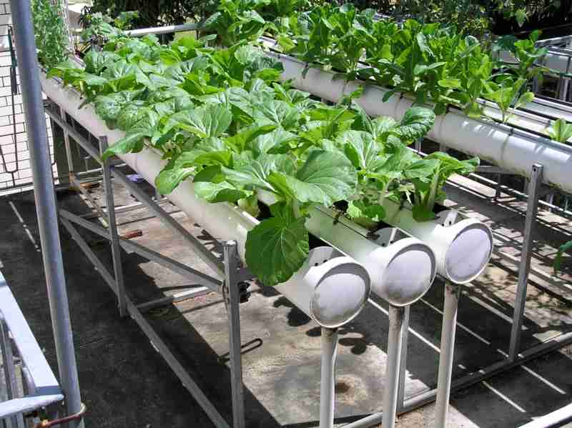
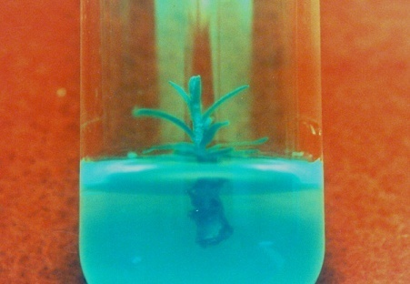
Cultures
Cell culture
Agriculture
Hydroponics
Tissue culture

Slide 91
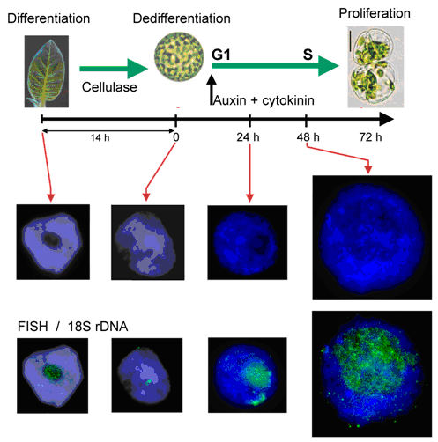
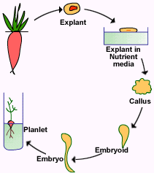
Important principles
Totipotency
Differentiation

Slide 92
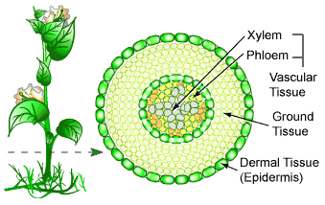
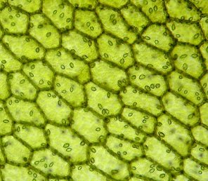
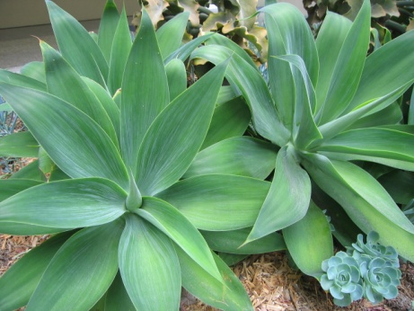
What is tissue culture?
It is a technique of growing cells, tissues, organs or whole organism in vitro (in glass) on artificial culture medium under aseptic and controlled conditions.

Slide 93
Types of tissue culture
Plant tissue culture
Animal tissue culture

Slide 94
Animal tissue culture

Slide 96
Plant tissue culture

Slide 97
Micropropagation
Rapid vegetative propagation of several agricultural and horticultural crops.
Replacing the conventional methods of propagation.
The mass multiplication of agricultural, horticultural, medicinal and other desirable plants by tissue culture techniques is known as micropropagation/clonal propagation.

Slide 98
Clone
Genetically same genome

Slide 99
Characteristics of in vitro culture
The micro scale
The optimum conditions
The aseptic conditions
The un usuall growth pattern
Cellular or subcellular functions

Slide 100
Objectives
Rapid clonal multiplication
Propagation of difficult to root plants
Elimination of diseases
Synthetic or artificial seeds
A supplement to traditional plant breeding's techniques
Genetic engineering

Slide 101
Requirements for establishing tissue culture
Preparation Area
Inoculation or transfer room
Growth room
Green house

Slide 102
Commercial consideration
Capital investment
Expertise
Range of applicability
Major crops
Minor crops

Slide 103
Problems
Phenolic compounds
Phenolic compounds produced in the plants
whose oxidation products not only darken both tissues and media as well inhibit the growth

Slide 104
Vitrification
The development of swollen, disorder leaves which become irreversibly translucent and necrotic, a condition that may lead to the death of the shoot cluster
Referred as water soaking

Slide 105
Bacterial contamination
Contamination occur due to microorganism, particularly bacteria

Slide 106
Quality of plants propagated
Genetic difference occurred when proper media and conditions are not provided

Slide 107
Supply of electricity
Continuous supply of electricity is essential for tissue culture techniques

Slide 108
Measuring of PH

Slide 109
Autoclave for sterilization

Slide 110
Medium preparation

Slide 111
Composition of media
Macro-nutrients= 100 ml/L
Micro-nutrients= 1 ml/L
Vitamins = 10 ml/L
Iron = 10 ml/L
Sugar= 30 g
Agar = 6-8 g/L

Slide 112
Types of medium
1. Solid medium: 6-8% agar-agar
2. Semi solid medium: Less amount of agar
3. Liquid medium: Agar is not added. It is used for cell suspension culture.

Slide 113
Tissue culture units
Universities
Research laboratories
Private firms
Nurseries

Slide 114
Application of tissue culture
Rapid propagation.
Minimum growing space is required.
Multiplication of medicinal plants.
Pathogen free plants -meristem culture.
It is useful in the plants like papaya, coconut, etc.
Large number of plants can be stored in the small space.

Slide 118
Seed Culture

Slide 119
Anther culture

Slide 120
Protoplast culture

Slide 121
Trench layering
establishment of the mother bed: 1-year-old trees are planted at a 30˚-45˚ angle
the following season, trees are laid flat in a trench, staked down and covered (just barely) with soil
as buds break and grow out, soil is added, leaving shoot tips exposed
6-8 in. rooted layers (e.g., ‘Paradox’ walnuts) can be harvested at the end of the growing season

Slide 123
Plant modifications (natural layering)
tip layering
runners and stolons
offsets
suckers
crown division

