Slide 1
Plot of the “Tess Of the D’Urbervilles”

Slide 6
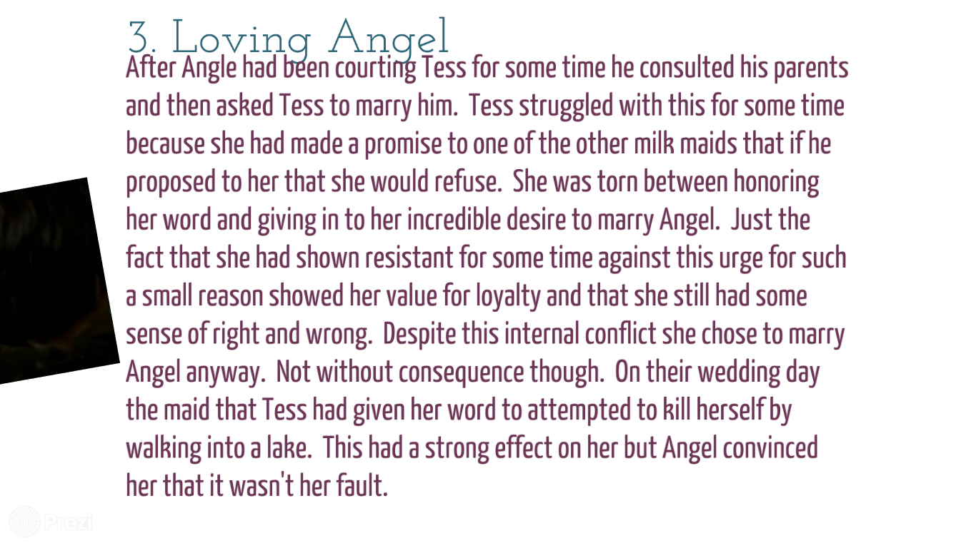

Slide 7
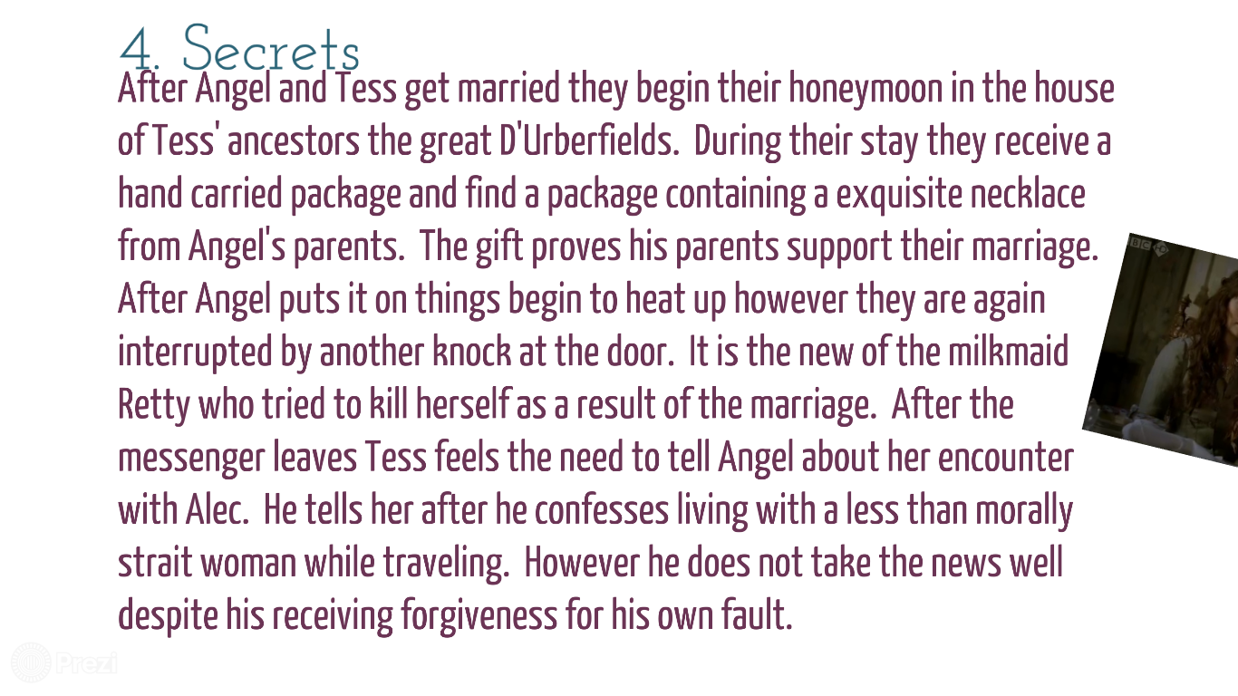

Slide 10
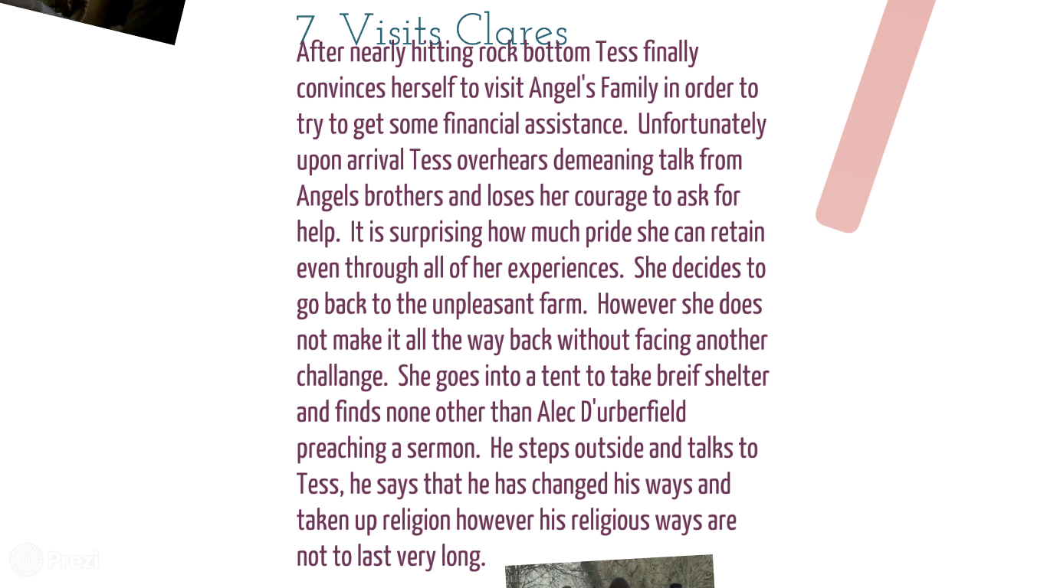

Slide 16
Characters:

Slide 22
Themes of the Tess of the D’Urbervilles

Slide 23
Following themes are highly mentioned in Tess of the D’Urbervilles: Injustice of Existence Changing Ideas of Social Class Men dominating Women Fate vs Free will Women and Feminity Justice and Judgement Contrasting Regions Marriage Love Time Sex Memory and Past Religion

