Slide 1
Weed management

Slide 2
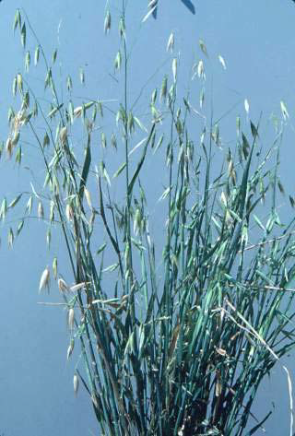
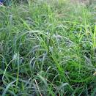
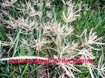
weed
A weeds is a plant growing where it is not wanted
Weed is an unwanted plant.
A plant out of place
A plant that is extremely noxious, useless, unwanted or poisonous.

Slide 3
weed problems
The total annual loss of agricultural produce
1) Weeds: 45% 2) Insects: 30% 3) Diseases: 20% 4) Other pests (Rats, wild animals)
A recent estimate shows that weeds cause annual loss of Rs. 1980 crores to Agricultural which is more than combined losses caused by insects, pests and disease.
Weeds depleted crop’s environment of nutrients, water, light and space. Crop yields are reduced considerably. In addition, weeds interfere and cause inconvenience to agriculture operations. The quality of produce is reduced by weed infestation .
Weed management is an important component of plant protection improving the production potential of crops.

Slide 4
Methods of weed management
For designing any weed control programme in a given area, one must know the nature & habitat of the weeds in that area, how they react to environmental changes & how they respond to herbicides.
Principles of weed management are;
Prevention
Eradication
Control

Slide 5
a. Preventive weed control
It is a long term planning so that the weeds could be controlled or managed more effectively and economically than is possible where these are allowed to disperse freely.
Following preventive control measures are suggested for adoption wherever possible & practicable.
Avoid using crop that are infested with weed seeds for sowing
Avoid feeding screenings and other material containing weed seeds to the farm animals.
Avoid adding weeds to the manure pits.
Clean the farm machinery thoroughly before moving it from one field to another. This is particularly important for seed drills
Avoid the use of gravel sand and soil from weed-infested
Cont…

Slide 6
6. Inspect nursery stock for the presence of weed seedlings, tubers, rhizomes, etc.
7. Keep irrigation channels, fence-lines, and un-cropped areas clean
8.Inspect your farm frequently for any strange looking weed seedlings.
9. Quarantine regulations are available in almost all countries to deny the entry of weed seeds and other propagules into a country through airports and shipyards.

Slide 7
Weed free crop seeds
Separating crop seeds from admixture of crop & weed seeds using physical differences like size, shape, colour, weight / texture & electrical properties
b. Eradication: (ideal weed control rarely achieved)
It infers that a given weed species, its seed & vegetative part has been killed or completely removed from a given area & that weed will not reappear unless reintroduced to the area.

Slide 8
c. Control
In control methods, the weeds are seldom killed but their growth is severely restricted, the crop makes a normal yield.
Weed control methods are grouped into cultural, physical, chemical and biological.
Every method of weed control has its own advantages and disadvantages.
No single method is successful under all weed situations. Many a time, a combination of these methods gives effective and economic control than a single method.

Slide 9
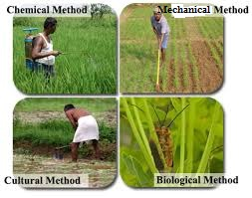
COMPONENTS OF WEED MGT.

Slide 10
Mechanical Weed Control
Mechanical or physical methods of weed control are being employed ever since man began to grow crops. The mechanical methods include tillage, hoeing, hand weeding, digging cheeling, sickling, mowing, burning, flooding, mulching etc
Tillage:
Tillage removes weeds from the soil resulting in their death. It may weaken plants through injury of root and stem pruning, reducing their competitiveness or regenerative capacity.
2. Hoeing:
Hoe has been the most appropriate and widely used weeding tool for centuries. It is however, still a very useful implement to obtain results effectively and cheaply.
3. Hand weeding:
It is done by physical removal or pulling out of weeds by hand or removal by implements called khurpi, which resembles sickle.

Slide 11
4. Digging:
Digging is very useful in the case of perennial weeds to remove the underground propagating parts of weeds from the deeper layer of the soil.
5. Sickling and mowing:
Sickling is also done by hand with the help of sickle to remove the top growth of weeds to prevent seed production and to starve the underground parts.Mowing is a machine-operated practice mostly done on roadsides and in lawns.
6. Burning:
Burning or fire is often an economical and practical means of controlling weeds.
8. Flooding:
Flooding kills plants by reducing oxygen availability for plant growth. The success of flooding depends upon complete submergence of weeds for longer periods.

Slide 12
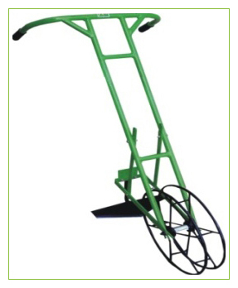
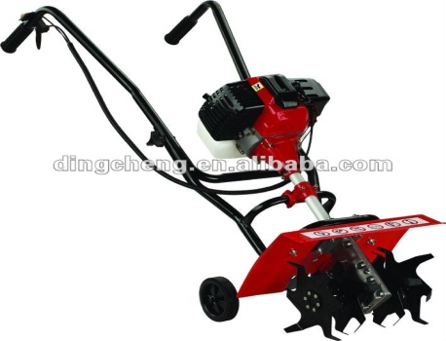
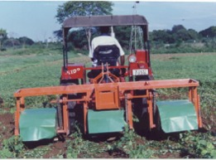
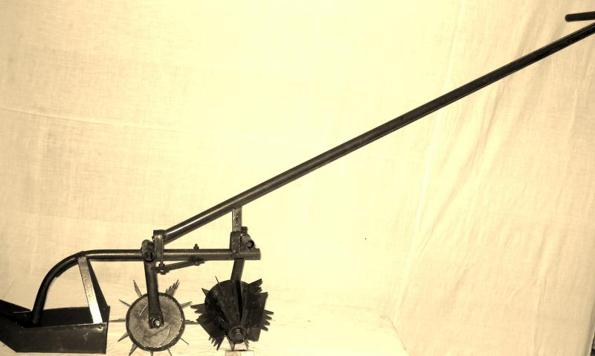
Mechanical weeders
Dry Land Weeder
Power rotary weeder
Tractor operated multi row rotary weeder
Cono weeder

Slide 13
CULTURAL WEED CONTROL
Several cultural practices like tillage, planting, fertiliser application, irrigation etc., are employed for creating favourable condition for the crop. These practices if used properly, help in controlling weeds.
1.Field preparation:
The field has to be kept weed free. Flowering of weeds should not be allowed. This helps in prevention of build up of weed seed population.
2. Summer tillage:
The practice of summer tillage or off-season tillage is one of the effective cultural methods to check the growth of perennial weed population in crop cultivation.
3. Maintenance of optimum plant population:
Lack of adequate plant population is prone to heavy weed infestation, which becomes, difficult to control later
4. Irrigation and Drainage:
Frequent irrigation or rain during initial stage of crop growth induced several flushes of weed. In lowland rice, where standing water is present most of the time, germination of weeds is less.

Slide 14
5. Crop rotation:
The possibility of a certain weed species or group of species occurring is greater if the same crop is grown year after year.
6. Growing of intercrops:
Inter cropping suppresses weeds better than sole cropping and thus provides an opportunity to utilize crops themselves as tools of weed management.
7. Mulching:
Mulch is a protective covering of material maintained on soil surface. Mulching has smothering effect on weed control by excluding light from the photosynthetic portions of a plant and thus inhibiting the top growth.
8. Varieties :
Short statured erect leave varieties permit more light compared to tall and leafy traditional varieties. Weeds continue germinate for long time in dwarf varieties resulting in high weed growth.
9. Intercultivation:
It is a very effective and cheap method of weed control in line sown crop. Most of the intercultivation implements have a blade which cuts the weeds just below the soil surface and thus kill weeds.

Slide 15
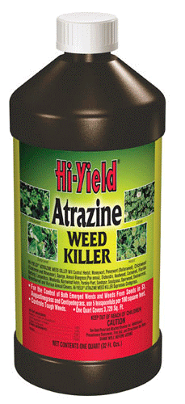
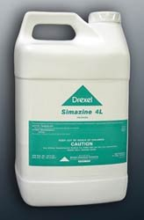
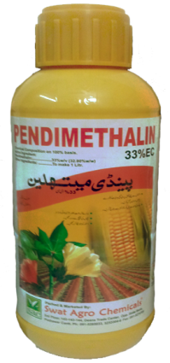
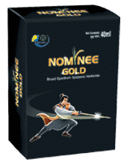
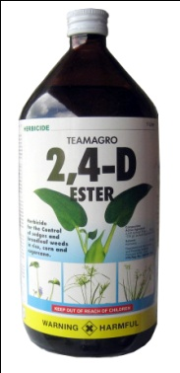
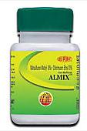
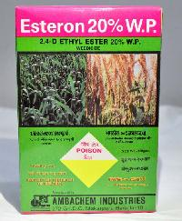
Chemical Control
Chemicals that are used to kill plants or weeds are called herbicides. Their use has been increasing rapidly since 1944 when 2,4-D was first use as herbicide. In many instance, they offer most practical, effective and economic means for controlling weeds.
Pre emergence treatment with herbicides provide early season weed control. In addition they reduce drudgery of hand weeding.
example :-

Slide 16
Biological control
Use of living organism’s viz., insects, disease organisms, herbivorous fish, snails or even competitive plants for the control of weeds is called biological control.
In biological control method, it is not possible to eradicate weeds but weed population can be reduced. This method is not useful to control all types of weeds.
Introduced weeds are best targets for biological control.
The bioagent must feed or effect only one host. It should not feed other useful plants. It must be free of predators or parasites. It must adopt to the environmental condition. The bioagent must be capable of seeking out the host. It must be able to kill the weed or at least prevents its reproduction in some direct or indirect way.
Example:
Insects : Uroplata giraldi - Lantana camara,

