Slide 2
The Pentose Phosphate Pathway Produces NADPH and Biosynthetic Intermediates
The glycolytic pathway is not the only route available for the oxidation of sugars in plant cells. Sharing common metabolites, the oxidative pentose phosphate pathway (also known as the hexose monophosphate shunt) can also accomplish this task.
The reactions are carried out by soluble enzymes present in the cytosol and in plastids. Generally, the pathway in plastids predominates over the cytosolic pathway (Dennis et al. 1997).

Slide 3
The first two reactions of this pathway involve the oxidative events that convert the six-carbon glucose-6- phosphate to a five-carbon sugar, ribulose-5-phosphate, with loss of a CO2 molecule and generation of two molecules of NADPH (not NADH).
The remaining reactions of the pathway convert ribulose-5-phosphate to the glycolytic intermediates glyceraldehyde-3-phosphate and fructose-6-phosphate. Because glucose-6-phosphate can be regenerated from glyceraldehyde-3-phosphate and fructose-6-phosphate by glycolytic enzymes, for six turns of the cycle we can write the reaction as follows: 6 glucose-6-P + 12 NADP+ + 7 H2O → 5 glucose-6-P + 6 CO2 + Pi + 12 NADPH + 12 H+ The net result is the complete oxidation of one glucose-6- phosphate molecule to CO2 with the concomitant synthesis of 12 NADPH molecules

Slide 4
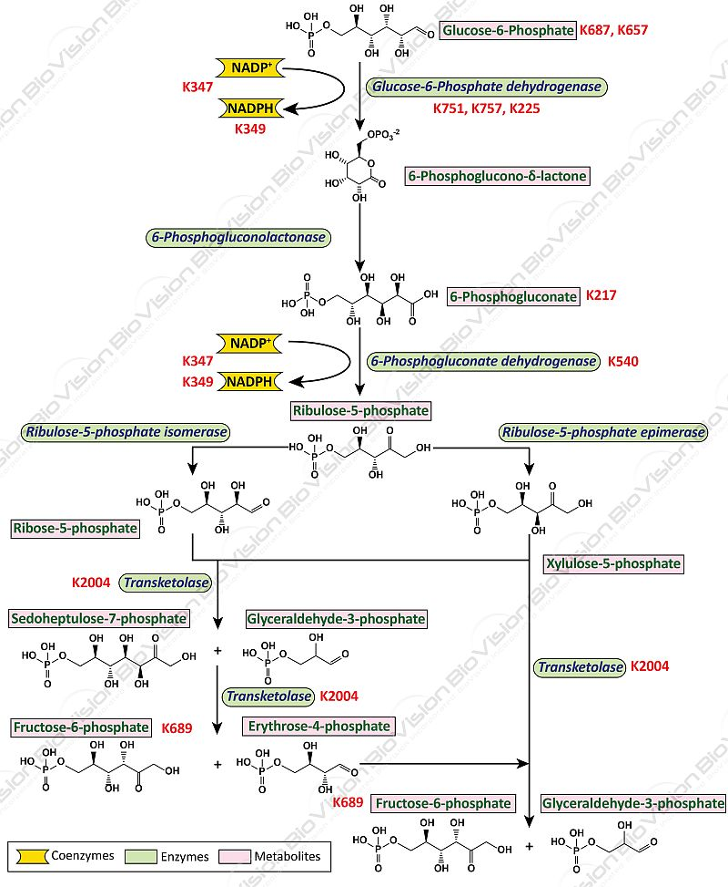

Slide 5
The glyoxylate cycle
The function of the glyoxylate cycle is to convert two molecules of acetyl-CoA to succinate. The acetyl-CoA produced by β-oxidation is further metabolized in the glyoxysome through a series of reactions that make up the glyoxylate cycle. Initially, the acetyl-CoA reacts with oxaloacetate to give citrate, which is then transferred to the cytoplasm for iso

Slide 6
merization to isocitrate by aconitase. Isocitrate is reimported into the peroxisome and converted to malate by two reactions that are unique to the glyoxylate pathway. 1. First isocitrate (C6) is cleaved by the enzyme isocitrate lyase to give succinate (C4) and glyoxylate (C2). This succinate is exported to the motochondria. 2. Next malate synthase combines a second molecule of acetyl-CoA with glyoxylate to produce malate. Malate is then oxidized by malate dehydrogenase to oxaloacetate, which can combine with another acetyl-CoA to continue the cycle .
The glyoxylate produced keeps the cycle operating in the glyoxysome, but the succinate is exported to the mitochondria for further processing.

