Slide 1
Administering User Security

Slide 2
Objectives
After completing this lesson, you should be able to:
Create and manage database user accounts:
Authenticate users
Grant and revoke privileges
Create and manage roles
Create and manage profiles:
Implement standard password security features
Control resource usage by users

Slide 3
Objectives
The following terms relate to administering database users and assist you in understanding the objectives:
A database user account is a way to organize the ownership of and access to database objects.
A password is an authentication by the Oracle database.
A privilege is a right to execute a particular type of SQL statement or to access another user’s object.
A role is a named group of related privileges that are granted to users or to other roles.
Profiles impose a named set of resource limits on database usage and instance resources.

Slide 4
Database User Accounts
Each database user account has:
A unique username
An authentication method
A default tablespace
A temporary tablespace
A user profile (set of resource and password restrictions assigned to the user)
An account status (locked, open , expired)

Slide 5
Database User Accounts
To access the database, a user must specify a valid database user account and successfully authenticate as required by that user account. Each database user has a unique database account.
A unique username: Usernames cannot exceed 30 bytes, cannot contain special characters, and must start with a letter.
Table space: A database is divided into one or more logical storage units called tablespaces. Tablespaces are divided into logical units of storage called segments, which are further divided into extents.
An authentication method: The most common authentication method is a password, but Oracle Database 11g supports several other authentication methods, including biometric, certificate, and token authentication.
A default tablespace: This is a place where a user creates objects if the user does not specify some other tablespace. Note that having a default tablespace does not imply that the user has the privilege of creating objects in that tablespace, nor does the user have a quota of space in that tablespace in which to create objects. Both of these are granted separately.
A temporary tablespace: This is a place where temporary objects, such as sorts and temporary tables, are created on behalf of the user by the instance. No quota is applied to temporary tablespaces.

Slide 6
Database User Accounts Full Notes Page
Database User Accounts (continued)
A user profile: This is a set of resource and password restrictions assigned to the user.
An initial consumer group: This is used by the resource manager.
An account status: Users can access only “open” accounts. The account_status may be in various combinations of “locked” and “expired.”
Notes:
Note: A database user is not necessarily a person. It is a common practice to create a user that owns the database objects of a particular application, such as HR. The database user can be a device, an application, or just a way to group database objects for security purposes. The personal identifying information of a person is not needed for a database user.

Slide 7
Predefined Accounts: SYS and SYSTEM
SYS account:
Is granted the DBA role
Has all privileges with ADMIN OPTION
Is required for startup, shutdown, and some maintenance commands
Owns the data dictionary
Owns the Automatic Workload Repository (AWR)
SYSTEM account is granted the DBA role.
These accounts are not used for routine operations.

Slide 8
Predefined Accounts: SYS and SYSTEM
The SYS and SYSTEM accounts have the database administrator (DBA) role granted to them by default.
In addition, the SYS account has all privileges with ADMIN OPTION and owns the data dictionary. To connect to the SYS account, you must use the AS SYSDBA clause for a database instance and AS SYSASM for an Automatic Storage Management (ASM) instance. Any user that is granted the SYSDBA privilege can connect to the SYS account by using the AS SYSDBA clause. Only “privileged” users who are granted the SYSDBA, SYSOPER, or SYSASM privileges are allowed to start up and shut down instances.
The SYSTEM account is granted the DBA role by default but not the SYSDBA privilege.
The SYS and SYSTEM accounts are required accounts in the database. They cannot be dropped.
Notes:
Best practice tip: Applying the principle of least privilege, these accounts are not used for routine operations. Users who need DBA privileges have separate accounts with the required privileges granted to them. For example, Jim has a low-privilege account called jim and a privileged account called jim_dba. This method allows the principle of least privilege to be applied, eliminates the need for account sharing, and allows individual actions to be audited.

Slide 9
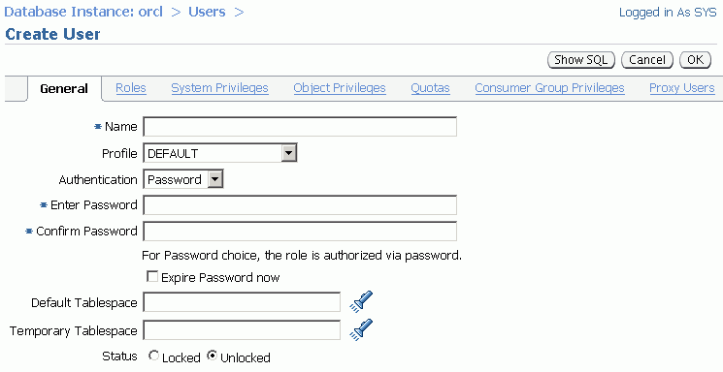
Creating a User
Select Server > Users, and then click the Create button.

Slide 10
Creating a User
On the Users page of Enterprise Manager, you manage the list of database users who are allowed to access the current database. You use this page to create, delete, and modify the settings of a user.
To create a database user:
1. In Enterprise Manager Database Control, click the Server tab and then click Users in the Security section.
2. Click the Create button.
Provide the required information. Mandatory items (such as Name) are marked with an asterisk (*).
The following pages give you more information about authentication. Profiles are covered later in this lesson.
Assign a default tablespace and a temporary tablespace to each user. If users do not specify a tablespace when creating an object, the object will be created in the default tablespace assigned to the object owner. This enables you to control where their objects are created.
If you do not choose a default tablespace, the system-defined default permanent tablespace is used. The case is similar for the temporary tablespace: If you do not specify a tablespace, the system-defined temporary tablespace is used.

Slide 11
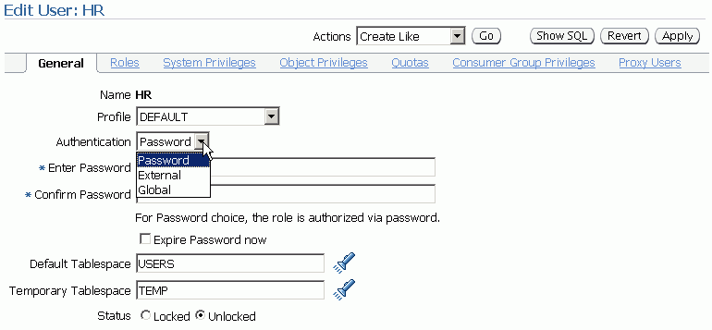
Authenticating Users
Password
External
Global

Slide 12
Authenticating Users
Authentication means verifying the identity of someone or something (a user, device, or other entity) that wants to use data, resources, or applications. Validating that identity establishes a trust relationship for further interactions. Authentication also enables accountability by making it possible to link access and actions to specific identities.
After authentication, authorization processes can allow or limit the levels of access and action that are permitted to that entity.
When you create a user, you must decide on the authentication technique to use, which can be modified later.
Password: This is also referred to as authentication by the Oracle database. Create each user with an associated password that must be supplied when the user attempts to establish a connection.
External: This is authentication by a method outside the database Users can connect to the Oracle database without specifying a username or password. A database password is not used for this type of login.
Global: With the Oracle Advanced Security option, global authentication enables users to be identified through the use of Oracle Internet Directory.

Slide 13
Administrator Authentication
Operating system security:
DBAs must have the OS privileges to create and delete files.
Typical database users should not have the OS privileges to create or delete database files.
Administrator security:
For SYSDBA, SYSOPER, and SYSASM connections:
DBA user by name is audited for password file and strong authentication methods
OS account name is audited for OS authentication
OS authentication takes precedence over password file authentication for privileged users
Password file uses case-sensitive passwords

Slide 14
Administrator Authentication
Operating system security:
In UNIX and Linux, DBAs by default belong to the install OS group, which has the required privileges to create and delete database files.
Administrator security:
Connections for the privileged users SYSDBA, SYSOPER, and SYSASM are authorized only after verification with the password file or with the OS privileges and permissions. If OS authentication is used, the database does not use the supplied username and password. OS authentication is used if there is no password file, if the supplied username or password is not in that file, or if no username and password are supplied. The password file in Oracle Database 11g uses case-sensitive passwords by default.
However, if authentication succeeds by means of the password file, the connection is logged with the username. If authentication succeeds by means of the operating system, it is a CONNECT / connection that does not record the specific user.
Notes:
SYSDBA and SYSOPER are administrative privileges required to perform high-level administrative operations such as creating, starting up, shutting down, backing up, or recovering the database. The SYSDBA system privilege is for fully empowered database administrators and the SYSOPER system privilege allows a user to perform basic operational tasks, but without the ability to look at user data.

Slide 15
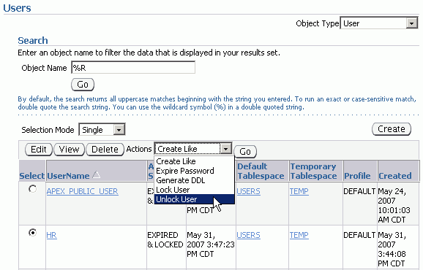
Unlocking a User Account and Resetting the Password
Select the user and click Unlock User.

Slide 16
Unlocking a User Account and Resetting the Password
During installation and database creation, you can unlock and reset many of the Oracle-supplied database user accounts.
If you did not choose to unlock the user accounts at that time, you can unlock the users and reset the passwords by selecting the user on the Users page and clicking Unlock User. Alternatively, perform the following steps on the Edit Users page:
Enter the new password in the Enter Password and Confirm Password fields.
Select the Unlocked check box.
Click Apply to reset the password and unlock the user account.

Slide 17
Privileges
There are two types of user privileges:
System: Enables users to perform particular actions in the database
Object: Enables users to access and manipulate a specific object
HR_DBA
Object privilege:
Update employees
System privilege:
Create session

Slide 18
Privileges
A privilege is a right to execute a particular type of SQL statement or to access another user’s object. The Oracle database enables you to control what the users can and cannot do in the database.
Privileges are divided into two categories:
System privileges: Each system privilege allows a user to perform a particular database operation or class of database operations.
For example, the privilege to create tablespaces is a system privilege. System privileges can be granted by the administrator or by someone who has been given explicit permission to administer the privilege.
There are more than one hundred distinct system privileges. Many system privileges contain the ANY clause.
Object privileges: Object privileges allow a user to perform a particular action on a specific object,
such as a table, view, sequence, procedure, function, or package. Without specific permission, users can access only their own objects.
Object privileges can be granted by the owner of an object, by the administrator, or by someone who has been explicitly given permission to grant privileges on the object.

Slide 19
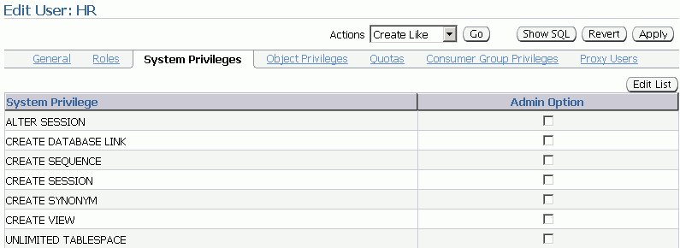
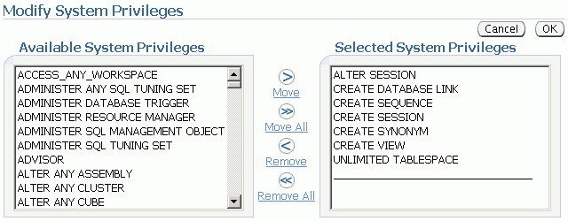
System Privileges

Slide 20
System Privileges
To grant system privileges, click the Systems Privileges tab on the Edit User page. Select the appropriate privileges from the list of available privileges, and move them to the Selected System Privileges list by clicking the Move arrow.
Granting a privilege with the ANY clause means that the privilege crosses schema lines.
For example, if you have the CREATE TABLE privilege, you can create a table—but only in your own schema.
Selecting the Admin Option check box enables the user to administer the privilege and grant the system privilege to other users. Carefully consider security requirements before granting system permissions. Some system privileges are usually granted only to administrators:
RESTRICTED SESSION: This privilege allows you to log in even if the database has been opened in restricted mode.
Notes:
The SELECT ANY TABLE privilege allows you to select from tables owned by other users. The SYS user and users with the DBA role are granted all of the ANY privileges; they can therefore do anything to any data object. The scope of the ANY system privileges can be controlled using the Oracle Database Vault Option.

Slide 21
System Privileges (continued)
SYSDBA and SYSOPER: These privileges allow you to
shut down,
start up,
and perform recovery
and other administrative tasks in the database.
SYSOPER allows a user to perform basic operational tasks, but without the ability to look at user data. It includes the following system privileges:
STARTUP and SHUTDOWN
CREATE SPFILE
ALTER DATABASE OPEN/MOUNT/BACKUP
ALTER DATABASE ARCHIVELOG
ALTER DATABASE RECOVER
RESTRICTED SESSION
The SYSDBA system privilege additionally authorizes incomplete recovery and the deletion of a database. Effectively, the SYSDBA system privilege allows a user to connect as the SYS user.
Notes:
ALTER DATABASE RECOVER (Complete recovery only. Any form of incomplete recovery, such as UNTIL TIME|CHANGE|CANCEL|CONTROLFILE, requires connecting as SYSDBA.)

Slide 22
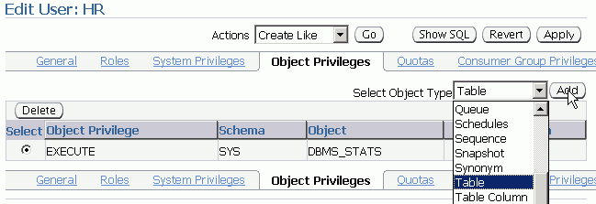
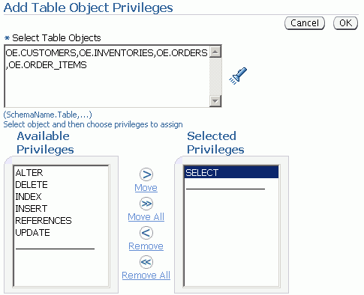
Object Privileges
To grant object privileges:
Choose the object type.
Select objects.
Select privileges.

Slide 23
Object Privileges
To grant object privileges,
click the Object Privileges tab on the Edit User page. Select the type of object on which you want to grant privileges, and then click the Add button. Choose the objects by either entering <username.object name> or selecting them from the list.
Then select the appropriate privileges from the Available Privileges list and click the Move button. When you have finished selecting privileges, click OK.
On the Edit User page, select the Grant check box if this user is allowed to grant other users the same access.

Slide 24
Benefits of Roles
Easier privilege management:
Use roles to simplify privilege management. Rather than granting the same set of privileges to several users, you can grant the privileges to a role and then grant that role to each user.
Dynamic privilege management:
If the privileges associated with a role are modified, all users who are granted the role acquire the modified privileges automatically and immediately.
Selective availability of privileges:
Roles can be enabled and disabled to turn privileges on and off temporarily. This allows the privileges of the user to be controlled in a given situation.

Slide 25
Assigning Privileges to Roles and Assigning Roles to Users
Users
Jenny
David
Rachel
Roles
HR_MGR
HR_CLERK
Delete
employees.
Create
Job.
Update
employees.
Privileges
Insert
employees.
Select
employees.
Notes:
In the slide example, the SELECT and UPDATE privileges on the employees table and the CREATE JOB system privilege are granted to the HR_CLERK role. DELETE and INSERT privileges on the employees table and the HR_CLERK role are granted to the HR_MGR role. The manager is granted the HR_MGR role and can now select, delete, insert, and update the employees table.

Slide 26
Assigning Privileges to Roles and Assigning Roles to Users
In most systems, it is time consuming and error prone to grant necessary privileges to each user individually. The Oracle software provides for easy and controlled privilege management through roles.
Roles are named groups of related privileges that are granted to users or to other roles. Roles are designed to ease the administration of privileges in the database and, therefore, improve security.
Role characteristics
Privileges are granted to and revoked from roles as though the role were a user.
Roles are granted to and revoked from users or other roles as though they were system privileges.
A role can consist of both system and object privileges.
A role can be enabled or disabled for each user who is granted the role.
A role can require a password to be enabled.
Roles are not owned by anyone, and they are not in any schema.

Slide 27
Creating a Role
A role is a named group of related privileges that are granted to users or to other roles. A DBA manages privileges through roles.
To create a role:
1. In Enterprise Manager Database Control, click the Server tab and then click Roles under the Security heading.
2. Click the Create button.

Slide 28
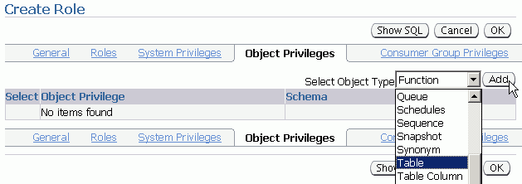
Creating a Role
Select Server > Roles.

Slide 29
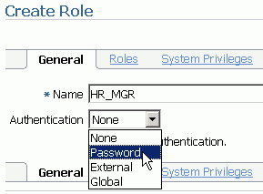
Secure Roles
Roles can be nondefault.
Roles can be protected through authentication.
Roles can also be secured programmatically.
SET ROLE vacationdba;
CREATE ROLE secure_application_role
IDENTIFIED USING <security_procedure_name>;

Slide 30
Secure Roles
Roles are usually enabled by default, which means that if a role is granted to a user, then that user can exercise the privileges given to the role. Default roles are assigned to the user at connect time.
It is possible to:
Make a role nondefault.
When the role is granted to a user, deselect the DEFAULT check box. The user must now explicitly enable the role before the role’s privileges can be exercised.
Have a role require additional authentication.
The default authentication for a role is None, but it is possible to have the role require additional authentication before it can be set.
Create secure application roles that can be enabled only by executing a PL/SQL procedure successfully.
The PL/SQL procedure can check things such as the user’s network address, the program that the user is running, the time of day, and other elements needed to properly secure a group of permissions.

Slide 31
Assigning Roles to Users
You can use roles to administer database privileges. You can add privileges to a role and grant the role to a user. The user can then enable the role and exercise the privileges granted by the role. A role contains all privileges that are granted to that role and all privileges of other roles that are granted to it.
By default, Enterprise Manager automatically grants the CONNECT role to new users. This allows users to connect to the database and create database objects in their own schemas.
To assign a role to a user:
1. In Enterprise Manager Database Control, click the Server tab and then click Users under the Security heading.
2. Select the user and click the Edit button.
3. Click the Roles tab, and then click the Edit List button.
4. Select the desired role under Available Roles and move it under Selected Roles.
5. When you have assigned all appropriate roles, click the OK button.

Slide 32
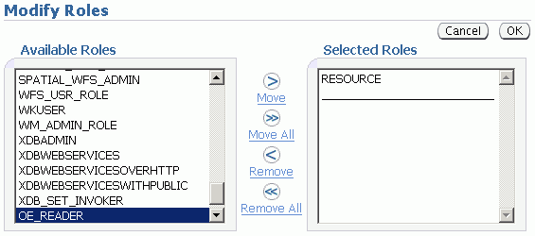
Assigning Roles to Users

Slide 33
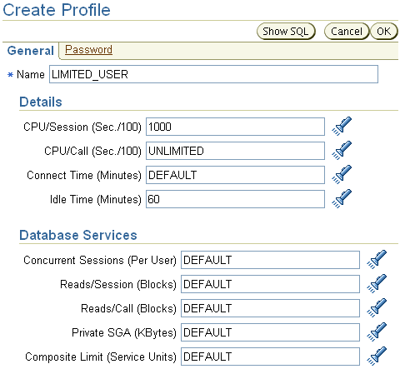
Profiles and Users
Profiles impose a named set of resource limits on database usage and instance resources. Profiles also manage the account status and place limitations on users’ passwords (length, expiration time, and so on).
Every user is assigned a profile
and may belong to only one profile
at any given time. If users have
already logged in when you change
their profile, the change does not
take effect until their next login.

Slide 34
Profiles and Users
The DEFAULT profile serves as the basis for all other profiles.
As illustrated in the slide, limitations for a profile can be implicitly specified (as in CPU/Session), can be unlimited (as in CPU/Call), or can reference whatever setting is in the DEFAULT profile (as in Connect Time).
Profiles cannot impose resource limitations on users unless the RESOURCE_LIMIT initialization parameter is set to TRUE. With RESOURCE_LIMIT at its default value of FALSE, profile resource limitations are ignored. Profile password settings are always enforced
Profiles enable the administrator to control the following system resources:
CPU: CPU resources may be limited on a per-session or per-call basis. A CPU/Session limitation of 1,000 means that if any individual session that uses this profile consumes more than 10 seconds of CPU time (CPU time limitations are in hundredths of a second), that session receives an error and is logged off:
ORA-02392: exceeded session limit on CPU usage, you are being logged off

Slide 35
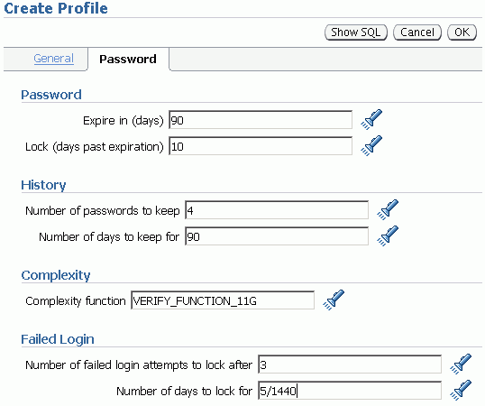
Creating a Password Profile

Slide 36
Creating a Password Profile
To create a password profile, click the Server tab and then click Profiles under the Security heading. On the Profiles page, click the Create button. Click the Password tab to set the password limits.
You can choose common values for each of the settings from a list of values (click the flashlight icon to browse), or you can enter a custom value.
All time periods are expressed in days but can also be expressed as fractions. There are 1,440 minutes in a day; 5/1,440 is therefore five minutes.
Enterprise Manager can also be used to edit existing password profiles.
If the utlpwdmg.sql script has been run, the VERIFY_FUNCTION and VERIFY_FUNCTION_11G functions are available. If you have created your own complexity function, the name of that function may be entered. The function name does not appear in the Select list. If the function produces run-time errors, the user is unable to change the password.
Dropping a Password Profile
In Enterprise Manager, you cannot drop a profile that is used by users. However, if you drop a profile with the CASCADE option (for example, in SQL*Plus), all users who have that profile are automatically assigned the DEFAULT profile.

Slide 37
Supplied Password Verification Function: VERIFY_FUNCTION_11G
The VERIFY_FUNCTION_11G function insures that the password is:
At least eight characters
Different from the username, username with a number, or username reversed
Different from the database name or the database name with a number
A string with at least one alphabetic and one numeric character
Different from the previous password by at least three letters
Tip: Use this function as a template to create your own customized password verification.

