Slide 1
Topic: Linear Regression
MSc Psychology 2nd
Course: Applications of Statistics in Psychology
Course Code: PSYC-6211
Course Instructor: Kanwal Iqbal

Slide 2
Scatter Diagram
A scatter plot also called a scatter graph, scatter chart, or scatter diagram. A Scatter (XY) Plot has points that show the relationship between two sets of data.

Slide 3
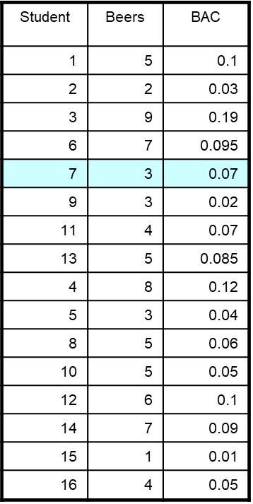
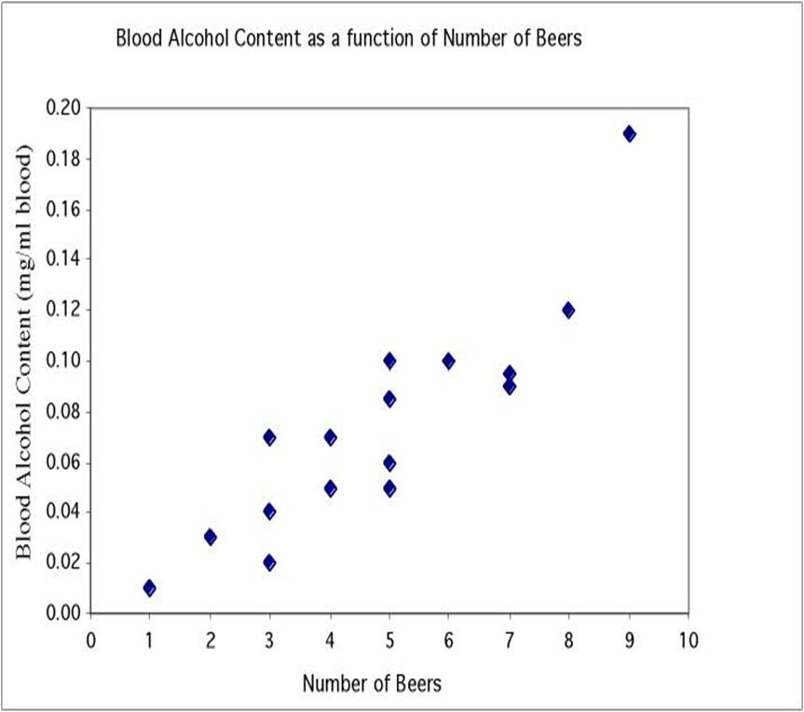
In a scatterplot, one axis is used to represent each of the variables, and the data are plotted as points on the graph.

Slide 4
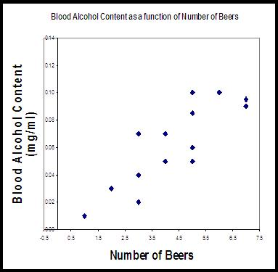
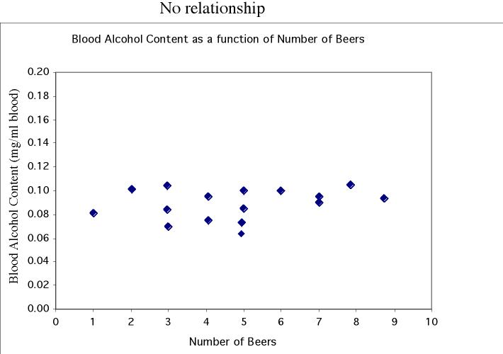
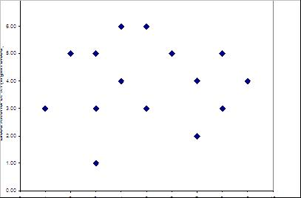
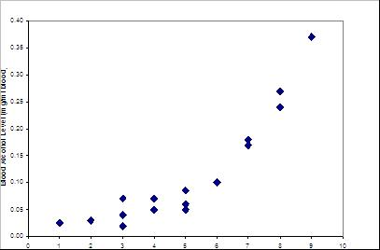
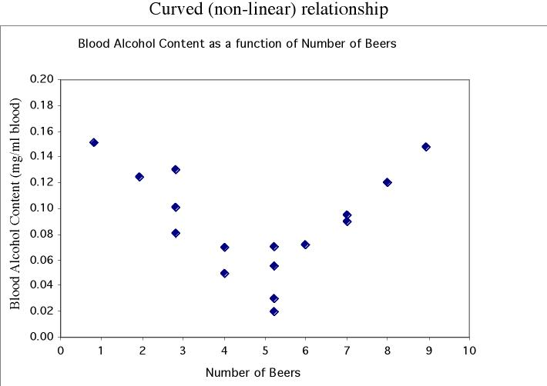
Form and direction of an association
Linear
No relationship
Nonlinear

Slide 5
Explanatory and response variables
A response variable measures or records an outcome of a study. An explanatory variable explains changes in the response variable.
Typically, the explanatory or independent variable is plotted on the x axis, and the response or dependent variable is plotted on the y axis.
Response
(dependent)
variable:
blood alcohol
content
Explanatory (independent) variable:
number of beers

Slide 6
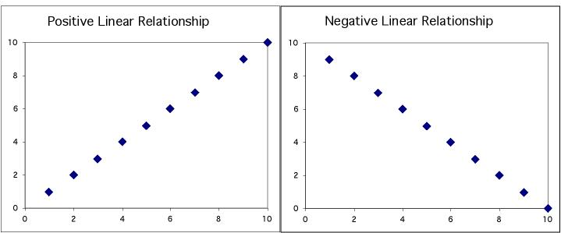
Positive association: High values of one variable tend to occur together with high values of the other variable.
Negative association: High values of one variable tend to occur together with low values of the other variable.

Slide 7
No relationship: X and Y vary independently. Knowing X tells you nothing about Y.

Slide 8
Outliers
In a scatterplot, outliers are points that fall outside of the overall pattern of the relationship.

Slide 9
Standard Error of Estimation
Definition:
The Standard Error of Estimate is the measure of variation of an observation made around the computed regression line. Simply, it is used to check the accuracy of predictions made with the regression line.
Likewise, a standard deviation which measures the variation in the set of data from its mean, the standard error of estimate also measures the variation in the actual values of Y from the computed values of Y (predicted) on the regression line.

Slide 10
Standard Error of Estimate
The mean error is equal to zero.
If s_{e} is small the errors tend to be close to zero (close to the mean error). Then, the model fits the data well.
Therefore, we can, use s_{e} as a measure of the suitability of using a linear model.
An estimator of s_{e} is given by s_{e}

Slide 11
Sum of Squares for Errors
This is the sum of differences between the points and the regression line.
It can serve as a measure of how well the line fits the data. SSE is defined by
A shortcut formula

Slide 12
Measure of Association
In statistics, any of various factors or coefficients used to quantify a relationship between two or more variables.
Measures of association are used in various fields of research but are especially common in the areas of psychology, where they frequently are used to quantify relationships between exposures and diseases or behaviors.

Slide 13
Measure of Association
A measure of association may be determined by any of several different analyses, including correlation analysis and regression analysis. (Although the terms correlation and association are often used interchangeably, correlation in a stricter sense refers to linear correlation, and association refers to any relationship between variables).

Slide 14
Measure of Association
The method used to determine the strength of an association depends on the characteristics of the data for each variable. Data may be measured on an interval/ratio scale, an ordinal/rank scale, or a nominal/categorical scale. These three characteristics can be thought of as continuous, integer, and qualitative categories, respectively.

Slide 15
Methods of Analysis
Pearson’s correlation coefficient
Spearman rank-order correlation coefficient
Chi-square test

Slide 16
Chi-square test
The chi-square test for association is a standard measure for association between two categorical variables. The chi-square test for independence, also called Pearson's chi-square test or the chi-square test of association.

Slide 17
For Example
A simple and generic example follows. If scientists were studying the relationship between gender and political party, then they could count people from a random sample belonging to the various combinations: female-Democrat, female-Republican, male-Democrat, and male-Republican. The scientists could then perform a chi-square test to determine whether there was a significant disproportionate membership among those groups, indicating an association between gender and political party.

Slide 18
Assumptions of Chi-square test
When you choose to analyze your data using a chi-square test for independence, you need to make sure that the data you want to analyze "passes" two assumptions.
You need to do this because it is only appropriate to use a chi-square test for independence if your data passes these two assumptions. If it does not, you cannot use a chi-square test for independence.
These two assumptions are:

Slide 19
Assumptions of Chi-square test
Your two variables should be measured at an ordinal or nominal level (i.e., categorical data).
Your two variable should consist of two or more categorical, independent groups.
Example independent variables that meet this criterion include gender (2 groups: Males and Females), ethnicity (e.g., 3 groups: Caucasian, African American and Hispanic), physical activity level (e.g., 4 groups: sedentary, low, moderate and high), profession (e.g., 5 groups: surgeon, doctor, nurse, dentist, therapist), and so forth.

Slide 20
Hypotheses
Null hypothesis: Assumes that there is no association between the two variables.
Alternative hypothesis: Assumes that there is an association between the two variables.

