Slide 1
SYLLABUS DESINGNING AND EVALUATION
Dr. Azhar Pervaiz
University of Sargodha
28.03.2020

Slide 2
Framework of language Teaching
Learners
Implementing goals
Context
Educational settings Syllabus Construction
Materials, Class room methods, lessons, test

Slide 3
Features of a well-designed syllabus
It should include very good and clear measurable objectives.
It should reflect students’ needs and be realistic about what they can achieve.
A syllabus needs variety, i.e. focusing on all skills and systems, language areas, functions, tasks, materials, input and output.
It should be flexible, informative and informing.
It should allow space to adapt lessons or deviate from the initial syllabus but factors like the school should be considered.

Slide 4
Who designs a syllabus.
In some organisations, a general syllabus is designed by the academic department for each class at the start of the year. This is considered to be THE syllabus.
Test designers were also mentioned as people who tend to be good syllabus writers.
It is difficult for new teachers to design a syllabus before they have the experience of writing achievable aims.
Not all teachers are required to be syllabus designers, that’s why it’s a special skill and paid well.

Slide 5
Needs analysis:
Pre course: pre-course tests to reveal the English level
Ongoing

Slide 6
Pre Course : Mixed Needs Versus Specific Needs
In pre-course needs analysis, we employed means of questionnaires, interviews and pre-course tests. Questionnaires were filled by potential course participants, from which we seek their necessities, lacks, wants and also their subject areas, work experiences and other relevant information.

Slide 7
Separate Syllabuses Versus Synthetic Syllabuses
Global aims of this course as to enhance
Listening skills, speaking skills,
Reading & writing skills
subject input to activate learners' interests, awareness, confidence & autonomy
to improve general English and various specific needs to learn some technical English, we initially designed an integrated course which is constituted by seven sub-courses

Slide 8
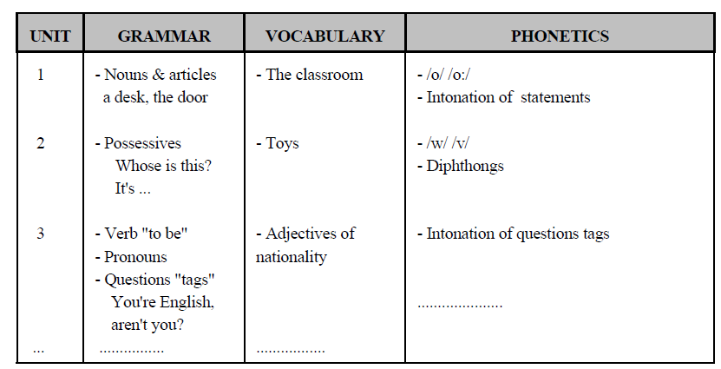
Structural Grammatical Syllabus

Slide 9
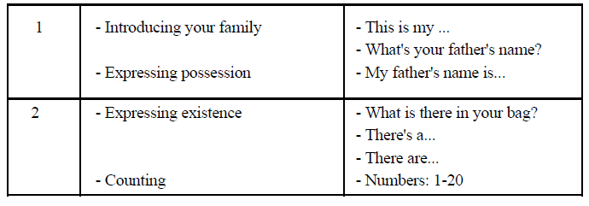

Slide 10
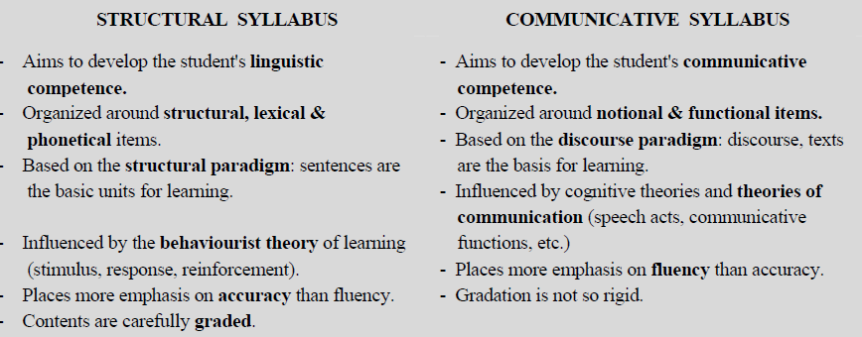
Comparison

Slide 11
After types

Slide 12
1. Linguistic factors:
- Linguistic uniformity and diversity in the community
- Relationship between L1 and L2
2. Social and cultural factors:
- Attitudes of learners towards L2
- Language differences and social groups
3. Historical setting and the national political situation
- Choice of particular L2
- Political relations with the L2 country

Slide 13
4. Geographical aspects
- Geographical distance between the communities
5. Economic and technological development
- Need of L2 for economic development
6. Educational framework in the region/Autonomous Communnity
- Starting age
- Time allocated for L2 weekly
- Introduction of other foreign languages

Slide 14
STAGES
3.1. Curricular design
This involves policy making decisions, national language policies and adjustments made
by the local communities. It is concerned with the determination of overall aims to
satisfy national and local social needs and interests.
3.2. Determining aims
In this stage, the general objectives and specific objectives to be achieved are set up by
schools in their curricular projects.

Slide 15
3.3. Programme preparation:
This involves a development of teaching and learning resources by means of:
- The planning and preparation of teaching units according to
a) overall aims
b) specific objectives and
c) desirable methodology.
- The development of teaching and learning materials.

Slide 16
3.4. Classroom implementation:
Applying the curriculum in the classroom involves the interaction of teachers, students
and programme resources in a school setting, working to achieve the aims and objectives
established in 3.1. and 3.2. It includes:

Slide 17
- Teaching acts: They depend on the interpretation of the official curriculum, the
teacher’s sympathy with it, the teacher's beliefs and his or her professional
capacity to perform in certain ways.
- Learning acts: They depend on the students' needs and interests, motivations,
capabilities. According to Johnson (1989), SL curricula should include "learner

Slide 18
3.5. Evaluation
This involves the appraisal of the curricular process (stages 3.1. to 3.4.) and the
curricular results obtained: the final "product".

Slide 19
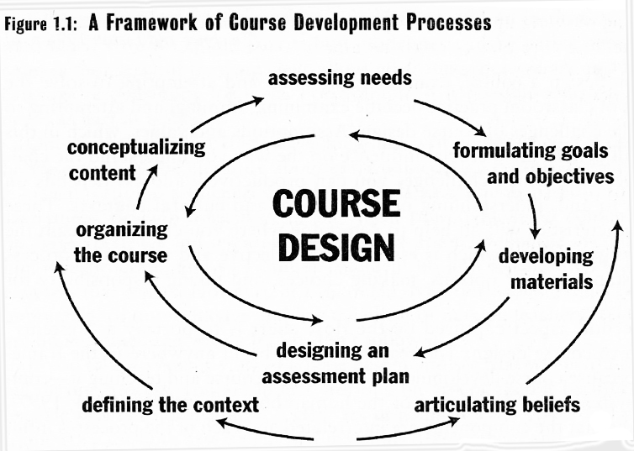
process

Slide 20
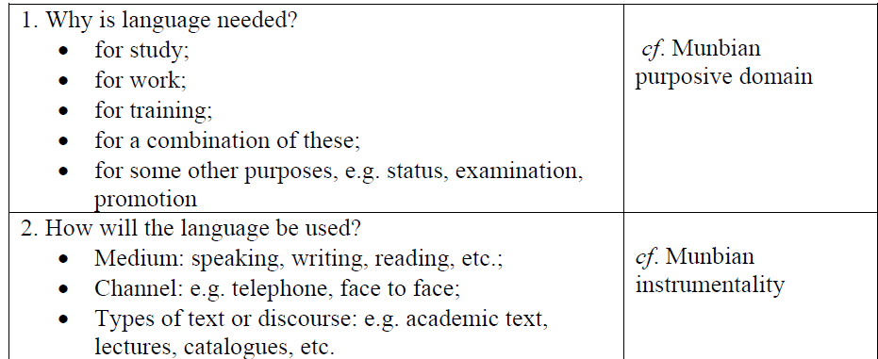
Why is language needed?

Slide 21
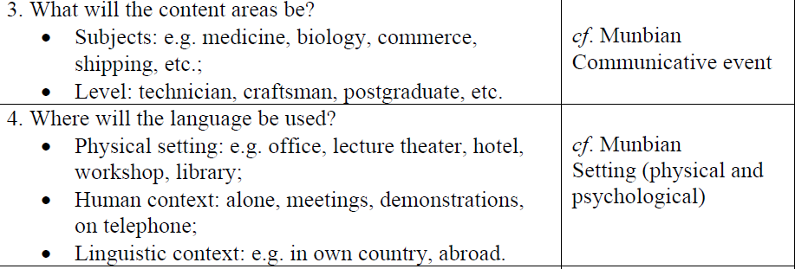

Slide 22
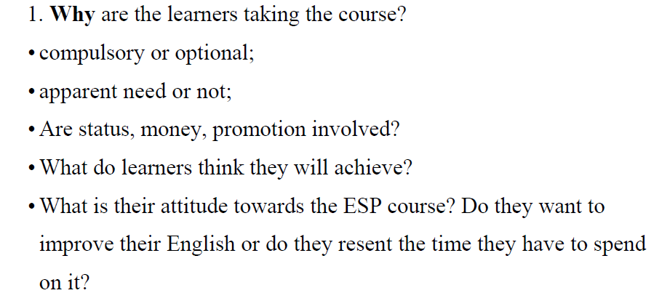
Needs and Wants

Slide 23
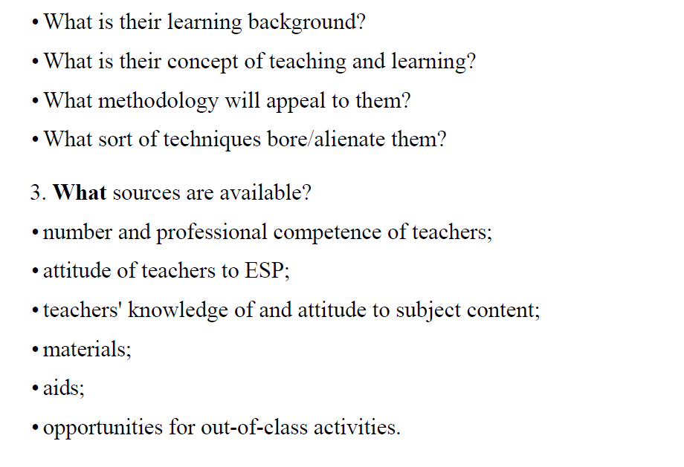
How do the learners Learn

Slide 24
Course Planning and Syllabus Design

Slide 25
The Dimensions of Course Development
Developing a Course Rationale
Describing Entry and Exit Level
Choosing Course Content
Determining the Scope and Sequence
Preparing the Scope and Sequence Plan
Planning the Course Structure

Slide 26
The Course Rationale
Who is the course for?
Students, teachers, potential clients
What is the course about?
The content of the course
What kind of teaching and learning will take place in the course?
The objective of the course

Slide 27
The Course Rationale
The purpose of rationale:
Plan various components of the course
Exemplify the kinds of teaching and learning the course
Provide the consistency of components of course in terms of course values and goals

Slide 28
The Course Rationale
An example of a course rationale:
Goal:
Working adult wish to improve their communication skills in English in order to improve their employment prospects.
Content:
It teaches basic communication skills needed to communicate in a variety of different work setting.
Role of teacher:
1.enable participants to recognize their strengths and needs in language learning
2.give them the confidence to use English more effectively to achieve their own goals.

Slide 29
Describing the Entry and Exit Level
To plan a language course:
=>to know the level at which the program will start
=>the level learners may be expected to reach at the end of the course
Language program and Commercial materials
=> elementary, intermediate, advanced

Slide 30
Describing the Entry and Exit Level
An approach is used in language program planning to identify different levels of performance.
in order to ensure that a language program is coherent and move learners towards that level of proficiency
the levels from 0 to 9 (Native-like proficiency)
detail description of language behavior in all four skills—what a students is able to do at different stages

Slide 31
Describing the Entry and Exit Level
Ex: IELTS can be used for planning learner entry and exit levels in a program.
IELTS Examination—Appendix 2 p.174 (writing)
The levels from Beginner, Elementary, Intermediate, Upper- Intermediate, Advanced to Special Purpose—6 Stages
(Paltridge, 1992)

Slide 32
Describing the Entry and Exit Level
Ex: Band Descriptors: Oral Interaction Skills
UCLES/RSA Certificates in Communicative Skills in English—Appendix 3 p.176 (oral interaction)
The levels from 1 to 4Level
Certificates in all four skills—listening, reading, writing, and oral interaction
(Weir, 1990)

Slide 33
Choosing Course Content
The decisions of course content:
the nature of langauge/language use /language learning/the most essential elements of language
Ex: a typical writing course
Grammar (ex: the present tense in description)
Functions (ex: like and dislike)
Topics (ex: writing about world issues)
Skills (ex: developing topic sentence)
Processes (ex: prewriting strategies)
Texts (ex: writing a business letter)

Slide 34
Choosing Course Content
Ex: a typical speaking course
Functions: expressing opinions
Interaction skills: opening and closing conversation skills
Topics: current affairs, business topics

Slide 35
Choosing Course Content
Additional Ideas/Sources of Content Selection from:
Available literature on the topic
Published material on the topic
Review of similar course
Review test/exam in the area
Analysis of students’ problems
Consultation with teachers and specialists

Slide 36
Choosing Course Content
Ex: Initial Ideas of Course on the Listening/Speaking Skills
Asking questions
Opening and closing conversations
Expressing opinions
Dealing with misunderstanding
Describing experience
Social talk
Telephone skills
Situational language
Describing daily routines
Recognizing sound contrasts
Communication strategies

Slide 37
Choosing Course Content
Ex: Review/Refine the topic of course
Are all the suggested topic necessary?
Have any important topic been omitted?
Is there sufficiency time to cover them?
Has sufficiency priority been given to the most important areas?

Slide 38
Choosing Course Content
Ex: Review/Refine the topic of course
Has enough emphasis been put on the different aspects of the areas identification?
Will the areas cover enable students to attain the learning out come?
=>initial ideas for course content take place simultaneously with syllabus planning, the type of syllabus framework will be used as the basis for the course

Slide 39
Determining the Scope and Sequence
Scope -- Breadth and depth of coverage of items in the course.
What range of content will be covered?
What extent of topic should be studied?
Ex: the Rationale of listening and Speaking
Describing experience
How much will be included in relation to this topic?
How many periods of time in the course?

Slide 40
Determining the Scope and Sequence
Sequence — order of content
Simple to complex
Reading course: the text may be simplified at the beginning of the course and unsimplified at later level.
Chronology
Writing:
Brainstorming → Drafting → Revising → Editing
Proficiency course
Listening → Speaking → Reading → Writing

Slide 41
Determining the Scope and Sequence
Need:
Ex:The Sequences of Social Survival Curriculum
Basic literary skills
Personal identification
Money
Shopping
Time & date
Telephone
Health
Emergencies
Directions
Transportation
Housing
Post office
Banking/bills
Social language
Clarification

Slide 42
Determining the Scope and Sequence
Prerequisite learning
Building a foundation for next step
Ex: Grammar course
Whole to part or Part to whole
Reading course and Writing course
Spiral sequencing
Recycling of items to ensure that learners repeat

Slide 43
Planning the Course Structure
Two aspects of the process:
Selection a Syllables Framework
Major element
The basis for course focus
The basis for course content
Developing Instructional Blocks
The process used to make decisions about content
Self-contained learning sequence

Slide 44
Planning the Course Structure
Planner are influenced by some factors:
Knowledge and Beliefs about the Subject Area
Research and Theory
Common Practice
Trends

Slide 45
Planning the Course Structure
Grammatical (Structural) Syllabus:
=>one that is organized around grammatical items.
Ex: A planner seeks to solve the problems
To select sufficient patterns to support the amount of teaching time available
To arrange items into a sequence that facilitates learning
To identify a productive range of grammatical items that allows for development of communicative skills
Appendix 4—presents the grammatical syllabus underlying a typical first-year EFL course

Slide 46
Planning the Course Structure
The disadvantages of grammatical syllabus:
Representing a partial dimension of language proficiency
Not reflect the acquisition sequences
Focus on sentence not on discourse
Not address communicative skills

Slide 47
Planning the Course Structure
Grammar remains a core of many language courses.
Reasons:
Teaching a language through its grammar represents a familiar approach to teaching for many people
Grammar provides a convenient framework for a course
Grammar represents a core component of language proficiency: communicative ability includes grammar use

Slide 48
Planning the Course Structure
Lexical syllabus:
=>One that identifies a target vocabulary to be taught.
Elementary level: 1000 words
Intermediate level: an additional 2000 words
Upper intermediate level: an additional 2000 words
Advanced level: an additional 2000+words

Slide 49
Planning the Course Structure
Functional syllabus:
=>one that is organized around communicative functions such as requesting, complaining, suggesting, agreeing.
Categories of functions
Imparting and seeking factual information
Expressing and finding out attitudes
Deciding on course of action
Socializing
Structuring discourse
Communication repair
Appendix 5 p.179 (threshold level syllabus)

Slide 50
Planning the Course Structure
The advantage of functional syllabus:
They reflect a more comprehensive view of language than grammar syllabuses
They can link to other types of syllabus contents (topic, grammar)
They provide a convenient framework for the design of teaching materials

Slide 51
Planning the Course Structure
The disadvantage of functional syllabus:
No clear criteria for selecting or grading functions
represent a simplistic view of communicative competence and fail to address the processes of communication
represent an atomistic approach to language
lead to a phrase-book approach to teaching that concentrates on teaching expression
Students have considerable gaps in their grammatical competence

Slide 52
Planning the Course Structure
Situational syllabus:
=>One that is organized around the language needed for different situations such as at the airport or at a hotel.
Ex: textbook on English for travel
On an airplane
At an immigration counter
At a bank
On the telephone
On the street
In the city
At home

Slide 53
Planning the Course Structure
The advantage of situational syllabus:
Presenting language in context and teaching language of immediate practical use
The disadvantages:
Language used in different situations
Langauge used in specific situations may not transfer to other situation
Grammar is dealt with incidentally, so a situational syllabus may result in gaps in a student’s grammatical knowledge

Slide 54
Planning the Course Structure
Situational Syllabus:
The elements of situation
1)The participants
2)Their role relations
3)The transaction they engage in
4)The skills or behaviors involved in each
transaction
5) The kind of oral and written texts that are
produced
6)The linguistic feature of the texts

Slide 55
Planning the Course Structure
Topical / Content-based Syllabus
For linking different syllabus
Each syllabus must include some contents
Example:
typical lesson- 1) selected the structured
2) content
topic-based syllabus- 1) content
2) continuity across the skill
areas

Slide 56
Planning the Course Structure
The advantages of content based syllabuses:
They facilitate comprehension
Content makes linguistic form more meaningful
Content serves as the best basic for teaching the skill areas
They address students’ needs
They motivate learners
They allow for integration of the four skills
They allow for use of authentic materials

Slide 57
Planning the Course Structure
Topic-based syllabuses
level: ESL programs for elementary/secondary schools
teaching features: integrated others subjects
Example:
Topic: culture shock
teaching features: 1)integrates skills course
2) based on students’ needs
(Brinton et al.)

Slide 58
Planning the Course Structure
Some themes could discuss in the class:
1) television 7) modern architecture
2) religious persuasion 8) microchip technology
3) advertising 9) ecology
4) drugs 10)alternative energy
5) racism 11) nuclear energy
6) native Americans 12) Dracula in
myth, novel, and films

Slide 59
Planning the Course Structure
Issues that arises in developing a topic-based syllabus:
How are themes, topics, and content decided on?
What is the balance between content & grammar or others in syllabus?
Are ESL teachers qualified to teach content-based courses?
What should be the basis for assessment—content or language?

Slide 60
Planning the Course Structure
Competency-based syllabus
based on competencies learners are expected to master in specific situations and activities
Competencies are a description of the
1)the essential skill (social survival)
2) knowledge (work-oriented)
3) attitudes
→required for effective performance of
particular task and activities

Slide 61
Planning the Course Structure
Skills syllabus :
1) belief--learning is a complex activity
2) Identify the microskills underlying the use of the
four macroskills of listening, speaking, reading,
& writing

Slide 62
QUESTIONS

Slide 63
Planning the Course Structure
Topic- “listening to a lecture”
Examples of skills that relate to different types of
language:
Writing: 1) creating a topic sentence
2) distinguishing between main ideas/
supporting sentences
3) self- editing
Listening:1) recognizing key information
2) using discourse markers to identify the
flow of discourse following rapid speech

Slide 64
Planning the Course Structure
Examples of skills that relate to different types of language:
Speaking:1) recognizing turn-taking signals
2) introducing a topic
3) using communication strategies
Reading: 1) reading for gist
2) guessing words from context
3) reading and making inferences

Slide 65
Planning the Course Structure
skills syllabus for the teaching of study skills: (p.160)
Basic reference skills
Skimming to obtain
Scanning to locate specifically required information
Transcoding information presented in diagrammatic
display
Note-taking skills

Slide 66
Planning the Course Structure
The advantages of skills-based syllabuses:
They focus on behavior / performance
They teach skills that can transfer to many other situations
They identify teachable and learnable units
→provide a practical framework for designing
courses and teaching materials

Slide 67
Planning the Course Structure
criticized on skills syllabuses:
1) There is no serious basis for determining skills
2) They focus on discrete aspects of performance
rather on developing more global and integrated
communicative abilities.

Slide 68
Planning the Course Structure
Task-based Syllabus:
organized around tasks that students will complete in the target language
Examples:
a) finding a solution to a puzzle
b) reading a map and giving directions
c) reading a set of instruments and assembling a toy

Slide 69
Planning the Course Structure
“Tasks are activities which have meaning as their primary focus. Success in tasks is evaluated in terms of achievements of an outcome, and tasks generally bear some resemblance to real-life language use”. (Skehan 1996,20)

Slide 70
Planning the Course Structure
While carrying out these tasks :
1) learners would receive comprehensible input
2) modified output
3) processed believed central to SLA

Slide 71
Planning the Course Structure
The basic claims made for a task-based syllabus:
1) Tasks are activities that drive the SLA process
2) Learners will acquire grammar as a by-product
of carrying out tasks
3) Tasks are motivating for learners and engage
them in meaningful communication

Slide 72
Planning the Course Structure
Task-based Syllabus: two kinds of tasks
a) Real-world task
b) Pedagogical tasks (p.162)
Jigsaw task
Information-gap task
Problem solving task
Decision-making task
Opinion exchange task

Slide 73
Planning the Course Structure
Factors that task –based syllabuses have not been widely implemented in language teaching:
1) definition of task
2) design and selection of tasks
3) development of accuracy

Slide 74
Planning the Course Structure
Task-based Syllabus
built around texts and samples of extended discourse
TB= situational approach
analysis of the contexts in which the learners will use the language
ex: 1)specific workplace
2) universities

Slide 75
Planning the Course Structure
A text-based syllabus is a type of integrated syllabus because it combines elements of different types of syllabus
Examples of text types that can be used in planning a text-based syllabus (p.163)
1) exchanges 5) story texts
2) forms 6) persuasive texts
3) procedures
4) information texts (Feez 1998)

Slide 76
Planning the Course Structure
In teaching from a text-based syllabus a five –part cycle is proposed that involves:
1) building the context for the text
2) modeling and deconstructing the text
3) joint construction of the text
4) independent construction of the text
5) linking related texts

Slide 77
Planning the Course Structure
The following advantages are suggested for a text-based syllabus:
1) It teaches explicitly about the structures and
grammatical features of spoken and written
texts
2) It links spoken and written texts to the social
and cultural contexts of their use

Slide 78
Planning the Course Structure
The following advantages are suggested for a text-based syllabus:
3) It allows for the design of units of work that
focus on developing skills in relation to whole
texts
4) It provides ss with guided practice as they
develop language skills for meaningful
communication through texts

Slide 79
Planning the Course Structure
Criticisms of this approach are similar to those made of competency-based approaches
1) It focus on specific skills rather then a more
general language proficiency
2) It may be impractical in many situations

Slide 80
Planning the Course Structure
An integrated syllabus:
decisions about a suitable syllabus framework for a course reflect different priorities in teaching
Some questions needed to be asked:
1) Which foci will be central in planning the
syllabus ?
2) Which will be secondary?
→ course planners need to decide between macrolevel
and microlevel planning units in the course

Slide 81
Developing instructional blocks
An instructional blocks
1) a self-contained learning sequence (own goals)
2) reflects the overall objectives for the course
Planning the organizational structure in a course involves
1) selecting appropriate blocks
2) deciding on the sequence

Slide 82
Developing instructional blocks
In organizing a course into teaching blocks one seeks to achieve the following:
1) to make the course more teachable and
learnable
2) to provide a progression in level of difficulty
3) to create overall coherence and structure for the
course

Slide 83
Developing instructional blocks
Two commonly used instructional blocks are planning by:
1) Modules: self-contained and independent
learning sequence with its own objectives
2) Units: a group of lessons that is planned around
a single instructional focus

Slide 84
Developing instructional blocks
The factors that account for a successful unit include: (p.166)
1) Length
2) Development
3) Coherence
4) Pacing
5) Outcome

Slide 85
Preparing the Scope & Sequence Plan
The Scope & Sequence Plan
a listing of the module/ unit
contents
-- an indication of how much teaching time
textbooks usually consists of (p.195)
-- unit-by-unit description of course
-- cross-referenced—syllabus items

Slide 86
Thanks for your listening

