Slide 1
INTEGRAL EQUATION
TEACHER NAME: NIDA IBRAR

Slide 2
Volterra integro-differential equation
Example 01
Use the Laplace transform method to solve the Volterra integro-differential equation.
$u^{′}\left(x\right)=1+ \int_{0}^{x}{u\left(t\right)dt , u\left(0\right)=1}$.
Sol
Taking Laplace on both side
$$ℒ\left\{u^{′}\left(x\right)\right\}=ℒ\left(1\right)+ℒ\left\{1\right\}∗U\left(s\right)$$
$$sU\left(s\right)−s\left(0\right)= \frac{1}{s}+\frac{1}{s}U\left(s\right).$$

Slide 3
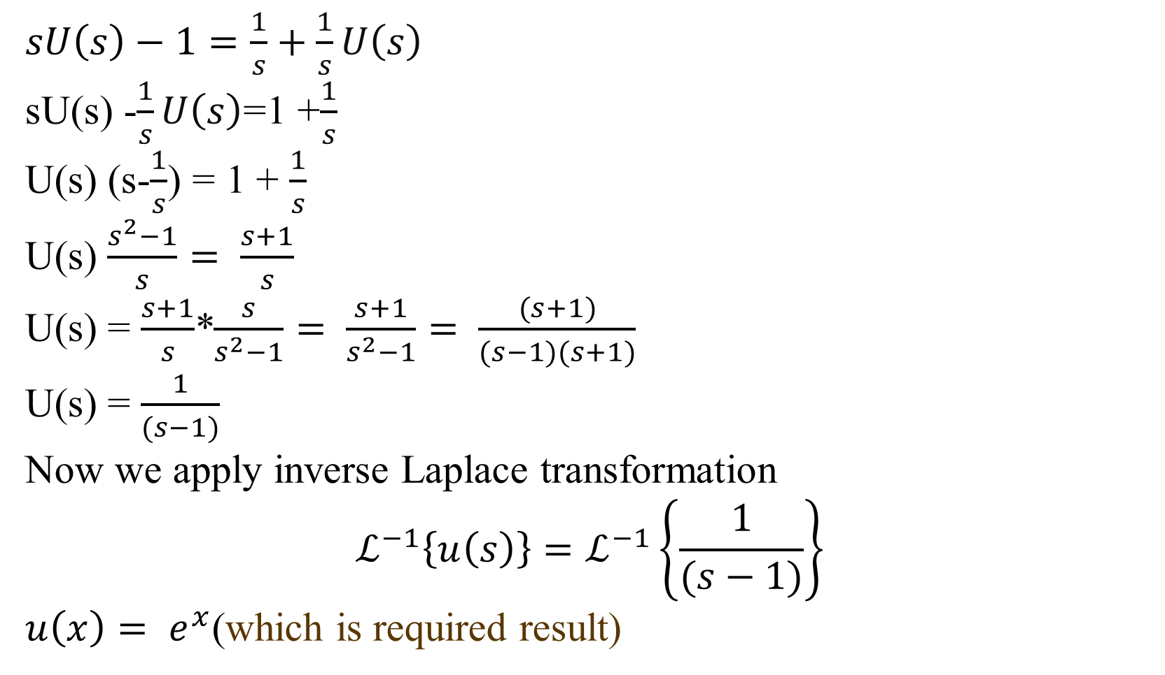
$sU\left(s\right)−1=\frac{1}{s}+\frac{1}{s}U\left(s\right)$
sU(s) -$\frac{1}{s}U\left(s\right)$=1 +$\frac{1}{s}$
U(s) (s-$\frac{1}{s}$) = 1 + $\frac{1}{s}$
U(s) $\frac{s^{2}−1}{s}= \frac{s+1}{s}$
U(s) = $\frac{s+1}{s}$*$\frac{s}{s^{2}−1}= \frac{s+1}{s^{2}−1}= \frac{(s+1)}{(s−1)(s+1)}$
U(s) = $\frac{1}{(s−1)}$
Now we apply inverse Laplace transformation
$$ℒ^{−1}\left\{u\left(s\right)\right\}=ℒ^{−1}\left\{\frac{1}{(s−1)}\right\}$$
$u\left(x\right)= e^{x}$(which is required result)

Slide 4
Example 02;
Use the Laplace transform method to solve the Volterra integro-differential
Equation
$u^{′′}\left(x\right)=−1−x+\int_{0}^{x}{\left(x−t\right)u(t)dt}$, u(0) = 1, u’(0) = 1.
Sol;
Taking Laplace transform on both side
$$ℒ\left\{u′′(x)\right\}=ℒ\left\{−1\right\}−ℒ\left\{x\right\}+ℒ\{\left(x−t\right)u\left(x\right)\}$$
$$s^{2}U\left(s\right)−su\left(0\right)−u^{′}\left(0\right)=−\frac{1}{s}−\frac{1}{s^{2}}+\frac{1}{s^{2}}U(s)$$
$$s^{2}U\left(s\right)−s\left(1\right)−1=−\frac{1}{s}−\frac{1}{s^{2}}+\frac{1}{s^{2}}U(s)$$
$$s^{2}U\left(s\right)−\frac{1}{s^{2}}U\left(s\right)−\left(s+1\right)=−\frac{1}{s}−\frac{1}{s^{2}}$$
$$U\left(s\right)\frac{{(s}^{4}−1)}{s^{2}}−\left(s+1\right)=−\frac{s−1}{s^{2}}$$

Slide 5
$$U\left(s\right)\frac{{(s}^{4}−1)}{s^{2}}−\left(s+1\right)=−\frac{s−1}{s^{2}}$$
$$U\left(s\right)\frac{{(s}^{4}−1)}{s^{2}}=\left(s+1\right)−\frac{s−1}{s^{2}}$$
$$U\left(s\right)\frac{{(s}^{4}−1)}{s^{2}}=\frac{s^{3}+s^{2}−(s+1)}{s^{2}}$$
$$U\left(s\right)= \frac{s^{2}\left(s+1\right)−1(s+1)}{{(s}^{4}−1)}=\frac{{(s}^{2}−1) (s+1)}{{(s}^{4}−1)}$$
$$U\left(s\right)=\frac{{(s}^{2}−1) (s+1)}{{(s}^{2}−1){(s}^{2}+1)}=\frac{(s+1)}{{(s}^{2}+1)}$$
$$U\left(s\right)= \frac{s}{{(s}^{2}+1)}+\frac{1}{{(s}^{2}+1)}.$$
$$taking inverse laplace on both side$$
$u\left(x\right)\cos{x+sinx }$(which is required result )
Example 03
Use the Laplace transform method to solve the Volterra integro-differential equation
$$u^{′′′}\left(x\right)=1+x+\frac{x^{2}}{2}−\frac{x^{4}}{4}+\frac{1}{2}\int_{0}^{x}{{\left(x−t\right)}^{2}u\left(t\right)dt, u\left(0\right)=1, u^{′}\left(0\right)=2, { u}^{′′}\left(0\right)=1}$$

Slide 6
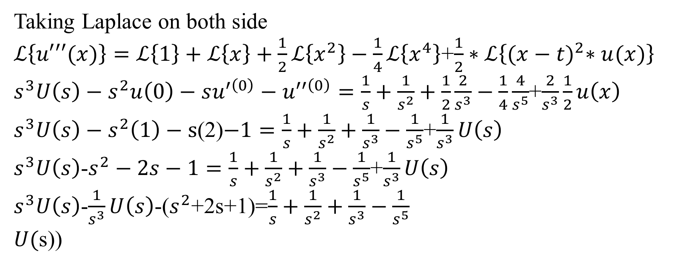
Taking Laplace on both side
$ℒ\left\{u′′′(x)\right\}=ℒ\left\{1\right\}+ℒ\left\{x\right\}+\frac{1}{2}ℒ\left\{x^{2}\right\}−\frac{1}{4}ℒ\left\{x^{4}\right\}$+$\frac{1}{2}∗ℒ\left\{{(x−t)}^{2}∗u(x)\right\}$
$s^{3}U\left(s\right)−s^{2}u\left(0\right)−su^{′\left(0\right)}−u^{′′\left(0\right)}=\frac{1}{s}+\frac{1}{s^{2}}+\frac{1}{2}\frac{2}{s^{3}}−\frac{1}{4}\frac{4}{s^{5}}$+$\frac{2}{s^{3}}\frac{1}{2}u\left(x\right)$
$s^{3}U\left(s\right)−s^{2}\left(1\right)−s$(2)$−1=\frac{1}{s}+\frac{1}{s^{2}}+\frac{1}{s^{3}}−\frac{1}{s^{5}}$+$\frac{1}{s^{3}}U\left(s\right)$
$s^{3}U\left(s\right)$-$s^{2}−2s−1=\frac{1}{s}+\frac{1}{s^{2}}+\frac{1}{s^{3}}−\frac{1}{s^{5}}$+$\frac{1}{s^{3}}U\left(s\right)$
$s^{3}U\left(s\right)$-$\frac{1}{s^{3}}U\left(s\right)$-($s^{2}$+2s+1)=$\frac{1}{s}+\frac{1}{s^{2}}+\frac{1}{s^{3}}−\frac{1}{s^{5}}$
$U($s))

Slide 7
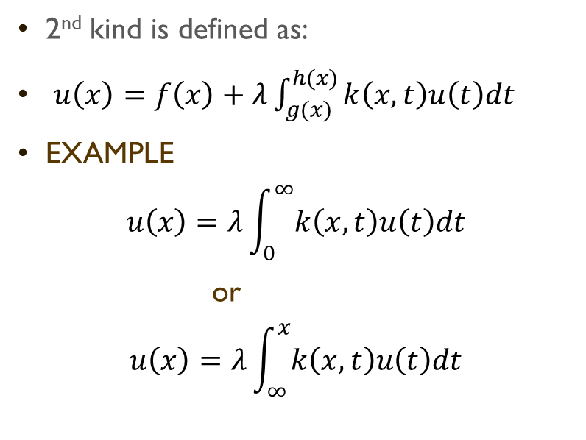
Chapter 7 Abels integral equation and singular integral equation
Singular integral equation:
one of the limits of integration g(x), h(x) or both are infinite is called singular integral equation
Singular integral equation of ist kind is defined as
$$u\left(x\right)=λ\int_{g(x)}^{h(x)}{k\left(x,t\right)u\left(t\right)dt}$$
2nd kind is defined as:
$u\left(x\right)=f\left(x\right)+λ\int_{g(x)}^{h(x)}{k\left(x,t\right)u\left(t\right)dt}$
EXAMPLE
$$u\left(x\right)=λ\int_{0}^{∞}{k\left(x,t\right)u\left(t\right)dt}$$
or
$$u\left(x\right)=λ\int_{∞}^{x}{k\left(x,t\right)u\left(t\right)dt}$$

Slide 8
Singular integral equation:
weakly singular integral equation
if the kernel K(x,t) becomes infinite at one or more points at the range
of integration.
FOR EXAMPLE
$$f\left(x\right)= \int_{0}^{x}{\frac{1}{\sqrt{\left(x−t\right)}}u\left(t\right)dt}$$
or
$$f\left(x\right)= \int_{0}^{x}{\frac{1}{{\left(x−t\right)}^{α}}u\left(t\right)dt}$$
or
$$u\left(x\right)=f\left(x\right)+λ\int_{0}^{x}{\frac{1}{{\left(x−t\right)}^{α}}u\left(t\right)dt}$$
These are the example of weakly singular integral equation.

Slide 9
Abel integral equations
Abel in 1823 investigated the motion of a particle that slides down along a smooth unknown curve, in a vertical plane, under the influence of the gravity.
The particle takes the time f(x) to move from the highest point of vertical height x to the lowest point 0 on the curve. The Abel’s problem is derived to find the equation of that curve.
Abel derived the equation of motion of the sliding particle along a smooth curve by the singular integral equation
Abels integral equation is defined as
$$f\left(x\right)= \int_{0}^{x}{\frac{1}{\sqrt{\left(x−t\right)}}u\left(t\right)dt}$$
It is also called Volterra integral equation of the first kind

Slide 10
Abels integral equation
Generalized Abel’s integral equation
If put $α=\frac{1}{2}$ in abel’s integral equation, this expression is called Generalized the Abel’s integral equation
$$f\left(x\right)= \int_{0}^{x}{\frac{1}{{\left(x−t\right)}^{α}}u\left(t\right)dt}$$

