Slide 1
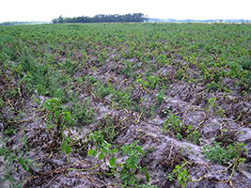
Late Blight of Potato
PLB (Potato Late Blight)

Slide 2
Blight
Literal meaning…….
Rapid killing of plant parts……

Slide 3
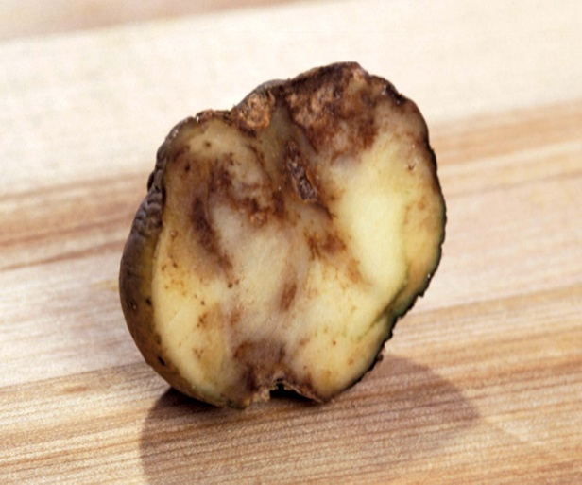
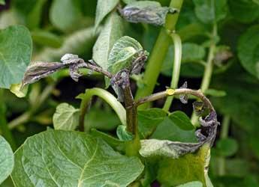
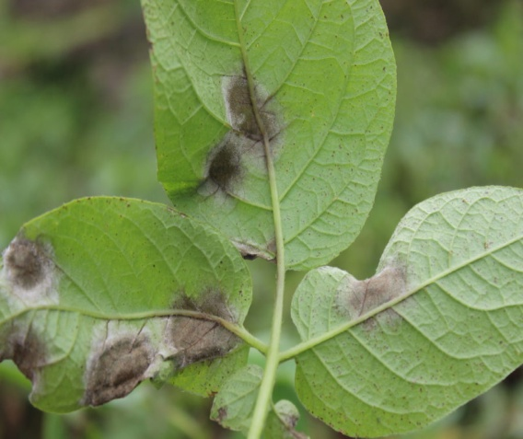
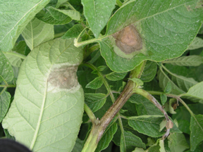
Plant Parts

Slide 4
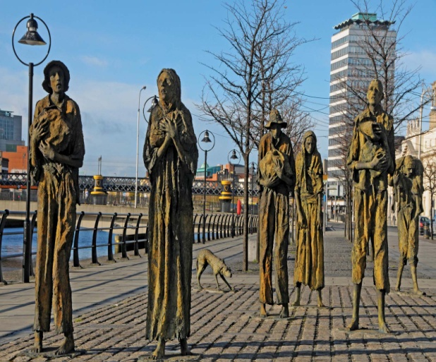
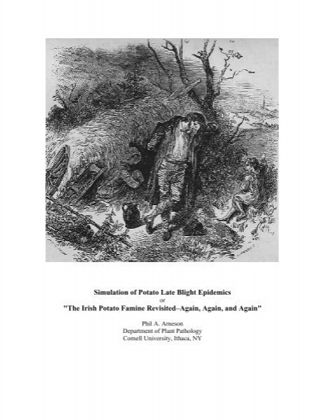
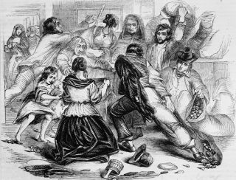
History

Slide 5
History

Slide 6
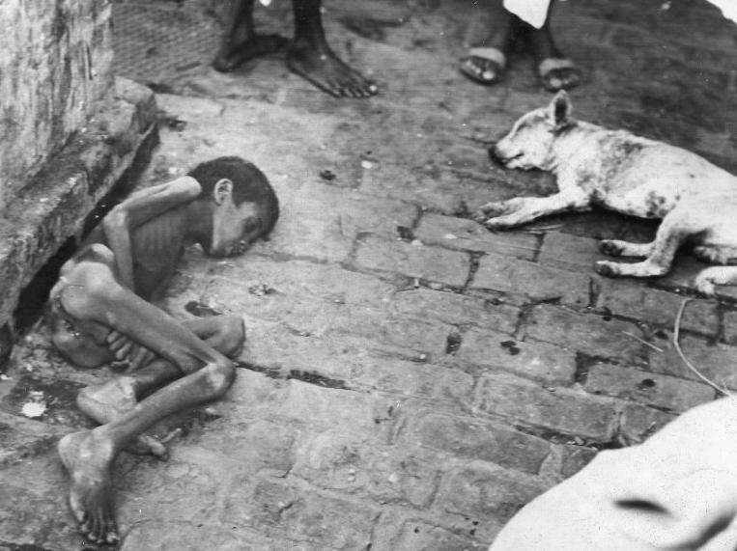
Importance
Most destructive* €5 million (€1 Billion)
1845 Great Irish Famine*
Deaths and Diaspora

Slide 7
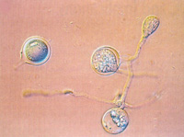
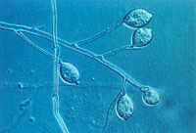
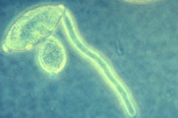
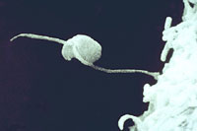
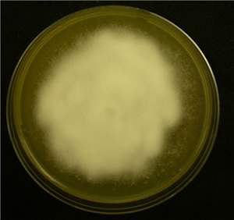
Etiology
Causal organism: Phytophthora infestans
Order: Peronosporales
Family: Pythiaceae

Slide 8
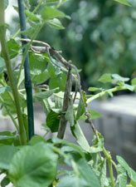
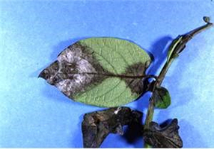
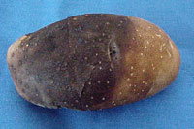
Plant Response against pathogen attack

Slide 9
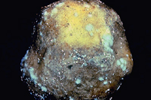
Symptoms

Slide 10
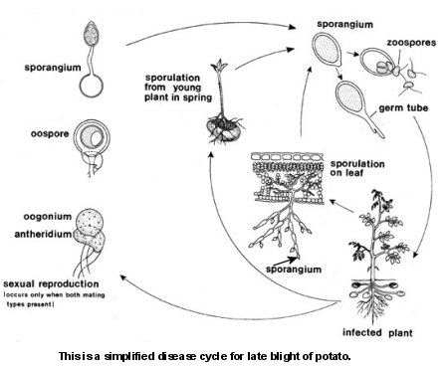
Disease Cycle

Slide 11
Epidemiology
12-13°C temp.
more than 90 % RH

Slide 12
Management
Seed tubers selected from healthy field
Sanitation: weeding for low humidity
Tuber treatment with mercuric chloride (1:1000)
High ridging as 15 cm*(because low lying areas conserve more moisture that favors pathogen growth).
Irrigation time should be adjusted in such a way that don’t extend the night dew duration.
Store in potato tubers in dry & well aerated place.
Spray with systemic fungicides (dimethomorph, Cymoxanil, fluopicolide).
Hilling: Covering of newly emerged plant at the base*(helps in early weed control and avoid from direct water contact).

