Slide 1
Measure of Central tendency
MEDIAN MODE AND QUARTILES

Slide 2
Measures of central tendency
Measure of central tendency provides a very convenient way of describing a set of scores with a single number that describes the “PERFORMANCE” of the group.
It is also defined as a single value that is used to describe the “CENTER” of the data
There are three commonly used measure of central tendency. There are the following
MEAN
MEDIAN
MODE

Slide 3
mean Mean is the value that is obtained by “sum” of all observations divide by a number of observation
COMPUTATION for UNGROUP DATA
$\overline{x }$= $\frac{\sum{X}}{n}$
$\overline{x}$ = A+$\frac{\sum{D}}{n}$
Mean = $\frac{\text{Sum} \text{of} \text{All} \text{Data} \text{Points}}{\text{Number} \text{of} \text{Data} \text{Points}}$,
Mean = Assumed Mean +$\frac{\text{Sum} \text{of} \text{All} \text{Deviations}}{\text{Number} \text{of} \text{Data} \text{Points}}$
COMPUTATION for GROUP DATA
$\overline{x}$= $\frac{\sum{fx}}{\sum{f}}$
$\overline{x}$=A+ $\frac{\sum{fD}}{\sum{f}}$

Slide 4
MEDIAN
The median represents the observation that divides the sample into halves regardless of the weight of the observation
Median is the central value of the variable that divide the series into two equal parts in such a way that half of the observation below the value and half of the observation above the value
Median is defined as the value of the middle item when the data are arranged in an ascending or descending order of magnitude.

Slide 5
Note: In the 1st data set there are two observation to the left of median “5” and two observation to the right of median. Therefore 5 is the median for both data set. By using “EXTREME” values median remain same but the mean changed.

Slide 6
note
Median of the data set dependent on whether the number of elements in the data set is odd or even
first reorder the data set from largest to the smallest or smallest to the largest
Mark off high and low values until you reach the middle value
if there are 2 middles than add them and divided by 2

Slide 7
MEDIAN

Slide 8
COMPUTATION of median for UNGROUP DATA

Slide 9
COMPUTATION of median for GROUP DATA

Slide 12
The Mode
Mode is the most frequent score in our data set
Scores or qualitative category that occurs with the greatest frequency
Mode is define as the score with the highest frequency. The most frequent score. It is called nominal statistics. In a grouped data set it is mid point of class interval with the highest frequency

Slide 13
Computation of Mode for ungroup Data

Slide 14
Computation of Mode for group Data

Slide 15
Computation of Mode for group Data

Slide 16
Computation of Mode for group Data

Slide 17
Measures of Position - Quartiles
The three quartiles Q1, Q2, and Q3 approximately divide an ordered data set into four equal parts. About ¼ of the data falls on or below the first quartile Q1. About ½ of the data falls below the second quartile Q2., and about ¾ of the data falls below the third quartile Q3.
The second quartile has the same median of the data set

Slide 18
Computation of quartile for ungroup data set
5, 6, 4, 6, 3, 7, 5, 3, 4, 5, 6, 5, 3, 2, 4, 4, 4
Find Q1:
Find Q3:
First, order the data:
2, 3, 3, 3, 4, 4, 4, 4, 4, 5, 5, 5, 5, 6, 6, 6, 7
Find Q1: have to average 3 and 4, giving 3.25
Find Q3: have to average 5 and 6, giving 5

Slide 19
Computation of quartile for ungroup data set

Slide 20
Computation of quartile for group data set

Slide 21
Computation of quartile for group data set

Slide 22
Computation of quartile for group data set

Slide 23
ASSIGNMENT

Slide 24
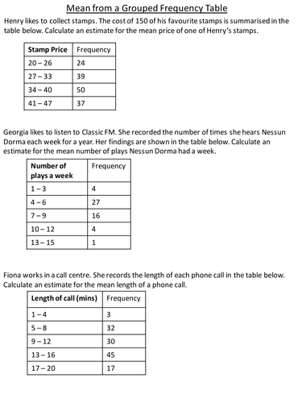

Slide 25
Thank you
Madeeha Rahim
Visiting Lecturer
Statistics

